Slide 1
Tombstones
What do tombstones tell us?

Slide 2
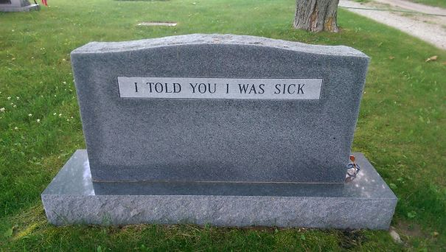

Slide 4
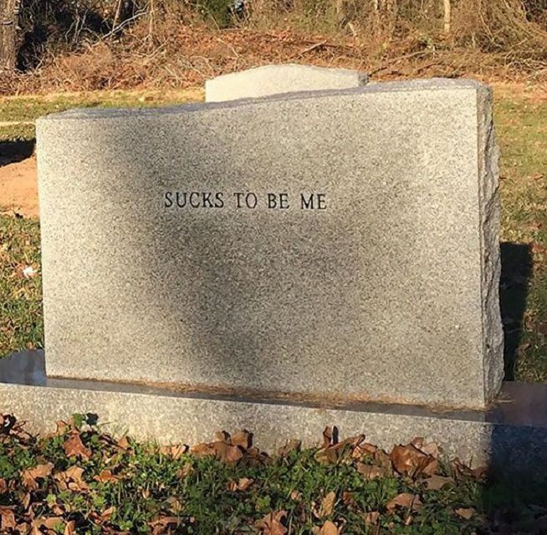

Slide 5
Activity
Write your own tombstone and share it with the class.

Slide 7
