Slide 1
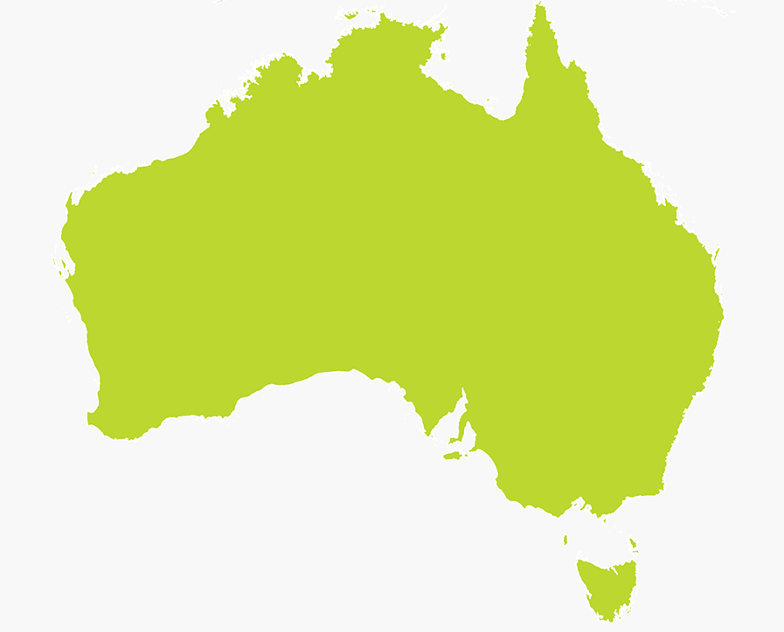
POVERTY IN AUSTRALIA

Slide 2
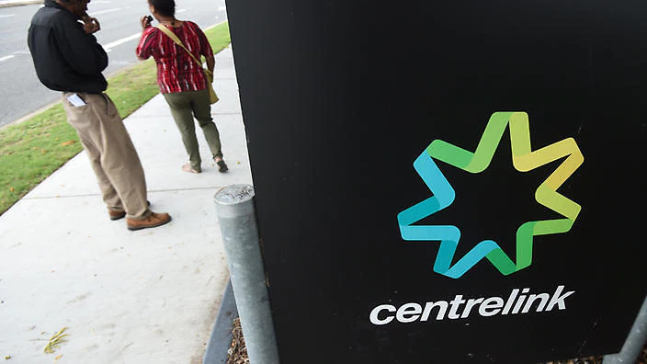
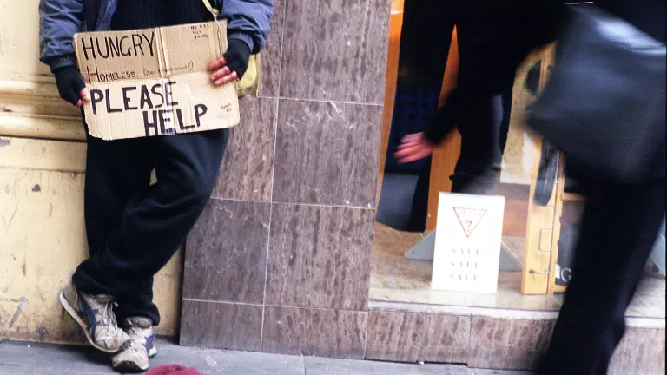
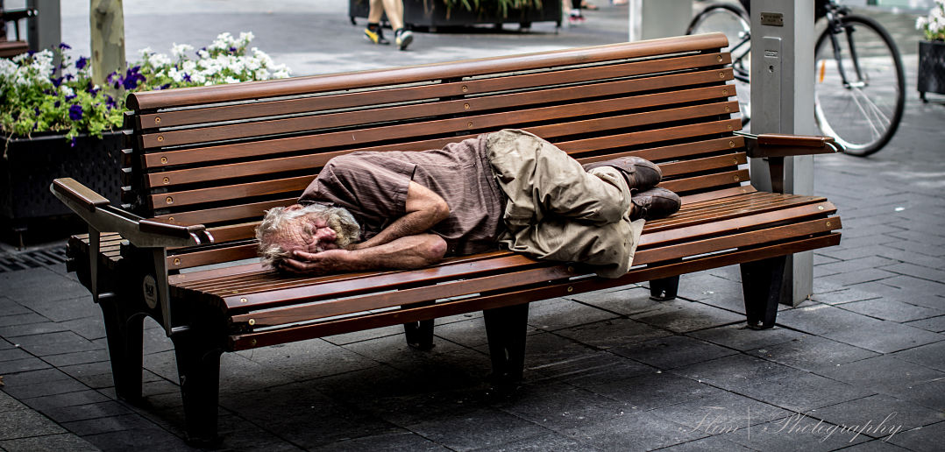

Slide 3
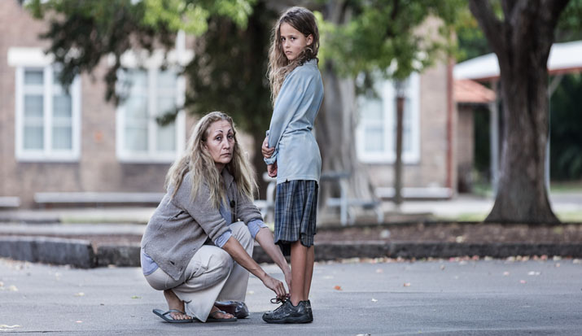
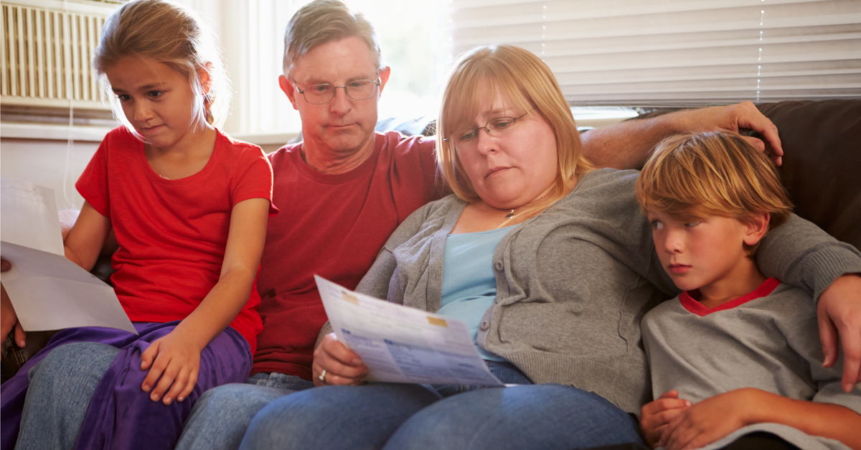
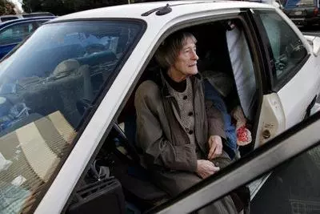
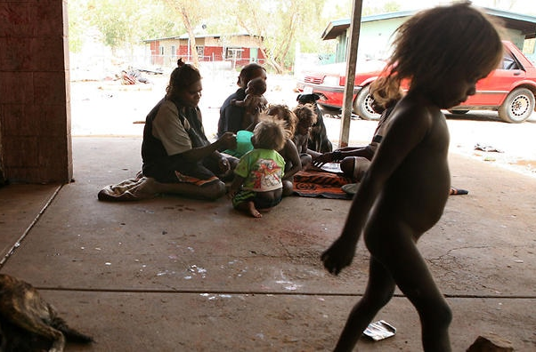

Slide 4
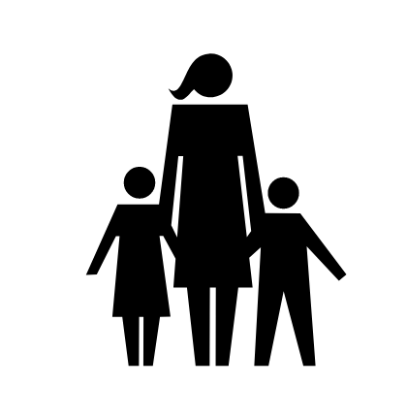
Taken from the 2018 Poverty in Australia report (ACOSS/UNSW)
Davidson, P., Saunders, P., Bradbury, B. and Wong, M. (2018), Poverty in Australia, 2018. ACOSS/UNSW Poverty and Inequality Partnership Report No. 2, Sydney: ACOSS.
Poverty line for a single adult : $433 per week
For a couple with two children: $909 per week
(Based on 50% of the median Australian income)
3.2 million people
(13.2% of all Australians) live below the poverty line
739,000 children (17.3%) live below the poverty line
The poverty gap average is $135 (The average amount below the poverty line that people in poverty have to live on )
32% of single parent families live below the poverty line
The median weekly income for indigenous Australians is around $300 less than non-indigenous Australians

Slide 5
POVERTY IN
WESTERN AUSTRALIA

Slide 7
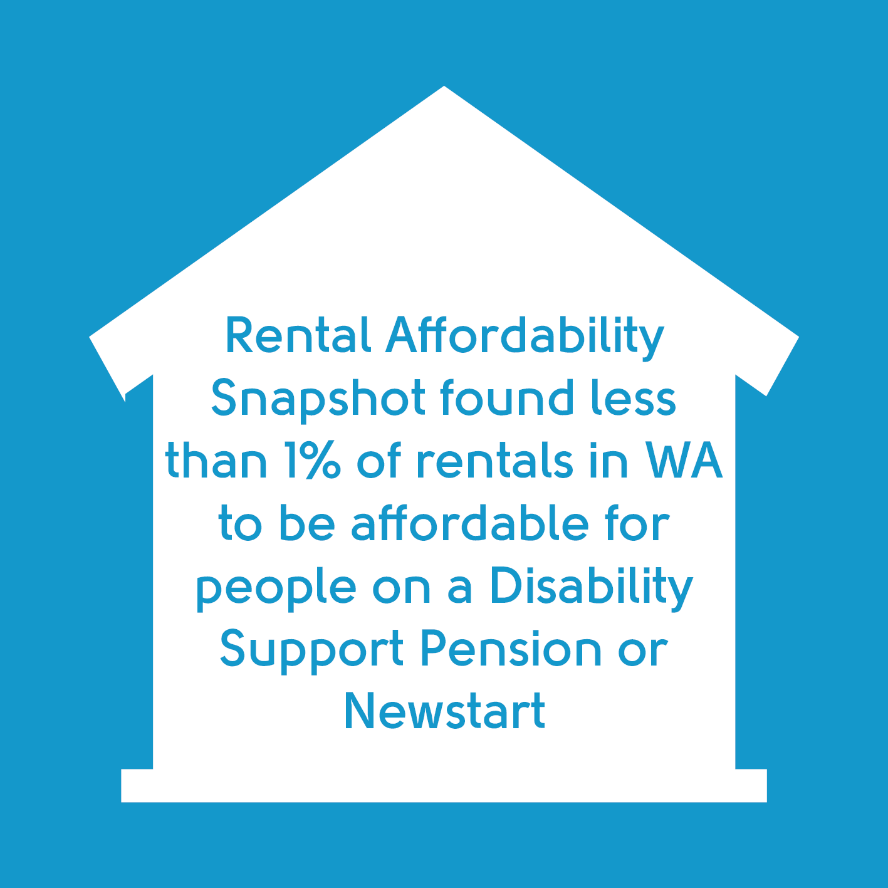

Slide 8
