Slide 2
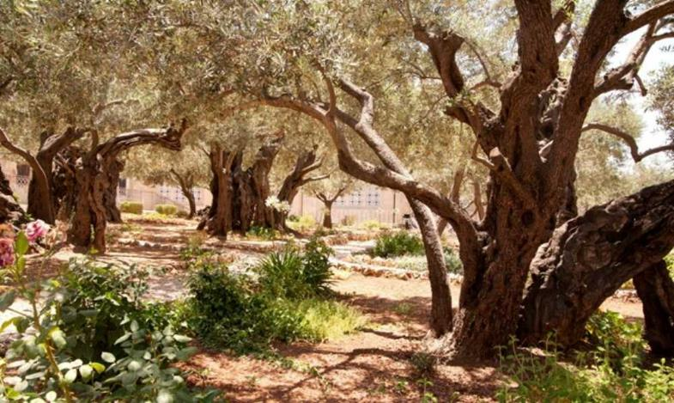
1. Jesus in the Garden of Gethsemane
Matthew 26:36-41 Contemporary English Version (CEV)
Jesus Prays
³⁶ Jesus went with his disciples to a place called Gethsemane. When they got there, he told them, “Sit here while I go over there and pray.”
³⁷ Jesus took along Peter and the two brothers, James and John. He was very sad and troubled, ³⁸ and he said to them, “I am so sad that I feel as if I am dying. Stay here and keep awake with me.”
³⁹ Jesus walked on a little way. Then he knelt with his face to the ground and prayed, “My Father, if it is possible, don’t make me suffer by having me drink from this cup. But do what you want, and not what I want.”
⁴⁰ He came back and found his disciples sleeping. So he said to Peter, “Can’t any of you stay awake with me for just one hour? ⁴¹ Stay awake and pray that you won’t be tested. You want to do what is right, but you are weak.”

Slide 3
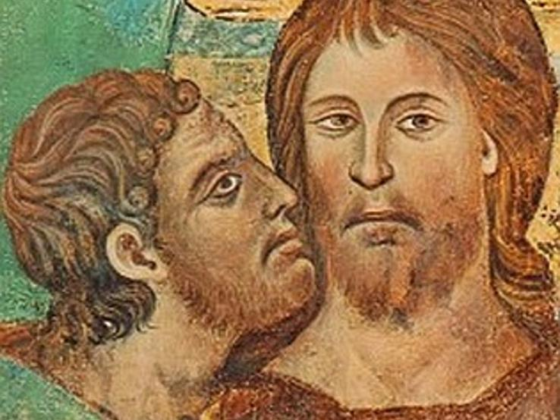
2. Jesus is betrayed by Judas and arrested
Mark 14:43-46
⁴³ Jesus was still speaking, when Judas the betrayer came up. He was one of the twelve disciples, and a mob of men armed with swords and clubs were with him. They had been sent by the chief priests, the nation’s leaders, and the teachers of the Law of Moses. ⁴⁴ Judas had told them ahead of time, “Arrest the man I greet with a kiss.^{[a]} Tie him up tight and lead him away.”
⁴⁵ Judas walked right up to Jesus and said, “Teacher!” Then Judas kissed him, ⁴⁶ and the men grabbed Jesus and arrested him.

Slide 4
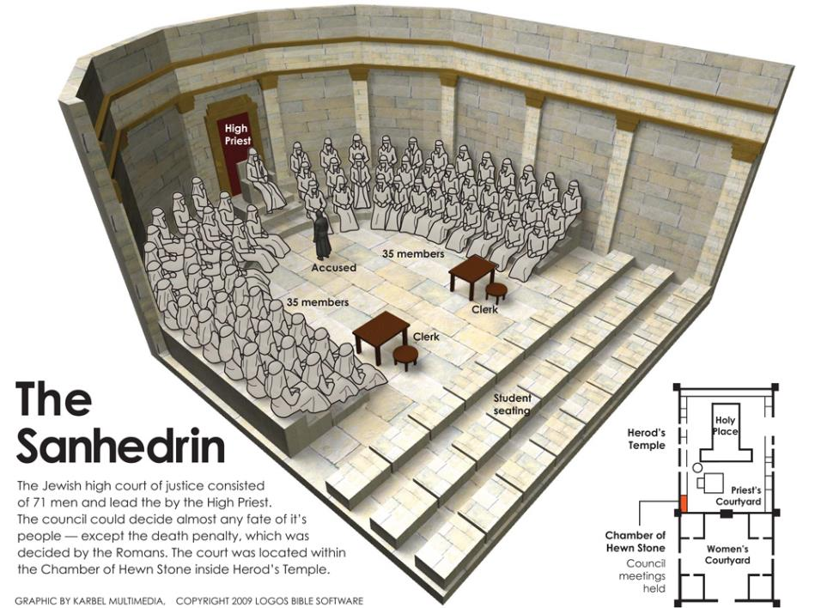
3. Jesus is condemned by the Sanhedrin
Luke 22:66-71
⁶⁶ At daybreak the nation’s leaders, the chief priests, and the teachers of the Law of Moses got together and brought Jesus before their council. ⁶⁷ They said, “Tell us! Are you the Messiah?”
Jesus replied, “If I said so, you wouldn’t believe me. ⁶⁸ And if I asked you a question, you wouldn’t answer. ⁶⁹ But from now on, the Son of Man will be seated at the right side of God All-Powerful.”
⁷⁰ Then they asked, “Are you the Son of God?” Jesus answered, “You say I am!” ⁷¹ They replied, “Why do we need more witnesses? He said it himself!”

Slide 5
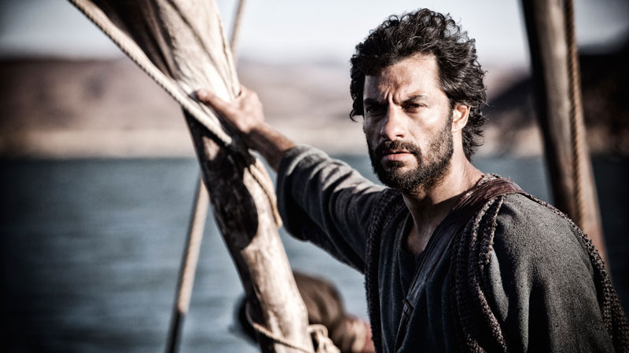
4. Peter denies Jesus
Matthew 26:69-75
⁶⁹ While Peter was sitting out in the courtyard, a servant girl came up to him and said, “You were with Jesus from Galilee.”
⁷⁰ But in front of everyone Peter said, “That isn’t so! I don’t know what you are talking about!”
⁷¹ When Peter had gone out to the gate, another servant girl saw him and said to some people there, “This man was with Jesus from Nazareth.”
⁷² Again Peter denied it, and this time he swore, “I don’t even know that man!”
⁷³ A little while later some people standing there walked over to Peter and said, “We know that you are one of them. We can tell it because you talk like someone from Galilee.”
⁷⁴ Peter began to curse and swear, “I don’t know that man!”
Right then a rooster crowed, ⁷⁵ and Peter remembered that Jesus had said, “Before a rooster crows, you will say three times that you don’t know me.” Then Peter went out and cried hard.

Slide 6
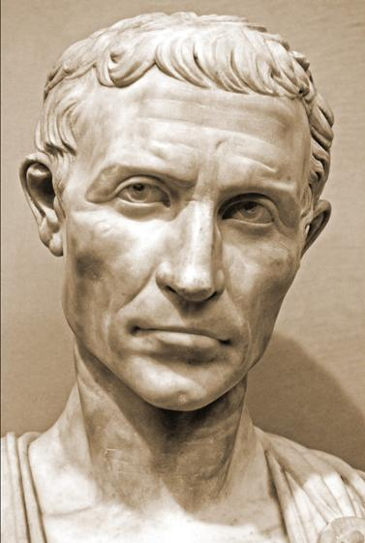
5. Jesus is judged by Pilate
Mark 15:1-6
15 Early the next morning the chief priests, the nation’s leaders, and the teachers of the Law of Moses met together with the whole Jewish council. They tied up Jesus and led him off to Pilate.
² He asked Jesus, “Are you the king of the Jews?”
“Those are your words,” Jesus answered.
³ The chief priests brought many charges against Jesus. ⁴ Then Pilate questioned him again, “Don’t you have anything to say? Don’t you hear what crimes they say you have done?” ⁵ But Jesus did not answer, and Pilate was amazed.
⁶ During Passover, Pilate always freed one prisoner chosen by the people.
Mark 15:15
¹⁵ Pilate wanted to please the crowd. So he set Barabbas free. Then he ordered his soldiers to beat Jesus with a whip and nail him to a cross.

Slide 7
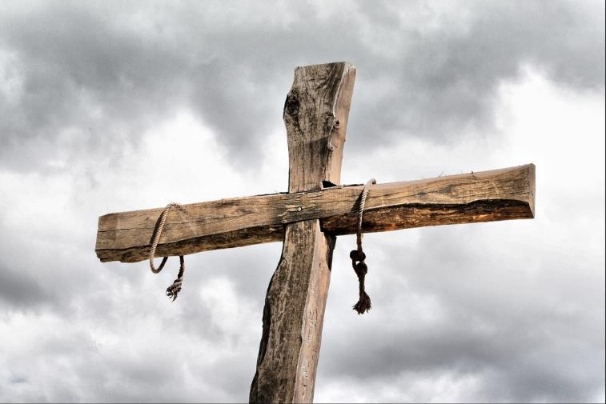
7. Jesus bears the cross
John 19:6
⁶ When the chief priests and the temple police saw him, they yelled, “Nail him to a cross! Nail him to a cross!”
Pilate told them, “You take him and nail him to a cross! I don’t find him guilty of anything.”
John 19:15-17
¹⁵ “Kill him! Kill him!” they yelled. “Nail him to a cross!”
“So you want me to nail your king to a cross?” Pilate asked.
The chief priests replied, “The Emperor is our king!” ¹⁶ Then Pilate handed Jesus over to be nailed to a cross.
Jesus Is Nailed to a Cross
Jesus was taken away, ¹⁷ and he carried his cross to a place known as “The Skull.”^{[a]} In Aramaic this place is called “Golgotha.

Slide 8
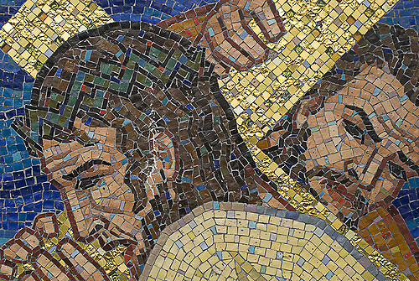
8. Jesus is helped by Simon of Cyrene
Mark 15:21
²¹ Simon from Cyrene happened to be coming in from a farm, and they forced him to carry Jesus' cross. Simon was the father of Alexander and Rufus.

Slide 9
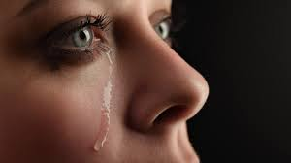
9. Jesus meets the women of Jerusalem
Luke 23:27-31
²⁷ A large crowd was following Jesus, and in the crowd a lot of women were crying and weeping for him. ²⁸ Jesus turned to the women and said:
Women of Jerusalem, don’t cry for me! Cry for yourselves and for your children. ²⁹ Someday people will say, “Women who never had children are really fortunate!” ³⁰ At that time everyone will say to the mountains, “Fall on us!” They will say to the hills, “Hide us!” ³¹ If this can happen when the wood is green, what do you think will happen when it is dry?

Slide 10
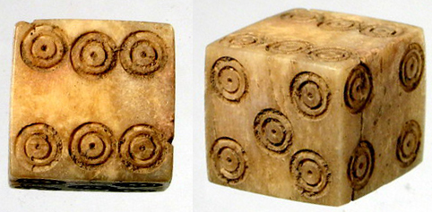
10. Jesus is Crucified
Luke 23:33-35
³³ When the soldiers came to the place called “The Skull,” they nailed Jesus to a cross. They also nailed the two criminals to crosses, one on each side of Jesus.
³⁴⁻³⁵ Jesus said, “Father, forgive these people! They don’t know what they’re doing.”
While the crowd stood there watching Jesus, the soldiers gambled for his clothes. The leaders insulted him by saying, “He saved others. Now he should save himself, if he really is God’s chosen Messiah!”

Slide 11
11. Jesus promises his kingdom to the good thief
Luke 23:39-43
³⁹ One of the criminals hanging there also insulted Jesus by saying, “Aren’t you the Messiah? Save yourself and save us!”
⁴⁰ But the other criminal told the first one off, “Don’t you fear God? Aren’t you getting the same punishment as this man? ⁴¹ We got what was coming to us, but he didn’t do anything wrong.” ⁴² Then he said to Jesus, “Remember me when you come into your kingdom!”
⁴³ Jesus replied, “I promise that today you will be with me in paradise.

Slide 12
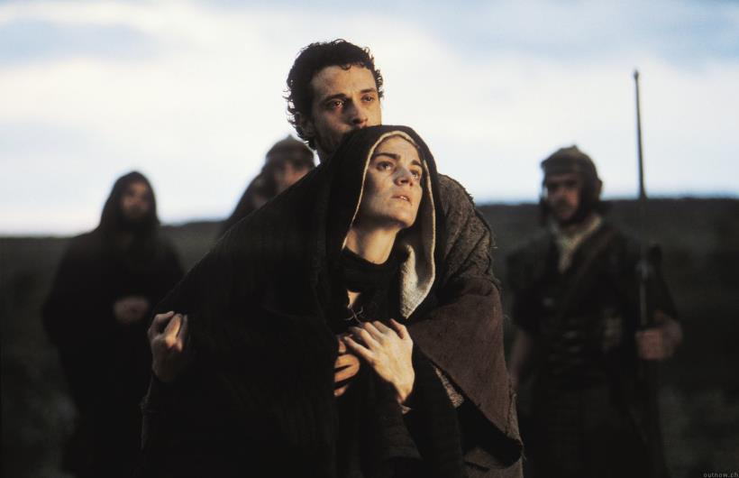
12. Jesus speaks to his mother and the disciple
John 19:25-27
²⁵ Jesus' mother stood beside his cross with her sister and Mary the wife of Clopas. Mary Magdalene was standing there too. ²⁶ When Jesus saw his mother and his favourite disciple with her, he said to his mother, “This man is now your son.” ²⁷ Then he said to the disciple, “She is now your mother.” From then on, that disciple took her into his own home.

Slide 13
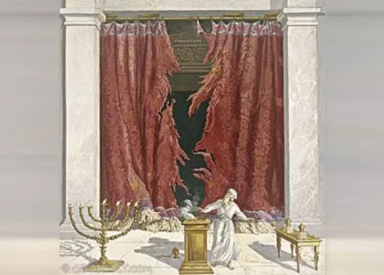
13. Jesus dies on the cross
Luke 23:44-46
⁴⁴ Around noon the sky turned dark and stayed that way until the middle of the afternoon. ⁴⁵ The sun stopped shining, and the curtain in the temple split down the middle. ⁴⁶ Jesus shouted, “Father, I put myself in your hands!” Then he died.

Slide 14
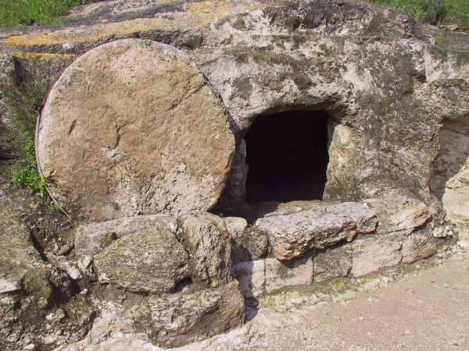
14. Jesus is placed in the tomb
Matthew 27:57-60
⁵⁷ That evening a rich disciple named Joseph from the town of Arimathea ⁵⁸ went and asked for Jesus' body. Pilate gave orders for it to be given to Joseph, ⁵⁹ who took the body and wrapped it in a clean linen cloth. ⁶⁰ Then Joseph put the body in his own tomb that had been cut into solid rock and had never been used. He rolled a big stone against the entrance to the tomb and went away.

Slide 15
