Slide 1
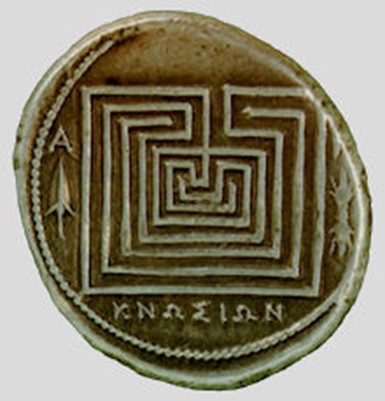
Labyrinths

Slide 2
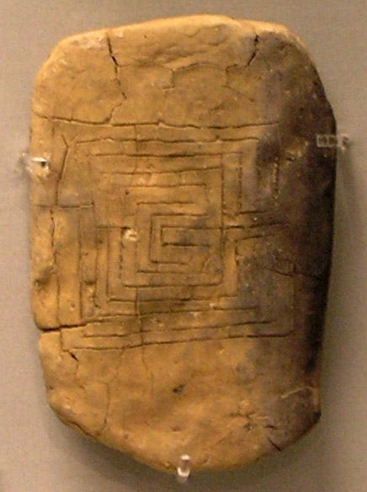
Notes:
Labyrinths have been known to exist for over 4000 years

Slide 3
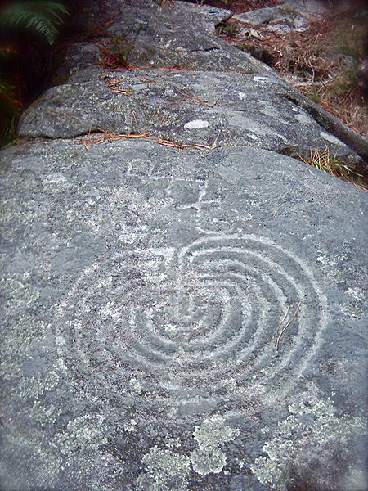
Notes:
On stones

Slide 4
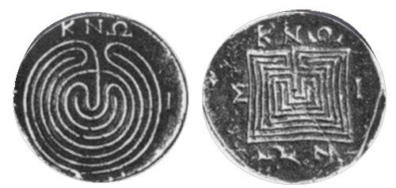
Notes:
Labyrinths have also been found on small ancient coins

Slide 5
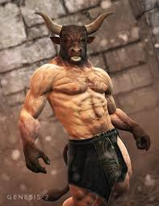
Notes:
There are the remains of an early pre-Christian labyrinth on Mt Knossos in Crete,
and which had its mythical Minotaur as guardian

Slide 6
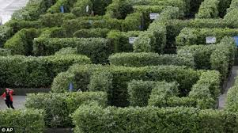
WHAT IS A LABYRINTH?
Notes:
Labyrinths are not a MAZE
Mazes are “multicursal”.
They engage our logic, our minds, to solve the riddles of wrong turns and dead ends

Slide 7
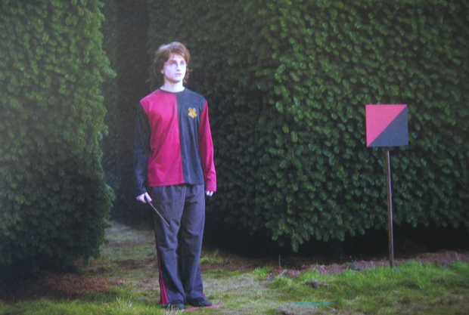
Notes:
Perhaps even where the walls of the maze move – as in Harry Potter

Slide 8
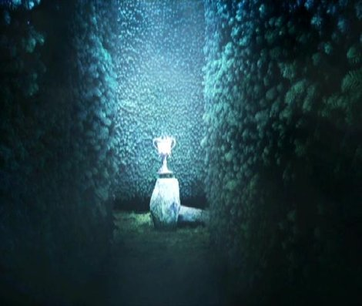
Notes:
And where the goal is ever elusive

Slide 9
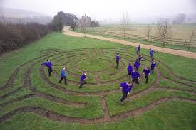
WHAT IS A LABYRINTH?
Notes:
A Labyrinth however is “unicursal”
It is one well defined path
which all can see from the outset
The path however turns this way, then that way, it leads us …….
from the entrance towards and into the centre …….
and then back out again on the same path
We don’t have to engage our minds necessarily when we walk this, for
our feet follow the path and we can just “be” –
The Labyrinth is another way of mindfulness, or of meditation

Slide 10
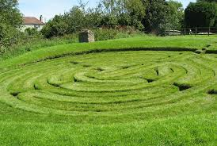
Notes:
In earlier times of Christianity most people could not read
They experienced their faith through their senses – sounds, sights, smells, touch, and taste
Walking in the footsteps of Jesus through Jerusalem and its surrounds was the ultimate experience, but very few could actually do this
Whatever the past or future held, one approach to following Christ can be found in the quote from St Augustine “solvitur ambulando”
….. which means, it is solved by walking.
But by medieval times as the Crusaders sought to recapture / protect Jerusalem, such journeys were too dangerous even for those who could afford them
And so iconic but more local pilgrimages were designated
Such as to Lourdes, or Chartres, or Canterbury, or on the Camino Way to Santiago de Compostela
The end of such pilgrimages were in shrines or Cathedrals which often had a labyrinth

Slide 11
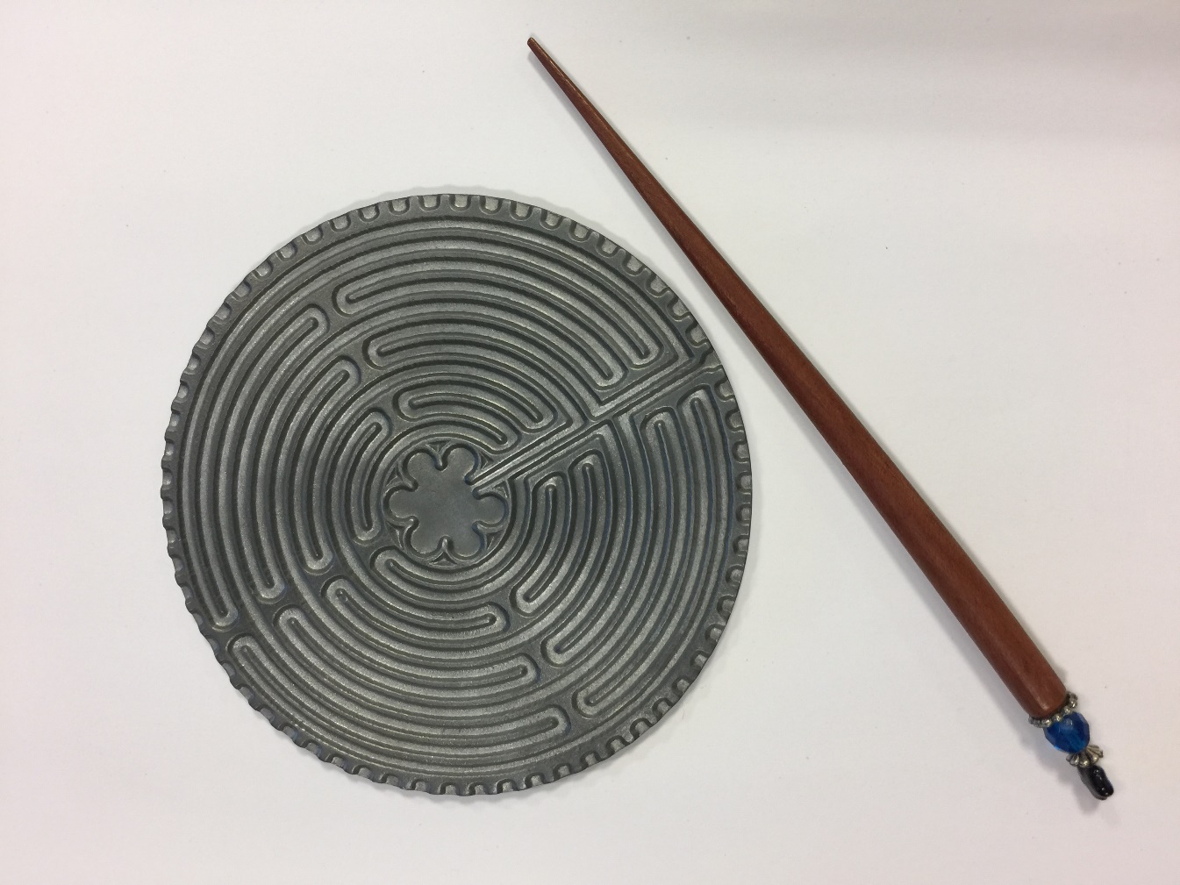
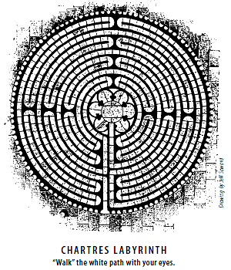
WHERE IS THE WALK?
Notes:
Numbers of medieval labyrinths still exist
As in the case of Chartres, in France
And more modern ones such as
Grace Cathedral in San Francisco, or the palm size version and tracing pen, which you can take anywhere with you

Slide 12
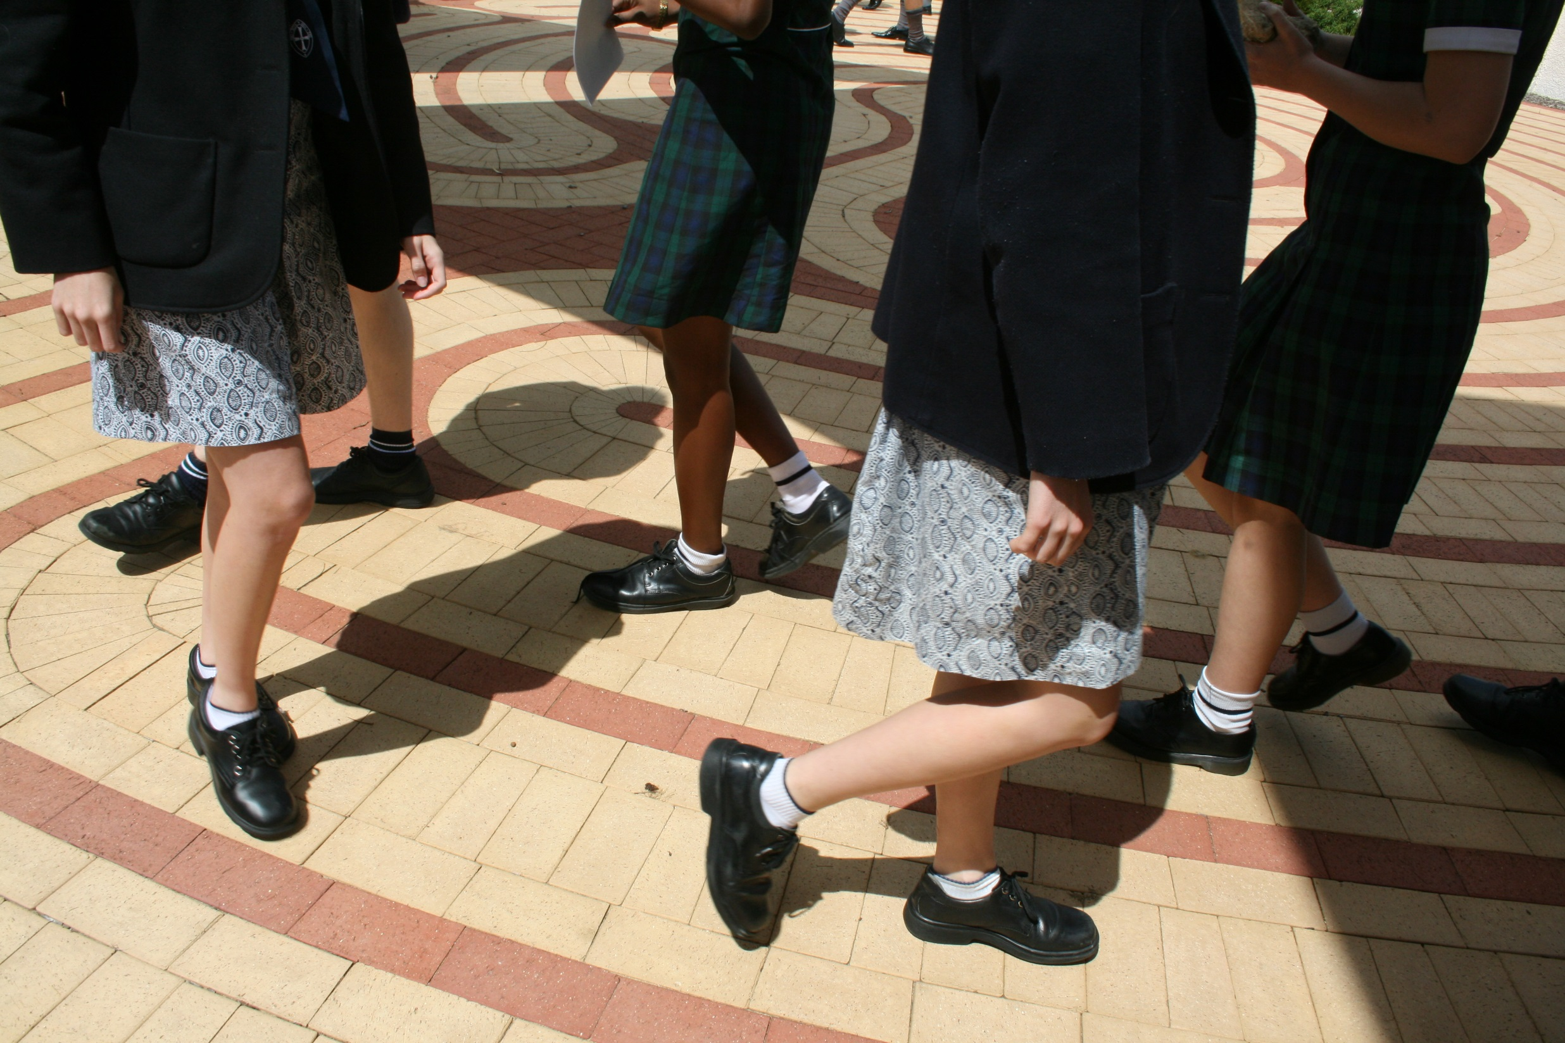
Notes:
There is also a Labyrinth at the Wollaston site where the ASC Head Office is located.

Slide 13
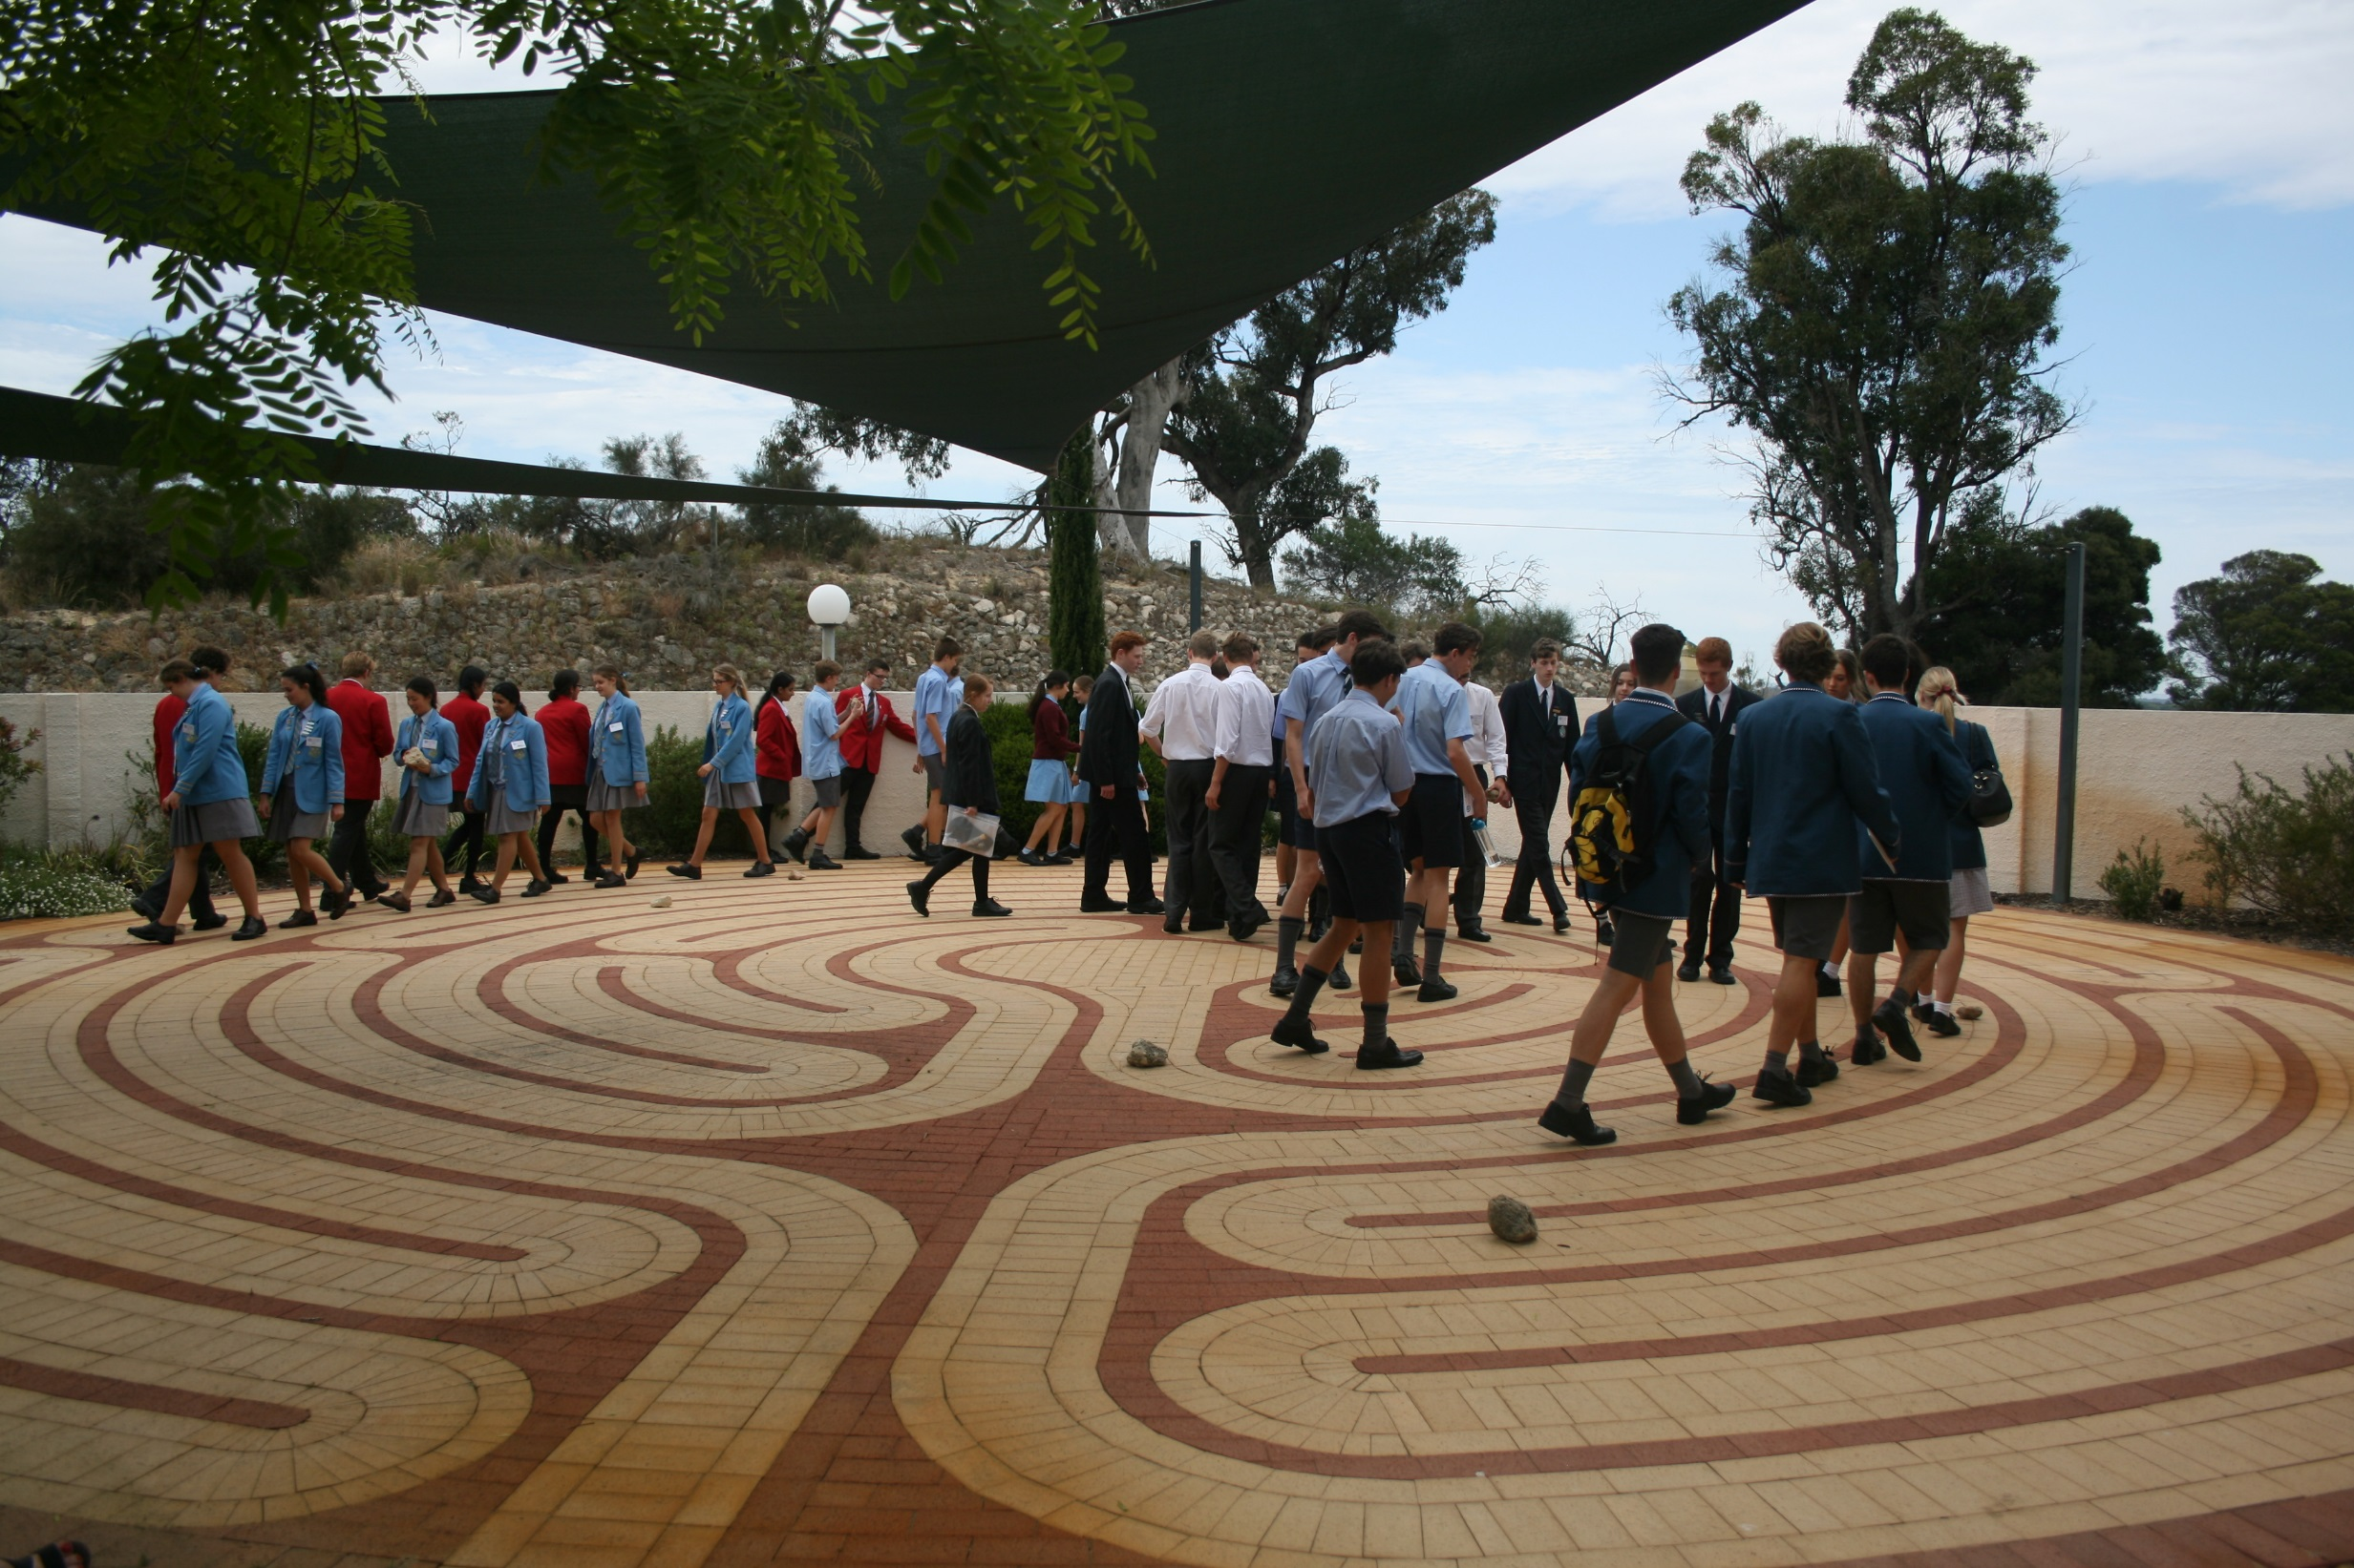

Slide 14
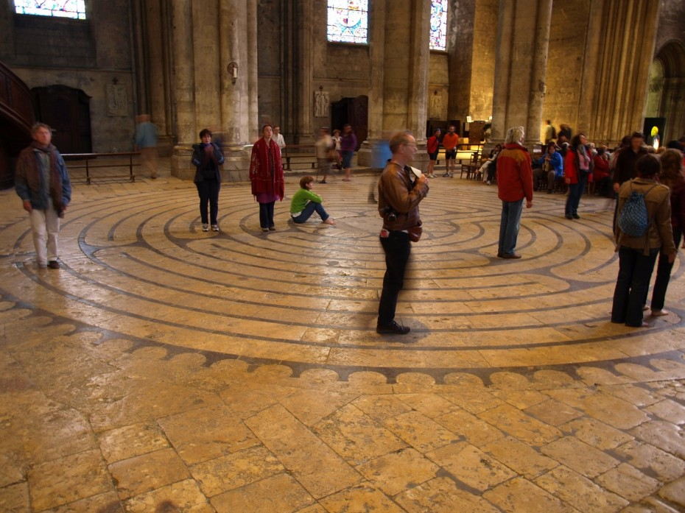
Inward – letting go
Centre – resting place
Outward - relationship
Notes:
We’ve also seen the Labyrinth is a single path – unicursal
YET
In its Christian expression it contains a threefold path within itself – Trinitarian!
We enter. We release, quieten, or purge ourselves of as much as we can from the outside world - PURGATION
In following the long, winding, seemingly “illogical” path, we do reach the centre – a place for ILLUMINATION, for continued meditation
We move from the centre, back towards the outside, now reenergised to have new RELATIONSHIPS, with God, with ourselves, with one another, with the created world

Slide 15
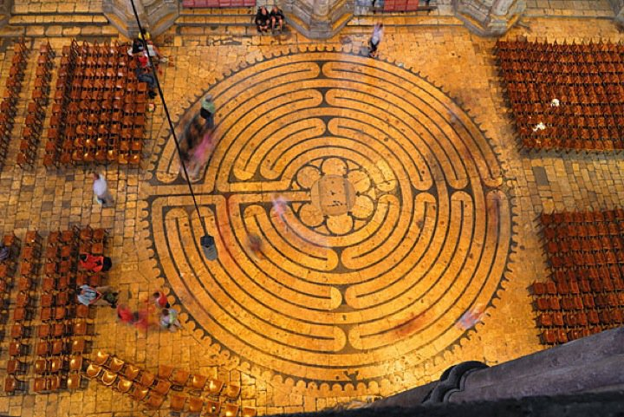


Slide 16


Slide 17


Slide 18
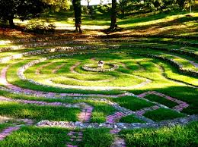

Slide 19
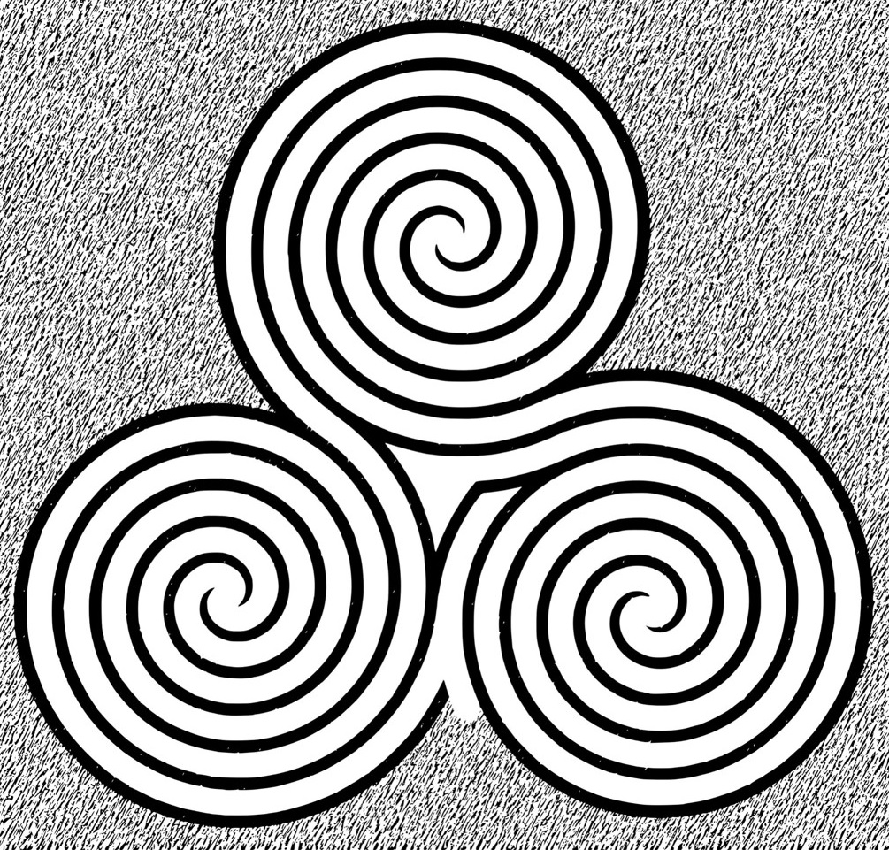
Notes:
Tri-centred

Slide 20
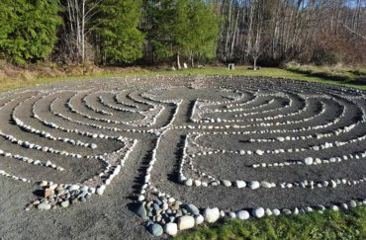

Slide 21
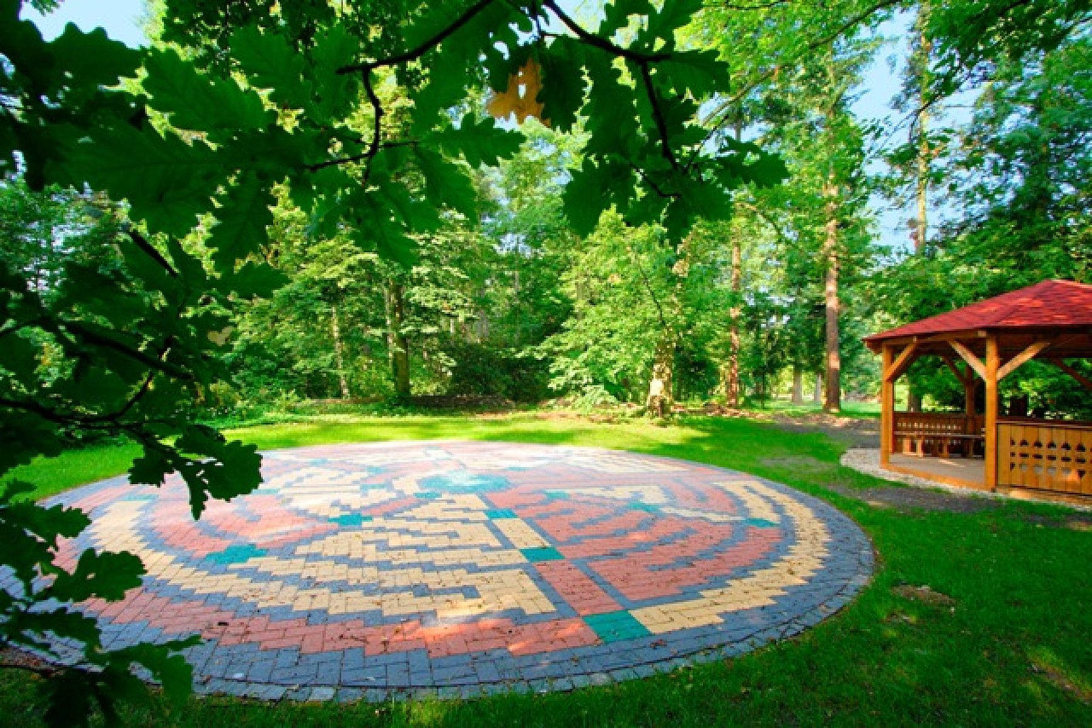

Slide 22
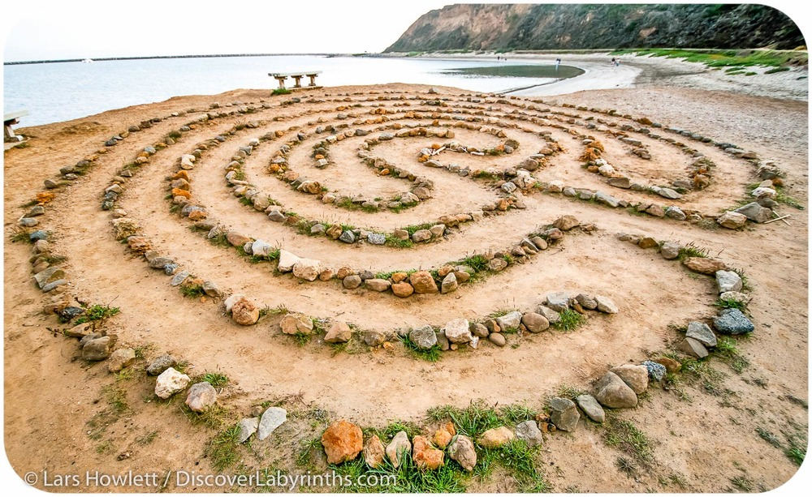

Slide 23
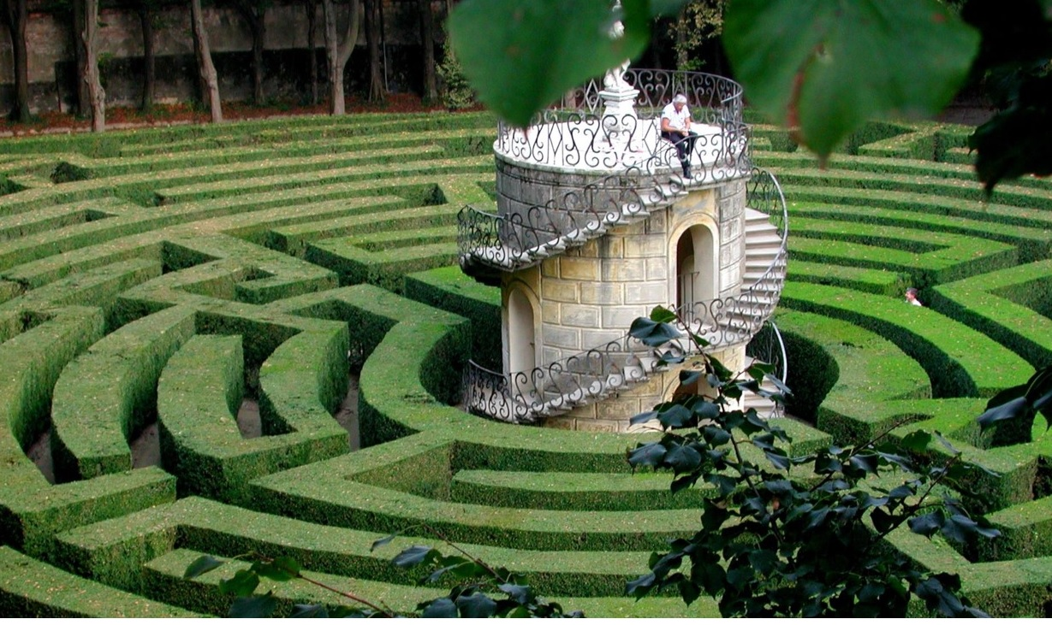
Notes:
A grand version with a very obvious centre place for contemplation

Slide 24
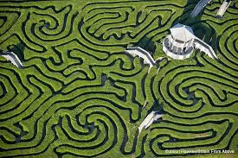

Slide 25
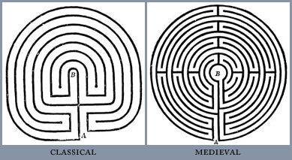
Notes:
And have developed through both classical and medieval times

Slide 26
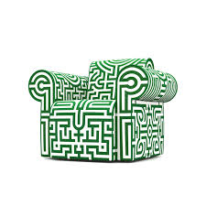
Notes:
Good luck tracing this one!

Slide 27
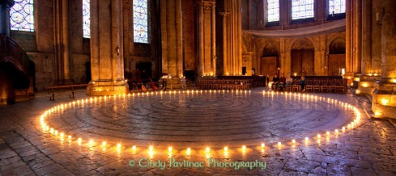

Slide 28
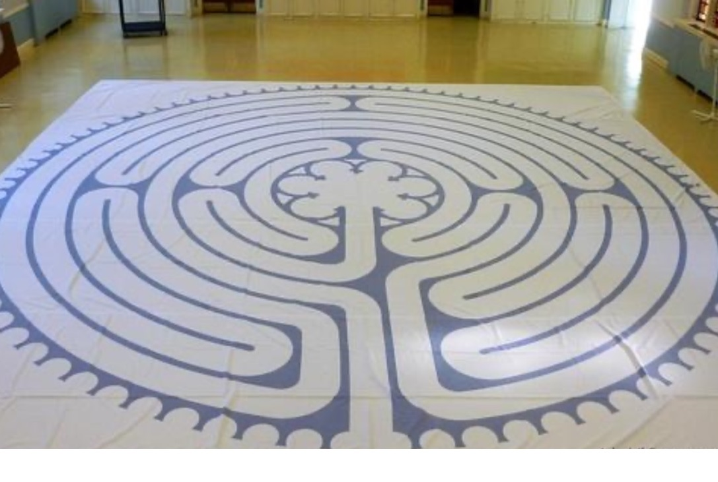
Notes:
A cloth based version

