Slide 1
Trauma Experiences in Australia

Slide 2
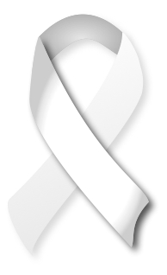
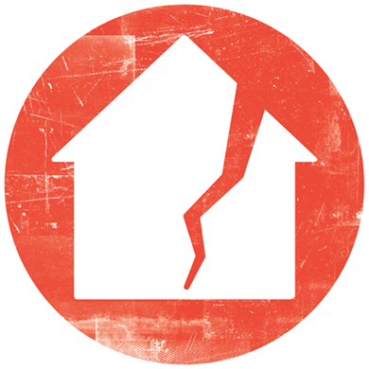
TRAUMA EXPERIENCES IN AUSTRALIA
1 in 6 women
1 in 20 men
Violence from a partner sometime from their 15th birthday
White Ribbon
www.whiteribbon.org.au
2.9 million people or 13.3% of all Australians
Live below the Poverty Line which is less than $400 a week for a single adult
Australian Council of Social Services
www.acoss.org.au/poverty-2
10 000 Western Australians homeless each night
1 300 beds available in emergency accommodation
Shelter WA
www.shelterwa.org.au

Slide 3
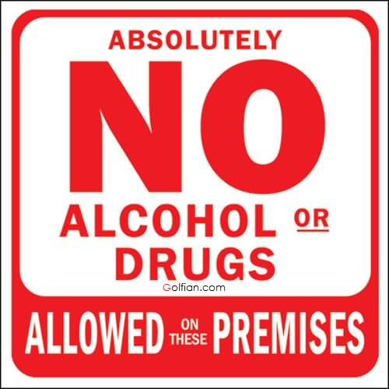
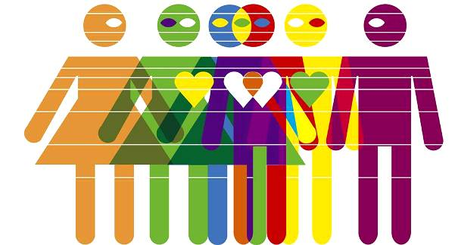
1 in 5 people aged 14 or older
15% of Australians
Consumed more than 2 standard drinks per day, exceeding lifetime risk guidelines
Have used illicit drugs
Australian Institute of Health and Welfare
www.aihw.gov.au/alcohol-and-other-drugs
Receive support from Child Protection services around Australia
Australian Institute of Health and Welfare
http://www.aihw.gov.au/child-protection
1 in 33 children
11 in 100 Australians are of diverse sexual orientation, sex or gender identity
LGBTI young people report experiencing verbal, physical and other types of abuse at rates much higher than the general population. 80 per cent of homophobic bullying involving LGBTI young people occurs at school and has a profound impact on their well-being and education.
www.humanrights.gov.au/face-facts-lesbian-gay-bisexual-trans-and-intersex-people

Slide 4
1 in 5 adults
Will experience a mental health issue personally or in their family
Beyond Blue
www.beyondblue.org.au
Closing the Gap between Aboriginal lives and that of the general community.
Indigenous people die 10 years younger
An Aboriginal man is 15 times more likely to be jailed
www.smh.com.au/federal-politics/political-news/closing-the-gap-five-numbers-that-should-shame-australia-20160210-gmqlbl.html

