Slide 1
The Creation Story
Images are from The Action Bible by David Cook

Slide 2
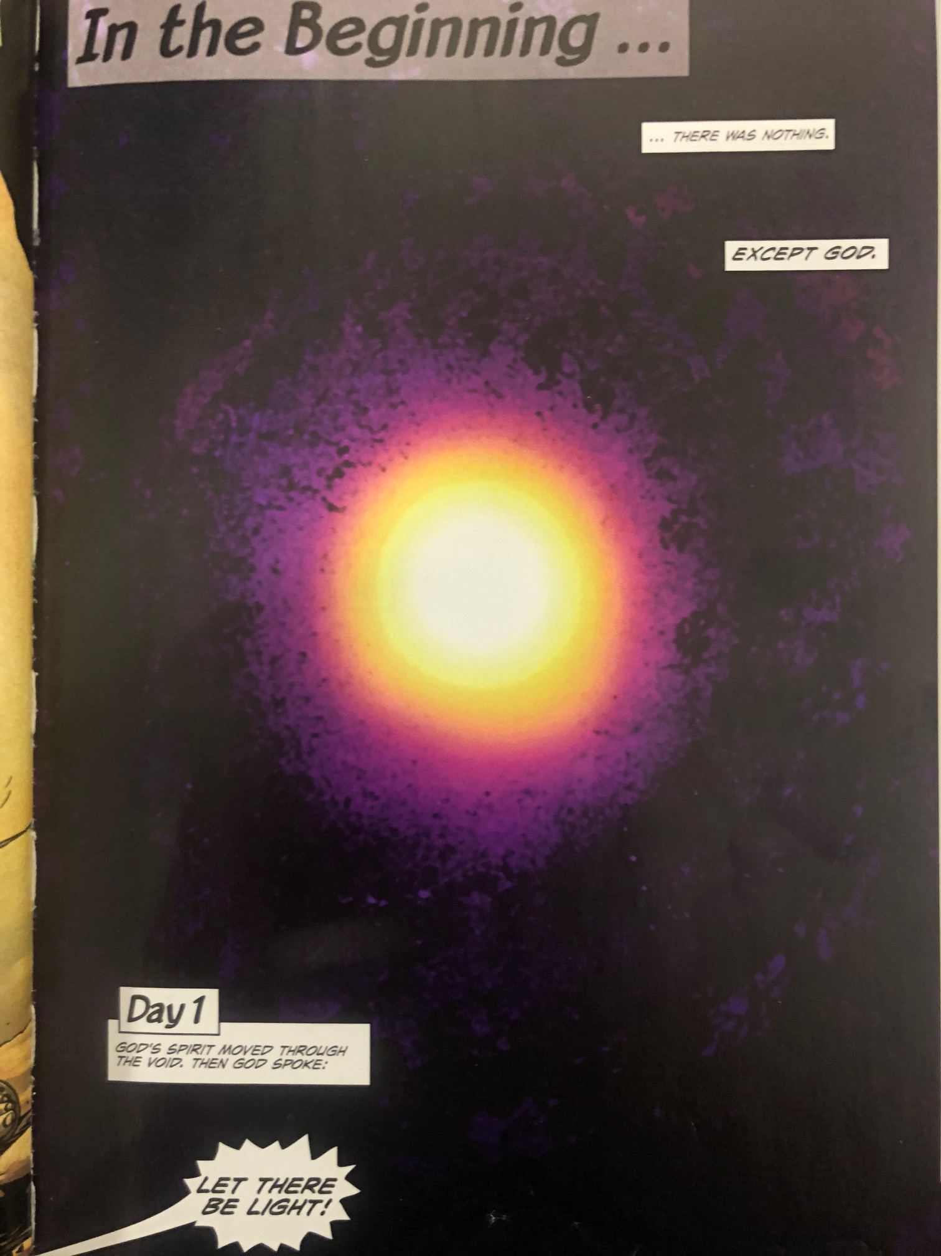

Slide 3
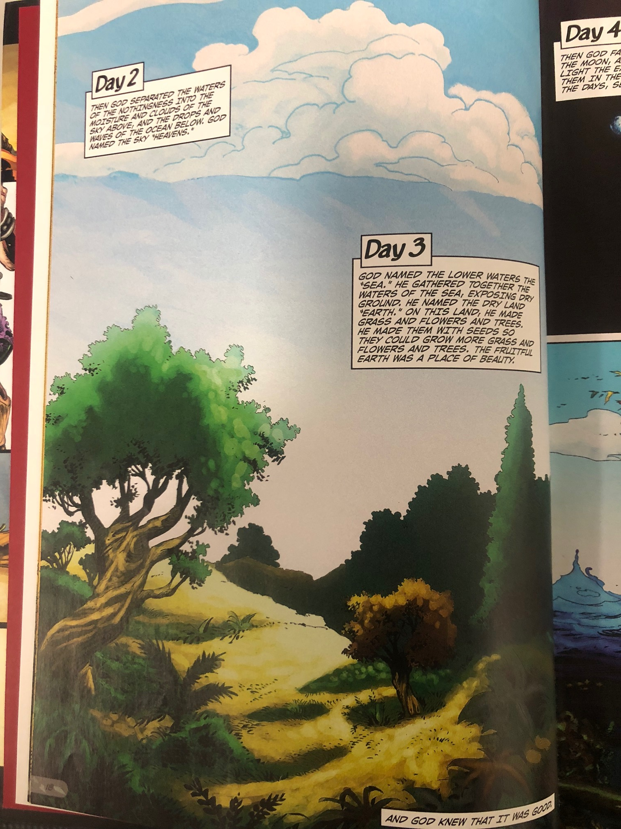

Slide 4
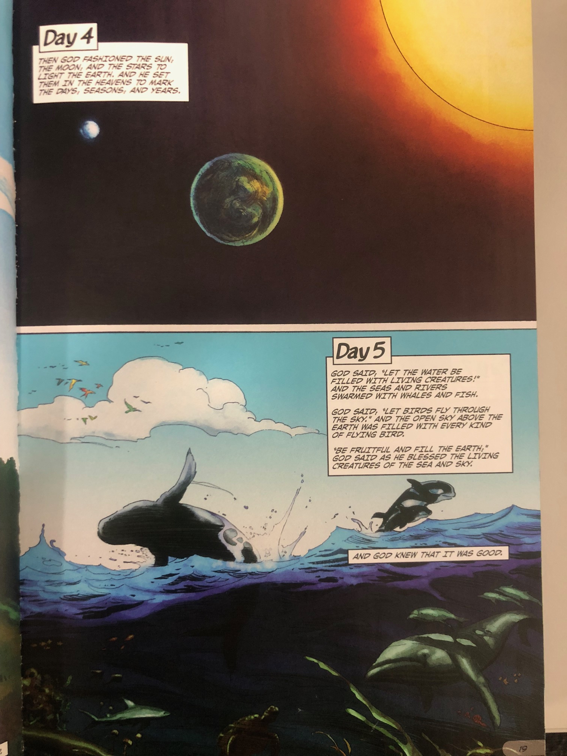

Slide 6
