Slide 1
God Keeps his Promises
How many stars do you see?

Slide 2
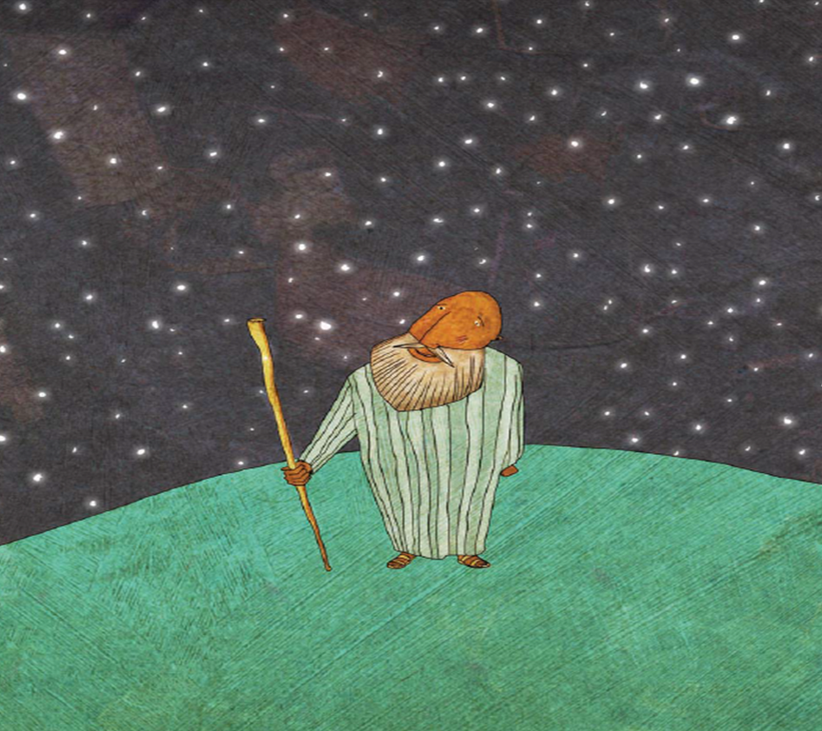
Source: The Jesus Storybook Bible by Sally Lloyd-Jones

Slide 3
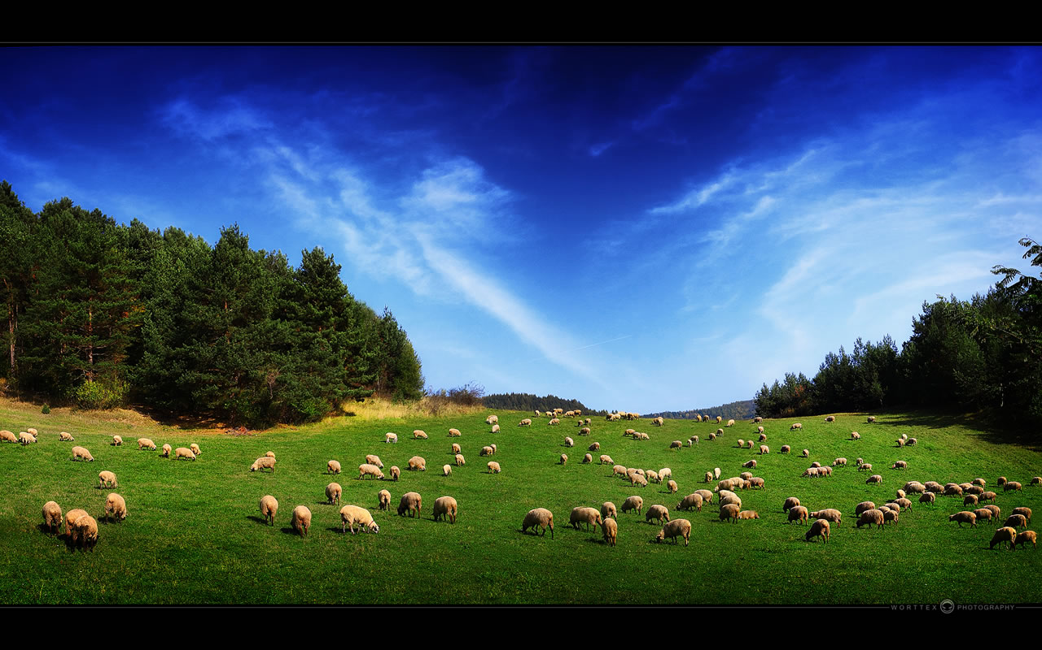
God’s Promises to Abraham
In the story Abraham is homeless. God promises Abraham that in the future he will have land or a place to live.
This Photo by Unknown Author is licensed under CC BY-NC-ND

Slide 4
God’s Promises to Abraham
In the story Abraham has no children. God promises Abraham his family will go on to become a great nation.
This Photo by Unknown Author is licensed under CC BY-SA-NC
Notes:
Refer back to the stars in the sky picture/promise from the start of the lesson.

Slide 5
God’s Promises to Abraham
God promises to bless Abraham and to bless the world through Abraham. Blessing is another way of saying God will look after Abraham.
This Photo by Unknown Author is licensed under CC BY-SA-NC
This Photo by Unknown Author is licensed under CC BY-NC-ND

