Slide 1
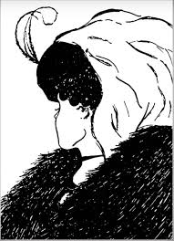
Notes:
What can you see?
Who saw an old women?
Who saw a young women?
Who saw a goat?
Your understanding of where knowledge comes from and how it is constructed is really important as you think about the process of critical thinking, particularly in the Religious Studies classroom. Education theory in this area ranges on a spectrum between positivist certainty and postmodern relativism. Positivist certainty says I can only see the old women, other peoples arguments are not convincing. I can only see one women therefore that’s all there is. At the other extreme postmodern relativism opens the door to telling stories to construct the outcomes you want. I can see a goat….
The model of critical thinking put forward in the syllabus sits somewhere in the middle of the spectrum.

