Slide 1
Understanding Islam
Subtitle here

Slide 2
Islam and Religious Art

Slide 3
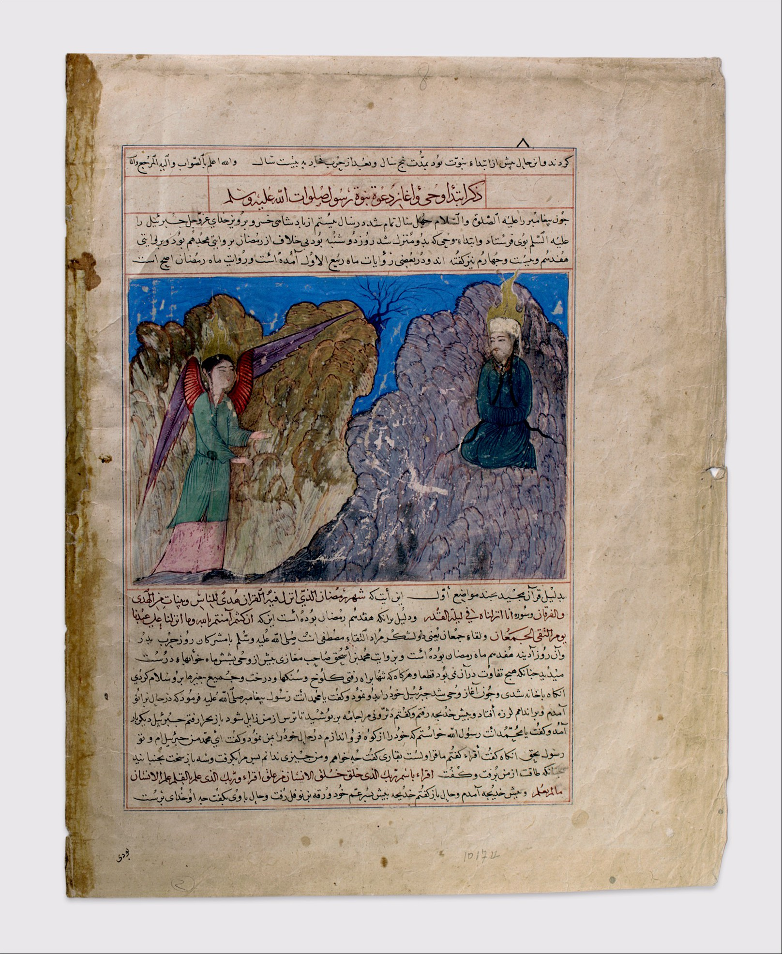
Muhammad's Call to Prophecy and the First Revelation: Folio from a manuscript of the Majma' al-Tawarikh (Compendium of Histories) About 1425
Notes:
Muhammad's Call to Prophecy and the First Revelation: Folio from a manuscript of the Majma' al-Tawarikh (Compendium of Histories) About 1425 Present-day Afghanistan, Herat Opaque watercolor, silver, and gold on paper, 16 7/8 x 13 1/4 in. (42.8 x 33.7 cm) The Metropolitan Museum of Art, New York, Cora Timken Burnett Collection of Persian Miniatures and Other Persian Art Objects, Bequest of Cora Timken Burnett, 1956 (57.51.37.3)
KEY WORDS AND IDEAS Birth of Islam, Mecca, Prophet Muhammad, Archangel Gabriel, revelation, figural painting
LINK TO THE THEME OF THIS UNIT This manuscript page presents a scene from the life of the Prophet Muhammad.
FUNCTION A folio like this would have originally been part of a larger manuscript, in this case the Compendium of Histories (a chronicle of religious and historic events), written by Hafiz-i Abru in 1423. Rulers commissioned such manuscripts for distribution to educate their subjects.
DESCRIPTION/VISUAL ANALYSIS This image depicts Muhammad's first revelation and is framed on the top and bottom by text in Persian that includes quotations from the Qur'an. In the top right of the composition, the Prophet sits upon Mount Hira, his head surrounded by a flaming halo as he looks toward the Archangel Gabriel, who stands below with outstretched arms and returns the Prophet's gaze. The illustration is remarkable for its bright, saturated colors and gold.
CONTEXT This illustration depicts Gabriel's first appearance to Muhammad. The Archangel commands Muhammad to recite God's word. Muhammad initially hesitated before he spoke God's message.
The text surrounding the image describes this crucial episode in the history of Islam—the first revelation and Muhammad's acceptance of his role as God's messenger:
Recite: In the Name of thy Lord who created, created Man of a blood-clot. Recite: And thy Lord is the Most Generous, who taught by the Pen, taught Man what he knew not. (Qur'an, 96:1–5)
Source: https://www.metmuseum.org/learn/educators/curriculum-resources/art-of-the-islamic-world/unit-one/featured-works-of-art/image-1

Slide 4
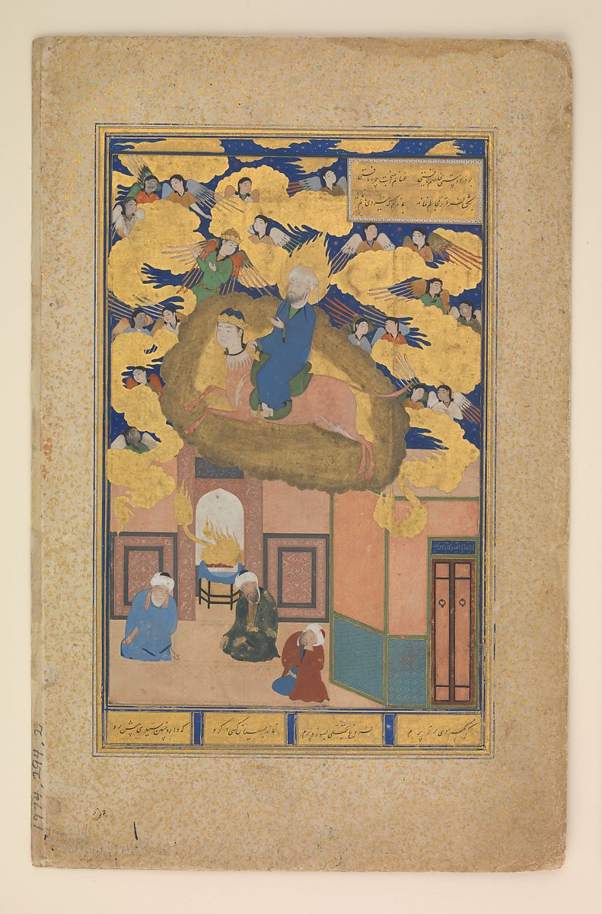
The Night Journey of The Prophet Muhammad (Mi'raj): Folio from the Bustan (Orchard) of Sa'di About 1525–35
Notes:
The Night Journey of The Prophet Muhammad (Mi'raj): Folio from the Bustan (Orchard) of Sa'di About 1525–35 Calligrapher: Sultan Muhammad Nur (about 1472–about 1536) Penned in present-day Afghanistan, probably Herat Illustrated in present-day Uzbekistan, probably Bukhara, 1530–35 Ink, opaque watercolor, and gold on paper; painting: 7 1/2 x 5 in. (19 x 12.7 cm) The Metropolitan Museum of Art, New York, Purchase, Louis V. Bell Fund and the Vincent Astor Foundation Gift, 1974 (1974.294.2)
KEY WORDS AND IDEAS Birth of Islam, Prophet Muhammad, Buraq (celestial steed), manuscript, mihrab (prayer niche), figural painting
LINK TO THE THEME OF THIS UNIT From a sixteenth-century manuscript of a thirteenth-century literary work, this painting depicts one of the most spiritual and revered episodes in Muhammad's life—his ascension to Heaven.
FUNCTION The Bustan (Orchard) of Sa'di, one of the great works of Persian literature, contains moral advice and illustrated anecdotes. Like other folios featuring the Prophet, this image teaches followers about his life. It was once part of a richly illustrated and illuminated (gilded) manuscript of poetic verses commissioned for private use by a ruler or other wealthy patron.
DESCRIPTION/VISUAL ANALYSIS The Prophet Muhammad is mounted on the celestial steed Buraq at the center of the composition. They ascend to the heavens, guided by the Archangel Gabriel. The illustration clearly distinguishes between the heavenly world of angels and golden clouds, and the earthly world below, where three figures are asleep in a mosque.
CONTEXT Painted by Muslim artists for a Muslim patron, this image portrays the Prophet unveiled, a practice now deemed blasphemous by conservative religious authorities. Throughout Islamic history, however, artists depicted the Prophet both with and without a face veil.
Source: https://www.metmuseum.org/learn/educators/curriculum-resources/art-of-the-islamic-world/unit-one/featured-works-of-art/image-2

Slide 5
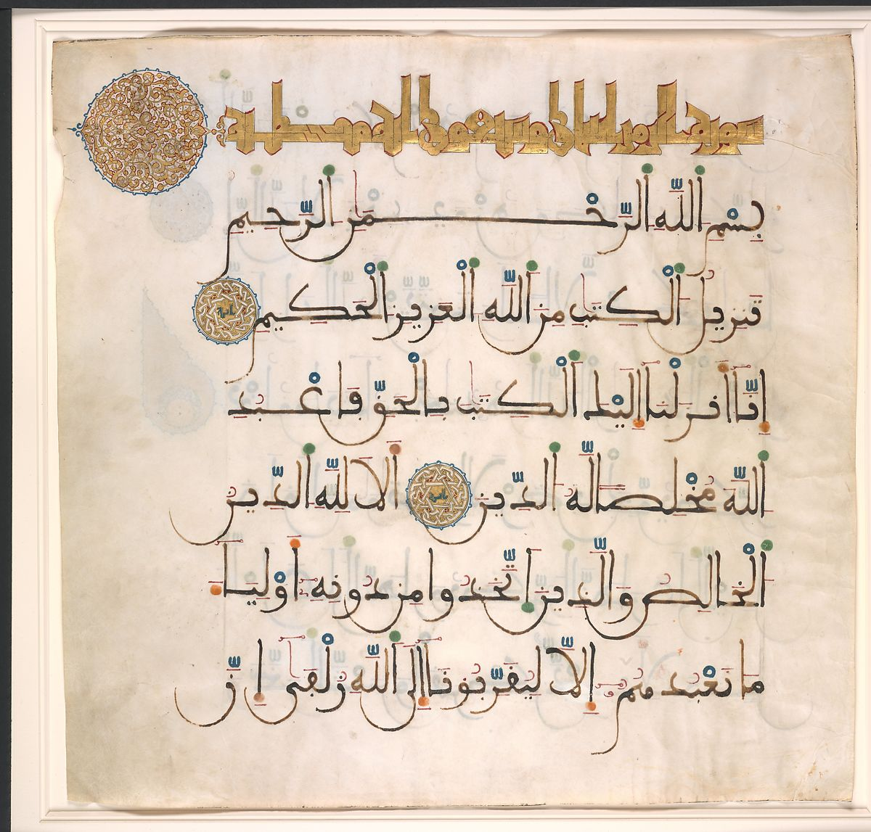
Folio from a Qur'an manuscript Late 13th–early 14th century
Notes:
Folio from a Qur'an manuscript Late 13th–early 14th century Spain Ink, opaque watercolor, and gold on parchment; 21 1⁄16 x 22 in. (53.5 x 55.9 cm) The Metropolitan Museum of Art, New York, Rogers Fund, 1942 (42.63)
KEY WORDS AND IDEAS Spread of Islam, Qur'an, Arabic, calligraphy (maghribi), recitation
LINK TO THE THEME OF THIS UNIT This large leaf is a page from a manuscript of the Qur'an. The skilled calligraphy and elaborate ornamentation reflect the eminence of the Qur'an in Islam.
FUNCTION Large, richly illuminated Qur'ans like the one to which this folio originally belonged, celebrated the word of God and raised the written word to an art form. As manuscripts containing the literal word of God, Qur'ans have an indispensible function in both private and public Muslim religious life. They also support oral recitation: cues in the script helped the reciter identify key details such as where to pause and how to vocalize various letter sounds.
DESCRIPTION/VISUAL ANALYSIS The chapter heading, Sura al-Zumar (The Crowds), appears at the top of the page in gold letters. Read from right to left, the title ends in a large circular medallion with an elaborate vegetal pattern that showcases the illuminator's extraordinary talent. Similar smaller medallions indicate the end of each verse, where the reciter is expected to pause. The blue and red dots that appear throughout the page help ensure the proper pronunciation of short vowels, which are not written out in Arabic. Their colorful and precise execution adds a further decorative touch to the page.
CONTEXT This manuscript was probably produced in Islamic Spain. It features maghribi script, which is characterized by cursive letters and swooping sublinear elements (see also Regional Scripts and Variations). The use of this script is typical of Spanish and North African Qur'ans, as is the use of parchment, which was unusual in other regions at this late date. The text includes the first, second, and part of the third verses of the Sura al-Zumar chapter of the Qur'an, which focuses on the centrality of God and Muhammad’s role as the Prophet.
While all Muslims are encouraged to read the Qur'an, correct recitation is a skill acquired through rigorous practice and schooling. In illuminated copies of the Qur'an like this one, elements that may look purely decorative, including the medallions mentioned above, often have practical purposes, such as marking the ends of verses. Because of the exalted place of the Qur'an in Islamic culture, illuminators often exhibited the finest accomplishments of their craft in these manuscripts.
Qur'ans come in many sizes. Very large Qur'ans sometimes serve for public recitation (see, for example, the massive Qur'an of Umar Aqta: 1972.279 and 18.17.1). Others are very small and could be carried on one's person (fig. 7).
Fig. 7. Folio from a Qur'an manuscript, 9th century; probably Egypt or Iraq; ink, opaque watercolor, and gold on parchment; 1 1/2 x 2 7/8 in. (3.8 x 7.3 cm); The Metropolitan Museum of Art, New York, Rogers Fund, 1962 (62.152.2)
The small size of this Qur'an would have allowed the owner to carry it on his or her person, making it ideal for travel. A personal Qur'an like this could also have functioned as a talisman, exemplifying the belief that the word of God brings blessings and protection to the believer through its mere presence.
Source: https://www.metmuseum.org/learn/educators/curriculum-resources/art-of-the-islamic-world/unit-one/featured-works-of-art/image-3

Slide 6
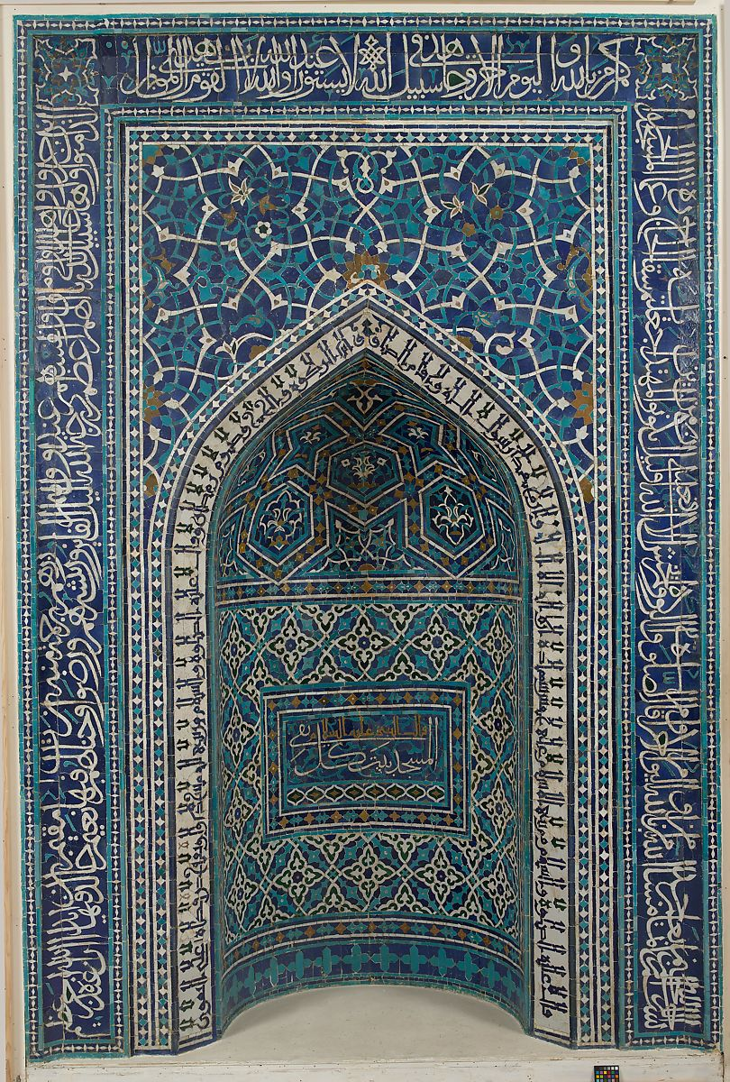
Mihrab From a religious school dated A.H. 755 / A.D. 1354–55
Notes:
Mihrab From a religious school dated A.H. 755 / A.D. 1354–55 Iran, Isfahan Mosaic of polychrome-glazed cut tiles on stonepaste body, set into mortar; 11 ft. 3 1⁄16 in. x 9 ft. 5 11⁄16 in. (343.1 x 288.7 cm), Wt. 4,500 lbs. (2041.2 kg) The Metropolitan Museum of Art, New York, Harris Brisbane Dick Fund, 1939 (39.20)
KEY WORDS AND IDEAS Five Pillars of Islam, Arabic, calligraphy (kufic, thuluth, and muhaqqaq scripts), Mecca, Qur'an, madrasa (religious school), Iran, tilework
LINK TO THE THEME OF THIS UNIT Mihrabs, like this example from Iran, are central architectural features of mosques and many Islamic religious schools all over the world.
FUNCTION A mihrab is a niche in the wall of a mosque or religious school (madrasa) that indicates the direction of Mecca (qibla), which Muslims face when praying. It is the architectural and symbolic focal point of religious buildings.
DESCRIPTION/VISUAL ANALYSIS This mihrab is decorated with inscriptions on a background of cobalt blue, turquoise, golden yellow, white, and dark green tile mosaic. The outermost rectangular band contains cursive verses from the Qur'an (9:14–22) describing God as all-knowing and omnipresent. The frame around the niche is decorated with arabesque designs outlined in blue and interspersed with floral blossoms. An inscription from the hadith (Sayings of the Prophet), written in angular kufic script (see also The Development and Spread of Calligraphic Scripts) along the edge of the pointed arch, describes the Five Pillars of Islam. At the center of the mihrab, directly facing the worshippers, an inscription reads: "The Prophet, may peace be upon him, said, 'the mosque is the abode of the pious.’”
CONTEXT This prayer niche comes from a fourteenth-century religious school (Madrasa Imami) in Isfahan, in present-day Iran. Students would have performed their daily prayers here, but would also have gone to the communal mosque on Fridays. This mihrab shows that lavish ornamentation was encouraged rather than shunned, even in religious settings.
LEARN MORE Heilbrunn Timeline of Art History Collections
RELATED AUDIO FROM THE GALLERY GUIDE
Sheila Canby: The call to prayer reminds pious Muslims five times a day to make their prayers to God. Imam Shamsi Ali, from the Islamic Cultural Center of New York, recites it for us in his beautiful voice.
[Recitation]
Navina Haidar: Can you tell what this huge object is made from? Look at the surface. It's made from tile. Each individual shape was cut and painted separately. Then everything was pieced together absolutely perfectly, like an enormous jigsaw puzzle.
Notice the tall section in the middle that curves inward, with the pointed top. That shape tells us that this is a mihrab. In every mosque, a mihrab shaped like this shows the direction towards Mecca, the holy city for Muslims. In the mosque, people face the mihrab wall when they pray.
This dazzling mihrab was made more than six hundred years ago. Look around the outside edge at that thick border of dark blue, with white and turquoise markings. Those are words in Arabic, from the Muslim holy book, the Qur'an. In Islamic art in general, creating beautiful letters is considered one of the most important forms of art. In a mosque, this lettering would often be combined with elaborate patterns, like they are here.
Within the patterns, do you see some shapes that remind you of stars or intertwining flowers? Imagine all the walls inside a mosque being covered in tile patterns and words. Sometimes they are. It's meant to feel like a vision of the heavens, or heavenly gardens.
Source: https://www.metmuseum.org/learn/educators/curriculum-resources/art-of-the-islamic-world/unit-one/featured-works-of-art/image-4

Slide 7
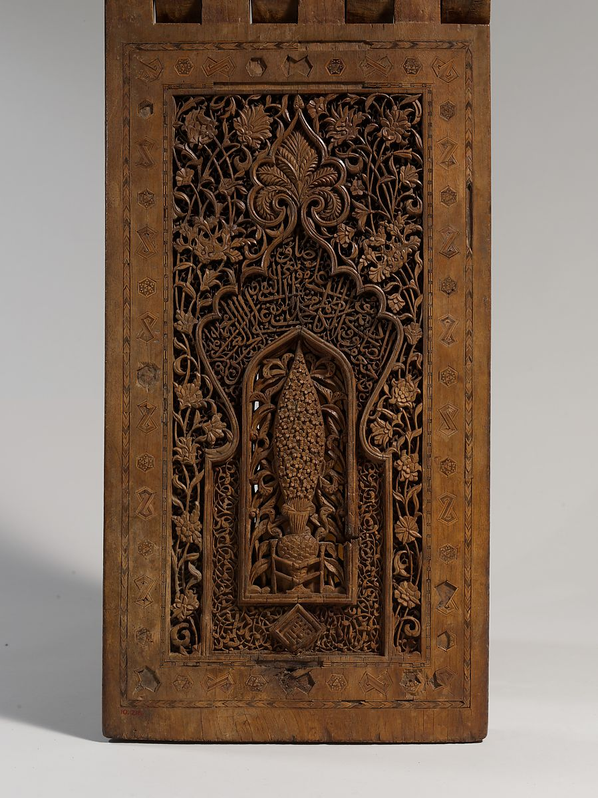
Qur'an stand (rahla) Dated A.H. 761 / A.D. 1360
Notes:
Qur'an stand (rahla) Dated A.H. 761 / A.D. 1360 Maker: Hasan ibn Sulaiman Isfahani Iran Teak; carved, painted, and inlaid; 45 x 50 x 16 1/2 in. (114.3 x 127 x 41.9 cm) The Metropolitan Musuem of Art, New York, Rogers Fund, 1910 (10.218)
KEY WORDS AND IDEAS Qur'an, imam (prayer leader), madrasa (religious school), calligraphy (thuluth, kufic, and naskh scripts), vegetal and floral ornament, wood
LINK TO THE THEME OF THIS UNIT/FUNCTION Lavishly decorated stands (rahlas) were designed to hold large copies of the Qur'an. According to its inscriptions, this one was used in a religious school (madrasa) in a town near Isfahan, in present-day Iran.
DESCRIPTION/VISUAL ANALYSIS This stand is made of two interlocking wood panels decorated with carved inscriptions and floral, vegetal, and geometric motifs. The upper square panels bear the word God ("Allah") repeated in four quadrants over a background of carved spiral arabesques. The lower rectangular sections are deeply carved in several layers; at the center of a representation of a prayer niche (mihrab) stands a cypress tree. The frame of the niche is decorated with calligraphy and spiraling arabesques, while naturalistic flowers cover the surface outside this border. The inscriptions include the name of the carver, Hasan ibn Sulaiman of Isfahan, and evoke the might of God and the holiness of Muhammad and the twelve Shi'i imams, his successors.
CONTEXT Inscriptions from religious texts frequently decorate Qur'an stands. Those using this stand would have been highly educated and thus able to read and understand the calligraphy. However, in Islam, the words of God are a blessing to believers, even when they cannot be read.
LEARN MORE Heilbrunn Timeline of Art History Collections
RELATED AUDIO FROM THE GALLERY GUIDE
Sheila Canby: This object that we're looking at is a Qur'an stand, or rahle, made of beautiful carved wood. It's dated to 761 Hijra, or 1360 A.D., and it's signed by someone named Hasan ibn Sulaiman al-Isfahani. And that's interesting, because here you have an artist whose name ends in al-Isfahani, so he or his family came from Isfahan, and you have beautifully carved wood, which is often a sign that something has been made in the north of Iran, which is very wooded.
On the lower outer surface we have a cypress tree in a niche, which is shaped, in a sense, like a prayer niche, so that's interesting. And cypress trees are very symbolic in poetry. They seem to be symbols of beauty, human beauty, people who stood tall like cypresses. But I think it's also a kind of eternal life type of symbol. And then there's marvelous relief carving of flowers above the niche. On the interior is a Naskhi, or cursive inscription. The calligraphy includes blessings on the Prophet Muhammad, and then for the twelve Shi'i, or Shiite, imams. Before the sixteenth century, you find references to the Shi'i imams that do not necessarily mean that people were strictly Shi'i; the divisions, most of the time, were less strict than they became later on. Perhaps it means that this was being used in a Shi'i context, but it doesn't necessarily mean that.
Source: https://www.metmuseum.org/learn/educators/curriculum-resources/art-of-the-islamic-world/unit-one/featured-works-of-art/image-5

Slide 8
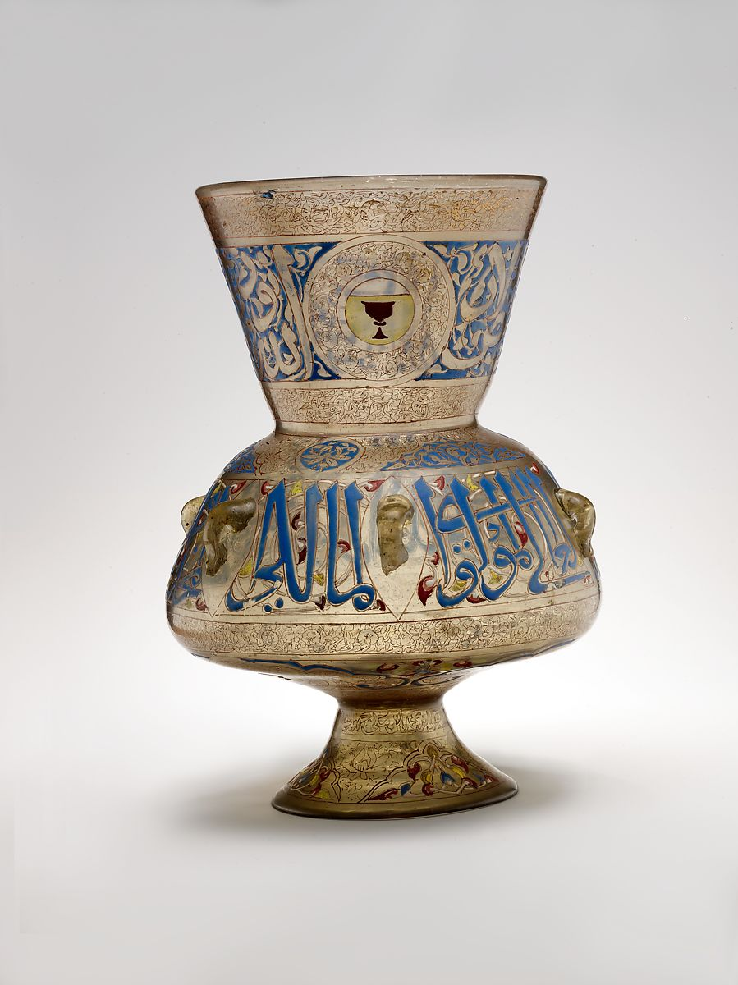
Mosque lamp About 1329–35
Notes:
Mosque lamp About 1329–35 Maker: 'Ali ibn Muhammad al-Barmaki Egypt Glass, colorless with brown tinge; blown, blown applied foot, enameled and gilded; H. 14 1/8 in. (35.9 cm), Max. Diam. 10 1/16 in. (25.6 cm) The Metropolitan Museum of Art, New York, Gift of J. Pierpont Morgan, 1917 (17.190.991)
KEY WORDS AND IDEAS Egypt, Mamluk dynasty, patronage, amir (commander), mosque, blown glass
LINK TO THE THEME OF THIS UNIT Mosque lamps like this one symbolize God's presence. In the Ayat al-Nur (The Light Verse), one of the most quoted passages from the Qur'an, God is compared to light:
God is the Light of the heavens and the earth; The likeness of His Light is as a niche wherein is a lamp (the lamp in a glass, the glass as it were a glittering star) kindled from a Blessed Tree, an olive that is neither of the East nor of the West whose oil well-nigh would shine, even if no fire touched it; Light upon Light (God guides to His Light whom He Will.) (Sura al-Nur, 24:35)
FUNCTION Because the first and last daily prayers are held before dawn and after sunset, lamps are necessary for illumination in mosques and other religious buildings. In earlier periods, lamps such as this were used for both secular and religious purposes, but by the fourteenth century they were made almost exclusively for mosques, mausoleums, and religious schools (madrasas). Often a wealthy official would donate lamps to a mosque or shrine as an expression of charity and piety.
DESCRIPTION/VISUAL ANALYSIS This mosque lamp is made of blown glass shaped into a semi-spherical body with a low foot and wide opening, and enameled and gilded. The shape, intricate enameled decoration, and detailed inscriptions are typical of mosque lamps produced during the Mamluk sultanate (1250–1517) in Egypt and Syria. (See image 45.)
The calligraphic decoration is divided into three bands: one on the flare, one on the body, and a third on the underside. The name of the patron who commissioned the lamp is inscribed in the lower portion. When lit, the flickering flame illuminated areas without enamel paint, such as the text in the mid-section. The lamp is also decorated with bands of floral ornament.
CONTEXT The decoration on this lamp indicates the status of its patron. The cup design featured prominently near the mouth is the blazon (similar to a coat of arms) of the sultan's cupbearer (jashanqir), a position in the Mamluk court. During the Mamluk sultanate, high court officials usually had blazons that indicated their roles in the hierarchy and ceremonies of the court. The ceremonial cupbearer who commissioned this lamp is identified by an inscription as Saif al-Din Qawsun; the lamp may have been created for his mosque or mausoleum in Cairo.
LEARN MORE Heilbrunn Timeline of Art History Collections
Source: https://www.metmuseum.org/learn/educators/curriculum-resources/art-of-the-islamic-world/unit-one/featured-works-of-art/image-6

Slide 9
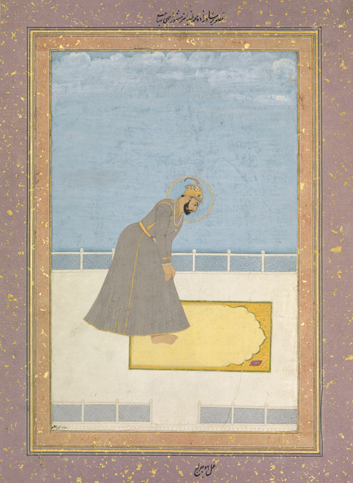
Portrait of Prince Muhammad Buland Akhtar, known as Achhe Sahib, at Prayer: Folio from an album, 17th century.
Notes:
Portrait of Prince Muhammad Buland Akhtar, known as Achhe Sahib, at Prayer: Folio from an album, 17th century; painter: Hujraj; India; ink and opaque watercolor on paper; 13 1/16 x 9 in. (33.2 x 22.9 cm); The Metropolitan Museum of Art, New York, Rogers Fund, 1925 (25.138.2)
This illustration shows a Mughal prince praying on a mat that features an arch recalling the shape of a prayer niche (mihrab), symbolic of the gateway to Paradise. The prince is barefoot as a gesture of humility before God. The simplicity of his surroundings is an indication of piety; the emphasis here is on the prince's spiritual nature rather than the opulence of his costume or surroundings (which is the case in many royal Mughal portraits; see The Mughal Court and the Art of Observation).
Source: https://www.metmuseum.org/learn/educators/curriculum-resources/art-of-the-islamic-world/unit-one/the-five-pillars-of-islam

Slide 10
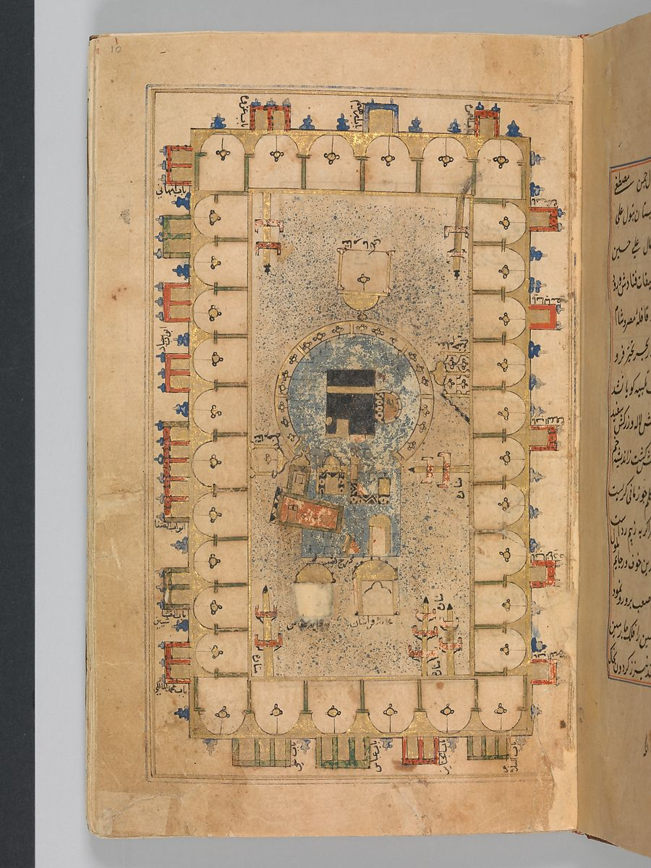
Folio from the Futuh al-Haramain (Description of the Holy Cities), mid-16th century; by Muhi al-Din Lari.
Notes:
Fig. 2. Folio from the Futuh al-Haramain (Description of the Holy Cities), mid-16th century; by Muhi al-Din Lari; Turkey; ink, opaque watercolor, and gold on paper; 8 3/8 x 5 3/4 in. (21.3 x 13.3 cm); The Metropolitan Museum of Art, New York, Rogers Fund, 1932 (32.131) This book illustration provides a schematic view of the innermost enclosure of the Haram Mosque in Mecca. It includes six minarets, the names of the gates, and even shows mosque lamps hanging in the arcades around the Ka'ba at the center of the composition. The book is a pilgrimage manual, which describes the holy cities of Mecca and Medina and the rituals that pilgrims are required to perform at each location. The most important of these rituals include walking around the Ka'ba seven times, running between the hills of Safa and Marwa to commemorate the story of Ishmael (Isma'il in Arabic) and his mother, and symbolically stoning the devil in the area of Mina.

