Slide 1
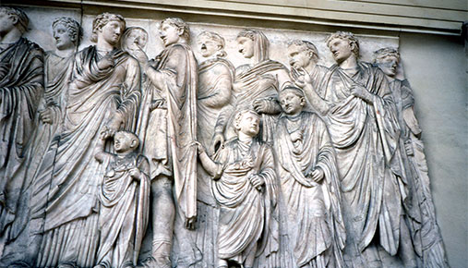
Studying Ancient Figures

Slide 2
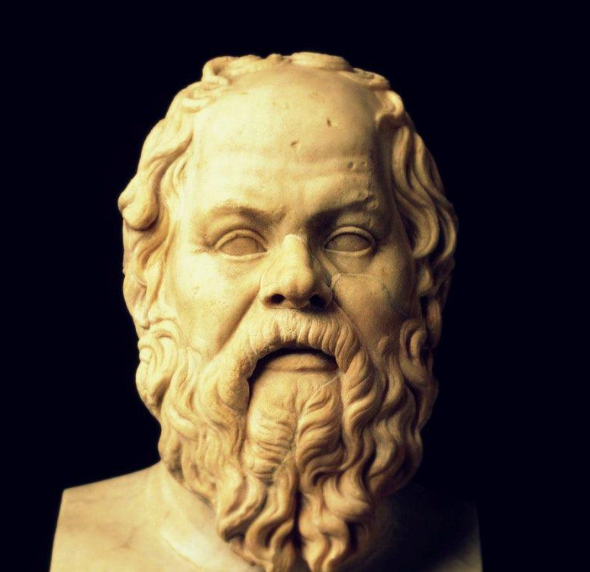
You’re an historian studying the life of Socrates (born c 470BC) – the first Western philosopher.
What kind of information do you look for?
What do you expect to find?
How will you know if the documents about him are reliable or not?
What tests will you use to determine this?
What sources are there (Goggle)?

