Slide 1
The Gospel of Mark
When? Who?

Slide 2
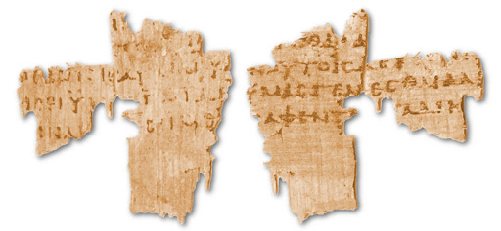
Archaeology
First fragment of Mark is Papyri 137 and is dated to 175-225AD

Slide 3
Archaeology
First fragment of Mark is Papyri 137 and is dated to 175-225AD
First complete copy of Mark is from 360AD

Slide 4
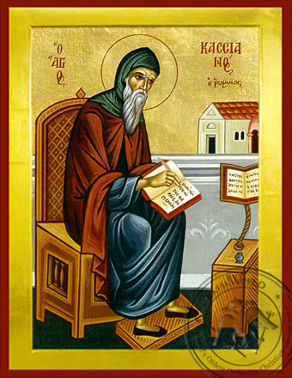
Literature
But quoted as early as 70s-80s AD by Matthew and Luke
Luke

Slide 5
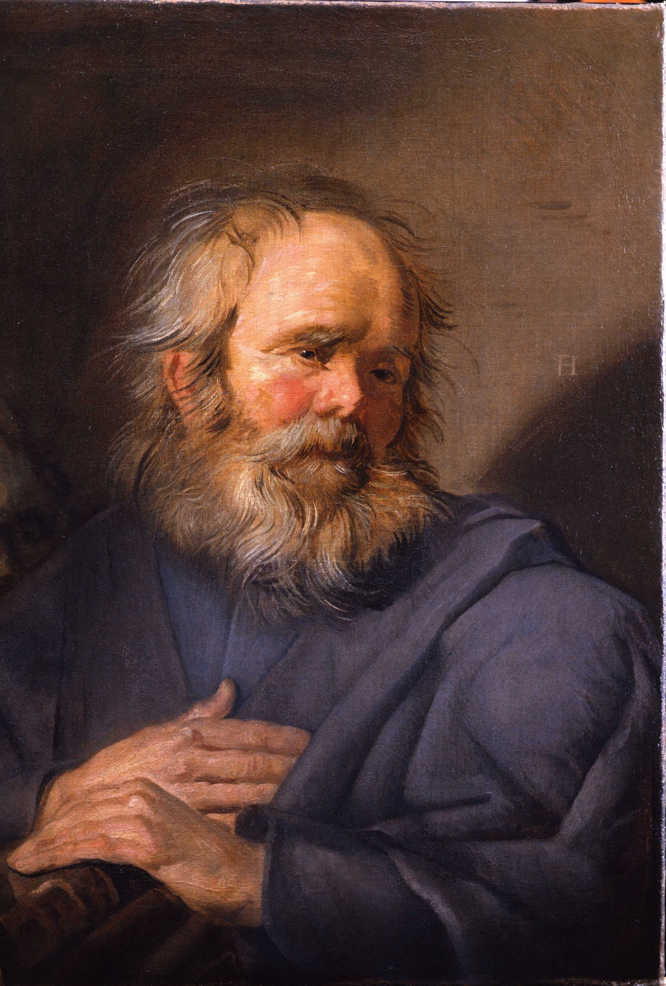
But who was he?
John Mark mentioned in Book of Acts, a companion of Peter.

Slide 6
But who was he?
Papias
Bishop Papias of Hierapolis (60-130AD) Claimed he was Peter’s interpreter
“And the elder used to say this, Mark became Peter’s interpreter and wrote accurately all that he remembered, not, indeed, in order, of the things said and done by the Lord. For he had not heard the Lord, nor had followed him, but later on, followed Peter, who used to give teaching as necessity demanded but not making, as it were, an arrangement of the Lord’s oracles, so that Mark did nothing wrong in thus writing down single points as he remembered them. For to one thing he gave attention, to leave out nothing of what he had heard and to make no false statements in them.”

Slide 7
But who was he?
Irenaeus Irenaeus (130-200AD) says Mark was Peter’s scribe:
“Matthew composed his gospel among the Hebrews in their own language, while Peter and Paul proclaimed the gospel in Rome and founded the community. After their departure, Mark, the disciple and interpreter of Peter, handed on his preaching to us in written form”

Slide 8
But who was he?
Justin Martyr (150AD) Early Christian apologist, Justin Martyr (150AD), wrote of a gospel of Peter in which the sons of Zebedee are called the ‘sons of thunder’. Only Mark’s gospel describes them like this.
“It is said that he [Jesus] changed the name of one of the apostles to Peter; and it is written in his memoirs that he changed the names of others, two brothers, the sons of Zebedee, to Boanerges, which means ‘sons of thunder’….”

Slide 9
But who was he?
Clement of Alexandria
Clement (150-215AD) claims Mark scribed Peter’s gospel:
“And so great a joy of light shone upon the minds of the hearers of Peter that they were not satisfied with merely a single hearing or with the unwritten teaching of the divine gospel, but with all sorts of entreaties they besought Mark, who was a follower of Peter and whose gospel is extant, to leave behind with them in writing a record of the teaching passed on to them orally; and they did not cease until they had prevailed upon the man and so became responsible for the Scripture for reading in the churches.”

Slide 10
But who was he?
Eusebius
Eusebius (312-324AD) wrote that Mark transcribed Peter’s teachings:
“The Gospel according to Mark had this occasion. As Peter had preached the Word publicly at Rome, and declared the Gospel by the Spirit, many who were present requested that Mark, who had followed him for a long time and remembered his sayings, should write them out. And having composed the Gospel he gave it to those who had requested it. When Peter learned of this, he neither directly forbade nor encouraged it.”

Slide 11
But who was he?
Tertullian
Tertullian (160-225AD) writes that Mark scribed for Peter.
“While that [gospel] which Mark published may be affirmed to be Peter’s whose interpreter Mark was.”

Slide 12
But who was he?
The Muratorian Fragment The Muratorian Fragment (170AD) is the oldest known list of New Testament books. It is a fragment but appears to agree with the idea that Mark scribed Peter’s gospel.
“But he was present among them, and so he put [the facts down in his Gospel]”

Slide 13
But who was he?
Origen Origen (185-254AD) agrees with the idea that Mark was Peter’s scribe:
“The second is by Mark, who composed it according to the instructions of Peter, who in his Catholic epistle acknowledges him as a son,”

Slide 14
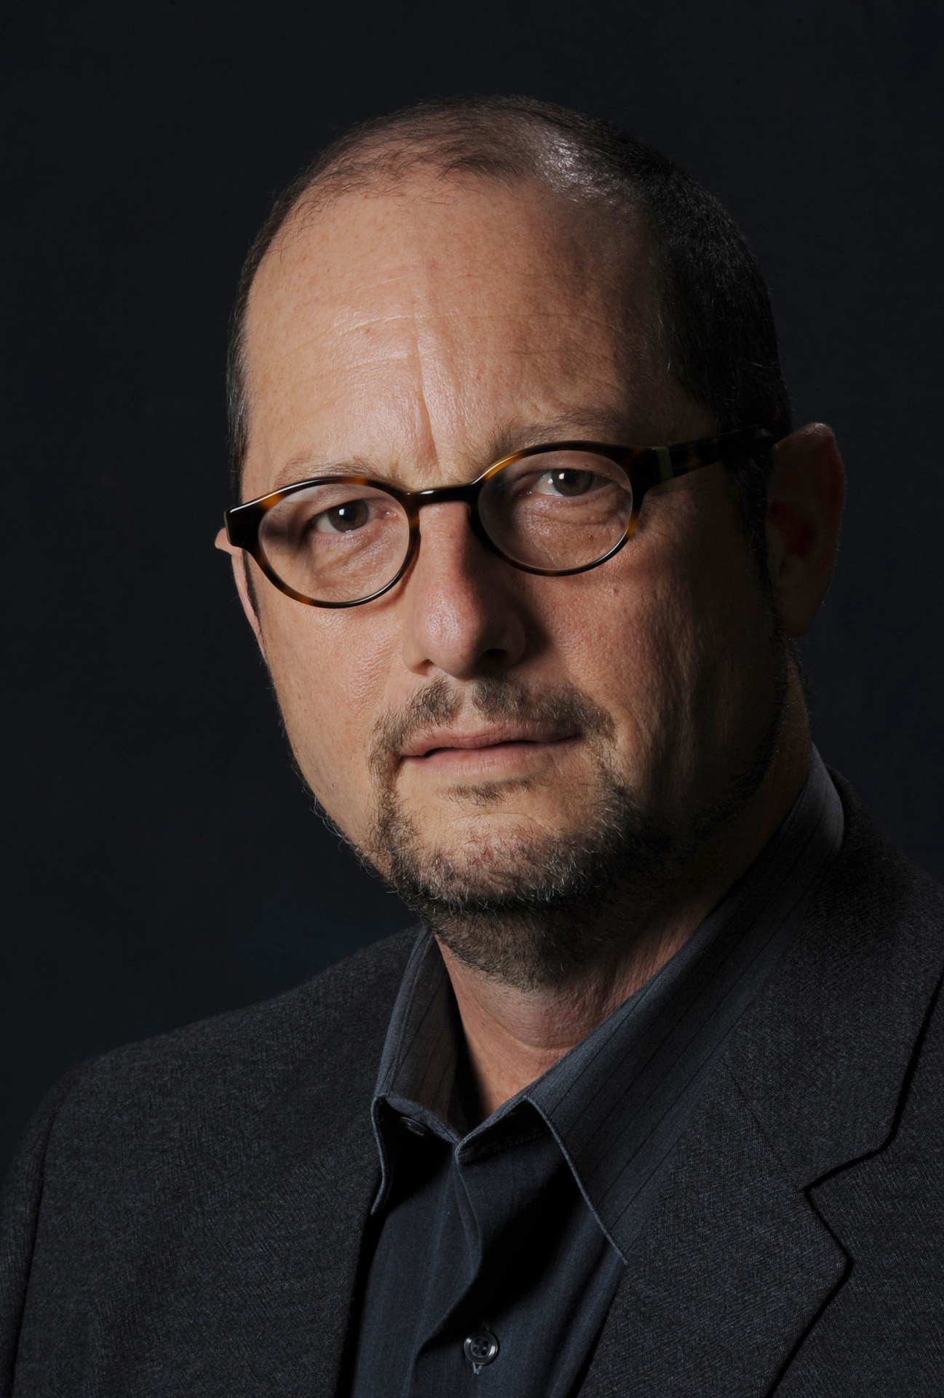
Contemporary Scholarship
Many contemporary scholars argue that the gospel was originally anonymous and that the title ‘According to Mark’ was originally not on the manuscript. e.g.
Bart Ehrman:
But are these traditional ascriptions correct? The first thing to observe is that the titles of the Gospels were not put there by their authors—as should be clear after just a moment's reflection. Suppose a disciple named Matthew actually did write a book about Jesus' words and deeds. Would he have called it "The Gospel According to Matthew"? Of course not. He might have called it "The Gospel of Jesus Christ" or "The Life and Death of Our Savior" or something similar.

Slide 15
Contemporary Scholarship
But if someone calls it the Gospel according to Matthew, then it's obviously someone else trying to explain, at the outset, whose version of the story this one is. And in fact we know that the original manuscripts of the Gospels did not have their authors' names attached to them.¹ 1. Because our surviving Greek manuscripts provide such a wide variety of (different) titles for the Gospels, textual scholars have long realized that their familiar names (e.g., "The Gospel according to Matthew") do not go back to a single "original" title, but were later added by scribes.
From Jesus: Apocalyptic Prophet of the New Millennium. Oxford University Press. p. 42.

Slide 16
Contemporary Scholarship
But why put the title ‘According to Mark’ on it?

Slide 17
Contemporary Scholarship
Date of writing:
Most contemporary scholars argue that the gospel was written sometime close to 70AD. They do this because of references to coming trouble in Jerusalem in Mark 13. This trouble did eventuate with the destruction of Jerusalem and the temple in 70AD by the Romans.

Slide 18
What can we know for sure?
Written within the lifetime of the first followers of Jesus: from 35AD-75AD

Slide 19
What can we know for sure?
Written within the lifetime of the first followers of Jesus: from 35AD-75AD
Written very close to the events it proports (for ancient history)

Slide 20
What can we know for sure?
Written within the lifetime of the first followers of Jesus: from 35AD-75AD
Written very close to the events it proports (for ancient history)
Intended to be biography/history.

Slide 21
AUTHOR | WHEN WRITTEN | EARLIEST COPY | TIME SPAN | No. OF COPIES
Homer Iliad
Caesar The Gallic Wars
Plato Tetralogies
Aristotle
Herodotus History
Euripides
New Testament
Is the Bible reliable?
900 BC
400 BC
500 years
643
100 - 44 BC
900 AD
1,000 years
10
427 - 347 BC
900 AD
1,200 years
7
384 - 322 BC
1,100 AD
1,400 years
49
480 - 425 BC
900 AD
1,300 years
8
480 - 406 BC
1,100 AD
1,500 years
9
50 - 90 AD
130 AD
200 AD
40 years
110 years
24,000
school.carm.org: This chart was adapted from charts in Evidence that Demands a Verdict, by Josh McDowell, 1979, pages 42 and 43
Notes:
On the question of historical liability. It is worth considering what we consider as reliable for other historical documents. If students are looking for historical evidence for why they should trust the Bible the evidence is pretty over whelming.

