Slide 1
Jesus and the Old Testament

Slide 2
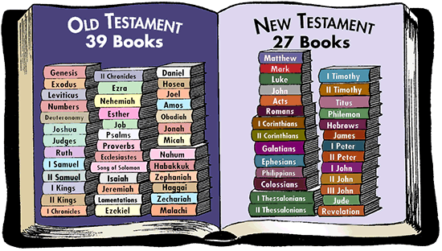
The Bible is divided into two main parts: the Old Testament and the New Testament.
The Old Testament tells the story of God and his people from the very beginning until about 400 years before the birth of Jesus. The New Testament begins with Jesus’ birth.
Each of these parts is also divided into smaller sections which are called books.

Slide 3
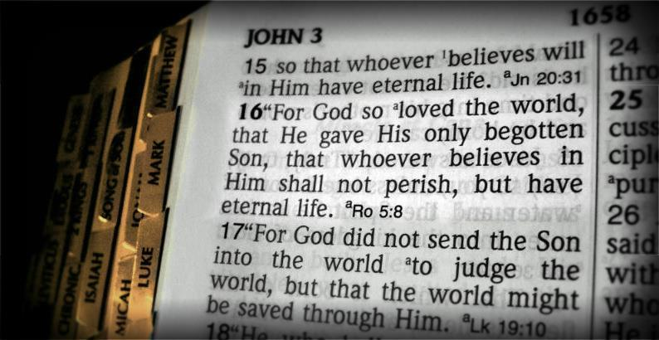
Each book is divided into chapters and each chapter is divided into verses
It works like this: The heading at the top of the page is John 3 which means that John is the name of this book. The Chapter is number 3 and we can see verses 15 and 16 in the image. So you have John 3:15-16.
Notes:
For students to understand what the Bible is we also need to teach them about the structure of the Bible.
They need to understand the historical context of the Old and New testaments as well as how to find passages within the Bible. Just like students need to learn how to use an atlas in Geography or a protractor in Maths.

Slide 4
Steps for finding a passage in the Bible
Look of the page number for the book on the contents page e.g Mark
Find the relevant chapter in the book (big number)
Find the relevant verse/s (small number)

Slide 5
Activity
Jesus fulfilled (made true) over 150 prophecies (God’s promises) from the Old Testament
In small groups see if you can find what promises Jesus made true in each of the passages listed on the following slide.

Slide 6
Jesus fulfilled over 150 prophecies from the Old Testament
 | Old Testament Prophecy | New Testament Fulfilment
1 | Genesis 12:3; 17:17,19 | Matthew 1:1-2, 16; Luke 3:23, 34
2 | 2 Samuel 7:12-16; Isaiah 9:6-7 | Luke 1:32
3 | Micah 5:2 | Luke 2:4-7
4 | Isaiah 7:13-14 | Luke 1:26-31
5 | Hosea 11:1 | Matthew 2:13-15
6 | Isaiah 40:3 | Matthew 3:1-3

Slide 7
Answers
 | Answer
1 | Descendent of Abraham
2 | Descendent of David
3 | Born in Bethlehem
4 | Born of a virgin
5 | Flees to Egypt
6 | Follows a messenger

Slide 8
Jesus fulfilled over 150 prophecies from the Old Testament
 | Old Testament Prophecy | New Testament Fulfilment
7 | Psalm 78:1-2 | Matthew 13:24-35
8 | Zachariah 9:9 | Matthew 21:1-11
9 | Psalm 41:9 | John 13:18
10 | Zachariah 12:10 | John 19:34
11 | Psalm 22:15-16 | John 20:25-27
12 | Exodus 12:43-46; Psalm 34:19-20 | John 19:33-36
13 | Psalm 16:10-11, 49:15 | Mark 16:5-6
14 | Psalm 68:18 | Acts 1:9; 2:32-33; 1 Corinthians 15:3-4

Slide 9
Answers
 | Answer
7 | Teaches in Parables
8 | Rides into Jerusalem on a donkey
9 | Betrayed by a close friend who eats with him
10 | Side is pierced
11 | Hands and feet are pierced
12 | No bones are broken
13 | Rises from the dead
14 | Ascends to heaven and sits at God’s right hand

