Slide 1
Son of Man

Slide 2
Jesus was human
(= Son of Man)

Slide 3
Adam
Seth
Enosh
Kenan
Mahalalel
Jared
Enoch
Methuselah
Lamech
Noah
Shem
Arphaxad
Cainan
Shelah
Eber
Peleg
Reu
Serug
Nahor
Terah
Abraham
Isaac
Jacob
Judah and Tamar
Perez
Hezron
Ram
Amminadab
Nahshom
Salmon and Rahab
Boaz and Ruth
Obed
Jesse
David and Bathsheba
Solomon
Rehoboam
Abijah
Asa
Jehoram
Uzziah
Jotham
Ahaz
Hazekiah
Manasseh
Amon
Josiah
Jehoiachin
Shealtiel
Zerubbabel
Abihud
Eliakim
Azor
Jacob
Mattan
Eleazer
Elihud
Akim
Zadok
JOSEPH
JESUS
Jesus’ legal right to David’s throne, which can come only from his father’s lineage, is fulfilled through Joseph. Jesus fulfils his physical right to David’s throne through Mary.
Ishmael (Islam)
Nathan
Mattatha
Menna
Melea
Eliakim
Jonam
Joseph
Judah
Simeon
Levi
Matthat
Jorim
Eliezer
Joshua
Er
Elmadam
Cosam
Addi
Melki
Neri
Shealtiel
Zerubbabel
Rhesa
Joanan
Joda
Josek
Semein
Mattathias
Maath
Naggai
Esli
Nahum
Amos
Mattathias
Joseph
Jannai
Melchi
Levi
Matthat
Heli
MARY
JESUS’ FAMILY TREE
Notes:
Have you ever come across long lists of names in the Bible? Those sections are generally the genealogies. These sections are important because they help us see the historical narrative of the Bible. In the Bible we learn about God through his relationship with his people. In the Old Testament this is the Israelites and in the New Testament it’s Jesus’ followers. Understanding the genealogies helps us to understand the story arc of the Bible.
We learn from the genealogies that Jesus is an Israelite. But not just any Israelite he is a great, great, great,….grandson of David on both Joseph and Mary’s side of his family tree. This is important because in the Old Testament we learn that the promised Messiah will be one David’s relatives.

Slide 4
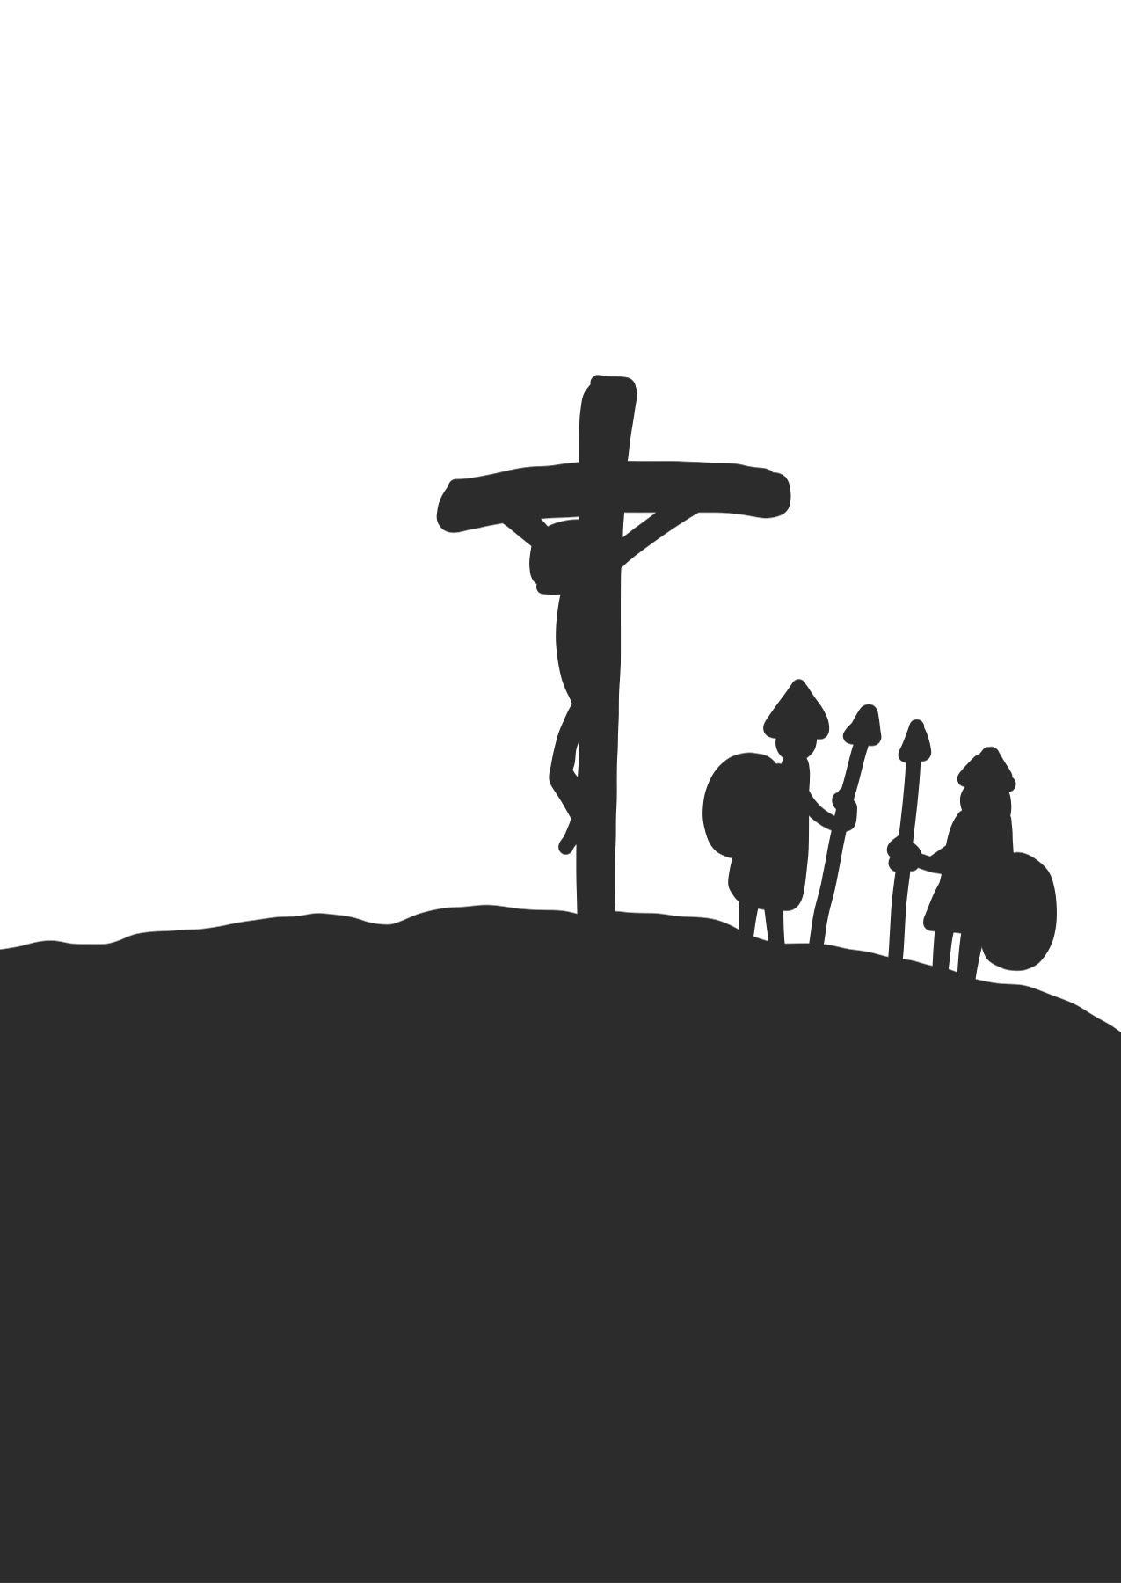
Jesus’ ministry on Earth
Jesus died on a cross
Jesus was born to Mary

Slide 5
Jesus is crowned king over all creation
(= Jesus is the Son of God)

Slide 6
^{Daniel 7:13-14 (CEV)}
¹³ As I continued to watch the vision that night,
I saw what looked like a son of man coming with the clouds of heaven, and he was presented to the Eternal God. ¹⁴ He was crowned king and given power and glory, so that all people of every nation and race would serve him. He will rule forever, and his kingdom is eternal, never to be destroyed.

Slide 7
The Son of God became a man so he could enable men to become Sons of God
C.S. Lewis

Slide 8
^{John 3:13-15 (MSG)}
No one has ever gone up into the presence of God except the One who came down from that Presence, the Son of Man. In the same way that Moses lifted the serpent in the desert so people could have something to see and then believe, it is necessary for the Son of Man to be lifted up—and everyone who looks up to him, trusting and expectant, will gain a real life, eternal life.

Slide 9
In Front of the Story Questions
What do I know about this topic?
What do I think my friends and family would think of this topic?
How might different people understand this topic?
Why might my understanding of this topic be different to other peoples’ understanding of this topic?

