Slide 1
Is the Bible True?

Slide 2
The Lost Coin
Read Luke 15:8-10
⁸ “Or suppose a woman has ten silver coins and loses one. Won’t she light a lamp and sweep the entire house and search carefully until she finds it? ⁹ And when she finds it, she will call in her friends and neighbors and say, ‘Rejoice with me because I have found my lost coin.’ ¹⁰ In the same way, there is joy in the presence of God’s angels when even one sinner repents.” (NLT)

Slide 3
Truth
Do you think Luke believed this story was a real event? Why or why not?
What do you think Luke’s purpose was in recording this story?
What ‘truth’ is Jesus trying to communicate in this story?
Can something that does not happen still communicate truth?
What does this tell us about truth?

Slide 4
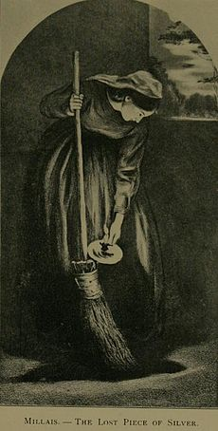
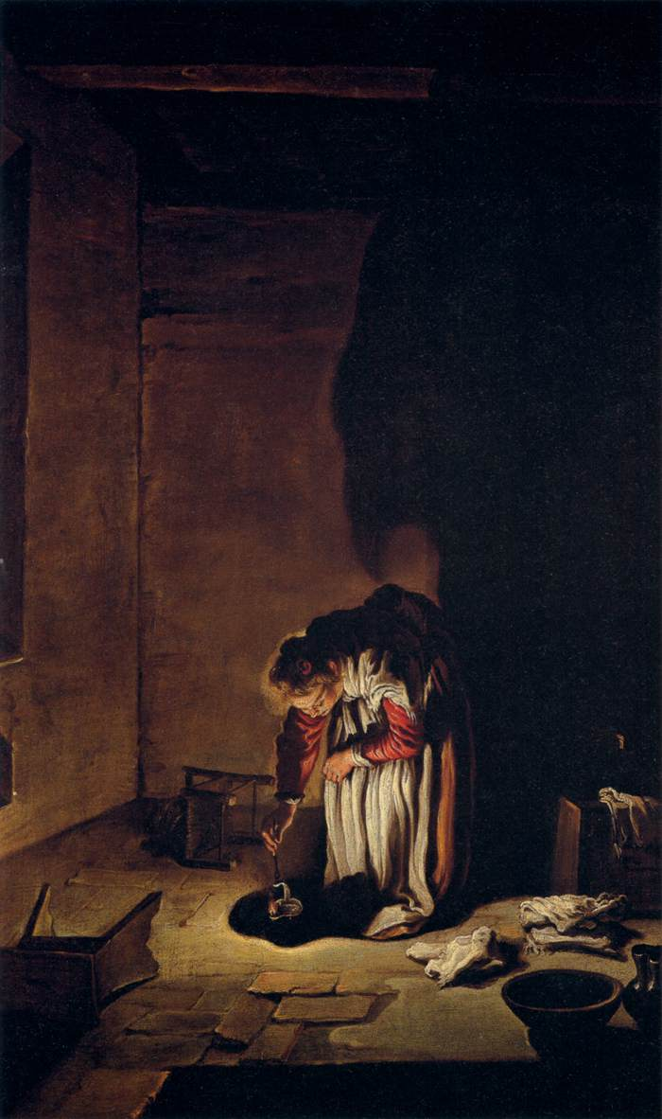
Do the artworks accurately capture what the parable is trying to communicate?
Do the different features in each picture impact the truthfulness of the picture? Why or why not?
Would it be possible to paint a picture of the parable that was ‘untruthful’?

Slide 5
Text Types in the Bible
The Bible contains different text types that have different purposes. We need to consider the purpose of the different books in the Bible to understand the truth contained in them.
Activity
Have a look at a Bible. Write a list of as many different text types as you can find e.g. poetry.
Notes:
Video on different literary styles in the Bible. This is meant as a reminder of the lesson with the different books. The point is for students to understand different text types need to read differently. This video may be too complicated for young students.
https://www.bible.com/videos/3171-literary-styles-in-the-bible-from-the-bible-project

Slide 6
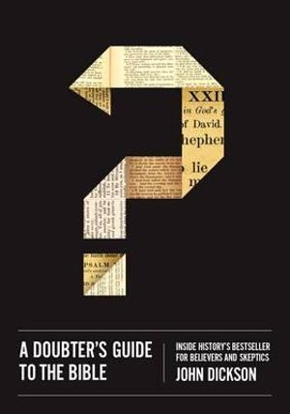
John Dickson A Doubter’s Guide to the Bible (2014)
“The Bible is history’s number one bestseller by a factor of about ten. Six billion copies have been sold. Admittedly, it had a head start on other books; it was the first item of the modern printing press. But it has been number one every year since records have been kept-except for 2007, when Harry Potter and the Deathly Hallows topped the list, with forty-four million sales. Unlike most bestsellers, however, the Bible actually increases sales each year. The latest figures for the Bible are hard to fathom. It sold thirty million copies in 2009 alone. That’s 82,000 copies a day, 3,400 copies an hour. That means someone gets a Bible every second.”
All the Bibles sold would reach the moon almost three times and circle the earth more than 28 ½ times

Slide 7
10 Reasons you can trust the Bible about Jesus
Christianity is historical: the heart of the Christian faith is a series of events recorded in a collection of histories and letters
The Gospels are widely recognised by historians (people who study history)
The New Testament contains a collection of independent evidence about Jesus: many of the books in the New Testament were written independently of each other.
The New Testament sources are written close to when the events occurred
Before the New Testament was written, the words and deeds of Jesus were preserved by oral tradition
Non-Christian writings confirm the broad outline of Jesus life
Absence of evidence is not evidence of absence
The New Testament is probably the best preserved text of all ancient history
Archaeology confirms important facts about the world of Jesus
Jesus is more trustworthy than we are trusting: it isn’t about us having no doubts. It’s about us developing a sense (however strong that sense might be) of the dependability of Jesus himself.
John Dickson
Founding Director of the Centre for Public Christianity and Honorary Fellow of the Department of Ancient History at Macquarie University
www.eternitynews.com.au/good-news/10-reasons-you-can-trust-the-bible/
Notes:
Jesus is a historical figure. It’s important to help students understand this. While they may disagree with some of the claims made about Jesus, particularly his resurrection. In the academic discipline of history they would be very lonely if they claimed Jesus never existed. It may also be important to consider the difference between evidence and proof. Often students believe Science proves things and don’t realise that it’s only really some mathematical concepts that can be proves. Everything else we believe tends to be based on evidence. This evidence may take different forms and students need to apply their critical thinking skills to come to a conclusion.

Slide 8
Are there mistakes in the Bible?

Slide 9
How do we
find out?
Notes:
Watch video: https://request.org.uk/bible/questions-about-the-bible/is-the-bible-reliable/ (4min)

Slide 10
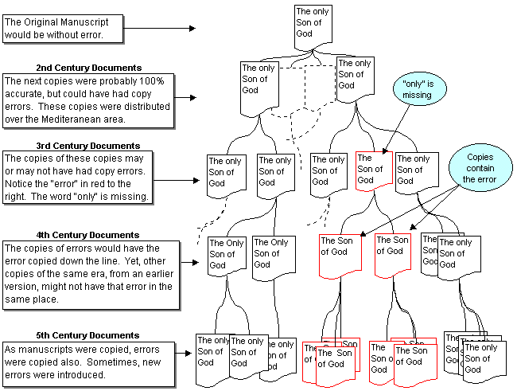
It’s all about comparing copies from different times and places…

Slide 11
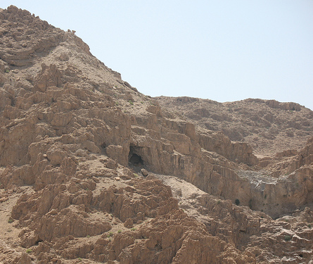
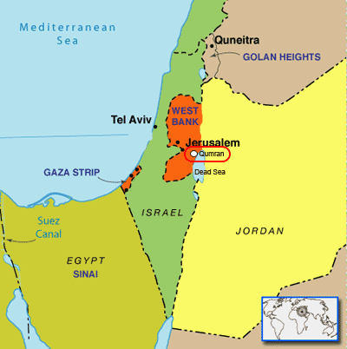
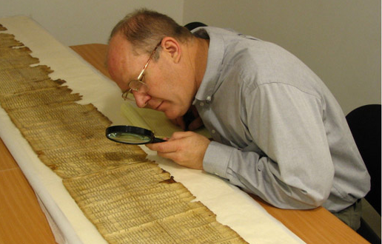
The Dead Sea Scrolls have provided Old Testament manuscripts approximately 1,000 years older than our previous oldest manuscript.
They have demonstrated that the Old Testament was accurately transmitted during this interval...
Dr. Bryant Wood, archaeologist
Over six hundred scrolls and thousands of fragments have been discovered in the 11 caves of the Qumran area. Fragments of every Biblical book except Esther have been found… including a well-preserved copy of the entire prophecy of Isaiah -the oldest copy of an Old Testament book ever to be discovered
www.christiananswers.net

Slide 12
AUTHOR | WHEN WRITTEN | EARLIEST COPY | TIME SPAN | No. OF COPIES
Homer Iliad
Caesar The Gallic Wars
Plato Tetralogies
Aristotle
Herodotus History
Euripides
New Testament
900 BC
400 BC
500 years
643
100 - 44 BC
900 AD
1,000 years
10
427 - 347 BC
900 AD
1,200 years
7
384 - 322 BC
1,100 AD
1,400 years
49
480 - 425 BC
900 AD
1,300 years
8
480 - 406 BC
1,100 AD
1,500 years
9
50 - 90 AD
130 AD
200 AD
40 years
110 years
24,000
school.carm.org: This chart was adapted from charts in Evidence that Demands a Verdict, by Josh McDowell, 1979, pages 42 and 43
Notes:
While on the question of historical liability. It is worth considering what we consider as reliable for other historical documents. If students are looking for historical evidence for why they should trust the Bible the evidence is pretty over whelming.

