Slide 1
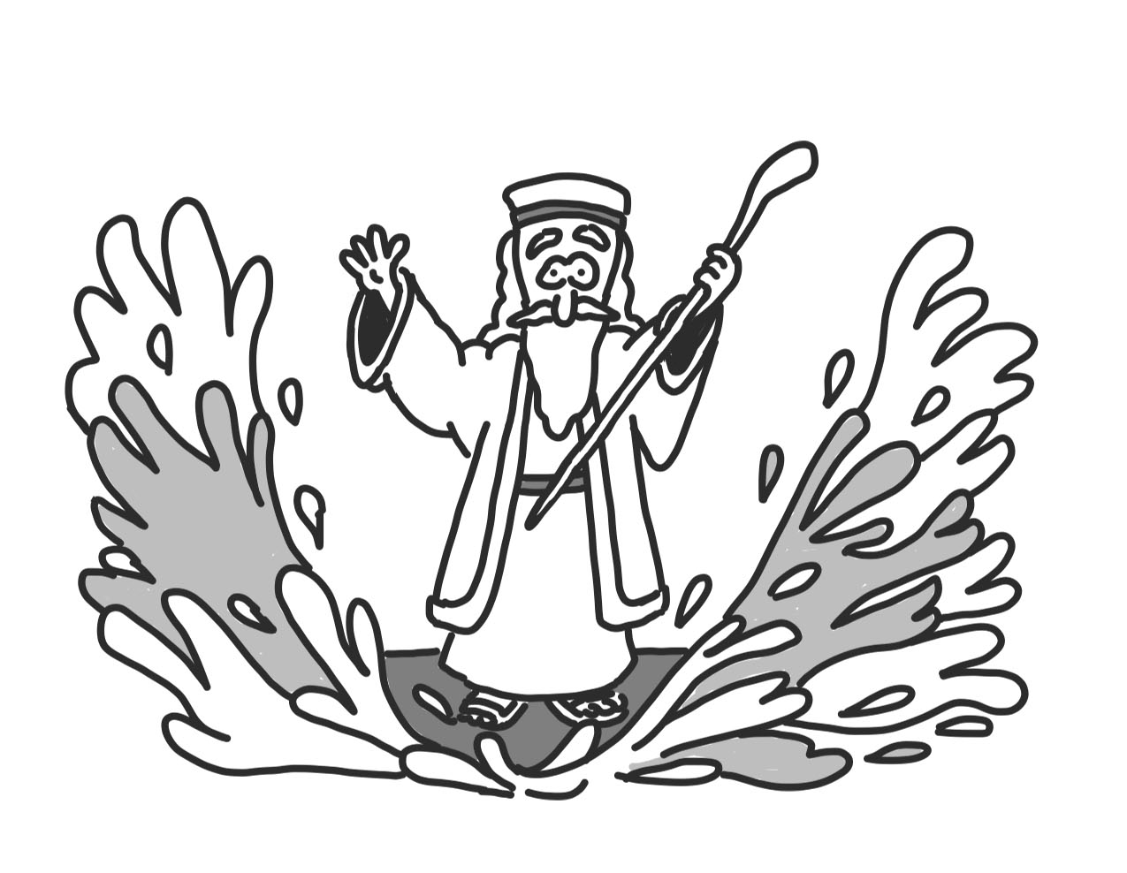
Where did Israel come from?

Slide 2
Adam
Seth
Enosh
Kenan
Mahalalel
Jared
Enoch
Methuselah
Lamech
Noah
Shem
Arphaxad
Cainan
Shelah
Eber
Peleg
Reu
Serug
Nahor
Terah
Abraham
Isaac
Jacob
Judah and Tamar
Perez
Hezron
Ram
Amminadab
Nahshom
Salmon and Rahab
Boaz and Ruth
Obed
Jesse
David and Bathsheba
Solomon
Rehoboam
Abijah
Asa
Jehoram
Uzziah
Jotham
Ahaz
Hazekiah
Manasseh
Amon
Josiah
Jehoiachin
Shealtiel
Zerubbabel
Abihud
Eliakim
Azor
Jacob
Mattan
Eleazer
Elihud
Akim
Zadok
JOSEPH
JESUS
Jesus’ legal right to David’s throne, which can come only from his father’s lineage, is fulfilled through Joseph. Jesus fulfils his physical right to David’s throne through Mary.
Nathan
Mattatha
Menna
Melea
Eliakim
Jonam
Joseph
Judah
Simeon
Levi
Matthat
Jorim
Eliezer
Joshua
Er
Elmadam
Cosam
Addi
Melki
Neri
Shealtiel
Zerubbabel
Rhesa
Joanan
Joda
Josek
Semein
Mattathias
Maath
Naggai
Esli
Nahum
Amos
Mattathias
Joseph
Jannai
Melchi
Levi
Matthat
Heli
MARY
JESUS’ FAMILY TREE
Notes:
Have you ever come across long lists of names in the Bible? Those sections are generally the genealogies. These sections are important because they help us see the historical narrative of the Bible. In the Bible we learn about God through his relationship with his people. In the Old Testament this is the Israelites and in the New Testament it’s Jesus’ followers. Understanding the genealogies helps us to understand the story arc of the Bible.
We learn from the genealogies that Jesus is an Israelite. But not just any Israelite he is a great, great, great,….grandson of David on both Joseph and Mary’s side of his family tree. This is important because in the Old Testament we learn that the promised Messiah will be one David’s relatives.

Slide 3
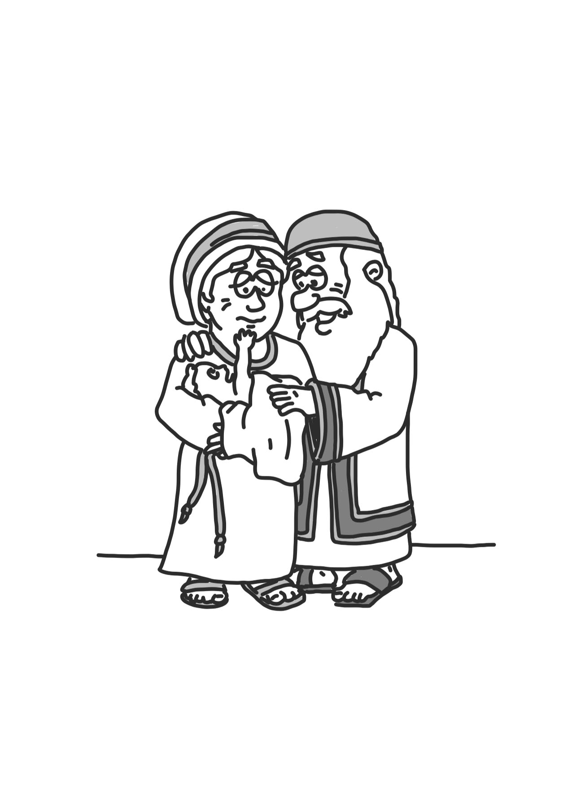
Abraham
Abraham
Years passed and things didn’t get any better... God’s world was still full of tears. It was never meant to be like this. But God was getting ready to do something about it. He was going to make all the wrong things right, and he was going to do it through... a family.
God told Abraham his Secret Rescue Plan.‘ Abraham, I will make your family very big,’ God promised. ‘Until one day your family will come to number more than even all the stars in the sky.’
‘You will be my special family, my people, and through you everyone on earth will be blessed!’ It was an incredible promise – God was going to rescue the world through Abraham’s family! One of his great-great-great grandchildren would be the Child, the Promised One, the Rescuer.
Sally Lloyd-Jones: The Jesus Storybook Bible (p56, 58, 59)

Slide 4
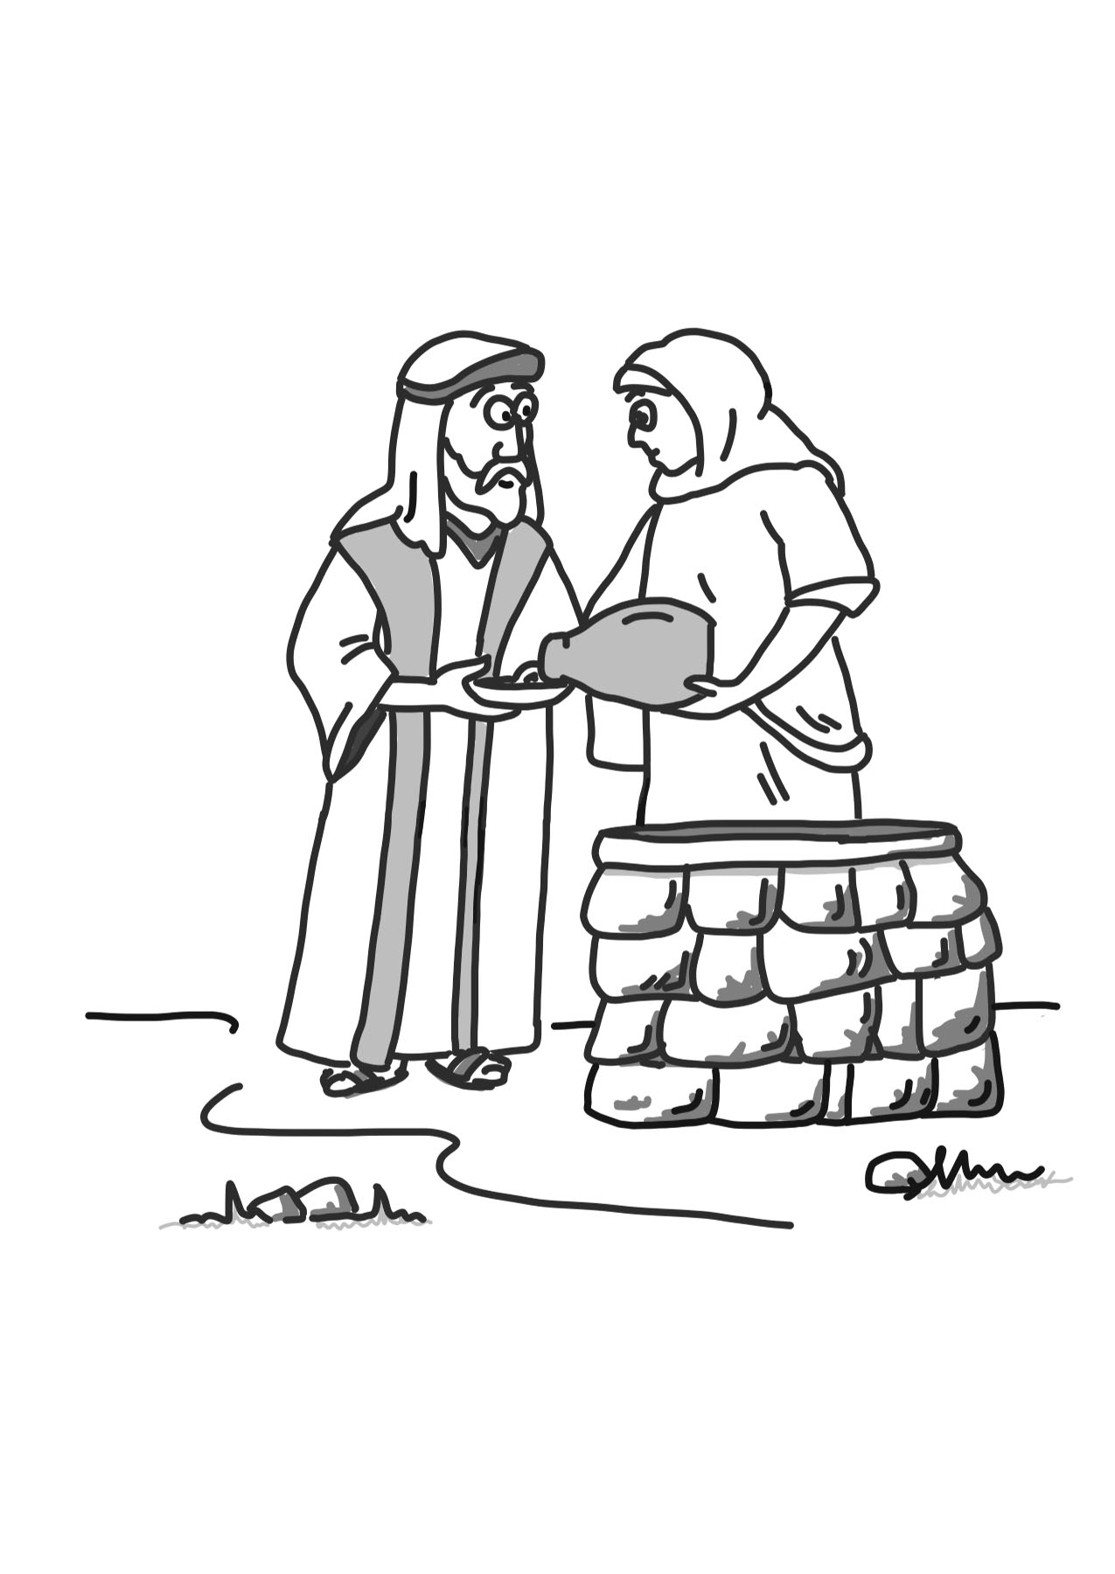
Isaac
Sure enough, nine months later, just as God had promised, Sarah gave birth to a baby boy. They named him Isaac…God would do as he promised. He would always look after Abraham’s family, his special people.
Sally Lloyd-Jones: The Jesus Storybook Bible (p60)

Slide 5
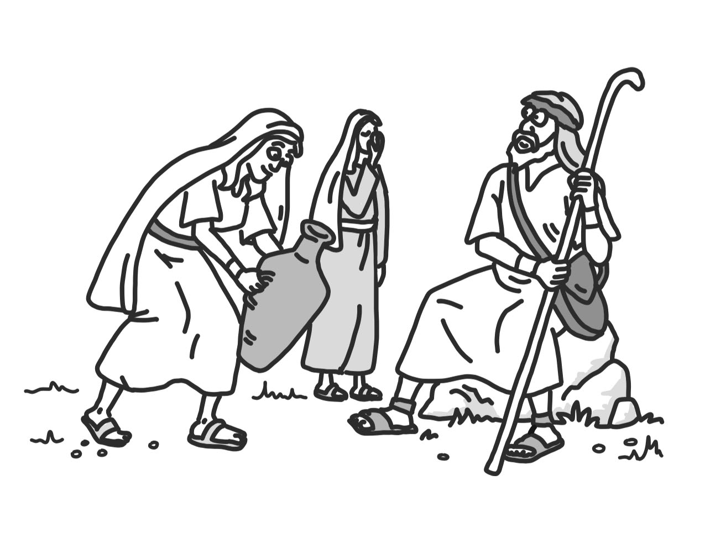
Jacob
Jacob-of all people-was the one God gave the special promise to, the same promise he had given his grandfather Abraham…Now Jacob had two wives, but of his two wives, Jacob loved Rachel the best. Jacob had twelve sons but of all his sons, Joseph was his favourite.
Sally Lloyd-Jones: The Jesus Storybook Bible (p70-76)

Slide 6
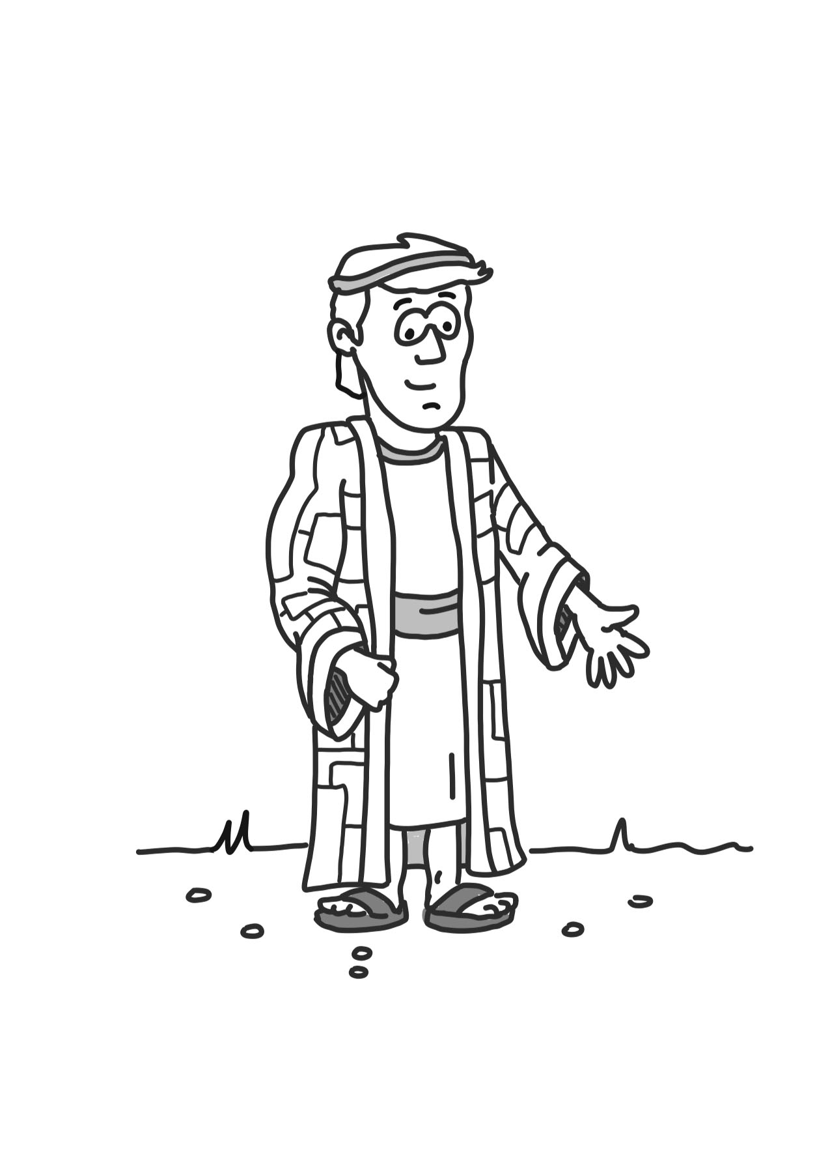
Joseph
“One day Joseph's brothers tore Joseph's rainbow robe off him and sold him to slave traders-for 20 pieces of silver. The traders took Joseph to Egypt and made him into a slave…one night, Pharaoh (king of Egypt) had a scary dream about thin cows gobbling up fat cows. What on earth did it mean? He didn’t know but Joseph was a dream expert, so Pharaoh sent for him. “it means a famine is coming,” Joseph explained. “There won’t be enough food.” Pharaoh was so pleased by Joseph's skill that he immediately took him out of jail and made him a prince. Now back home, Joseph's brothers ran out of food and everyone was hungry…Joseph's brothers travelled to Egypt to buy food…Joseph threw his arms around his brothers. “Don’t be afraid,” he said. “Behind what you were doing, underneath everything that was happening, God was doing something good. God was making everything right again.” Joseph didn’t punish them, he rescued them – he brought God’s special family to live safely with him in Egypt…Joseph and his brothers grew old and died, but their children’s children stayed on in Egypt where they became a very large family.
Sally Lloyd-Jones: The Jesus Storybook Bible (p76-84).

