Slide 1
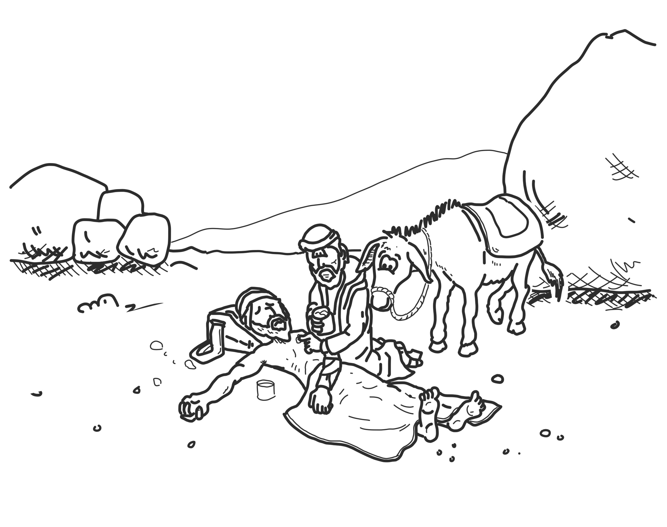
Ethical Decisions
How could a Christian ethic shape our understanding of human rights?

Slide 2
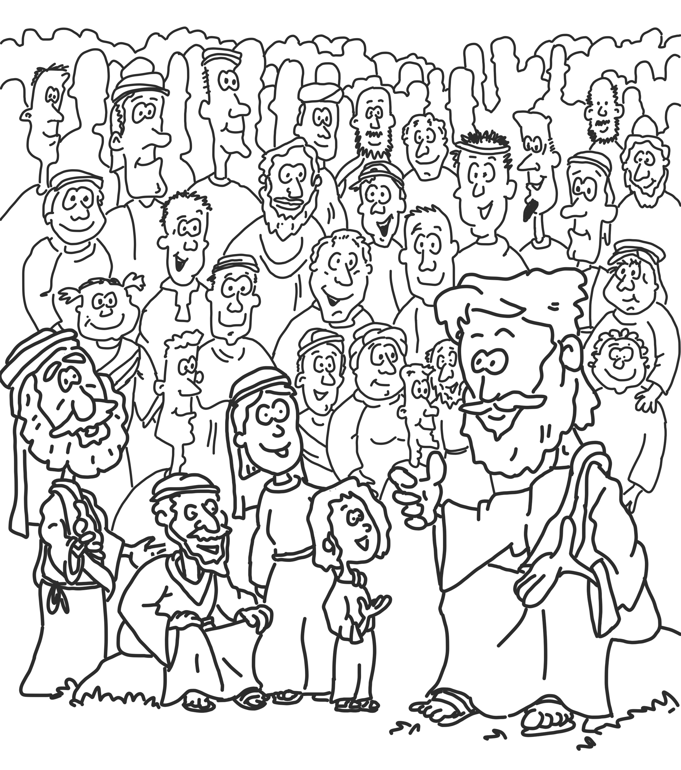
Human Rights
Human rights are the rights granted to us by the international legal system because we are human beings. They belong to all of us, regardless of who we are or where we live.
Notes:
United Nations Convention on the Rights of the Child (child friendly version)
https://www.savethechildren.org.uk/what-we-do/childrens-rights/united-nations-convention-of-the-rights-of-the-child

Slide 3
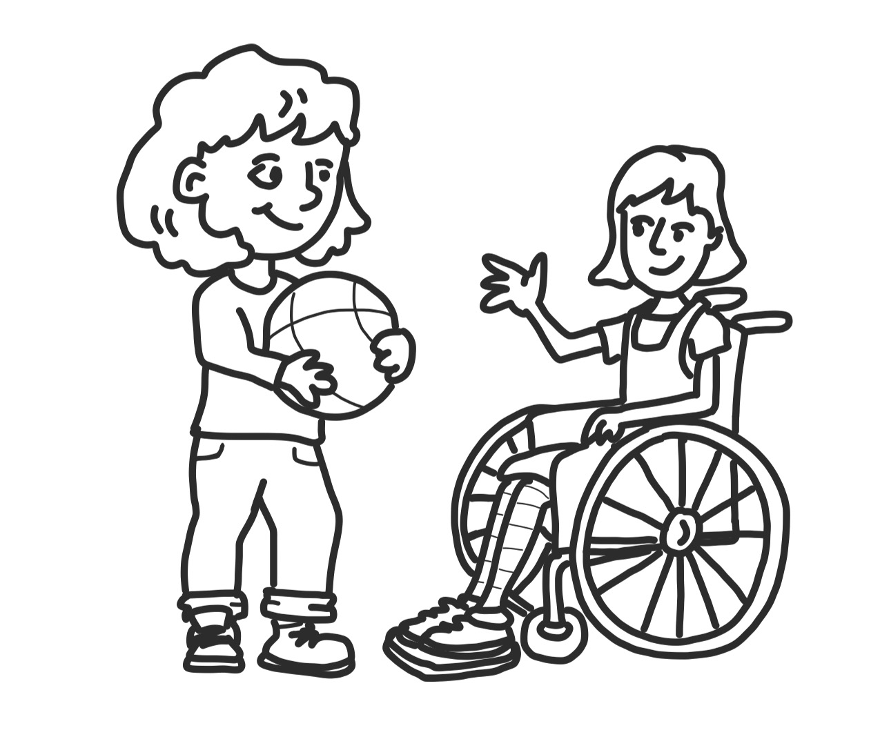
Some Examples of Human Rights
We are born free and equal and should treat others in the same way.
We have the right to life, and to be free and feel safe.
The law is the same for everyone. It must treat us all fairly
Nobody should be blamed for doing something until it is proved that they did it.

Slide 4
Despite international laws not all people enjoy their human rights
How can we respond to this knowledge?
Notes:
Go to International Justice Mission website (www.ijm.org.au) to read some stories. Ensure you pre read to content is appropriate for children.
https://ijm.org.au/ijm-staffs-son-spots-slavery-in-his-water-supply/

Slide 5
AN INTRODUCTION TO SOME IMPORTANT ETHICAL THEORIES
The laws made by government tell us what we can and cannot do. The law is always right.
DEONTOLOGY
CONSEQUENTIALISM
CHARACTER ETHICS
We can decide between right and wrong by examining their consequences. If something has good consequences, it is right.
We can decide between right and wrong by focusing on ourselves and our motivations. If we are the right kind of people we will make the right decisions.
We can decide between right
and wrong by following
a set of rules
THE LAW
HEDONISM
ETHICAL EGOISM
UTILITARIANISM
VIRTUE ETHICS
SITUATION ETHICS
If something brings pleasure (physical, emotional or spiritual) then it is right.
If something causes pain, then it is wrong.
So, ‘if it feels good – do it!’
The best thing for each individual is also the right thing for them.
A person’s only moral obligation is to do what is best for them.
The right decision is whatever brings ‘the greatest good for the greatest number’ of people.
Whatever is best for the majority is right.
It is not so much what you do but who you are that is important. A good person will always do the right thing. We should concentrate on becoming better people rather than on right and wrong decisions.
In each situation we need to work out what is most loving.
If we act in love towards others, then what we do will always be right.

Slide 6
Can you fill in a response for the remaining columns?
DEONTOLOGY
CONSEQUENTIALISM
CHARACTER ETHICS
RULES
CONSEQUENCES
CHARACTER
LAW
ETHICAL
EGOISM
VIRTUE
ETHICS
SITUATION
ETHICS
HEDONISM
UTILITARIANISM
The law says yes or no
It feels good
Best for ME
Best for majority
Be a good person
What’s loving
The answer here is complicated. While the law grants human rights to all it can’t effectively protect them.
You should only help people if it makes you happy
How can a Christain faith help us make decisions about human rights?
Notes:
There is a worksheet to go with this slide if you would prefer students to write their responses before sharing as a class.

Slide 7
Does the Christian worldview offer any help?
God’s Creation All were created by God as equal. | God’s Commandments God gave humans instructions to love God and love others but when humans rule creation they often show selfishness, cruelty and greed. | Jesus Christ Jesus loves others, loves creation and loves God. Jesus shows justice, mercy and love. Jesus gave up his rights for the good of others. | Hope Our world looks like a complete mess. God promises to bring justice, and make things new again. This offers us hope for now and the future.
Notes:
Each book of the Bible is like an individual episode, with its own details, plots and themes, but the books add together to create an overall plot:
1. God creates the world and has a perfect vision for it
2. People reject God’s vision, distort society and wreck the environment
3. God commits to rescuing the world, beginning with one group of people - the nation of Israel. They are to live out their special relationship with God so that all the nations will eventually come to know and love him as well.
4. God continues to be committed in love to his people (Israel), but they regularly choose to ignore him and make their own rules. Despite this, God gives them a homeland and maintains his commitment to them. He promises a saviour-king who will make things right once and for all.
5. God allows Israel’s land to be invaded and the people to be exiled because of their continued refusal to love him and live as his people. Although some eventually return, things are still not right with God.
6. Jesus appears on the scene. He is the ultimate solution to humanity’s exile from God - the promised saviour-king. Through his life, death and resurrection he brings a paradigm shift: a chance for human beings to have their broken relationship with God restored through him. When this happens, they become part of the new people of God, learning a new way of living out God’s values in the world.
7. New Testament writers spell out in more detail what this new way of life looks like, and as the Bible closes it looks forward to the end of history and the restoration of God’s original vision to be complete.
THE LENS: Jesus’ life, death and resurrection reframe our understanding of the Old Testament and its laws. For Christians, Jesus becomes a lens through which the whole Bible is read and understood – he is the focus of ethical thinking, but the whole Bible (read thoughtfully and carefully) is the context.
Elements of this slide are taken from Andrew Cameron’s book A Joined-up Life.

Slide 8
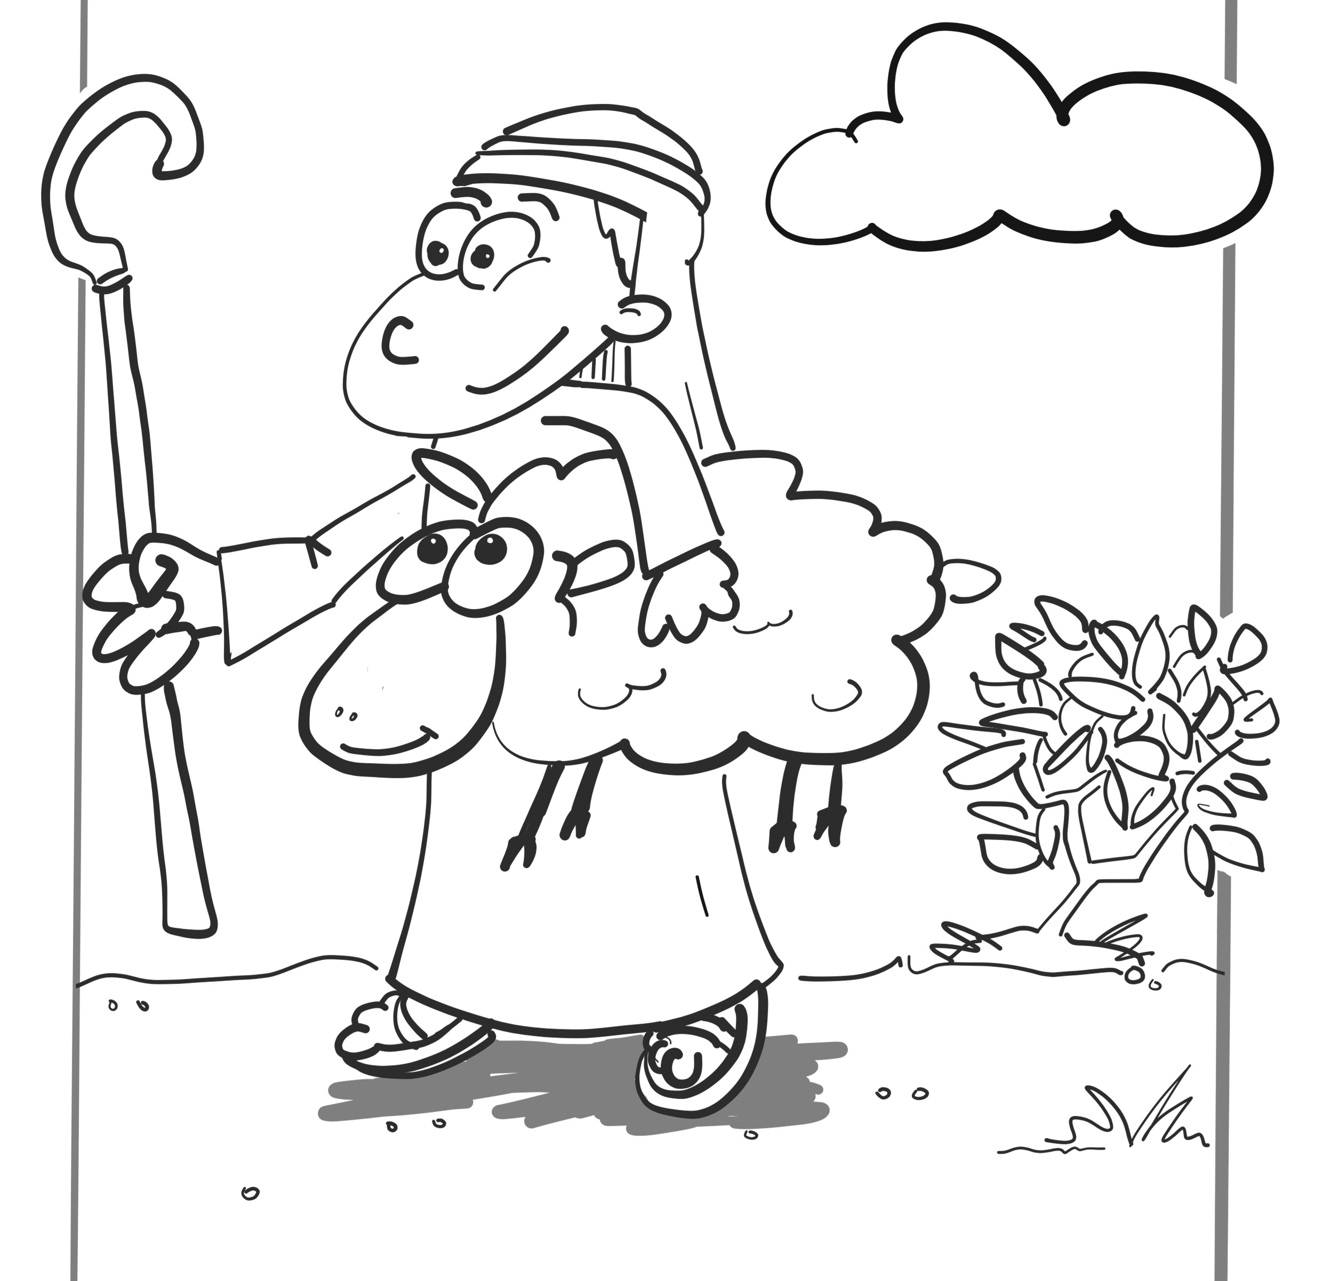
Matthew 25:31-46
³¹ When the Son of Man comes in his glory with all of his angels, he will sit on his royal throne. ³² The people of all nations will be brought before him, and he will separate them, as shepherds separate their sheep from their goats.
³³ He will place the sheep on his right and the goats on his left. ³⁴ Then the king will say to those on his right, “My father has blessed you! Come and receive the kingdom that was prepared for you before the world was created. ³⁵ When I was hungry, you gave me something to eat, and when I was thirsty, you gave me something to drink. When I was a stranger, you welcomed me, ³⁶ and when I was naked, you gave me clothes to wear. When I was sick, you took care of me, and when I was in jail, you visited me.”
³⁷ Then the ones who pleased the Lord will ask, “When did we give you something to eat or drink? ³⁸ When did we welcome you as a stranger or give you clothes to wear ³⁹ or visit you while you were sick or in jail?”
⁴⁰ The king will answer, “Whenever you did it for any of my people, no matter how unimportant they seemed, you did it for me.”

Slide 9
⁴¹ Then the king will say to those on his left, “Get away from me! You are under God’s curse. Go into the everlasting fire prepared for the devil and his angels! ⁴² I was hungry, but you did not give me anything to eat, and I was thirsty, but you did not give me anything to drink. ⁴³ I was a stranger, but you did not welcome me, and I was naked, but you did not give me any clothes to wear. I was sick and in jail, but you did not take care of me.”
⁴⁴ Then the people will ask, “Lord, when did we fail to help you when you were hungry or thirsty or a stranger or naked or sick or in jail?”
⁴⁵ The king will say to them, “Whenever you failed to help any of my people, no matter how unimportant they seemed, you failed to do it for me.”
⁴⁶ Then Jesus said, “Those people will be punished forever. But the ones who pleased God will have eternal life.”
What does this story from the Bible teach us about loving others?

Slide 10
Question
If you are a Christian, should you go to the cinema at the weekend or help the homeless?
Prepare arguments for both possible responses.
Notes:
Some bible passages that may be worth considering when thinking about the Christian ethic in relation to a human rights issue.
1 John 3:17-18
Luke 6:20
Luke 1:17
Matthew 25:31-46

Slide 11
MAKING ETHICAL DECISIONS: A CHRISTIAN STARTING POINT
Be guided by what matters to God: Loving him and loving others
Think about what will happen (…but sometimes you can’t control that!)
Learn to think and act more like Jesus by reading the Bible and learning from other Christians
Pray that God will help you make good choices
Remember you’re not God! He’s the only one who knows what’s really right all the time - situations can be complicated, and we all make mistakes.

