Slide 1
How big are the circles in the middle?
Notes:
Cool Optical Illusions. 12 Jan 2006
<http://unoriginal.co.uk/optical1_8.html>.
Your understanding of where knowledge comes from and how it is constructed is really important as you think about the process of critical thinking, particularly in the Religious Studies classroom. Education theory in this area ranges on a spectrum between positivist certainty and postmodern relativism. Positivist certainty says I can only see the old women, other peoples arguments are not convincing. I can only see one women therefore that’s all there is. At the other extreme postmodern relativism opens the door to telling stories to construct the outcomes you want. I can see a goat….
The model of critical thinking put forward in the syllabus sits somewhere in the middle of the spectrum.

Slide 2
What’s this?
Notes:
“We're used to seeing black text on a white background. At first you may have seen this as a series of blocks rather than the word ‘LIFT’.”
LIFT. 12 Jan 2006
<http://unoriginal.co.uk/optical5_6.html>.

Slide 3
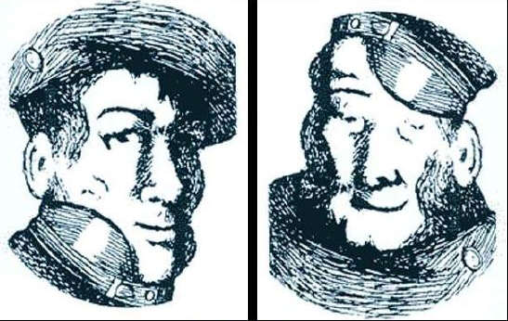
Two different people or the same one?
Notes:
“The second image is the first one turned upside down.”
Upside Down Optical Illusion. 12 Jan 2006
<http://unoriginal.co.uk/optical5_3.html>.

Slide 4
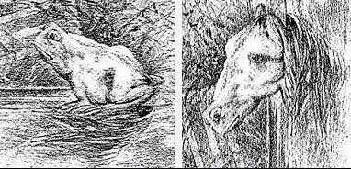
Two different images or the same one?
Notes:
“The horse image is the frog image turned on its side.”
Frog or Horse. 12 Jan 2006
<http://unoriginal.co.uk/optical5_4.html>.

