Slide 1
Beliefs and Perspectives
What do you see?

Slide 2
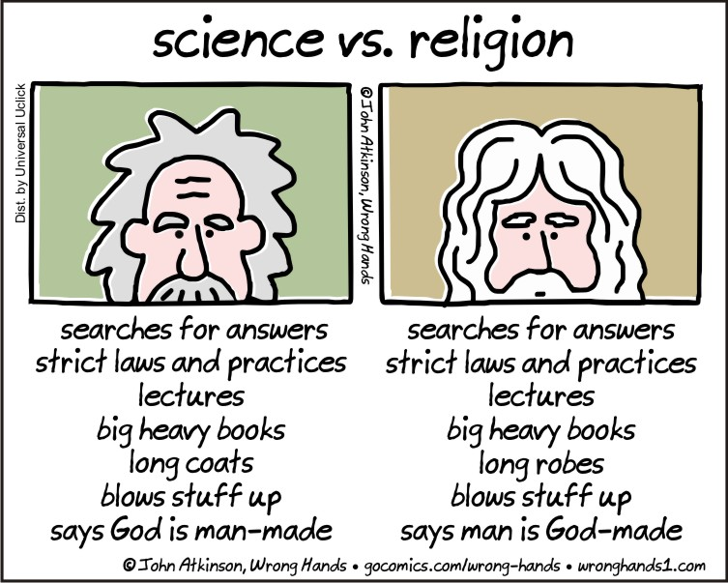

Slide 3
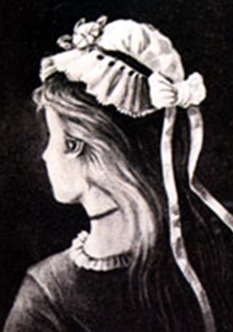
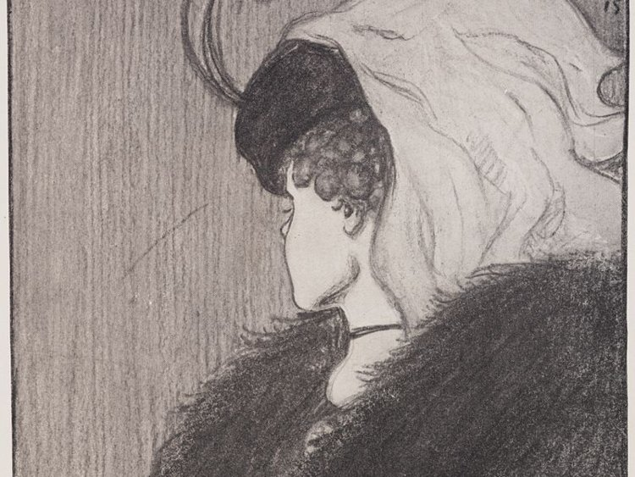
Notes:
Old woman or young woman?

Slide 4
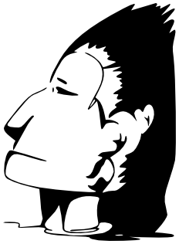
Notes:
Eskimo (person in parka) or Native American?

Slide 5
Notes:
Person playing saxophone or young woman’s face?

Slide 6
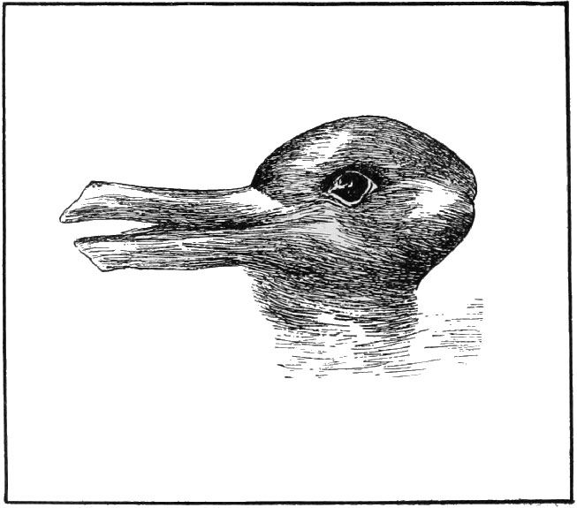
Notes:
A duck or a rabbit?

Slide 7
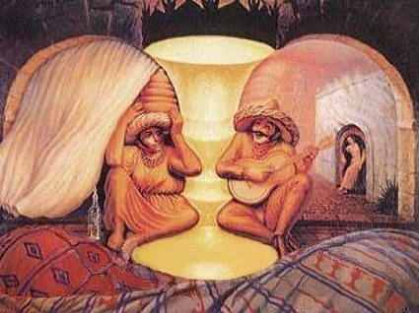
Notes:
An old couple or three people (2 in foreground, one in background?)

