Slide 1
Science on the Origins of the Universe & Life

Slide 2
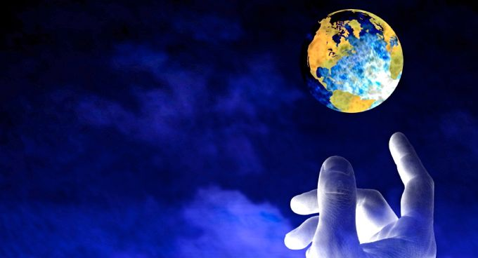
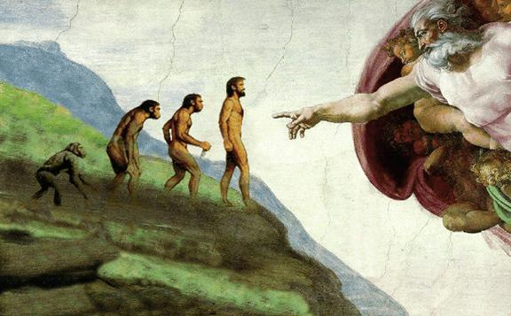
"A legitimate conflict between science and religion cannot exist. Science without religion is lame, religion without science is blind."
Albert Einstein

Slide 3
"Science and religion are two windows that people look through, trying to understand the big universe outside, trying to understand why we are here. The two windows give different views, but both look out at the same universe. Both views are one-sided, neither is complete. Both leave out essential features of the real world. And both are worthy of respect." Freeman Dyson

Slide 4
People often point to the scientific accounts and the Judaeo-Christian accounts of the origins of life and the origins of the Universe.
They seem to contradict each other so completely and so obviously that we can end the discussion by saying ‘science proves that religion is wrong’.
However, this is too simplistic a way of looking at it.
We have seen that science and religion are both trying to understand the Universe but in different ways. Religion can offer what science cannot and science can offer what religion cannot. Some would also argue that there is a lot of middle ground.
This does not mean that they contradict one another; it means that they are offering different ways of seeing the world, both of which are meaningful and valuable. Far from contradicting one another, they complement one another.

Slide 5
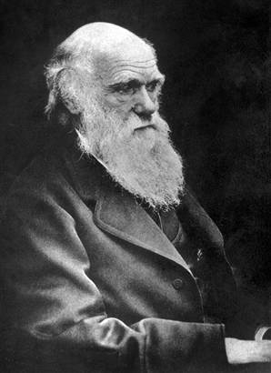
Charles Darwin’s Theory of Evolution by Natural Selection
There are two parts to Darwin’s Theory.
The Theory of Evolution - All species have evolved from a common ancestry.
Natural Selection – How this happens.

Slide 6
Inanimate Chemicals (primordial slime)
3 billion years ago
MILLIONS OF YEARS
EVOLVE
Bacterial Life
MILLIONS OF YEARS
EVOLVE
Multi-Cellular Organisms
MILLIONS OF YEARS
EVOLVE
More complicated plants and animals
MILLIONS OF YEARS
EVOLVE
Highly Complex Animals
MILLIONS OF YEARS
EVOLVE
MAN

Slide 7
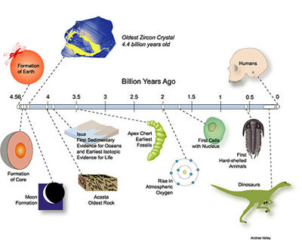
Evolution Time line
Simple Cells
Complex Cells
Multicellular Life
Simple Animals
Arthropods
Fish
Land Plants
Insects and Seeds
Amphibians
Reptiles
Mammals
Birds
Dinosaurs
Humans

Slide 8
Natural Selection
Natural Selection is the mechanism of evolution. It is how evolution ‘happens’.
Organisms/creatures/humans produce more offspring than can survive.
The offspring are not identical: variations exist within them e.g. a litter of kittens are not all the same.
Some of these variations are inherited, some are not.
Some variations will help the creature to survive, some will not.
Whether these variations are passed on is determined by the environment in which the animal lives.
e.g. a snake which is camouflage is more likely to survive in its environment.

Slide 9
Survival of the Fittest
Those animals that inherit beneficial characteristics are more likely to survive to adulthood.
They can then reproduce and pass on these characteristics to their young.
Over time this will increase the number of offspring with these beneficial variations
This is how new species can be formed from existing ones.

Slide 10
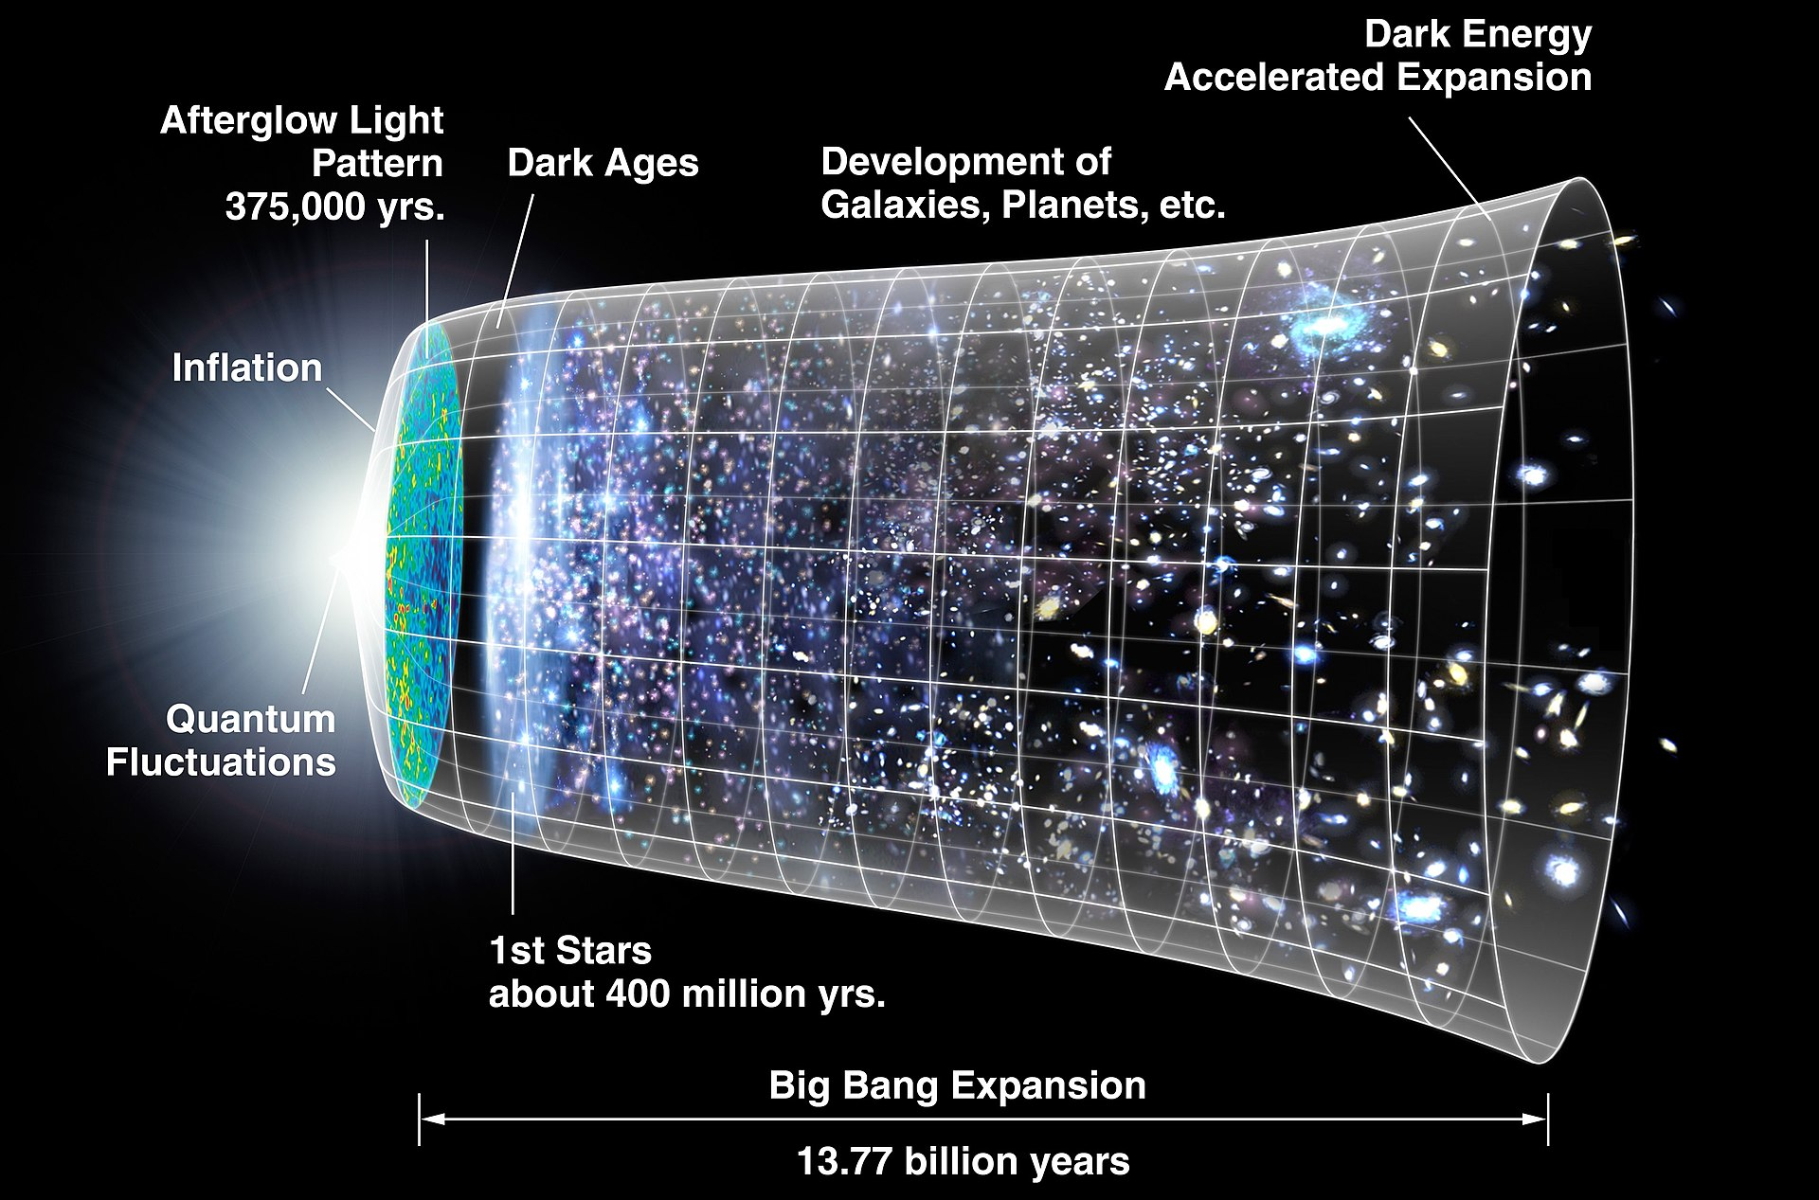
The Big Bang Theory
The Big Bang theory describes how the universe got from a high-density and high-temperature state to its current form.
Physicists are undecided whether the universe began from a single big bang, or that current knowledge is insufficient to describe the universe before this point.
Detailed measurements of the expansion rate of the universe place the Big Bang at around 13.8 billion years ago.

