Slide 1
World views
What is your world view?

Slide 2
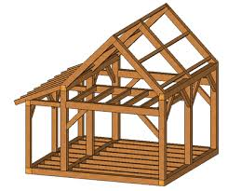
What is a world view?
The way we make sense of the world and our place in it
A worldview is a person’s way of understanding, experiencing and responding to the world. It can be described as a philosophy of life or an approach to life. This includes how a person understands the nature of reality and their own place in the world. A person’s worldview is likely to influence and be influenced by their beliefs, values, behaviours, experiences, identities and commitments. (UK Commission on RE Final Report, 2018, p. 8)

Slide 3
Notes:
http://www.feva.org/pdf/wv_sum.pdf – good explanation of each world view

