Slide 1
The Pursuit of Truth
The Parables of Jesus

Slide 2
The Lost Coin
Read Luke 15:8-10
⁸ “Or suppose a woman has ten silver coins and loses one. Won’t she light a lamp and sweep the entire house and search carefully until she finds it? ⁹ And when she finds it, she will call in her friends and neighbors and say, ‘Rejoice with me because I have found my lost coin.’ ¹⁰ In the same way, there is joy in the presence of God’s angels when even one sinner repents.” (NLT)

Slide 3
Truth
Do you think Luke believed this story was a real event? Why or why not?
What do you think Luke’s purpose was in recording this story?
What ‘truth’ is Jesus trying to communicate in this story?

Slide 4
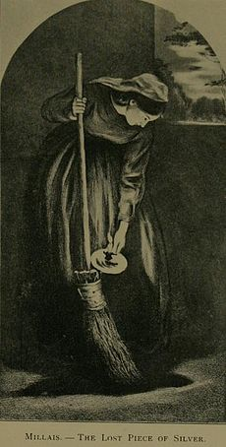
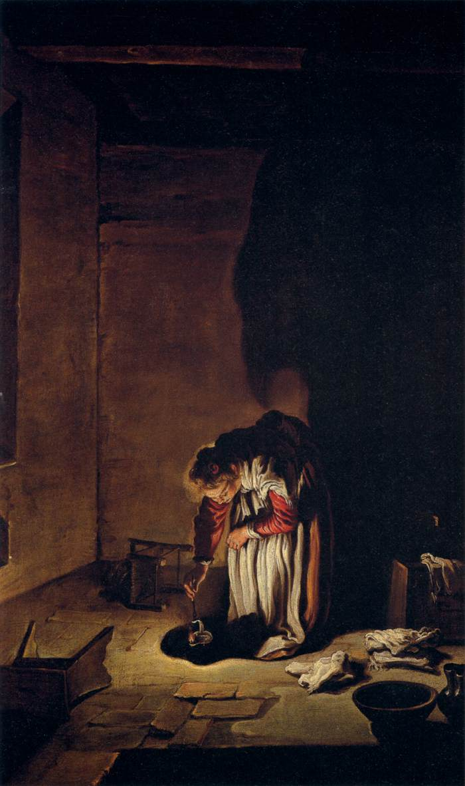
Do the artworks accurately capture what the parable is trying to communicate?
Do the different features in each picture impact the truthfulness of the picture? Why or why not?
Would it be possible to paint a picture of the parable that was ‘untruthful’?

Slide 5
The Parable of the Vineyard Workers
Matthew 20:1-16
“For the Kingdom of Heaven is like the landowner who went out early one morning to hire workers for his vineyard. ² He agreed to pay the normal daily wage and sent them out to work.
³ “At nine o’clock in the morning he was passing through the marketplace and saw some people standing around doing nothing. ⁴ So he hired them, telling them he would pay them whatever was right at the end of the day. ⁵ So they went to work in the vineyard. At noon and again at three o’clock he did the same thing.

Slide 6
⁶ “At five o’clock that afternoon he was in town again and saw some more people standing around. He asked them, ‘Why haven’t you been working today?’
⁷ “They replied, ‘Because no one hired us.’
“The landowner told them, ‘Then go out and join the others in my vineyard.’
⁸ “That evening he told the foreman to call the workers in and pay them, beginning with the last workers first. ⁹ When those hired at five o’clock were paid, each received a full day’s wage. ¹⁰ When those

Slide 7
hired first came to get their pay, they assumed they would receive more. But they, too, were paid a day’s wage. ¹¹ When they received their pay, they protested to the owner, ¹² ‘Those people worked only one hour, and yet you’ve paid them just as much as you paid us who worked all day in the scorching heat.’
¹³ “He answered one of them, ‘Friend, I haven’t been unfair! Didn’t you agree to work all day for the usual wage? ¹⁴ Take your money and go. I wanted to pay this last worker the same as you. ¹⁵ Is it against the law for me to do what I want with my money? Should you be jealous because I am kind to others?’
¹⁶ “So those who are last now will be first then, and those who are first will be last.” (NLT)

Slide 8
Truth
Do you think Matthew believed this story was a real event? Why or why not?
What do you think Matthew’s purpose was in recording this story?
What ‘truth’ is Jesus trying to communicate in this story?

Slide 9
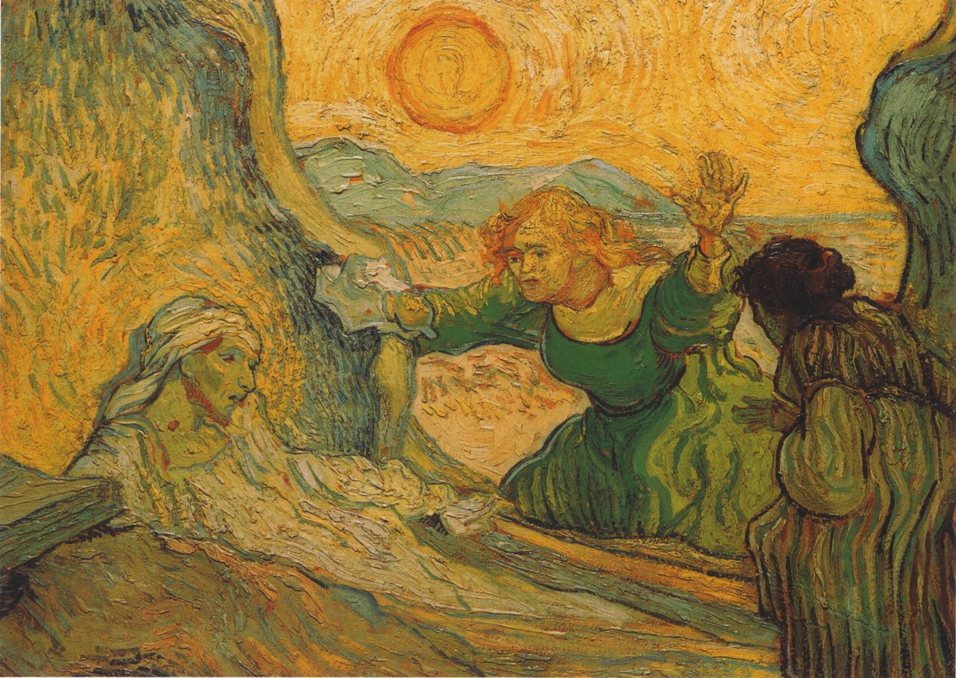
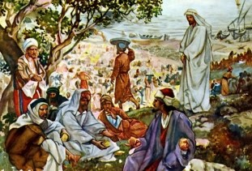
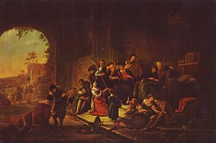
Do the artworks accurately capture what the parable is trying to communicate?
Do the different features in each picture impact the truthfulness of the picture? Why or why not?
Would it be possible to paint a picture of the parable that was ‘untruthful’?

Slide 10
What is a Parable?
The story about the vineyard and the coin are parables. A parable is a short story used to teach an important truth message.
Why do you think Jesus used parables?
Can made up stories communicate truth?
Could the scientific method be applied to this parable to discover the ‘truth’ contained in it? Does this make the ‘truth’ communicated by the parable more or less true?
Is it possible to ‘believe in’ the scientific method and the parables found in the Gospels? Why or why not?

