Slide 1
The Lord’s Prayer

Slide 2
The Lord’s Prayer
Notes:
Prayer is talking to God. God tells us to pray all kinds of prayers and ask for everything we need. Sometimes Christians say a special prayer together called the Lord’s Prayer. It’s called the Lord’s Prayer because Jesus gave it to his friends to help them learn how to pray. Christians still pray this prayer together today.

Slide 3
Our Father in heaven,
Hallowed be your name,
your kingdom come,
your will be done,
on earth as in heaven.
Give us today our daily bread.
Forgive us our sins
as we forgive those who sin against us.
Save us from the time of trial,
and deliver us from evil.
For the kingdom, the power, and the glory are yours now and forever.
Amen.
Notes:
You may wish to show your students this YouTube clip of children praying the Lord’s Prayer. Alternatively you could film a clip with students from your school to show to students.
https://www.youtube.com/watch?v=wlBK97Q4Ae8

Slide 4
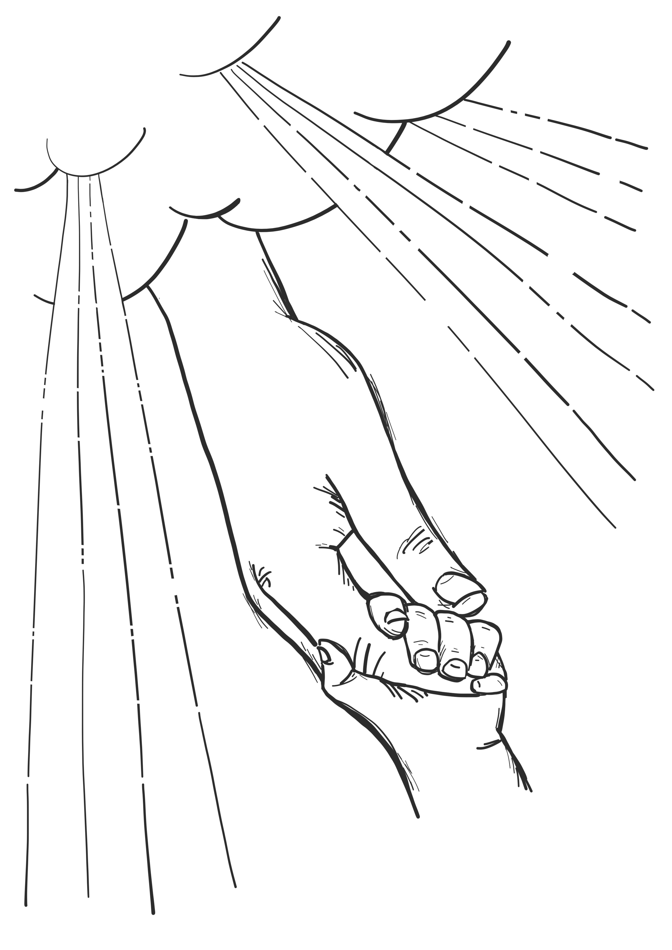
Our Father in heaven

Slide 5
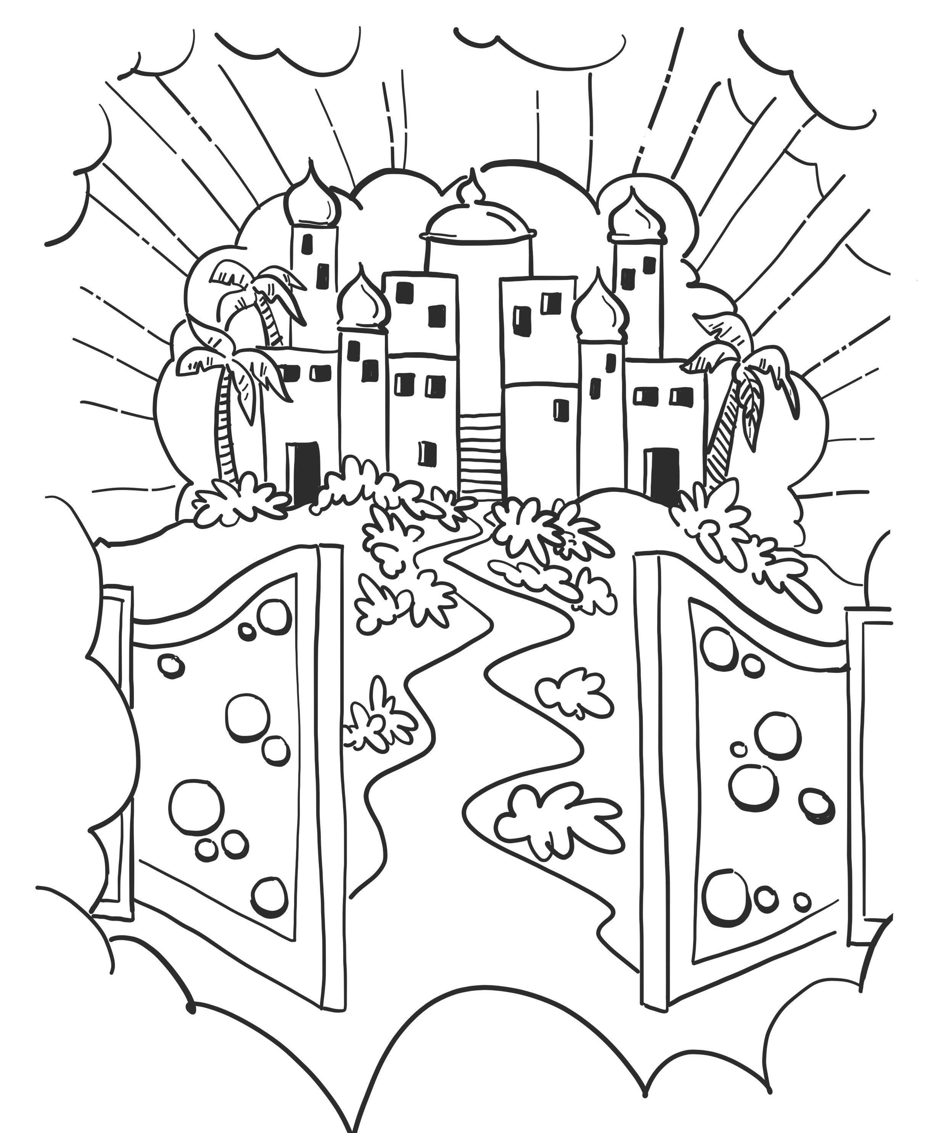
Hallowed be your name,
your kingdom come,
your will be done,
on earth as in heaven.

Slide 6
Give us today our daily bread

Slide 7
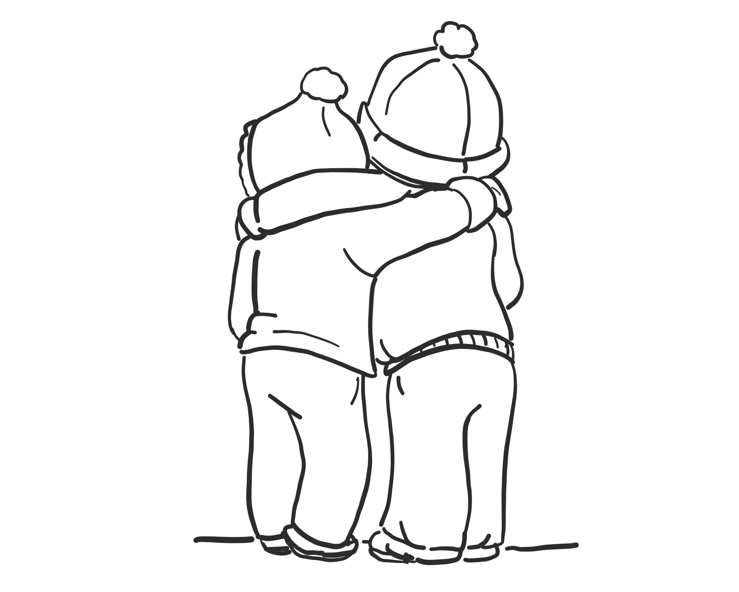
Forgive us our sins
as we forgive those who sin against us.

Slide 8
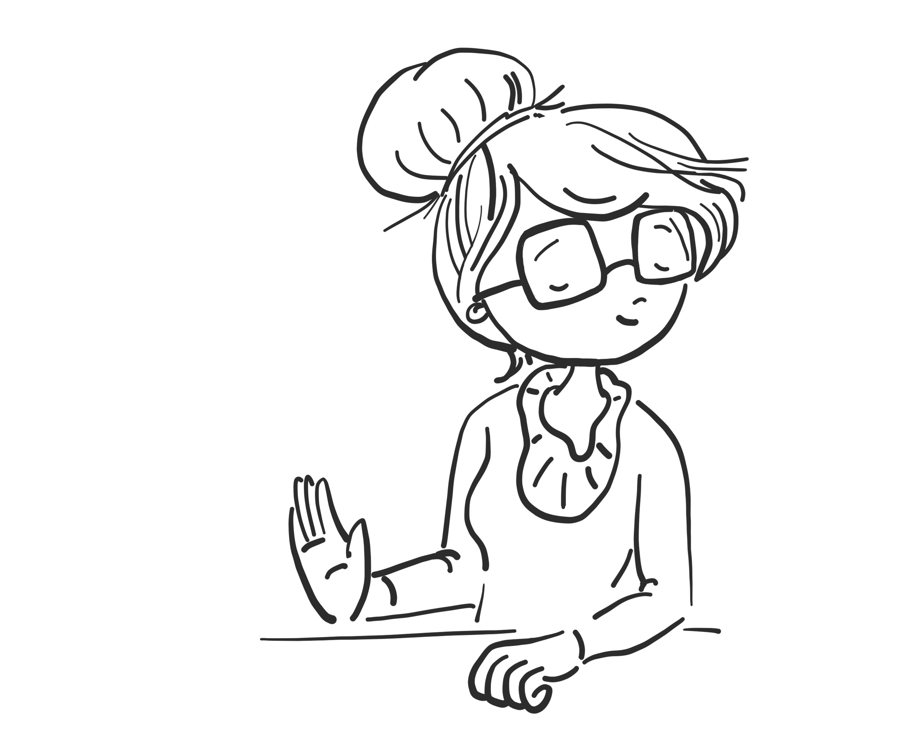
Save us from the time of trial,
and deliver us from evil.

Slide 9
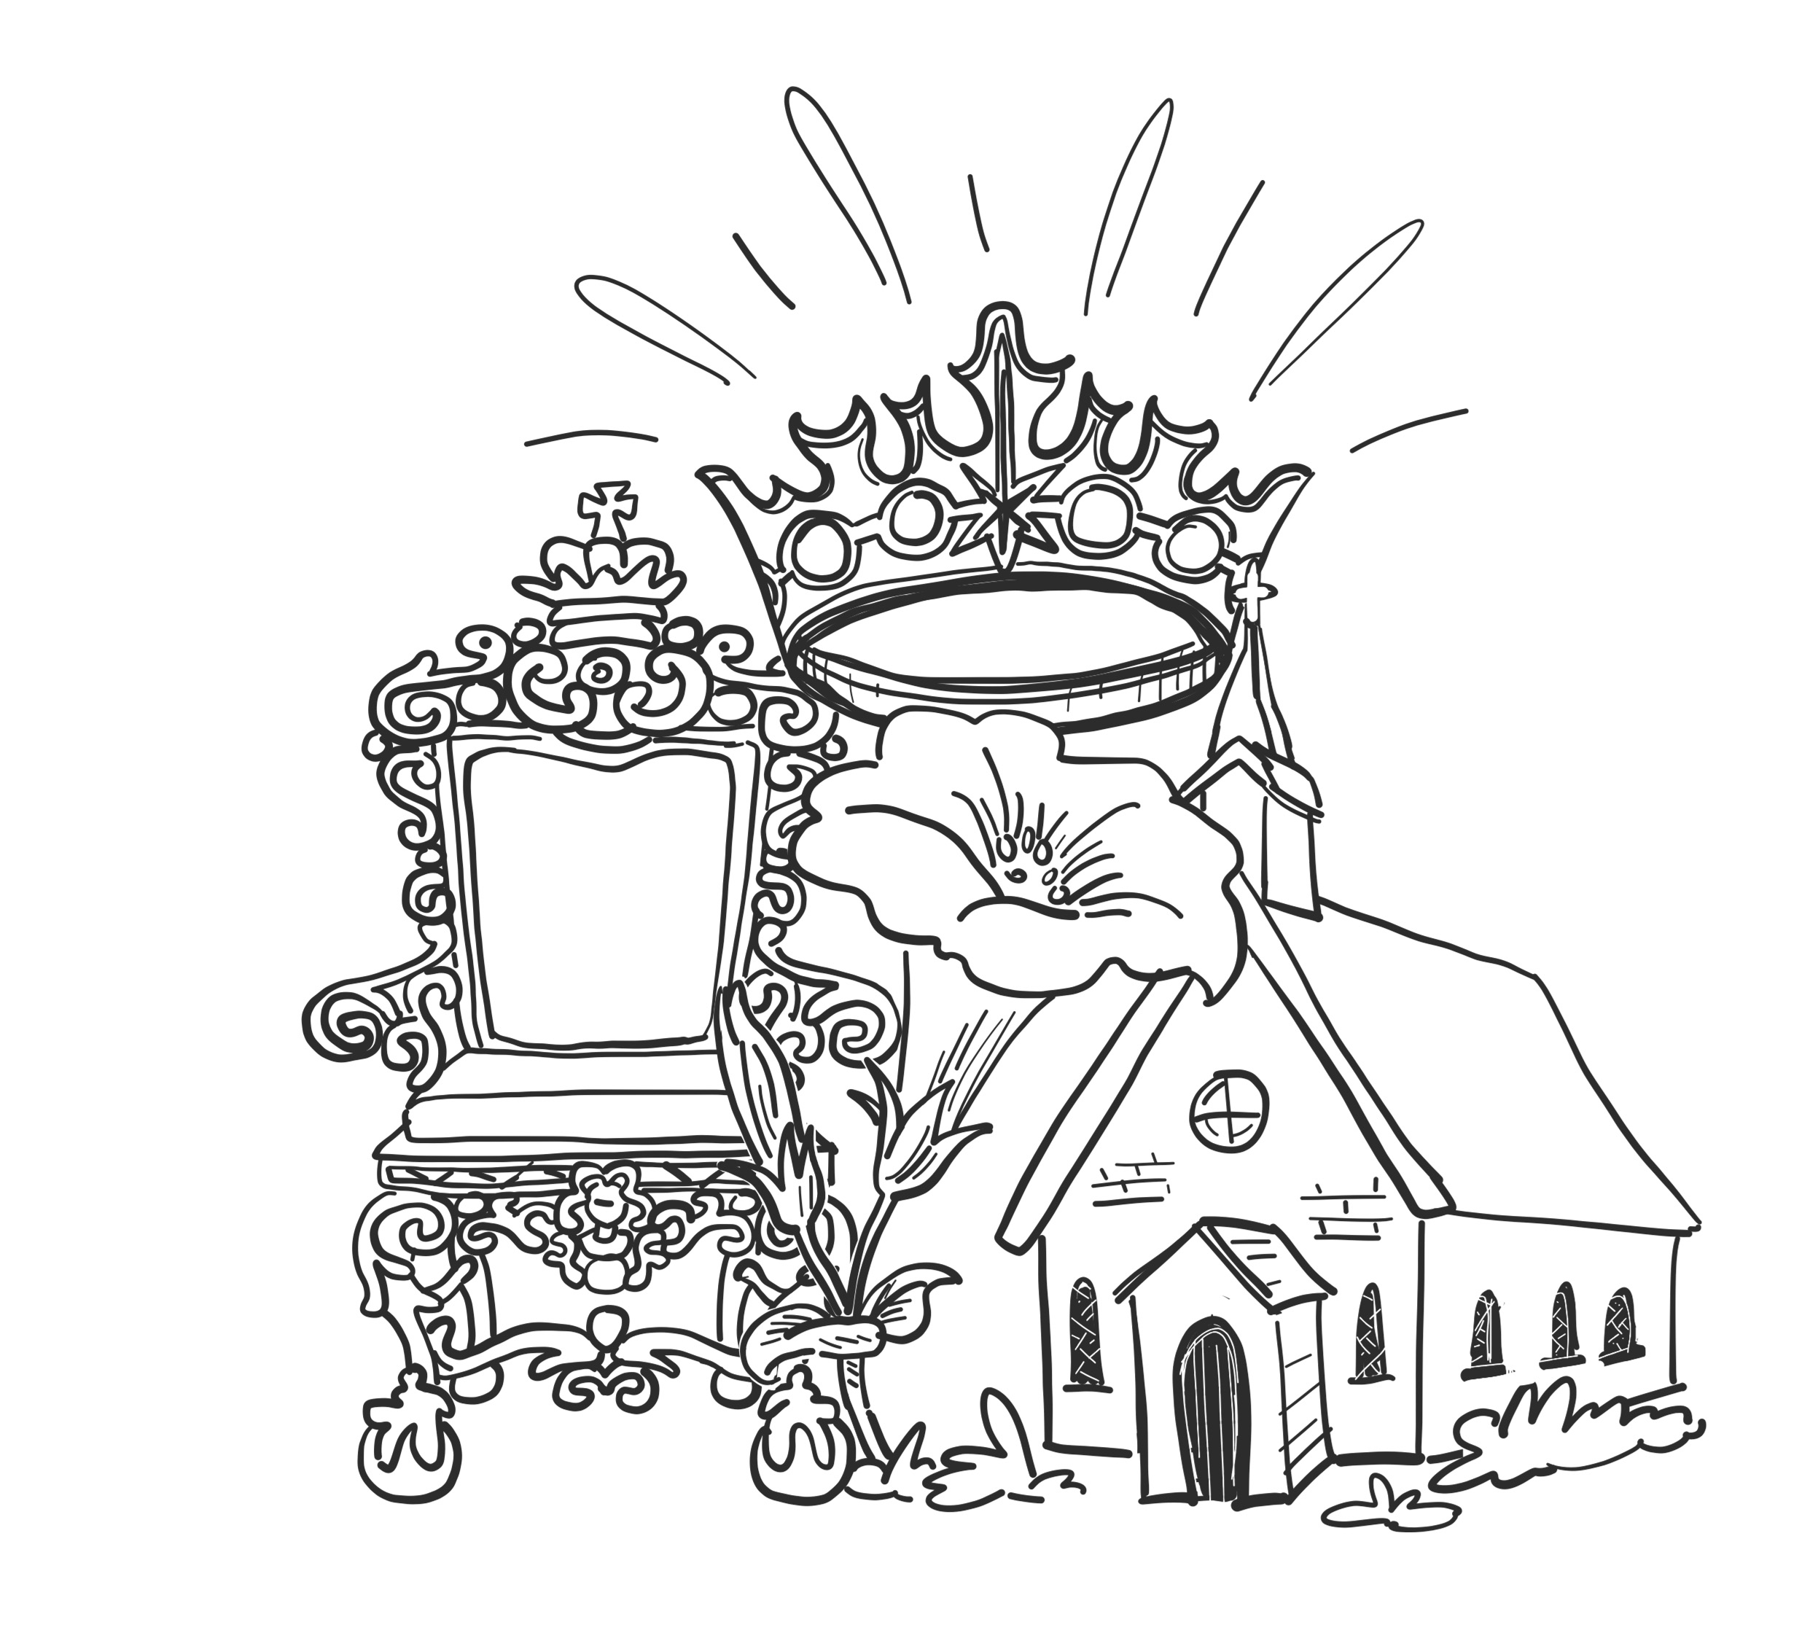
For the kingdom, the power, and the glory are yours now and forever.
Amen.

Slide 10
Hello Daddy!
We want to know you.
And be close to you.
Please show us how.
Make everything in the world right again.
And in our hearts, too.
Do what is best-just like you do in heaven,
And please do it down here, too.
Please give us everything we need today.
Forgive us for doing wrong, for hurting you.
Forgive us just as we forgive other
people when they hurt us.
Rescue us! We need you.
We don’t want to keep running away and hiding from you.
Keep us safe from our enemies.
You’re strong God.
You can do whatever you want.
You are in charge.
Now and forever and always!
We think you’re great!
Amen!
Yes we do!
Source: The Jesus Storybook Bible. Sally Lloyd-Jones. p226
Notes:
This has also been produced as a picture book called ‘Loved’ by Sally Lloyd-Jones.

