Slide 1
World Religions: Who is God?

Slide 2
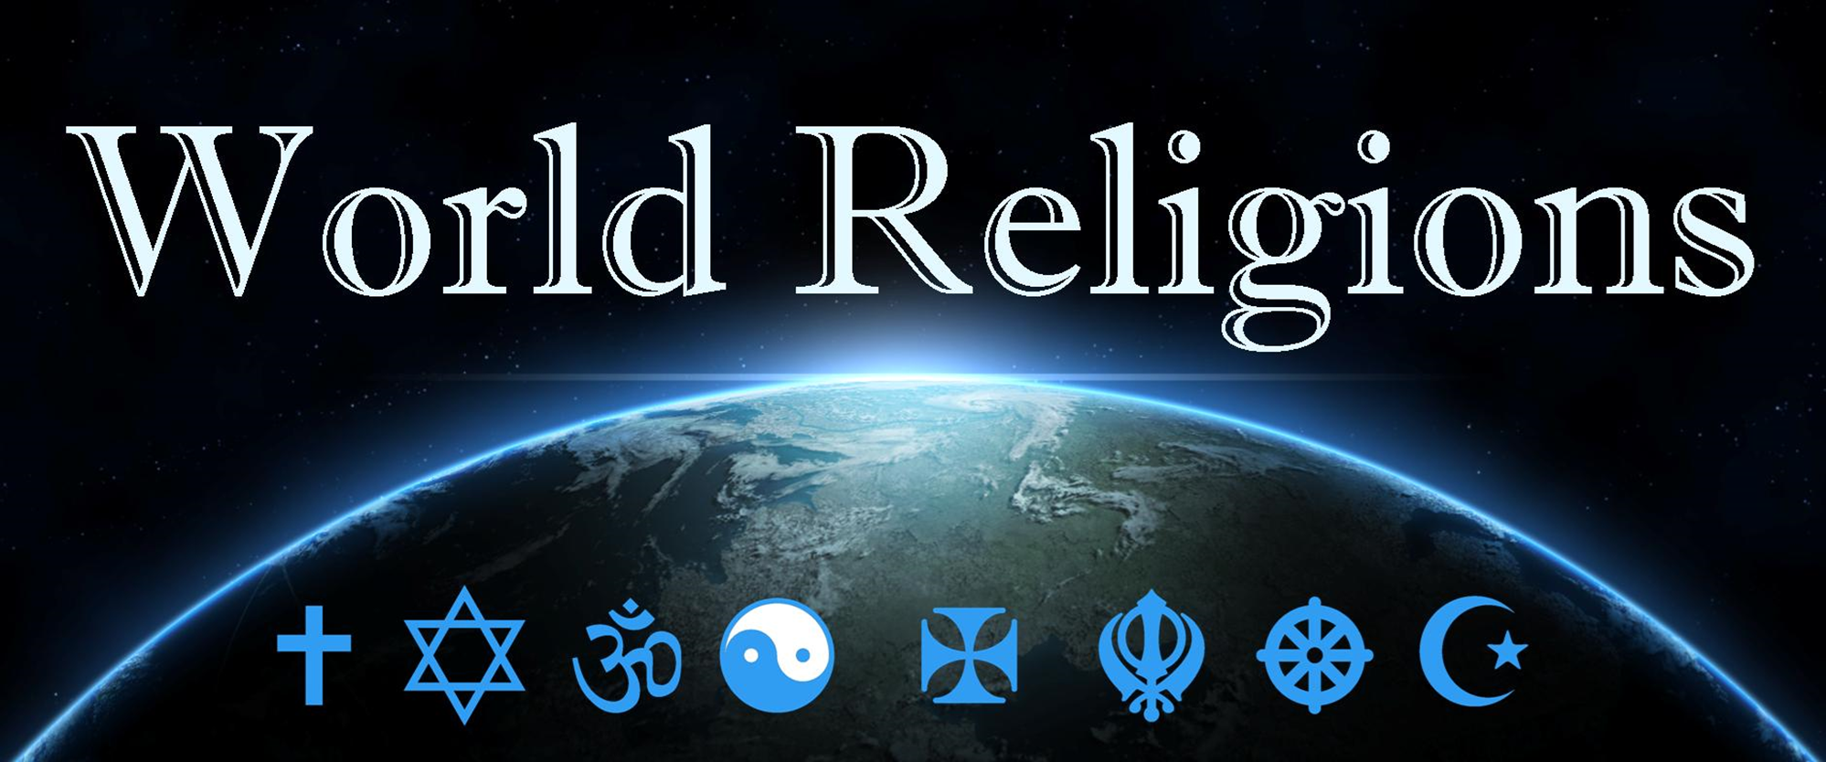
Who is God?

Slide 3
Who is God?
Is there anything too hard for God?

Slide 4
Creeds - summary of belief
Three creeds adopted by the worldwide church centuries ago summarize the most important tenets of our faith...
Apostles' Creed This creed is called the Apostles' Creed not because it was produced by the apostles themselves but because it contains a brief summary of their teachings.
Athanasian Creed Apart from the opening and closing sentences, this creed consists of two parts, the first setting forth the orthodox doctrine of the trinity, and the second dealing chiefly with the incarnation and the two-natures doctrine.
Nicene Creed The Nicene Creed, also called the Nicaeno-Constantinopolitan Creed, is a statement of the orthodox faith of the early Christian church in opposition to certain heresies, especially Arianism.

Slide 5
Nicene Creed, 381AD
We believe in one God, the Father almighty, maker of heaven and earth, of all things visible and invisible.
And in one Lord Jesus Christ, the only Son of God, begotten from the Father before all ages, God from God, Light from Light, true God from true God, begotten, not made; of the same essence as the Father. Through him all things were made. For us and for our salvation he came down from heaven; he became incarnate by the Holy Spirit and the virgin Mary, and was made human. He was crucified for us under Pontius Pilate; he suffered and was buried.
The third day he rose again, according to the Scriptures. He ascended to heaven and is seated at the right hand of the Father. He will come again with glory to judge the living and the dead. His kingdom will never end.
And we believe in the Holy Spirit, the Lord, the giver of life. He proceeds from the Father and the Son, and with the Father and the Son is worshiped and glorified. He spoke through the prophets. We believe in one holy catholic and apostolic church. We affirm one baptism for the forgiveness of sins. We look forward to the resurrection of the dead, and to life in the world to come. Amen.

Slide 6
Notes:
Born from Uranus (Heaven) and Gaia (earth), the first 12 Greek Gods were called the Titans

Slide 7
Notes:
Born from Uranus (Heaven) and Gaia (earth), the first 12 Greek Gods were called the Titans

Slide 8
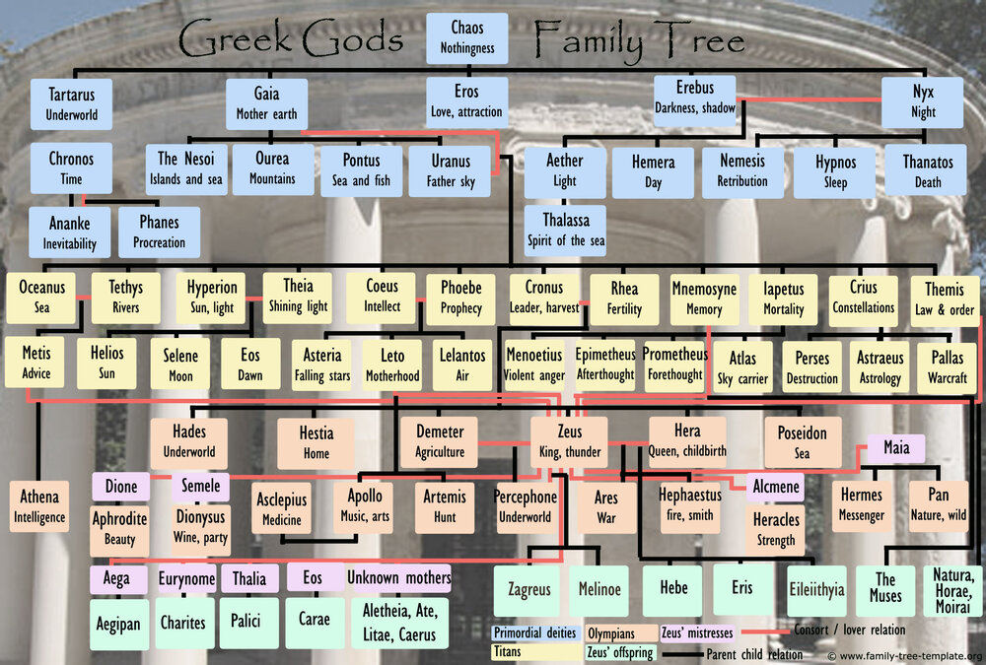
Notes:
The Olympian gods and goddesses of Greek mythology were the principal deities of Ancient Greece, and each was thought to have a home on Mount Olympus. The Gods and Goddesses were a family, with the core being brothers and sisters, and the rest being their firstborn offspring. The Olympians acquired their authority after a war of the gods of Greece where Zeus is credited with leadership and the eventual victory. He had led his siblings to triumph over the last generation of the ruling clan of deities known as the Titans. Zeus gained his victory by overthrowing his own father, Cronus, who was the king of the Titans. He, therefore, became the chief deity in a new group of deities comprising primarily of his siblings and children.

Slide 9
Read about the Greek Gods
Write points about the Greek Gods
Monotheism vs Polytheism
Compare the ideas of God in Christianity (monotheism), see the creeds or Psalm 139:1-18) with the Greek Gods (Polytheism)
Collect ideas on board
Google Greek God Family Tree

Slide 10
Who is God? Who are the Gods? Monotheism (Christian) Polytheism (Greek)
One God (Trinity)
Not made, The first and last, Eternal
Creator of all things created
Almighty
Judge
All Knowing
All Good
Saviour
Relational

Slide 11
Who is God? Who are the Gods? Monotheism (Christian) Polytheism (Greek)
One God (Trinity)
Not made, The first and last, Eternal
Creator of all things created
Almighty
Judge
All Knowing
All Good
Saviour
Relational
Many Gods (Titians, Top Gods, Minor Gods, Demi gods)
Gods used to explain the world, seasons, Gods for all different things
Gods are born, have a beginning, not eternal
Gods die, Kronos eats his kids then is killed by Zeus
A bit mean, not kind
Human characteristics and limitations, like super humans.
People are a bother to the gods or a plaything
Myths are moral teachings, not history

