Slide 1
Biblical Women: God’s Heroines
A Study of Women in the Old and New Testaments

Slide 2
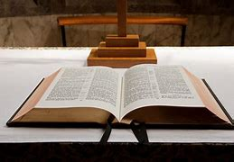
Reading the Bible – Big Picture
How do we begin to interpret or understand ancient texts?
When reading the bible, we need to keep in mind that it is one metanarrative
Metanarrative – ‘an overarching storyline that flows throughout all the books of the Bible, tying them together into one grand story - like sequels in a trilogy, or separate acts in the greater play of the Bible’
Bible.com

Slide 3
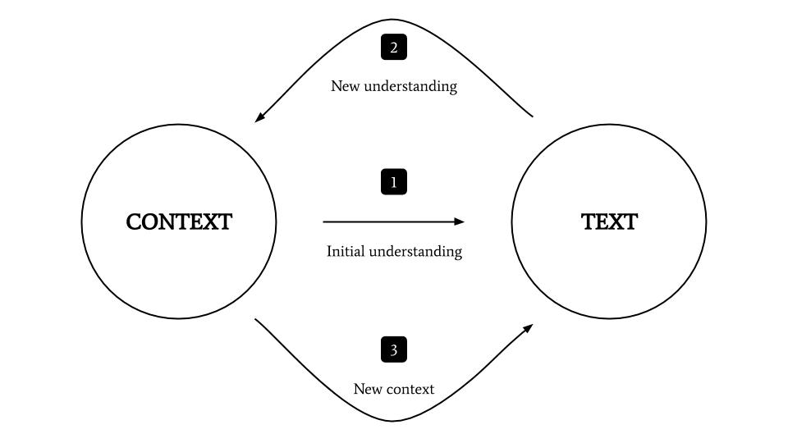
Reading the Bible – Big Picture
We need to be aware of biblical context – both historical and textual
Exegesis = study of scripture to discover the original intended meaning
Hermeneutics = interpretation and contemporary relevance

Slide 4
Reading the Bible – Ways of Reading
Literal – adhering strictly to the primary or exact meaning of the words
Figurative – metaphorical, poetic or allegorical meaning
The Scriptures – consider the tradition, the culture, the times
Patriarchal Culture – the Old Testament era had different gender assumptions
You only get a tiny glimpse of the women- read between the cracks!

Slide 5
Women in the Bible – some key facts
There are 93 women mentioned in the bible
Two books of the Old Testament, Ruth and Esther, are written by or about women
The name Mary is mentioned over 50 times in the bible
In that time, Jewish women were forbidden from being disciples. Yet Jesus engaged with many women – turning traditions on their head
Women were entrusted to be the first witnesses of Jesus’ resurrection – the very beginning of Christian ministry
Phoebe was entrusted to carry one of Paul’s letters (epistles) to Rome – “Romans”

Slide 6
Women in the Bible - Questions to consider
Why should we consider exploring the lives of women who lived so long ago?
What can we learn from these women?
Why do you think the stories of these women are in the bible?
What is one thing you find impressive about each woman?
What questions do you have for these women? If you met these women, what would you ask them?
Explore the concept of a ‘moral dilemma’. Did these women do the right thing?
Look at the similarities and differences of each woman?

Slide 7
Women in the Bible – Most important messages
Look for the most important messages in stories of women in the bible:
The big messages about love, obedience, faith, integrity, courage, creativity
Consider how each of these biblical women contribute to the mission of God
Look at connections, similarities and differences

