Slide 1
Biblical Women: God’s Heroines
The Book of Esther

Slide 2
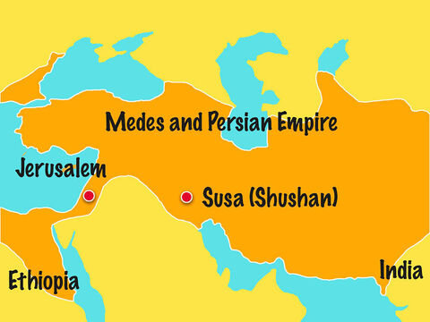
The Book of Esther
Esther remains one of the most popular books of the Old Testament.
It has many lessons for us today.
FreeBibleimages :: Home

Slide 3
“Esther” and Real-Life Decision-Making
“Esther” raises big ‘ethical’ dilemmas. Making ethical decisions requires ‘moral character’, and ‘positive values’.
Some of the issues raised by Esther’s situation include:
People in a position of power or influence need “integrity”. They must be willing to “hold their ground” and stand up for the powerless.
There are times when an individual cannot remain silent, even if they are under threat. Moral choices require personal courage.
Moral choices require self-discipline - Esther’s fasting and prayer was important.
Difficult moral choices may involve self-sacrifice – in order to help others.
Moral choices require thinking about the consequences for others.
Ethical decision-making may not involve public recognition.
People in power who are not believers, like King Xerxes, can fulfill the purposes of God.

Slide 4
Biblical Lessons to learn from Esther
For believers, “The Book of Esther” is a continual reminder that:
God is sovereign, and His will prevails against those who seek to destroy His followers.
God has a purpose for every life, even though it may not always be readily apparent.
It’s important to be willing to trust and follow God’s plans.

