Slide 1
Biblical Women: God’s Heroines
The Book of Ruth

Slide 2
The Book of Ruth
In most Christian canons, the ‘Book of Ruth’ is treated as one of the historical books in the Old Testament and is placed between Judges and Samuel.
The date is approx 1000 BC.
Ruth - Bible Cities (biblemaps.com)

Slide 3
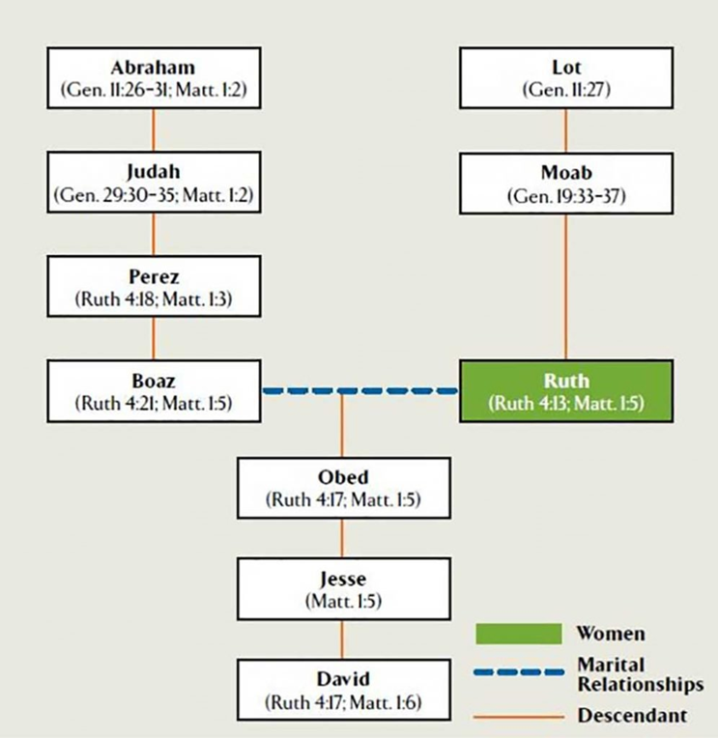
The Book of Ruth
Ruth’s story is both ordinary and exceptional. She is a foreign widow, but becomes so important she is included in the bible and is recognized in the lineage to Jesus.
Book of Ruth – Bible Tree

Slide 4
The Book of Ruth - Outline
The Good Life: Book of Ruth Outline

Slide 5
The Book of Ruth – Main Characters

Slide 6
“Ruth” and Real-Life Lessons for today?
“Ruth” faced big ‘ethical’ challenges. Making ethical decisions requires ‘moral character’, and ‘positive values’.
Some of the issues raised by Ruth’s situation include:
The importance of hope, even in the toughest of times
The past does not define our lives (Ruth is a foreigner);
there is always purpose for the future
Doing the right thing (Ruth’s loyalty) often requires
bravery and sacrifice
Seemingly ordinary people can grow into people of extraordinary moral character
Courage and ingenuity triumph over misfortune.
Family can be a great source of strength and comfort

Slide 7
Biblical Lessons to learn from “Ruth”
For believers, “The Book of Ruth” is a continual reminder that:
God keeps a careful eye on the powerless – the widow and the the homeless “… Father of the fatherless, a defender of widows, in his Holy habitation” (Psalm 68:5)
Women of strength and character are heroes in the Bible – characters of rock-solid faith and fearlessness
Grief and sorrow cannot stop divine love
Ruth’s story becomes part of the lineage and legacy of Jesus Christ
The importance of thankfulness and Godly gratitude

