Slide 1
Biblical Women: God’s Heroines
Images of Mary throughout the ages

Slide 2
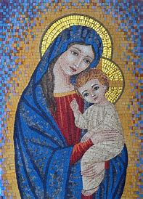
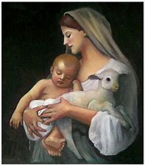
Mary, Mother of Jesus
L’Innocence by Bourgeureau, 1870
Taruna Rettinger, 2012
Duccio di Buoninsegna, 1310

Slide 3
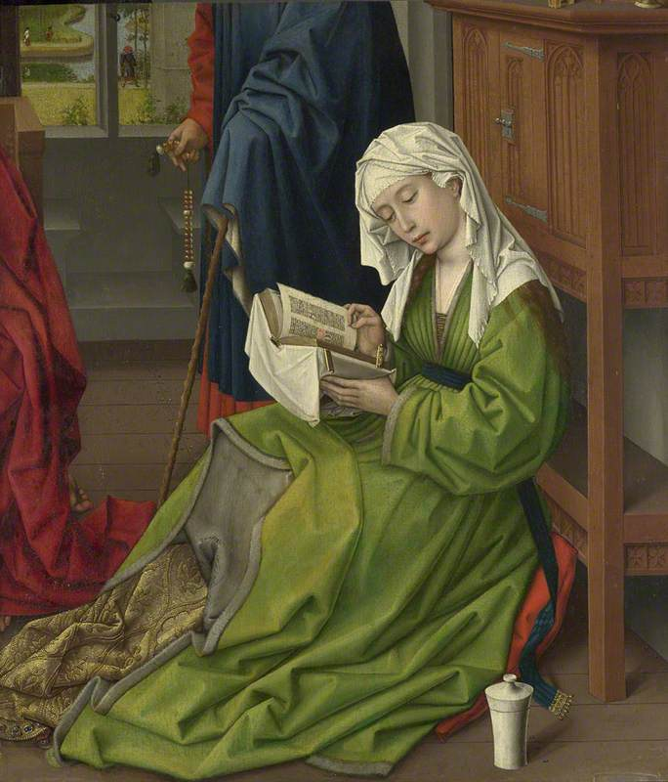
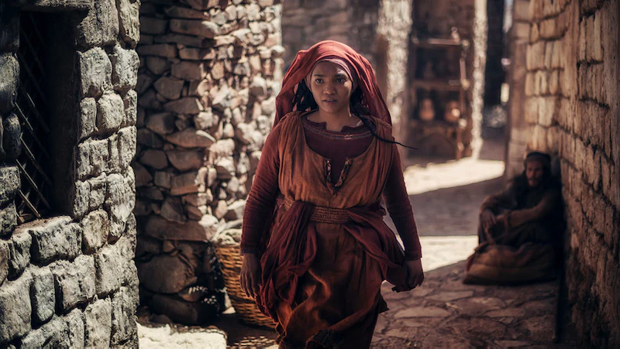
Mary Magdalene
TV Mini-series : ‘A.D. The Bible Continues’ 2016
Rogier van der Weyden (c.1399–1464)
Flemish (Bruges) School, 1690

