Slide 1
How did the Early Christian Church grow?
Religious Education
Name:

Slide 2
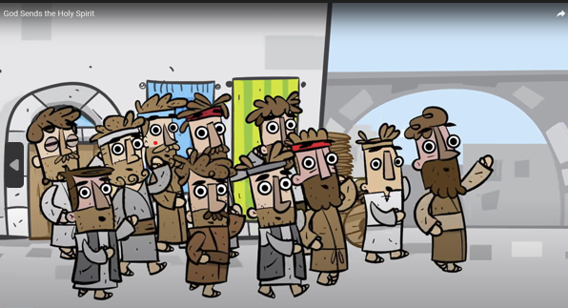
https://www.youtube.com/watch?v=OMQKy1Mx49M

Slide 3
Acts 2:32-47 read
As you watch the video, write down things that the Christians do…
Tell people about Jesus (v32-40)
Listen to the apostles teach about Jesus (v42)
Spend time together (v42)
Eat together (v42)
Pray (v42)
Share what they have (v44)
Look after people who need help (v45)

Slide 4
Write | Write a heading: “Telling People Good News”
Add | Add some pictures to help explain how this made the church grow
Write | Write a second heading: “Loving People”
Add | Add some pictures to explain what that looked like
In your Powerpoint

Slide 5
Loving People …

Slide 6
Telling People the Good News …

Slide 7
Why Join?
https://www.publicchristianity.org/the-origins-of-western-healthcare/

Slide 8
Why Join?
Does this help to explain the spread of Christianity?
If so, how?
If no, what would you expect to happen?
Add a picture of a nurse or hospital to you “Loving People” slide

Slide 9
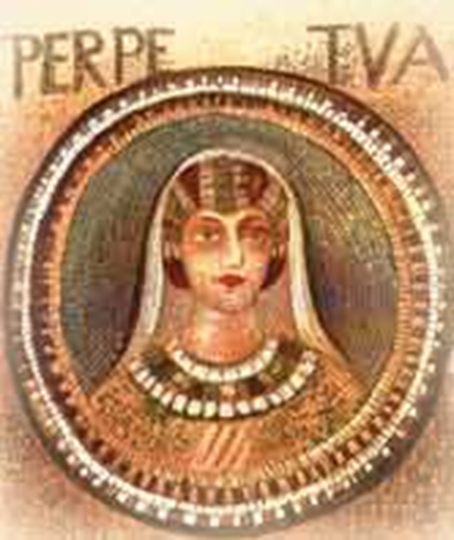
What it's worth?
Diary Entry:
'Father,' said I, 'do you see this vase here, for example, or waterpot or whatever?'
'Yes, I do', said he.
And I told him: 'Could it be called by any other name than what it is?'
And he said: 'No.'
'Well, so too I cannot be called anything other than what I am, a Christian.'
Heroes of the Faith: Perpetua - canonjjohn.com
Notes:
Tell the story of Perpetua & Felicitas. (notes below)
PERPETUA AND FELICITAS IN THE CARTHAGE ARENA
In 202, Christians who refused to sacrifice incense to Roman gods were considered traitors. Emperor Septimus Severus was cracking down on anti-state elements. As he saw it, the sacrifice was simply a patriotic gesture, not much more than our salute of the flag. But the Christians saw it as a denial of Christ. Among those swept into the emperor's dragnet in Carthage were two young women, Perpetua and Felicitas. The choice before them was clear: sacrifice or die.
For both women, the situation was complicated by motherhood. Felicitas was pregnant and Perpetua had a newborn son.
Perpetua's pagan father tried to manipulate her motherly instincts. "Please, Perpetua, think of me, your ageing father. But most of all, think of your little baby!" Because he could not convince the newly-converted 22-year-old to go perform her "duty," he was flogged. A man should have better control of his daughter! Perpetua was baptized while in prison. Felicitas, her slave girl, gave birth there.
Before her trial, Perpetua received visions from the Lord, reassuring her of his strength and presence. She wrote up her prison experience, becoming the first Christian authoress on record. She was condemned to die. On this day, March 7, 202, Perpetua and Felicitas left the prison for the arena "joyfully as though they were on their way to heaven." Before a raging crowd, they were thrown to wild beasts.
A mad heifer charged the women and tossed them, but Perpetua rose and helped Felicitas to her feet. She was ready, even eager, to die for the Lord. When she was thrown to the ground, Perpetua's clothing ripped. She modestly covered herself and asked if she could have a hairpin. She fixed her hair to avoid an unkempt appearance that might suggest she was in mourning.
Perpetua even spurred the other martyrs on. "You must all stand fast in the faith and love one another," she called to them. "Do not be weakened by what we have gone through!" When the beasts failed to finish them off, soldiers came to do the job. The soldier who approached Perpetua was trembling so much that she had to guide the sword to her own throat.
These two young women, new in faith, were instant heroines among fellow Christians. Joined together, their Latin names mean "everlasting happiness," which is what they expected to receive.

Slide 10
What it's worth?
Name: Perpetua and Felicitas
Does this story help explain the spread of Christianity?
If yes, how?
If no, what would you expect to happen?
Add a picture of Perpetua to your “Telling People Good News” slide
Heroes of the Faith: Perpetua - canonjjohn.com
Notes:
Tell the story of Perpetua & Felicitas. (notes below)
PERPETUA AND FELICITAS IN THE CARTHAGE ARENA
In 202, Christians who refused to sacrifice incense to Roman gods were considered traitors. Emperor Septimus Severus was cracking down on anti-state elements. As he saw it, the sacrifice was simply a patriotic gesture, not much more than our salute of the flag. But the Christians saw it as a denial of Christ. Among those swept into the emperor's dragnet in Carthage were two young women, Perpetua and Felicitas. The choice before them was clear: sacrifice or die.
For both women, the situation was complicated by motherhood. Felicitas was pregnant and Perpetua had a newborn son.
Perpetua's pagan father tried to manipulate her motherly instincts. "Please, Perpetua, think of me, your aging father. But most of all, think of your little baby!" Because he could not convince the newly-converted 22-year-old to go perform her "duty," he was flogged. A man should have better control of his daughter! Perpetua was baptized while in prison. Felicitas, her slave girl, gave birth there.
Before her trial, Perpetua received visions from the Lord, reassuring her of his strength and presence. She wrote up her prison experience, becoming the first Christian authoress on record. She was condemned to die. On this day, March 7, 202, Perpetua and Felicitas left the prison for the arena "joyfully as though they were on their way to heaven." Before a raging crowd, they were thrown to wild beasts.
A mad heifer charged the women and tossed them, but Perpetua rose and helped Felicitas to her feet. She was ready, even eager, to die for the Lord. When she was thrown to the ground, Perpetua's clothing ripped. She modestly covered herself and asked if she could have a hairpin. She fixed her hair to avoid an unkempt appearance that might suggest she was in mourning.
Perpetua even spurred the other martyrs on. "You must all stand fast in the faith and love one another," she called to them. "Do not be weakened by what we have gone through!" When the beasts failed to finish them off, soldiers came to do the job. The soldier who approached Perpetua was trembling so much that she had to guide the sword to her own throat.
These two young women, new in faith, were instant heroines among fellow Christians. Joined together, their Latin names mean "everlasting happiness," which is what they expected to receive.

