Slide 1
What do Christians believe?
Religious Education
Name:

Slide 2
BRAINSTORM: (on scrap paper)
Notes:
Identify as many basic Christian beliefs that the class can come up with.
Get them to talk to a buddy – which 2-3 things would they select as the MAIN, CORE BELIEFS of Christians?

Slide 3
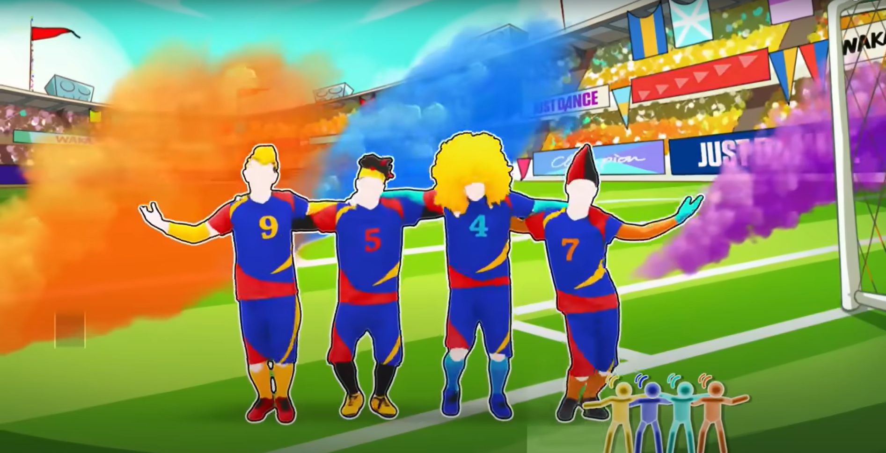
https://www.youtube.com/watch?v=1csN2kEgSDI
Notes:
Just Dance 2018 Waka Waka This Time For Africa Alternate
https://www.youtube.com/watch?v=1csN2kEgSDI

Slide 4
The Earliest Summary: 1 Corinthians 15:3-8
³ I gave you the message that I received. I told you the most important truths: that Christ died for our sins, as the Scriptures say; ⁴ that he was buried and was raised to life on the third day, as the Scriptures say; ⁵ and that he appeared to Peter and then to the twelve apostles. ⁶ After that Christ appeared to more than 500 other believers at the same time. Most of them are still living today, but some have died.⁷ Then he appeared to James and later to all the apostles.⁸ Last of all, he appeared to me.
Notes:
This summary of central Christian beliefs is in the letter Paul wrote to the Christians in Corinth. Historians (including atheist historians) say this summary is something Paul was taught when he first became a Christian, within a couple of years of Jesus’ death & resurrection.
It combines important beliefs, evidence for those beliefs, and the reminder that this was what God had always planned (revealed in Scripture).
https://en.wikipedia.org/wiki/1_Corinthians_15#Origins_of_the_creed

Slide 5
THE EARLIEST SUMMARY: 1 Corinthians 15:3-8
Michael Goulder
(Atheist NT professor): “[It] goes back at least to … a couple of years (or months) after the crucifixion. 30’s AD
Notes:
This summary of central Christian beliefs is in the letter Paul wrote to the Christians in Corinth. Historians (including atheist historians) say this summary is something Paul was taught when he first became a Christian, within a couple of years of Jesus’ death & resurrection.
It combines important beliefs, evidence for those beliefs, and the reminder that this was what God had always planned (revealed in Scripture).
Date
https://en.wikipedia.org/wiki/1_Corinthians_15#Origins_of_the_creed

Slide 6
THE EARLIEST SUMMARY: 1 Corinthians 15:3-8
The message that I received:
the most important truths:
Christ died for our sins, as the Scriptures say;
he was buried
Christ was raised to life on the third day, as the Scriptures say;
he appeared to Peter etc &
to more than 500 other believers

Slide 7
THE EARLIEST SUMMARY: 1 Corinthians 15:3-8
The message that I received:
the most important truths:
Christ died for our sins, as the Scriptures say;
he was buried
Christ was raised to life on the third day, as the Scriptures say;
he appeared to Peter etc &
to more than 500 other believers
Important belief

Slide 8
THE EARLIEST SUMMARY: 1 Corinthians 15:3-8
The message that I received:
the most important truths:
Christ died for our sins, as the Scriptures say;
he was buried
Christ was raised to life on the third day, as the Scriptures say;
he appeared to Peter etc &
to more than 500 other believers
Important belief

Slide 9
THE EARLIEST SUMMARY: 1 Corinthians 15:3-8
The message that I received:
the most important truths:
Christ died for our sins, as the Scriptures say;
he was buried
Christ was raised to life on the third day, as the Scriptures say;
he appeared to Peter etc &
to more than 500 other believers
Important belief

Slide 10
THE EARLIEST SUMMARY: 1 Corinthians 15:3-8
The message that I received:
the most important truths:
Christ died for our sins, as the Scriptures say;
he was buried
Christ was raised to life on the third day, as the Scriptures say;
he appeared to Peter etc &
to more than 500 other believers
Important belief
Evidence

Slide 11
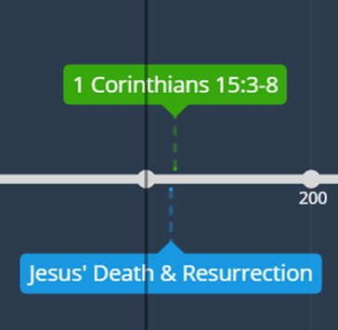
THE EARLIEST SUMMARY: 1 Corinthians 15:3-8
Belief | Evidence | Why it matters
Christ died for our sins
Christ was raised to life
Notes:
Get students to explain why each of these is an important belief.
(ie, Christ died for our sins = he takes the punishment we deserve so we can be friends with God;
Christ raised to life = proves him to be God’s promised king of the world)

Slide 12
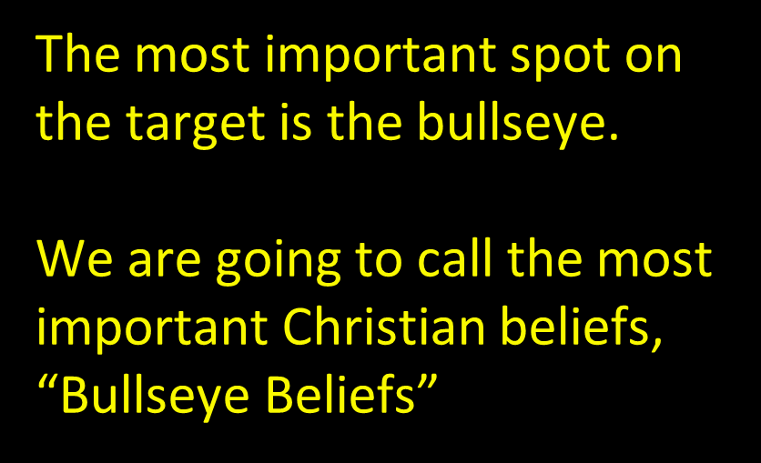
TARGET
Notes:
Just like the highest value spots on a target are at the bullseye, we can arrange Christian beliefs according to how important, or “central” they are.

Slide 13
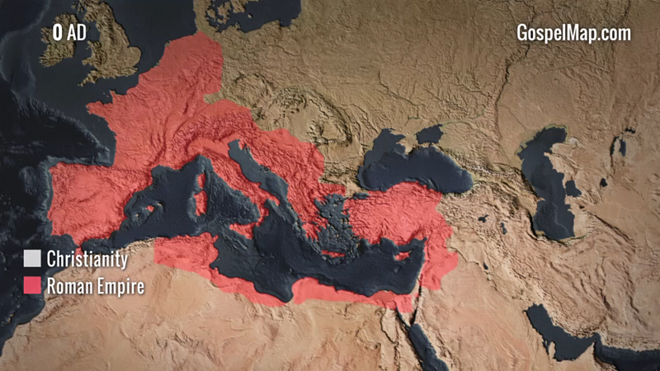
Time passes …
As the number of Christians grew, they realised that they should come up with some more detailed summaries of their faith…
Why might this be important?
https://drive.google.com/file/d/17Wy3neuxHFe9YbNspDkGIXg8GnhzfSmQ/view?usp=drive_link
Notes:
When the group of Christians was small, they could easily chat together and clarify things. Once the numbers and distances were much bigger, more detailed summaries helped ensure that Christians everywhere continued to believe the same things. Within 300 years Christianity was more widespread than the Roman Empire.
These summaries (known as creeds) are one of the ways we can be confident today that the content of Christianity hasn’t changed over the centuries.

Slide 14
Notes:
When the group of Christians was small, they could easily chat together and clarify things. Once the numbers and distances were much bigger, more detailed summaries helped ensure that Christians everywhere continued to believe the same things. Within 300 years Christianity was more widespread than the Roman Empire.
These summaries (known as creeds) are one of the ways we can be confident today that the content of Christianity hasn’t changed over the centuries.

Slide 15
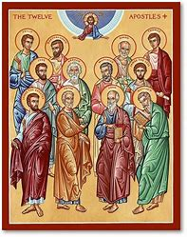
Apostles’ Creed c. 180 AD
I BELIEVE in God, the Father almighty, creator of heaven and earth.
I believe in Jesus Christ, his only Son, our Lord. He was conceived by the power of the Holy Spirit and born of the Virgin Mary. He suffered under Pontius Pilate, was crucified, died, and was buried. He descended to the dead.
www.theholyapostles.com/symbols-of-the-apostles
Notes:
Belief in God as Father (creator), Son & Holy Spirit, and Church but main focus on Jesus

Slide 16
Apostles’ Creed c. 180 AD
On the third day he rose again. He ascended into heaven, and is seated at the right hand of the Father. He will come again to judge the living and the dead. I believe in the Holy Spirit,
the holy universal Church, the communion of saints,
the forgiveness of sins, the resurrection of the body,
and the life everlasting.
byzantinepainting.com/en/icon-jesus-christ-on-the-throne-of-glory/
Notes:
Belief in God as Father (creator), Son & Holy Spirit, and Church but main focus on Jesus

Slide 17
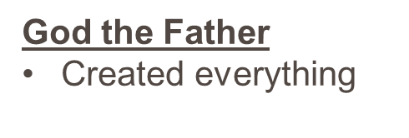
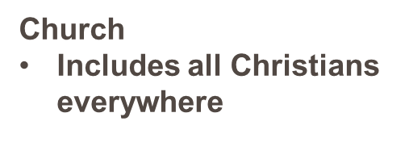
Bullseye beliefs
AS the OT said,
Jesus
Christ the King
Died for our sins, buried
Raised to life, appeared
God’s only son, born of Mary
At God’s right hand in heaven will return to judge
Notes:
Just like the highest value spots on a target are at the bullseye, we can arrange Christian beliefs according to how important, or “central” they are.

Slide 18
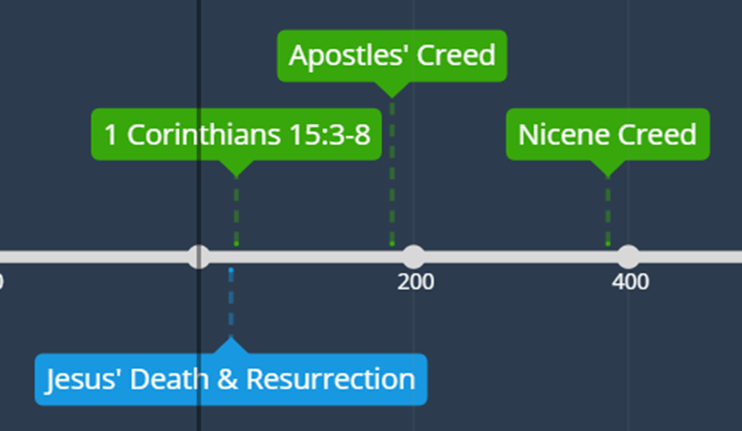
Nicene Creed c. 381 AD
WE BELIEVE in one God, the Father, the Almighty, maker of heaven and earth, of all that is, seen and unseen.
Notes:
New clarifications

Slide 19
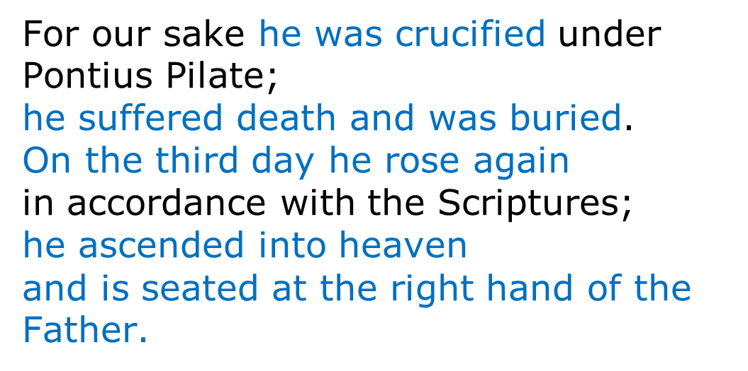
Nicene Creed c. 381 AD
Notes:
New clarifications

Slide 20
Nicene Creed c. 381 AD
Notes:
New clarifications

Slide 21
Nicene Creed c. 381 AD
Notes:
New clarifications

Slide 22
Bullseye beliefs
As the OT said,
Jesus
Christ (King) Lord forever
Died for our sins to save us
Raised to life, appeared
God’s only son, born of Mary
At God’s right hand in heaven, will return to judge
Giver of Life
Lord, truly God
Spoke through the prophets
God the Father
Created everything
Seen & unseen
Church
Includes all Christians everywhere
Should be in people’s own language
Truly God, everything made through him
Notes:
Just like the highest value spots on a target are at the bullseye, we can arrange Christian beliefs according to how important, or “central” they are.
Yellow 1 Corinthians 15 Creed from months after Jesus Death 30AD
Black Apostles Creed 180 AD
Purple Nicene Creed 381 AD
Green 39 Articles

Slide 23
Nicene Creed c. 381 AD
Notes:
New clarifications

Slide 24
39 Articles c. 1571 AD
Summary statements eg
6. The Bible contains everything we need for salvation.
8. We still believe the Apostles’ Creed & the Nicene Creed are right.
24. Church should be run in the language people understand.
31. Jesus did everything necessary for us to be saved when he died. We can’t add anything to that.
Notes:
This later set of statements was to correct different confusions – about whether Jesus’ death & resurrection was enough, or if people need to do some extra stuff now.

Slide 25
Bullseye beliefs
Bible
God’s Word
Has everything we need to know about God
As the OT said,
Jesus
Christ (King) Lord forever
Died for our sins
Raised to life, appeared
God’s only son, born of Mary
At God’s right hand in heaven, will return to judge
Giver of Life
Lord, truly God
Spoke through the prophets
God the Father
Created everything
Seen & unseen
Church
Includes all Christians everywhere
Should be in people’s own language
Truly God, everything made through him
Notes:
Just like the highest value spots on a target are at the bullseye, we can arrange Christian beliefs according to how important, or “central” they are.
Yellow 1 Corinthians 15 Creed from months after Jesus Death 30AD
Black Apostles Creed 180 AD
Purple Nicene Creed 381 AD
Green 39 Articles

Slide 26
This I Believe (Hillsong Music)
Listen to the song.
Have they done a good job expressing all the important points?
Notes:
This later set of statements was to correct different confusions – about whether Jesus’ death & resurrection was enough, or if people need to do some extra stuff now.

Slide 27
This I Believe (Hillsong Music)
YOUR TURN:
Try to write a summary of
The most important things
Christians believe all round
the world, and all
through history.
What is Christianity all about?
Notes:
Next lesson: points about which different Christians disagree…
(Target with core (from today), health & disputable matters)

