Slide 1
Church Denominations
Religious Education
Name:

Slide 2
In forever kingdom

Slide 3
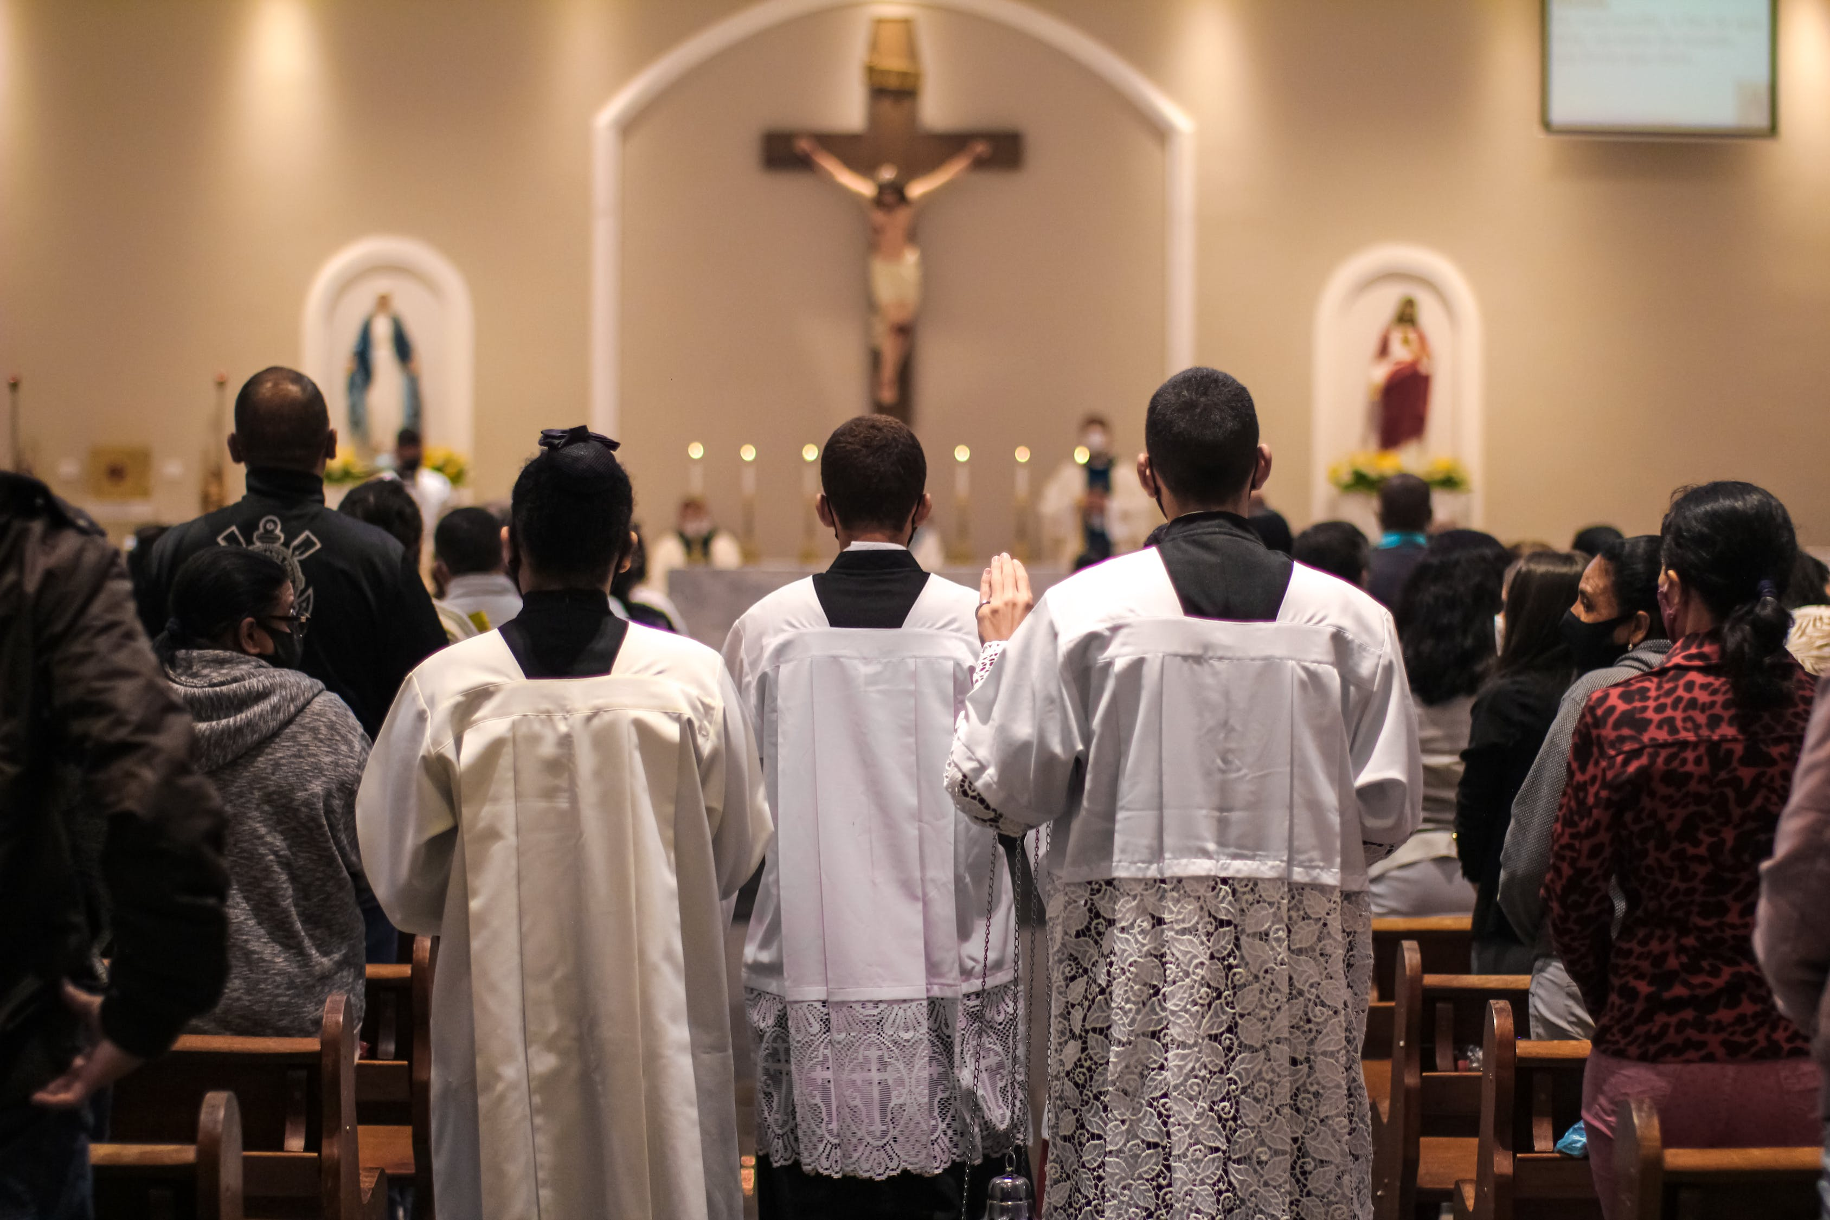
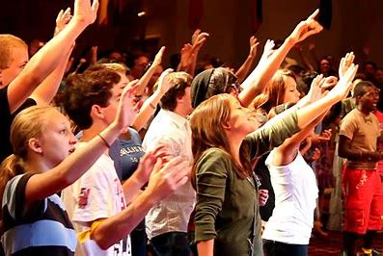
Charitymission.org
Church Leadership.com
Why are there so many ‘versions’ of church?
Church Leadership.com

Slide 4
Denominations – Introduction to Protestantism

Slide 5
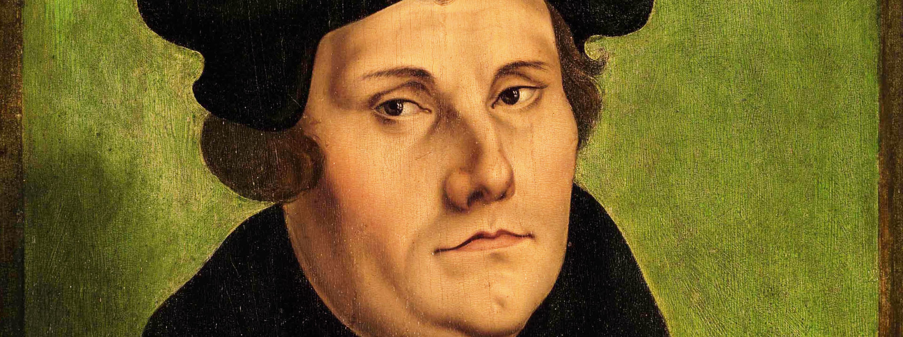
MARTIN LUTHER (1483 – 1546) and THE REFORMATION
https://iview.abc.net.au/show/pocket-compass/series/1/video/CK1807H004S00
Notes:
Need a free ABC Account to watch
Series 1 Episode 4 Luther: The Monk Who Changed The Church
Duration: 14 minutes 20 seconds14m
Now over 500 years since Martin Luther's challenge to the Catholic Church, Pocket Compass explores the relevance of the event that kickstarted a revolution that continues to resonate in Australian lives today.

Slide 6
Church Governance
Country / Nationality
In forever kingdom
Baptism
(When do you do it?
Worship Style

Slide 7
Pick one Denonimation and find some basic facts and images
Denominations …
Denominations …
Anglican
Catholic
Baptist
Presbyterian
Lutheranism
Reformed (Calvinism)
Methodist
Adventist
Pentecostalism
Salvation Army
Nondenominational
African Initiated Churches
Chinese Patriotic Christian Churches (Three-Self Patriotic Movement)
Eastern Orthodox
Oriental Orthodox
Notes:
https://en.wikipedia.org/wiki/List_of_Christian_denominations_by_number_of_members

