Slide 1
Church: Prayer
Religious Education
Name:
Notes:
We know what Christians believe, so now what happens in Church…

Slide 2
Crosswalk.Com
Prayer is …
Notes:
Ask the class what prayer is

Slide 3
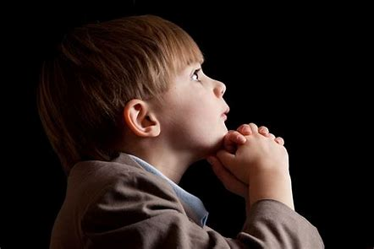
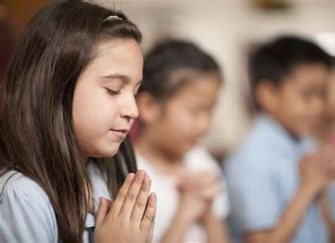
Ideas to pray about for Chapel next week ?
Crosswalk.Com
Notes:
Ask the class what prayer is …

Slide 4
Writing the prayer …
1. Dear God / Heavenly Father / Dear Lord, [choose your opening]
2. We pray for our world/Australia/St Mark’s. [This is your topic sentence.]
3. Thank you for… [complete the sentence about something you are thankful for]
4. Sorry that… [complete this sentence with something that you want to say “sorry” to God about]
5. Please… [complete this sentence with something you’d like God to do – either God himself, or something you’re asking God to help us do]
Notes:
Ask the class what prayer is

Slide 5
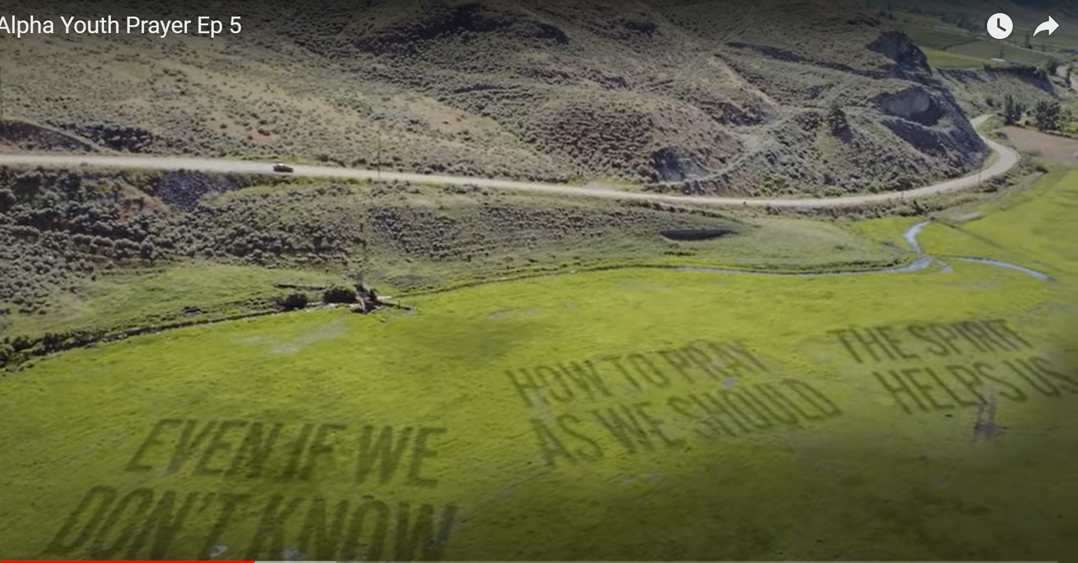
Alpha Youth Prayer Ep 5 - YouTube
Notes:
Why do Christians pray?
Alpha Youth Prayer EP 5, watch about 6 mins
https://youtu.be/Fl8VnmY99TA?t=237
6min
Ask the class what prayer is

Slide 6
‘And when you pray, do not be like the hypocrites, for they love to pray standing in the synagogues and on the street corners to be seen by others. Truly I tell you, they have received their reward in full. ⁶ But when you pray, go into your room, close the door and pray to your Father, who is unseen. Then your Father, who sees what is done in secret, will reward you. ⁷ And when you pray, do not keep on babbling like pagans, for they think they will be heard because of their many words. ⁸ Do not be like them, for your Father knows what you need before you ask him.
Notes:
What does the Bible say about prayer?

Slide 7
⁹ ‘This, then, is how you should pray:
‘“Our Father in heaven, hallowed be your name, ¹⁰ your kingdom come, your will be done, on earth as it is in heaven. ¹¹ Give us today our daily bread. ¹² And forgive us our debts, as we also have forgiven our debtors. ¹³ And lead us not into temptation, but deliver us from the evil one.”
THE LORD’S PRAYER
Matthew 6:9-13
Notes:
What does the Bible say about prayer?

Slide 8
PRAYER
5 ‘And when you pray, do not be like the hypocrites, for they love to pray standing in the synagogues and on the street corners to be seen by others. Truly I tell you, they have received their reward in full.
6 But when you pray, go into your room, close the door and pray to your Father, who is unseen. Then your Father, who sees what is done in secret, will reward you.
7 And when you pray, do not keep on babbling like pagans, for they think they will be heard because of their many words.
8 Do not be like them, for your Father knows what you need before you ask him.
DON’T:
INSTEAD:
DON’T:
BECAUSE:
Notes:
What does the Bible say about prayer?

Slide 9
⁹ ‘This, then, is how you should pray: ‘“Our Father in heaven, hallowed be your name, ¹⁰ your kingdom come, your will be done, on earth as it is in heaven. ¹¹ Give us today our daily bread. ¹² And forgive us our debts, as we also have forgiven our debtors. ¹³ And lead us not into temptation, but deliver us from the evil one.” | Who should we pray to? | Write your own version: Things we’re asking God that are not about us Things we’re asking God to do for us
Who should we pray to?
3 things we ‘re asking God for that are not about us
3 things we’re asking God to do for us
Notes:
How did Jesus teach us to pray?

Slide 10
THE LORD’S PRAYER
Notes:
How did Jesus teach us to pray?

Slide 11
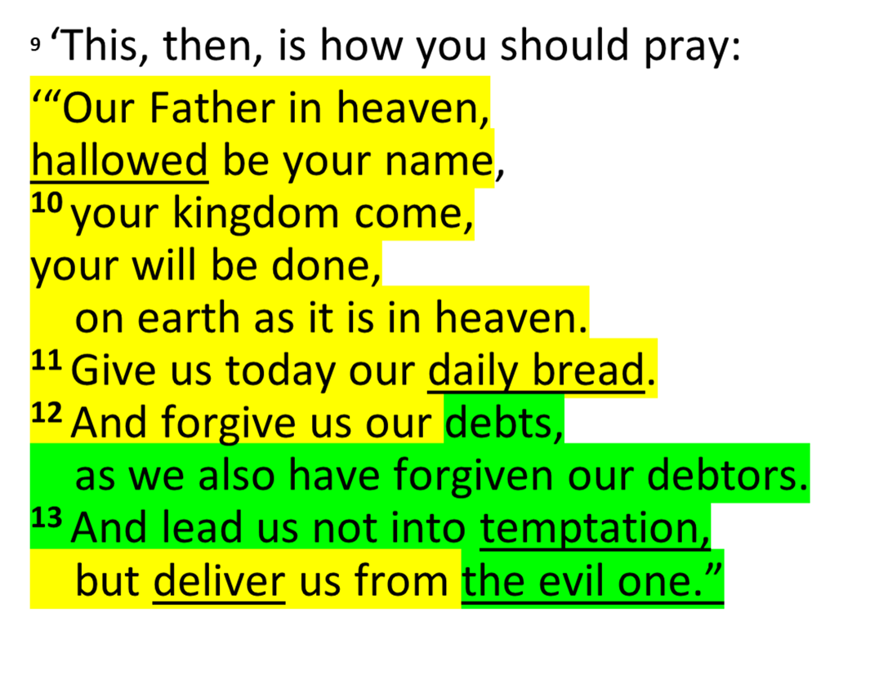
THE LORD’S PRAYER (CHAPEL)
Notes:
Yellow is same.
Green is different.
Underlined is hard to understand?

Slide 12
Our Father in heaven,
hallowed be your name,
your kingdom come,
your will be done,
on earth as in heaven.
Give us today our daily bread.
Forgive us our sins
as we forgive those who sin against us.
Save us from the time of trial
and deliver us from evil.
For the kingdom, the power, and the glory are yours
now and forever. Amen.
THE LORD’S PRAYER (CHAPEL)

Slide 13
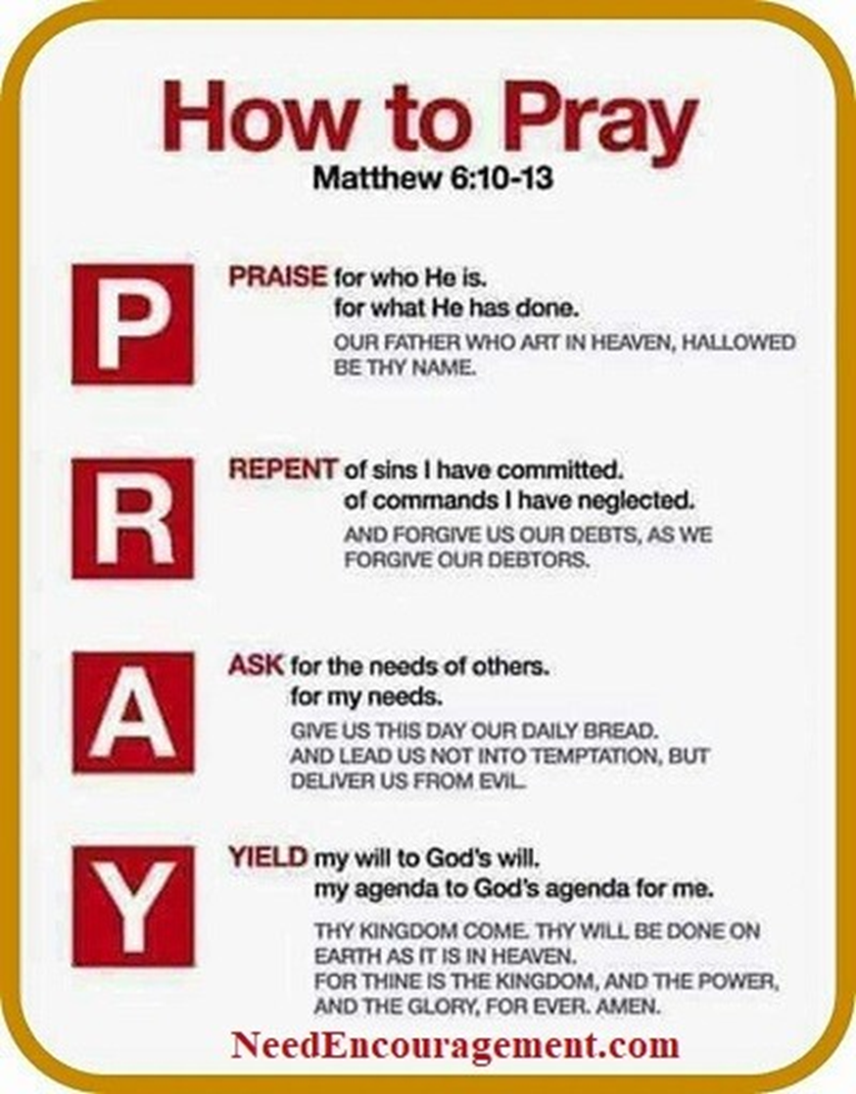
THE LORD’S PRAYER
(CHAPEL)
Notes:
How to pray

Slide 14
www.christianbook.com/acts-prayer-model
Notes:
How to pray

