Slide 1
Church: The Structure of the Anglican Church
Religious Education
Name:
Notes:
We know what Christians believe, so now what happens in Church…

Slide 2
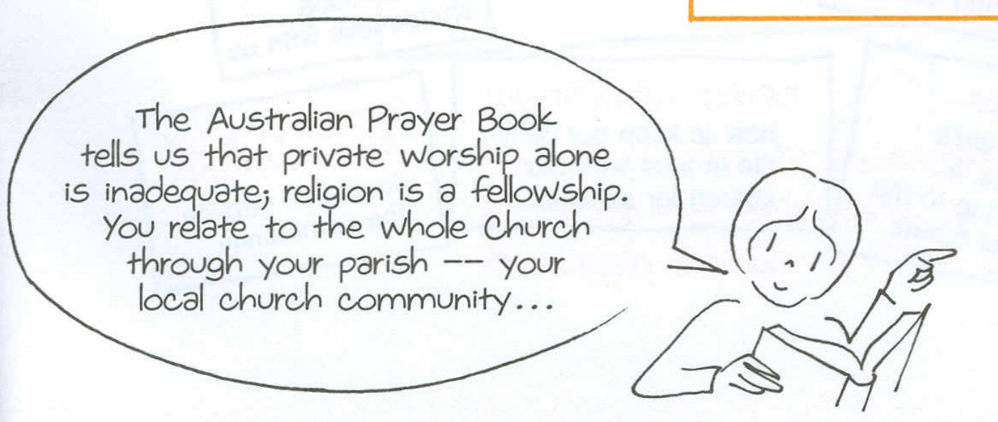
ASC unit images – Being an Anglican
Notes:
In summary

Slide 3
What is the structure of the Anglican Church in Australia?
Bishop – presides over the Diocese, assisted by
Diocese - group of parishes
Parish Clergy - Priest
Deacon – assist priests in parish work
Vestry – elected as legal representatives of parish
Lay People – take part in services, participate in teaching

Slide 4
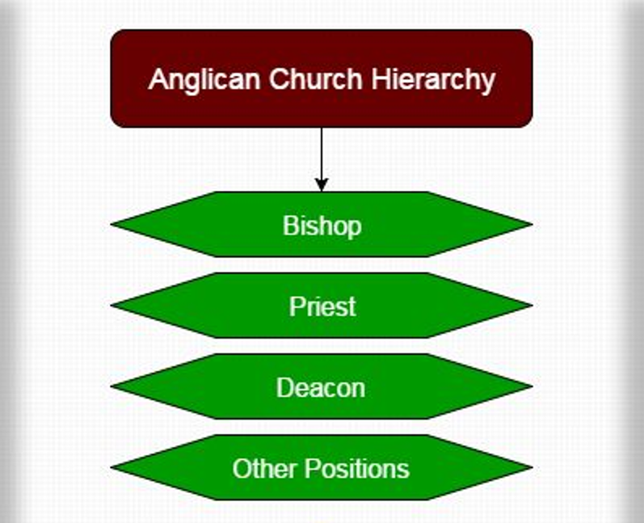
Notes:
In summary

Slide 5
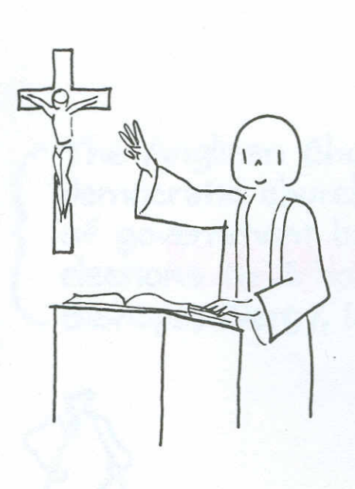
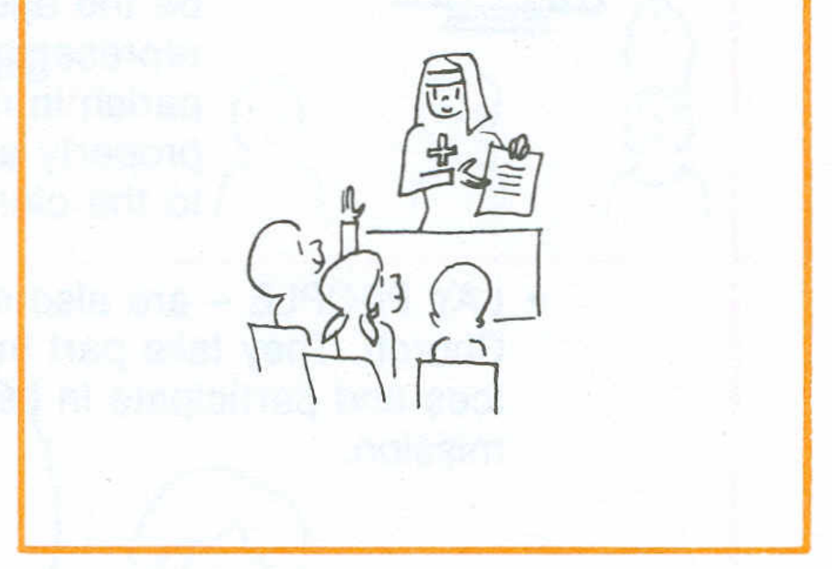
What is the Sacrament of Ordination …
Ordination is the sacrament consecrating clergy in service to God. Spiritual power and grace are given to help them devote their lives to the good of the community – teaching, administering sacraments, governing the church.
ASC unit images – Being an Anglican
ASC unit – Being an Anglican
Notes:
In summary

Slide 6
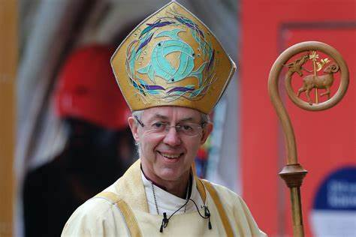
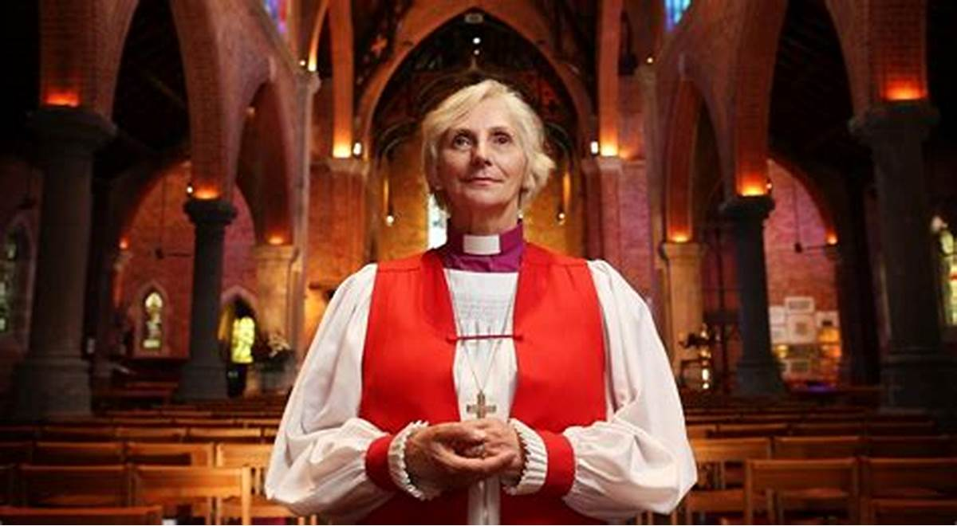
Archbishop of Canterbury Justine Welby
Archbishop of Perth Kay Goldsworthy
Bishops may be traced back to the early Church commissioned by Jesus.
They are spiritual overseers of their Diocese (a group of parishes, missions) which elected them to office. Bishops act as counsellors to clergy; ordain priests, deacons; administer confirmation; are final counsellors in Church matters. Together, Bishops share responsibility for the welfare of the Church.
Notes:
In summary

Slide 7
Priests are parish leaders. They must meet high standards of personal integrity and judgement. Their duties cover every pastoral, spiritual, and educational activity. Priests celebrate the Eucharist, baptise, pronounce absolution, and perform many other duties.
Anglican Priests' Ordination Service
Notes:
In summary

Slide 8
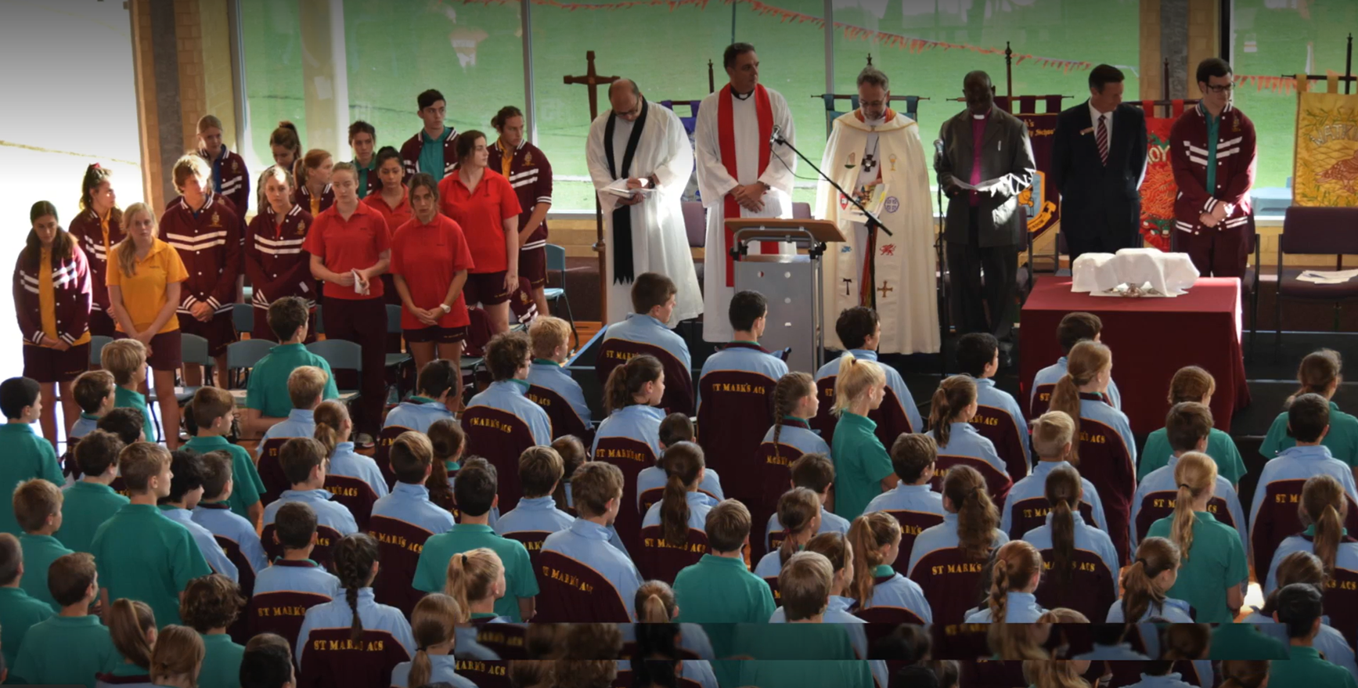
To enter the ordained ministry, a candidate should be:
have a sound education – usually capable of gaining a degree in theology
be physically and psychologically fit
be recommended by the rector, parish vestry, and diocesan agencies that act for the bishop
St Marks Anglican Community School, Hillarys, Perth
Notes:
In summary

Slide 9
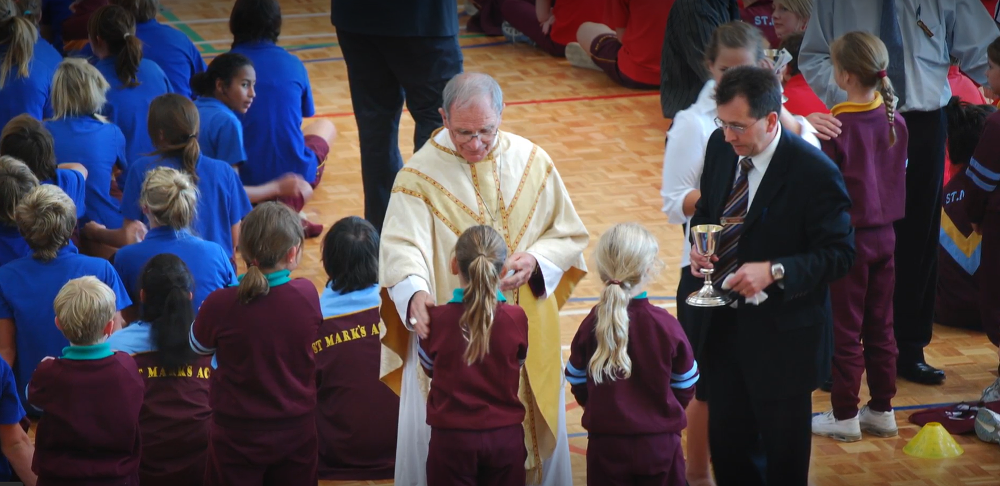
To enter the ordained ministry, a candidate should be:
have a sound education – usually capable of gaining a degree in theology
be physically and psychologically fit
be recommended by the rector, parish vestry, and diocesan agencies that act for the bishop
St Marks Anglican Community School, Hillarys, Perth
Notes:
In summary

Slide 10
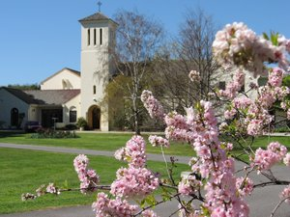
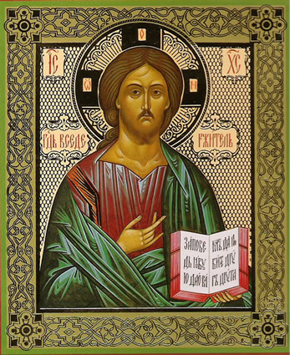
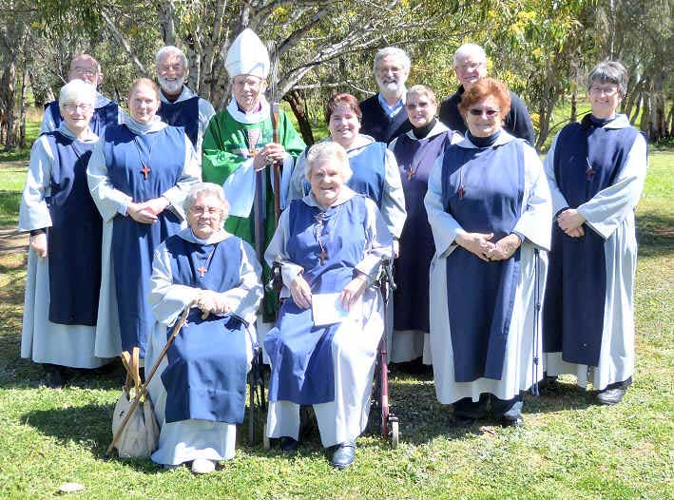
Religious Orders consist of men and women bound by traditional vows of poverty, chastity and obedience. Most monks and nuns live in communities; some are active in the world. Emphasis is on a life pf prayer, but members also perform social, medical, and educational duties, as well as religious ones.
Communityofstbarnabasandcecilia.com (Anglican)
www.blessedmart.com/shop/hand-painted-icons/christ-pantocrator-sinai-icon/
Notes:
In summary

Slide 11
https://blogs.bible.org/church-family/
Notes:
In summary

Slide 12
St Marks Anglican Community School, Hillarys, Perth
Notes:
In summary

Slide 13
St Marks Anglican Community School, Hillarys, Perth
Notes:
In summary

