Slide 1
Church: Singing and Communion
Religious Education
Name:
Notes:
We know what Christians believe, so now what happens in Church…

Slide 2
Bible (& talk)
Prayer
Singing
Holy Communion / the Lord’s Supper

Slide 3
It’s a great way for Christians to express their worship to God.
It’s a way to respond to God’s character and actions.
They remind one another of what is true.
Why do Christians sing in church?
It’s a good way to express emotions!
It helps Christians think about the future when Jesus returns
They are told to!
Notes:
Why do Christians sing in church?

Slide 4
Through Jesus, therefore, let us continually offer to God a sacrifice of praise—the fruit of lips that openly profess his name.
Hebrews 13:15
Why do Christians sing in church?
It’s a great way for Christians to express their worship to God
Notes:
Why do Christians sing in church?

Slide 5
Why do Christians sing in church?
Let the message of Christ dwell among you richly as you teach and admonish one another with all wisdom through psalms, hymns, and songs from the Spirit, singing to God with gratitude in your hearts. And whatever you do, whether in word or deed, do it all in the name of the Lord Jesus, giving thanks to God the Father through him.
Colossians 3:16-17
They remind one another of what is true.
Notes:
Why do Christians sing in church?

Slide 6
It’s a way to respond to God’s character and actions.
What are some examples today?
Why do Christians sing in Church?
Why do Moses & the Israelites sing? Exodus 15
Why does the Psalmist sing?
Psalm 96 Why does Mary sing? Luke 1:46-55
Notes:
Why do Christians sing in church?

Slide 7
Do not get drunk on wine, which leads to debauchery. Instead, be filled with the Spirit, speaking to one another with psalms, hymns, and songs from the Spirit. Sing and make music from your heart to the Lord …
Ephesians 5:18-19
They are told to!
Notes:
Why do Christians sing in church?

Slide 8
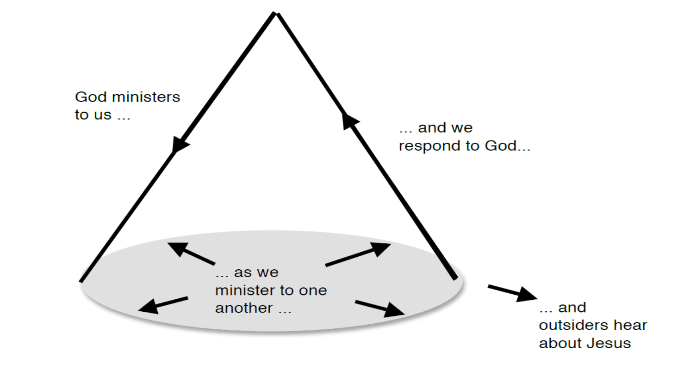
What’s Happening when Christians sing?

Slide 9
What happens when Christians sing?

Slide 10
Chris Tomlinson ‘Indescribable’
From the highest of heights to the…………. of the sea
Creation's revealing Your majesty
From the …………. of fall to the fragrance of spring
Every creature unique in the song that it ………….
All exclaiming
CHORUS:
Indescribable, uncontainable,
You placed the …………. in the sky and
You know them by name.
You are amazing God
All …………., untamable,
Awestruck we fall to our …… as we humbly proclaim
You are amazing God
Who has told every lightning bolt where it should go
Or seen heavenly storehouses laden with ………….
Who imagined the sun and gives source to its light
Yet conceals it to bring us the …………. of night
None can fathom
CHORUS:

Slide 11
Your turn …
Shout for joy to the Lord, all the earth. Worship the Lord with gladness; come before him with joyful songs. Know that the Lord is God. It is he who made us, and we are his; we are his people, the sheep of his pasture.
Enter his gates with thanksgiving and his courts with praise; give thanks to him and praise his name. For the Lord is good and his love endures forever; his faithfulness continues through all generations. (Psalm 100)
In pairs write a song/poem that you might be able to sing in Chapel

Slide 12
Find a good song for chapel
Google or YouTube, Christian music (or add a genre like heavymetal, rap, pop)
Emu Music, Hillsong, Bethel Music, Chris Tomlin, Lecrae, Newsboys
Notes:
Google or YouTube, Christian music (or add a genre like heavymetal, rap, pop etc) Emu Music, Hillsong, Bethel Musict, Chris Tomlin, Lecrae, Newsboys
https://www.youtube.com/watch?v=Jv8IqJm6q7w
Lecrae – I’ll find you
https://www.youtube.com/watch?v=WjZ01FcK0yk
Newsboys – We Believe
https://www.youtube.com/watch?v=S_OTz-lpDjw
Newsboys – God’s Not Dead

Slide 13
Bible (& talk)
Prayer
Singing
Holy Communion / the Lord’s Supper

Slide 14
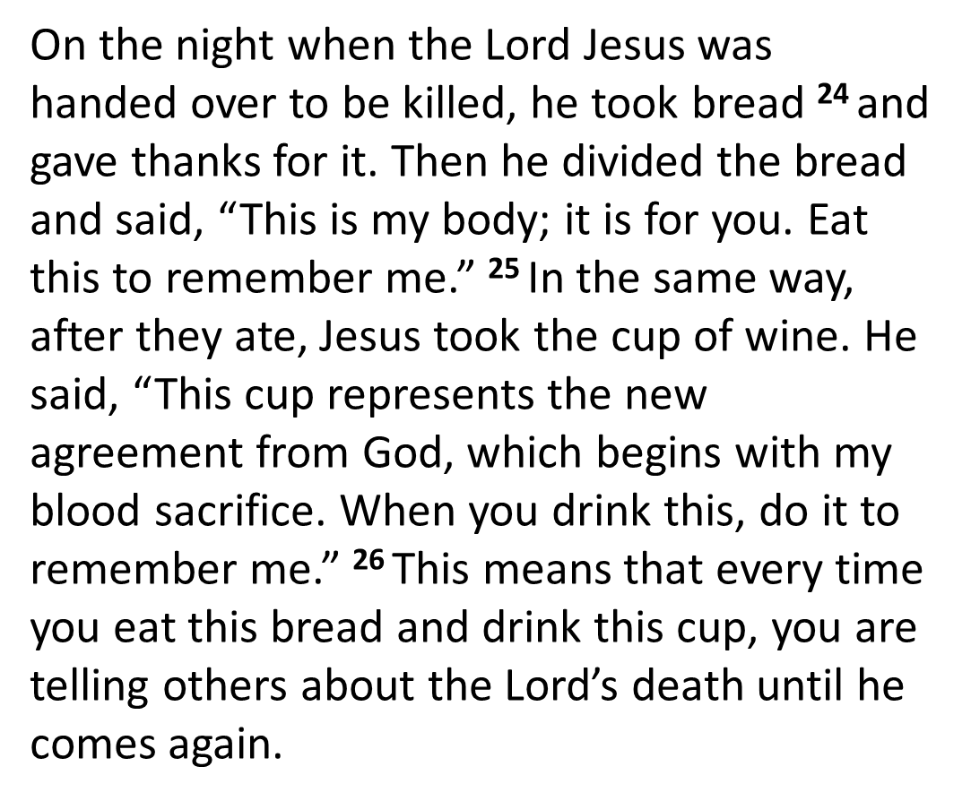
The Lord’s Supper / Holy Communion 1 Corinthians 11:23-26
Notes:
Explain why we do communion, Who could/should take communion, What happens in communion (can give both Catholic and Protestant view)

Slide 15
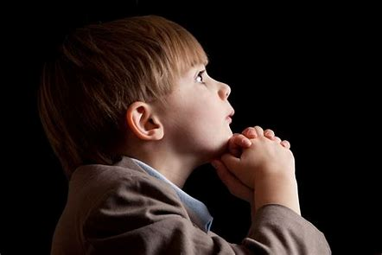
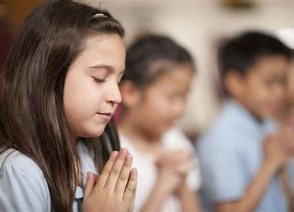
Ideas to pray about for Chapel next week ?
Notes:
Ask the class what prayer is …

Slide 16
Bible (& talk)
Prayer
Singing
Holy Communion / the Lord’s Supper

Slide 17
Writing the prayer …
1. Dear God / Heavenly Father / Dear Lord, [choose your opening]
2. We pray for our world/Australia/St Mark’s. [This is your topic sentence.]
3. Thank you for… [complete the sentence about something you are thankful for]
4. Sorry that… [complete this sentence with something that you want to say “sorry” to God about]
5. Please… [complete this sentence with something you’d like God to do – either God himself, or something you’re asking God to help us do]
Notes:
Ask the class what prayer is

Slide 18
It’s a way to respond to God’s character and actions.
What are some examples today?
Why do Moses & the Israelites sing? Exodus 15
Why does the Psalmist sing?
Psalm 96
Why does Mary sing? Luke 1:46-55
Why do Christians sing in Church?

Slide 19
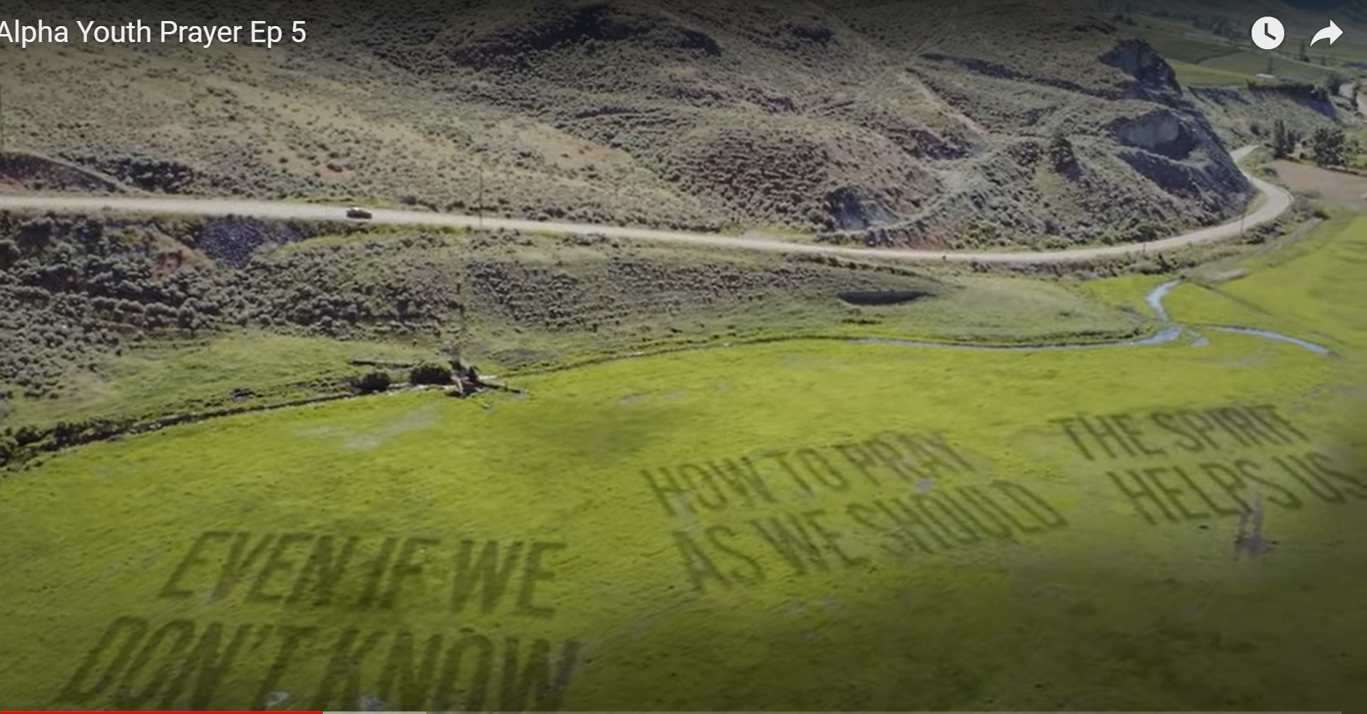
Alpha Youth Prayer Ep 5 - YouTube
Notes:
Why do Christians pray?
Alpha Youth Prayer EP 5, watch about 6 mins
https://youtu.be/Fl8VnmY99TA?t=237
6min
Ask the class what prayer is

Slide 20
‘And when you pray, do not be like the hypocrites, for they love to pray standing in the synagogues and on the street corners to be seen by others. Truly I tell you, they have received their reward in full. ⁶ But when you pray, go into your room, close the door and pray to your Father, who is unseen. Then your Father, who sees what is done in secret, will reward you. ⁷ And when you pray, do not keep on babbling like pagans, for they think they will be heard because of their many words. ⁸ Do not be like them, for your Father knows what you need before you ask him.
Notes:
Ask the class what prayer is

Slide 21
⁹ ‘This, then, is how you should pray:
‘“Our Father in heaven, hallowed be your name, ¹⁰ your kingdom come, your will be done, on earth as it is in heaven. ¹¹ Give us today our daily bread. ¹² And forgive us our debts, as we also have forgiven our debtors. ¹³ And lead us not into temptation, but deliver us from the evil one.”
THE LORD’S PRAYER
Matthew 6:9-13

Slide 22
PRAYER
5 ‘And when you pray, do not be like the hypocrites, for they love to pray standing in the synagogues and on the street corners to be seen by others. Truly I tell you, they have received their reward in full.
6 But when you pray, go into your room, close the door and pray to your Father, who is unseen. Then your Father, who sees what is done in secret, will reward you.
7 And when you pray, do not keep on babbling like pagans, for they think they will be heard because of their many words.
8 Do not be like them, for your Father knows what you need before you ask him.
DON’T:
INSTEAD:
DON’T:
BECAUSE:

Slide 23
⁹ ‘This, then, is how you should pray: ‘“Our Father in heaven, hallowed be your name, ¹⁰ your kingdom come, your will be done, on earth as it is in heaven. ¹¹ Give us today our daily bread. ¹² And forgive us our debts, as we also have forgiven our debtors. ¹³ And lead us not into temptation, but deliver us from the evil one.” | Who should we pray to? | Write your own version: Things we’re asking God that are not about us Things we’re asking God to do for us
Who should we pray to?
3 things we ‘re asking God for that are not about us
3 things we’re asking God to do for us
Notes:
Ask the class what prayer is

Slide 24
THE LORD’S PRAYER

Slide 25
Our Father in heaven,
hallowed be your name,
your kingdom come,
your will be done,
on earth as in heaven.
Give us today our daily bread.
Forgive us our sins
as we forgive those who sin against us.
Save us from the time of trial
and deliver us from evil.
For the kingdom, the power, and the glory are yours
now and for ever. Amen.
THE LORD’S PRAYER (CHAPEL)

Slide 26
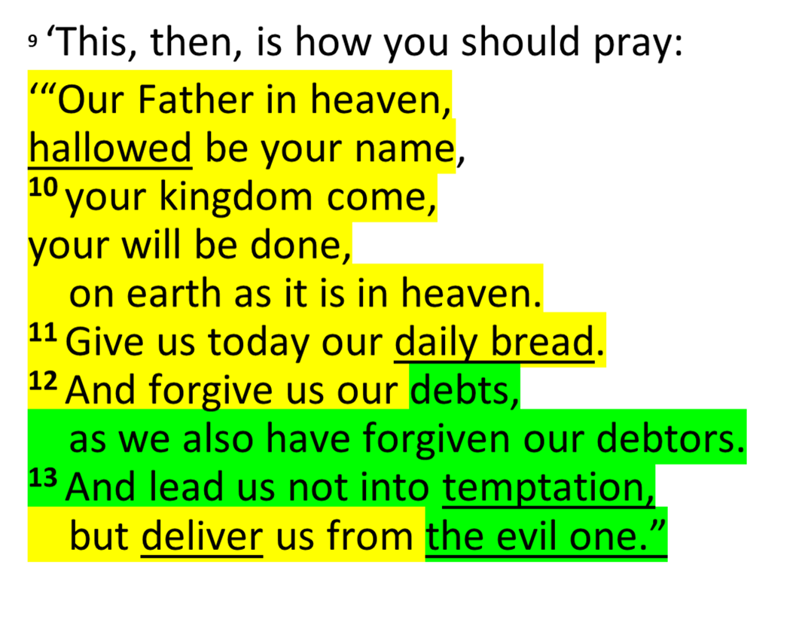
THE LORD’S PRAYER (CHAPEL)
Notes:
Yellow is same.
Green is different.
Underlined is hard to understand?

