Slide 1
World Religions

Slide 2
www.blogspot.com/2016/top-6-religions-of-world.html
Introduction

Slide 3
Religion

Slide 4
Survey
https://forms.office.com/Pages/ResponsePage.aspx?id=zeU4ux80VUeu6aHCK8mQ3ta6tDR5iIFFhQ8e4yIHnTFUOTBPNlE4WUxSVkxQV0c4SDY1Uk83NERZSi4u

Slide 5
Christian 31.1%
Islam (Muslim) 23.9%
Secular (non-religious, atheist) 16%
Hinduism 15.1 %
Buddhist 5.9%
Judaism (Jews) 1.9%
Christianity 31.1%
Islam 24.9%
secular (atheist, non-religious,) 15.2%
Hinduism 14.9%
Buddhism 5.6%
Judaism (Jews) 0.2%
What are the main religions?
Pew Research Centre, 2023

Slide 6
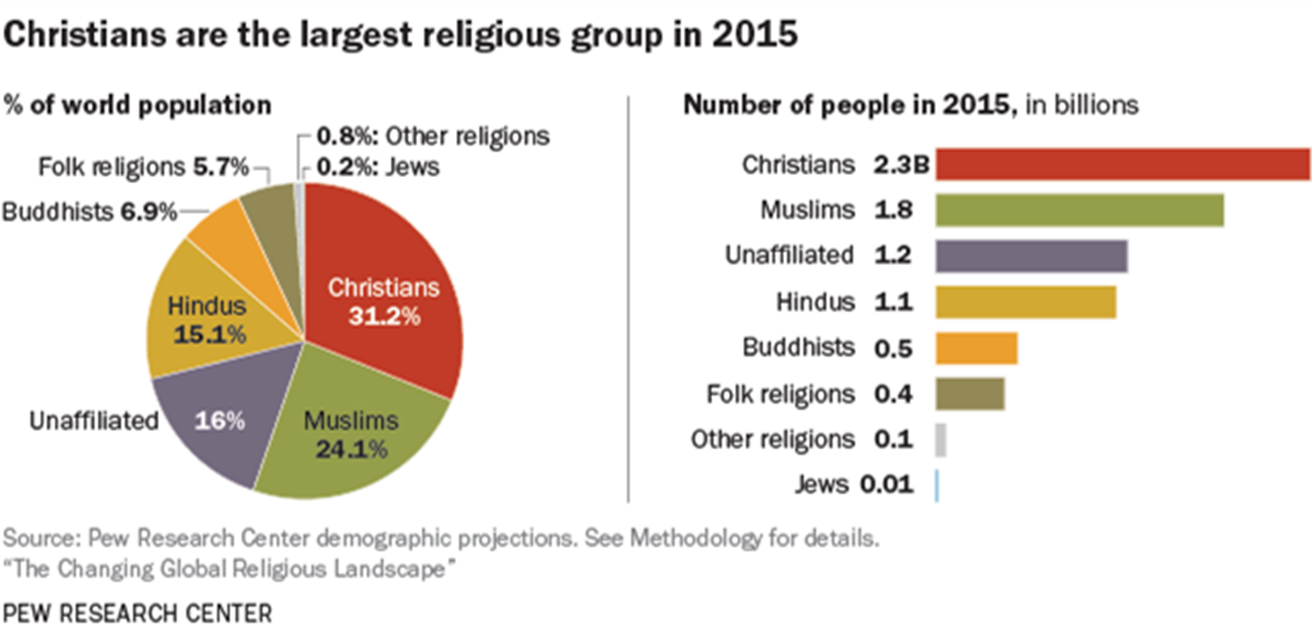

Slide 7
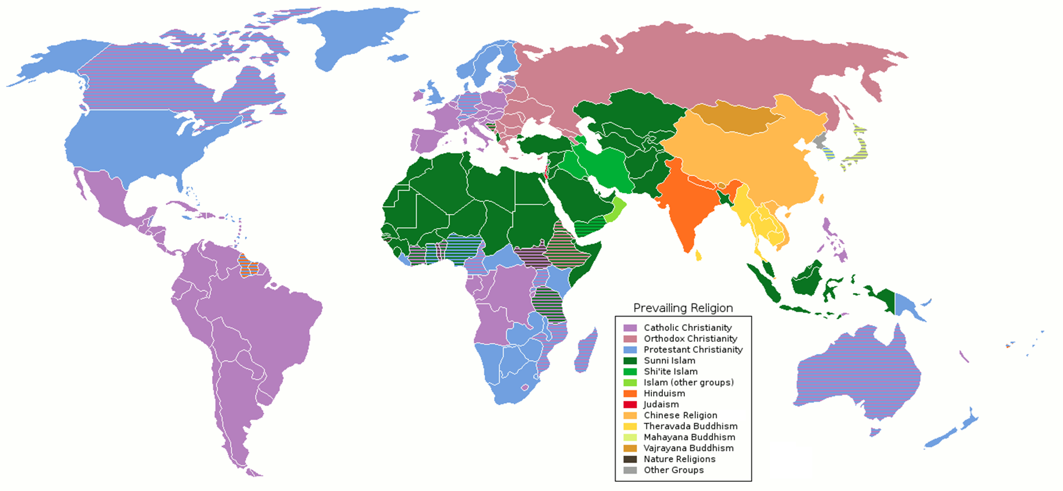
http://en.wikipedia.org/wiki/Major_religious_groups

Slide 8
What are some things religions claim to know?
All claim that they are the only way to know God
All claim to be the truth
All make big claims about God and Life

Slide 9
What are some things religions claim to know?
All claim that they are the only way to know God
All claim to be the truth
All make big claims about God and Life

Slide 10
Relativism –
“Gravity - is true for you but not for me.”
http://www.lolshouse.com/

Slide 11
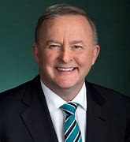
Relativism
Anthony Albanese is PM
True for me?
But not true for you?
https://www.news.com.au/tv/current-affairs

Slide 12
http://hslb.org/visit/collections/historical-newspaper-collection/
WW1 ended on 11 Nov 1918
True for me?
But not for you?

Slide 13
Relativism: Is it wrong to judge other cultures? | A-Z of ISMs Episode 18 - BBC Ideas - YouTube

