Slide 1
World Religions

Slide 2
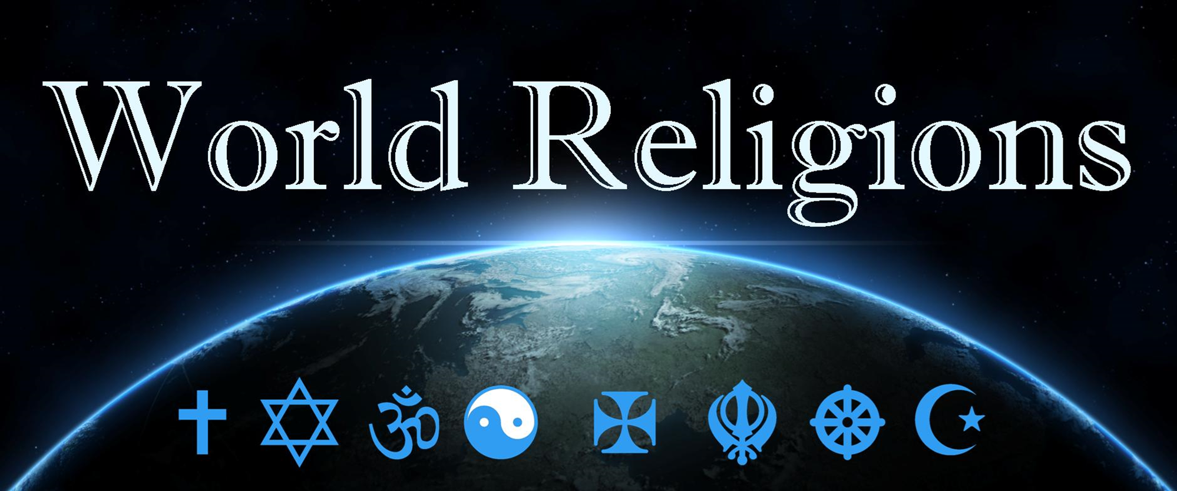
Introduction

Slide 3
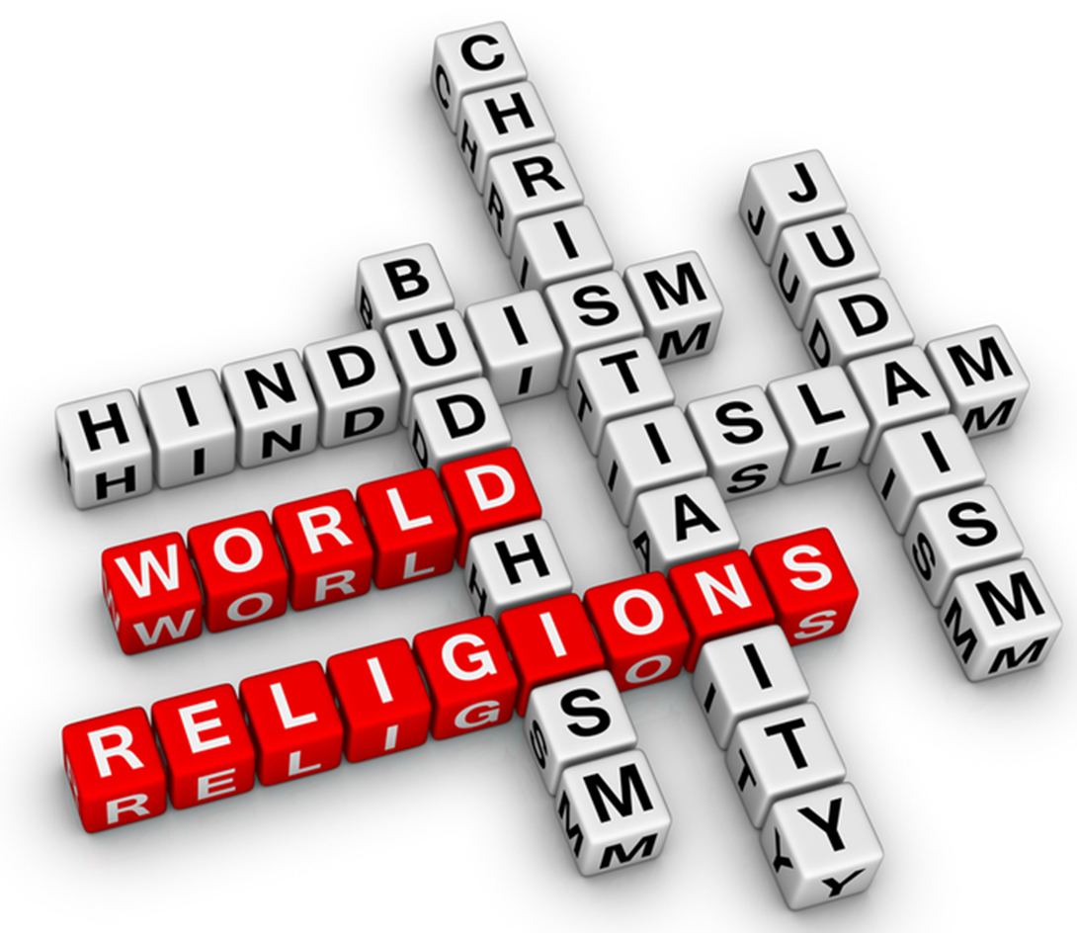
What do you know about the big religions?
WorldReligions.com

Slide 4
Who is God
Sacred book
Universe, God and People
Death, judgement and heaven
Life, how should I live, plus festivals
Important people and dates
Some helpful things to know about a religion …
Pew Research Centre, 2023

Slide 5
Who is God
Sacred book
Universe, God and People
Death, judgement and heaven
Life, how should I live, plus festivals
Important people and dates
Some helpful things to know about a religion …
Pew Research Centre, 2023

Slide 6
Fill in the table for each religion
Things that you know, or think you know
And questions you have
So what do we know about these religions?

Slide 7
Christian 31.1%
Islam (Muslim) 23.9%
Secular (non-religious, atheist)
Hinduism 15.1 %
Buddhist 5.9%
Judaism (Jews) 1.9%
Christianity 31.1%
Islam 24.9%
secular (atheist, non-religious,) 15.2%
Hinduism 14.9%
Buddhism 5.6%
Judaism (Jews) 0.2%
What are the main religions?
Pew Research Centre, 2023

Slide 8
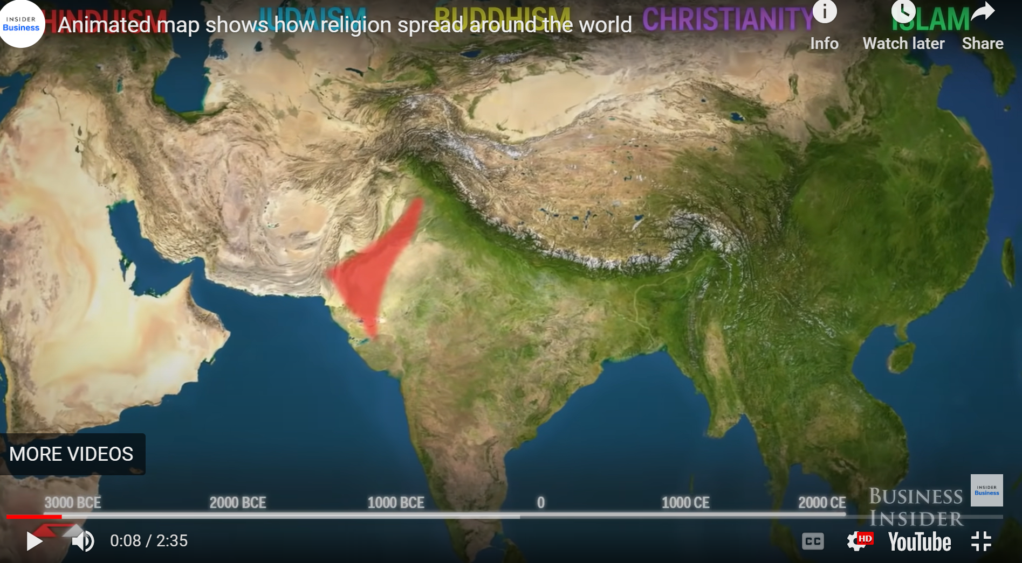
Animated map shows how religion spread around the world - World History Encyclopedia

Slide 9
What do I know? Christianity
Jesus died on the cross, rose again for ME.
Easter death and res
Christmas birth
Bible, OT and NT
Creation 7 days, Adam and Eve
Sunday rest/church
Jesus had 12 disciples
Prayer, Amen (I agree)
How did Mary get pregnant?
Mary’s cousin Elizabeth gave birth to John when she was quite old
Cross
Why would God punish Jesus for something he didn’t do?

Slide 10
What do I know? Judaism
OT not NT
Judea, Israel
Passover festivals
Still waiting for Messiah
Jesus was/is Jewish
First Monotheistic religion
Jesus did stuff by witchcraft
Jesus disagreed with Jewish religion practices
Modern state Israel about 80 years old
Moses, Abraham, David
Sabbath
Messiah (still waiting)
Bread and Wine
0.2% of world pop
Jewish God
Rabbi (teacher)
Pray to God
Rituals Festivals, Passover, Hanukah
Wear a hat

Slide 11
What do I know? Islam
Box in Mecca
Birka
Allah god
Middle east (mecca)
Mohammad, the prophet to who Allah revealed his words to, 600’s AD
Koran, Quran, written by Mohammad
Head Scarves, Birka
Koran, Quran
Ramadan (fasting)
ISIS extremist
Believe jesus is not real
Muslim (to submit to Islam)
Men and women different roles (equal?)
See adultery etc
Many wives

Slide 12
What do I know? Buddhism
No god (some worship Buddha)
Reincarnation, die come back as other life form, depending on how good you are (karma?)
Nepal (origins)
Buddha, Deli Llama
Follow Buddha
No meat
Monks
More committed
Karma
Buddha statues, rub his belly, head (good luck?)

Slide 13
What do I know? Hinduism
Set offering (lots)
Day of silence
Nepal, statues (lots)
Dust, paint powder
Holli the colour festival
Lots of Gods many with animal features eg elephant god Ganesh
India
Fire rituals
Offering to the gods (see Bali)
Nann bread and good food, lots is veggie
Many gods (lots) including a water God
Diwali

