Slide 1
World Religions: Judaism

Slide 2
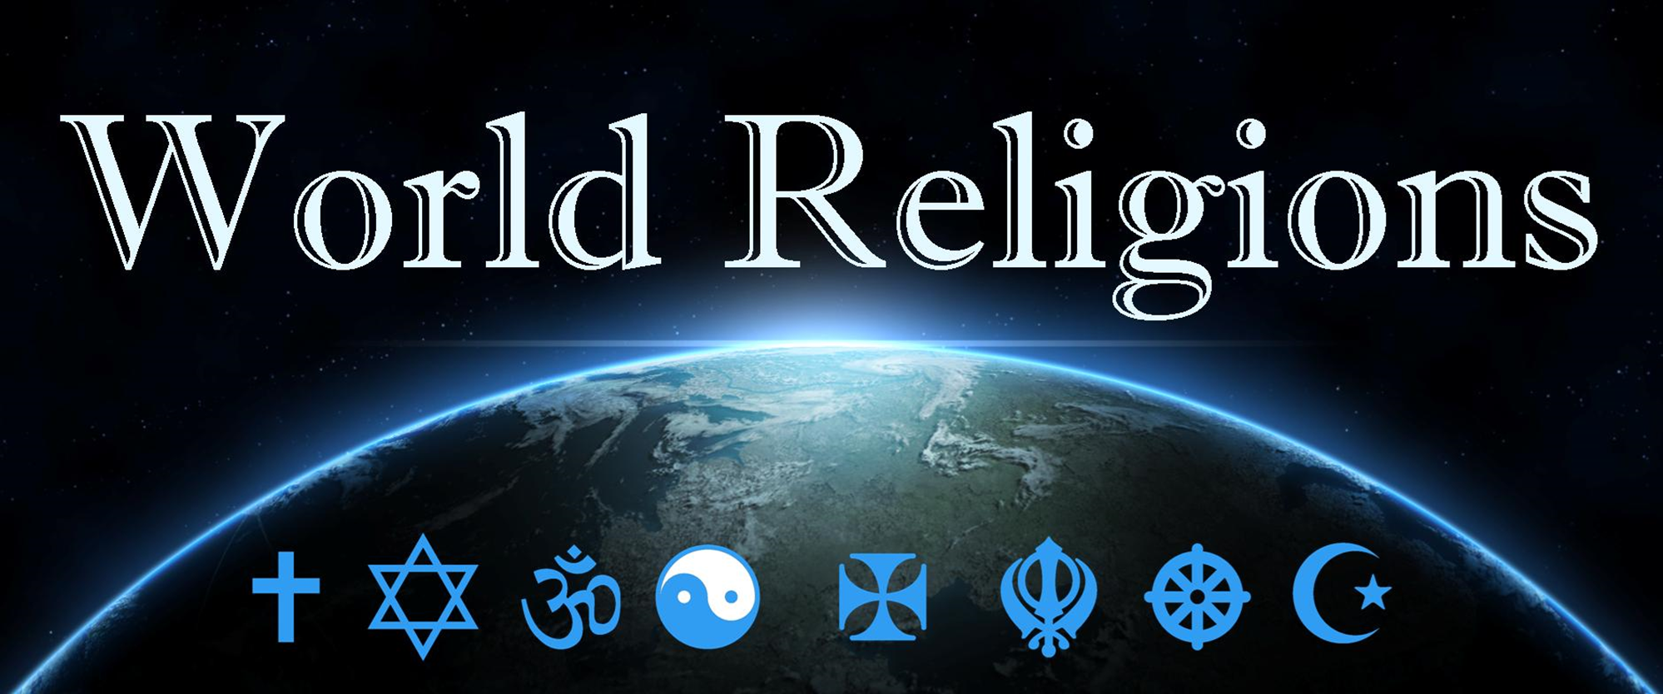
Judaism, way of the Book

Slide 3
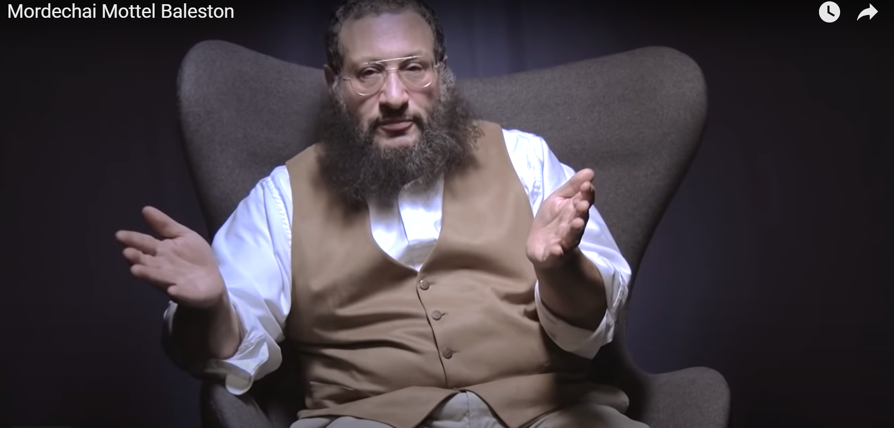
Judaism
Judaism: Believes in one God (like Christianity & Islam) but also rejects the claim that Jesus is God or anything more than a prophet (like Moses or Elijah). Judaism therefore, is still waiting for and expecting the coming of the promised messiah.
Mordechai Mottel Baleston, Judaism and Christianity - 5mins
https://www.youtube.com/watch?v=67fhPR6YtRY
Messengers Messianic Jewish New Jersey NJ (messiahnj.org)
Notes:
I met messiah.com
Mordechai Mottel Baleston, Judaism and Christianity - 5mins

Slide 4
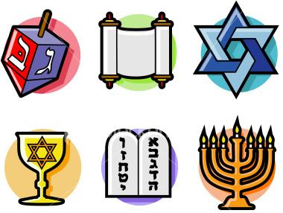
What do you know about Judaism?
Do you know what these different Jewish symbols mean?
By the end of this lesson you will be able to identify at least 2 of these Jewish symbols.
https://www.ancient-symbols.com/jewish_symbols.html

Slide 5
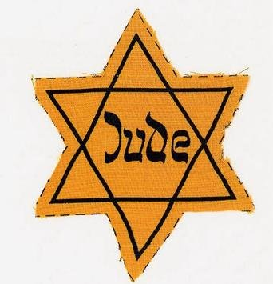
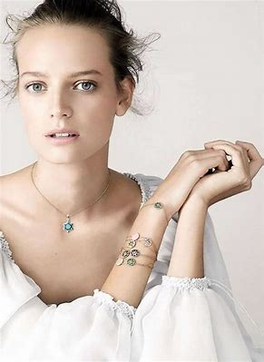
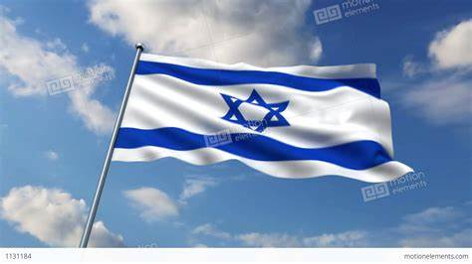
Do you know what this symbol is called?
Some Jews wear the star as jewellery.
It is also part of the flag of Israel
https://www.thetimes.co.uk
It is called the Star of David

Slide 6
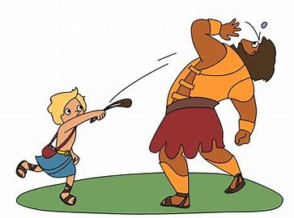
The Star of David
It is made up of 2 interlocking triangles.
It is named after the Jewish king David, who defeated the giant Goliath.
He went on to be the King of Israel and was one of Jesus’ ancestors.

Slide 7
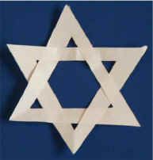
Make a Star of David
You need a piece of A5 white paper. (Half a sheet of A4)
Scissors

Slide 8
The Star of David

Slide 9
The Star of David

Slide 10
The Star of David

Slide 11
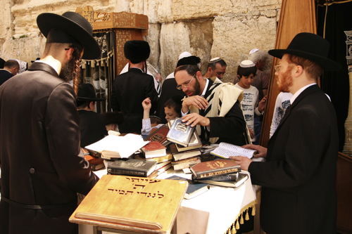
Judaism
Watch Video:
BBC My Life, My Religion: Judaism (29 mins)
Record some notes in the space of your books, like what is Judaism…
Hasidic Jews in Israel on School - The New York Times
Notes:
In accompanying ASC RE Unit Resources folder…
https://www.youtube.com/watch?v=lb-oCtDEh_w
BBC My Life, My Religion: Judaism 29 mins

