Slide 1
World Religions: Judaism

Slide 2
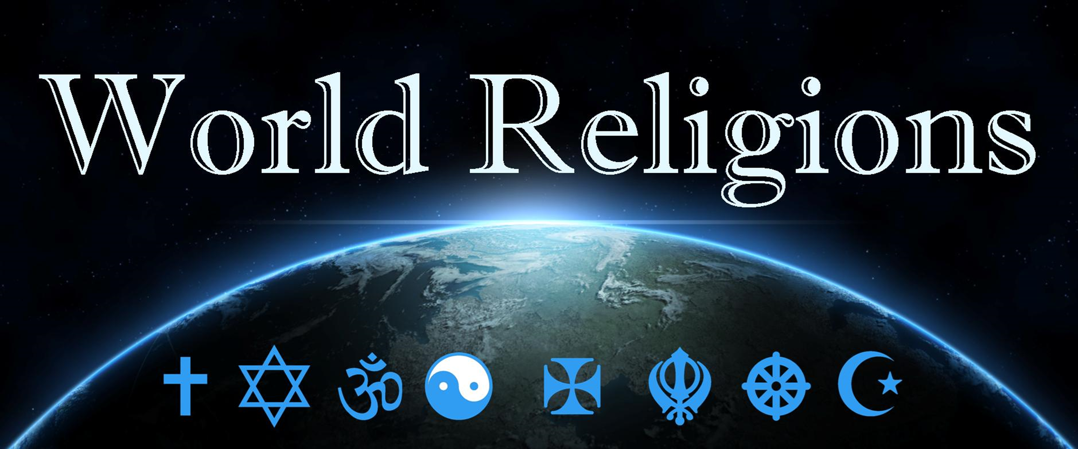
Judaism, way of the Book

Slide 3
Who is God?
Sacred text, how can I know God?
Universe, God and People?
Death, judgement and heaven?
Life, how should I live, and festivals?
Important people and dates
What are the main ideas we ought to know about a religion ?
Pew Research Centre, 2023

Slide 4
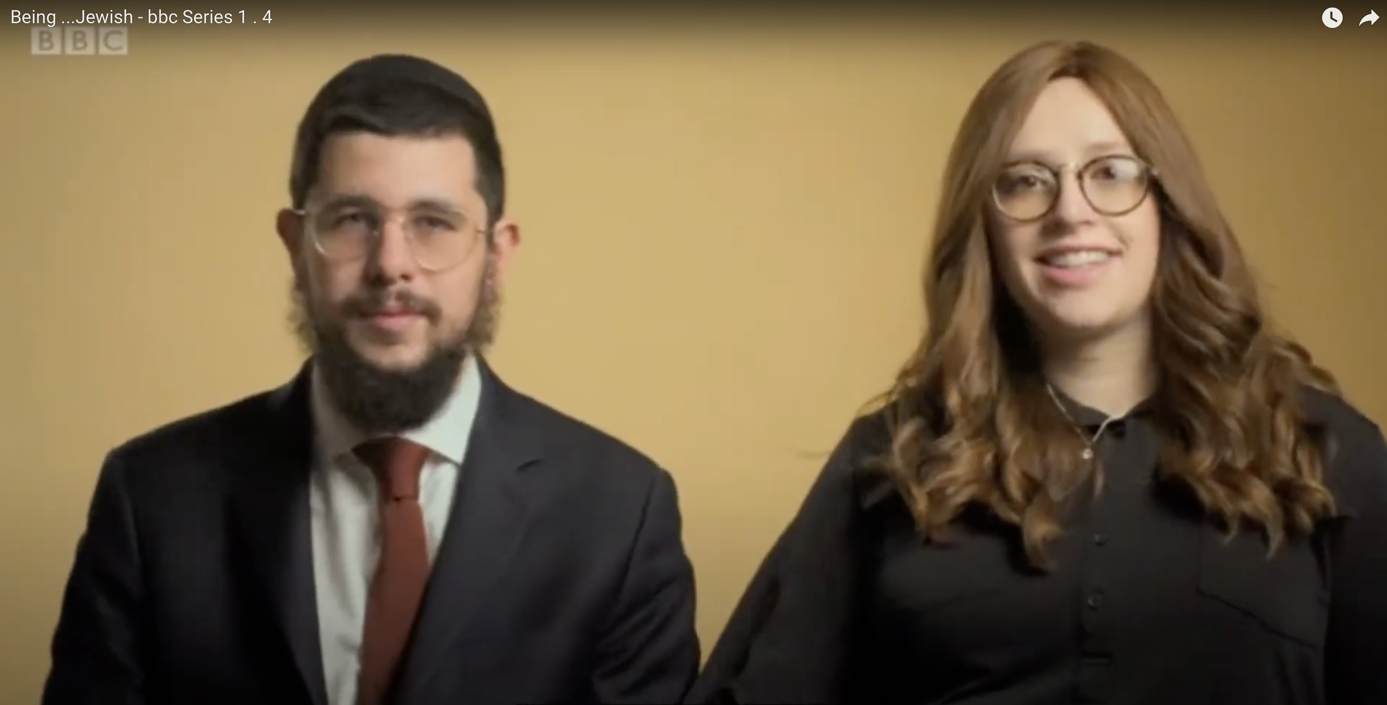
MY LIFE, MY RELIGION: JUDAISM
my life my religion Judaism - Search (bing.com)

Slide 5
Judaism – Who is God?
Yahweh
Monotheistic. “Hear O Israel, the Lord is our God, the Lord is One.”
God is one, incomparable, eternal, creator, relational, faithful, just, judge, saviour…
We know only God's revealed aspect that brought the universe into existence, and interacts with mankind and the world.
God is the God of Abraham, Isaac, and Jacob, as described in the Torah.
They believe that God’s name is too important to be written or spoken so they write G-d.

Slide 6
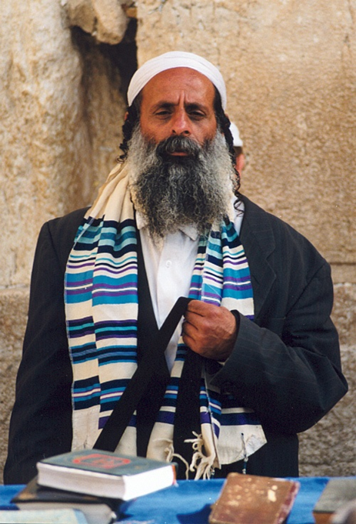
What do Jews believe about God?
There is only one G-d (monotheists)
G-d is eternal, beyond time and space
G-d does not have a physical body, and is everywhere at all times (omnipresent)
G-d is all-powerful (omnipotent) and all-knowing (omniscient)
G-d is the creator of the world and everything in it
G-d has a purpose for the world
G-d is completely good (benevolent) and completely loving
G-d is interested in how people behave, and wants them to treat each other properly.
G-d judges each individual
https://kids.britannica.com/kids/article/Judaism

Slide 7
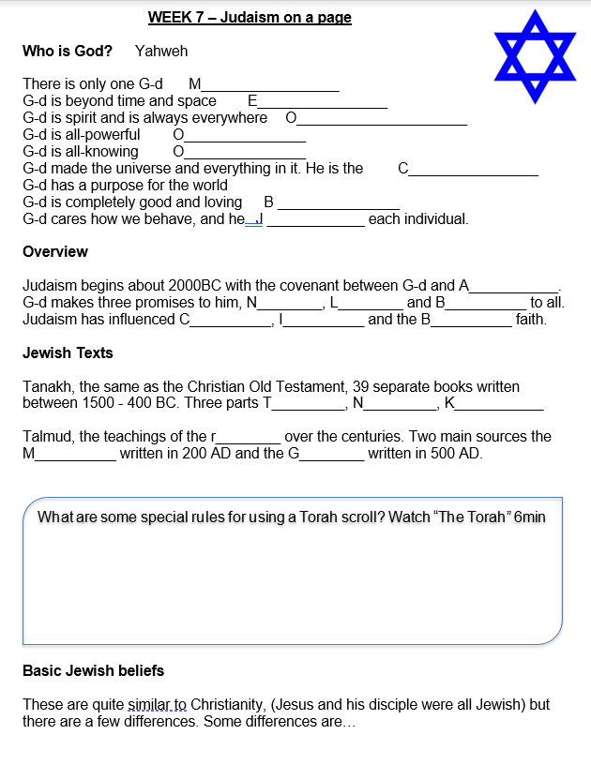
Judaism: an overview
Read the booklet
and complete the questions

Slide 8
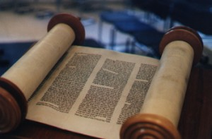
Judaism: Sacred Texts
Tanakh, 39 Books OT
Tanakh contains Torah (Law written by Moses), Neviim (Prophets), Ketuvim (Writings)
1500BC till 400BC
30 authors, Inspire word of God
Historical, Poetry, Wisdom etc.
Talmud, containing the Mishnah (the oral Torah, passed down by word of mouth, written down 200AD) and other teachings of the Rabbis, Gemara (200 – 500AD) guide to the civil and religious laws of Judaism.
Notes:
Ancient Translations – Fragments or earlier Greek and Hebrew, Septuagint 3rd Century BC (Greek LXX), Qumran (Dead sea scrolls) 150 BC to 70 AD, Masoretic Text 7th to 10th Century AD (Hebrew Aramaic)

Slide 9
Judaism: Sacred Texts

Slide 10
Judaism: Universe
Humanity is fundamentally good.
God loves us despite our unfaithfulness and will led us to salvation through our increase effort to follow his law.
God acts today for our good and the Messiah will come as God’s chosen king.

Slide 11
Judaism: Death
God judges based on what you have done, how you have followed God’s Law.
Heaven is being with God and his people, in God’s place under God’s rule.
Hell is being separated from God and his people.
How do we get there? Know and follow God’s law, work harder at it, pray for help. You save yourself with God’s help.

Slide 12
Judaism: Life
Observation of weekly Sabbath, strict discipline, regular attendance at Synagogue (by males)
Kosher laws
Festivals – Passover, Rosh Hashanah, Bar Mitzvah, Yom Kippur, Sukkoth, Hanukkah, Purim and Shavuot
https://www.youtube.com/watch?v=qUCNAnp2QAI
Notes:
Adam Sandler sings ‘The Chanukah song’ (4mins)

Slide 13
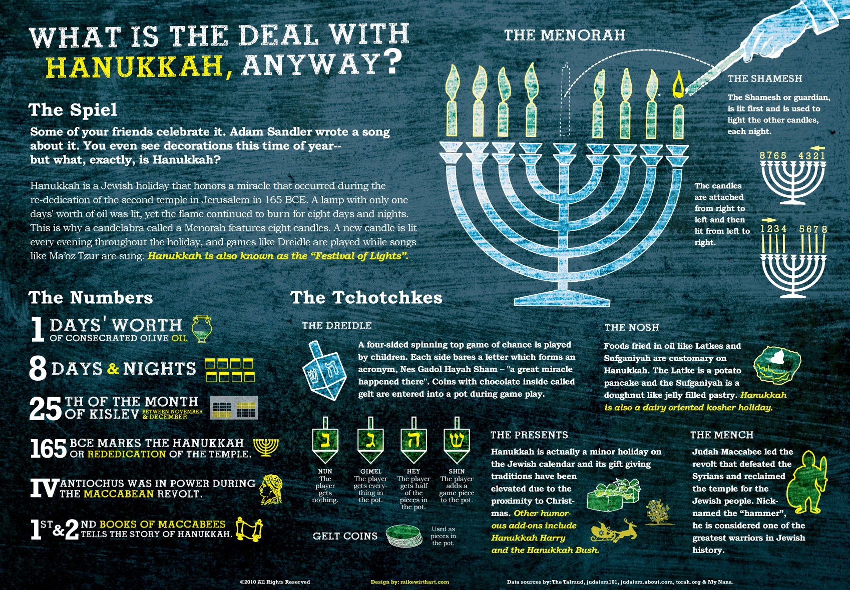
Judaism: Life

Slide 14
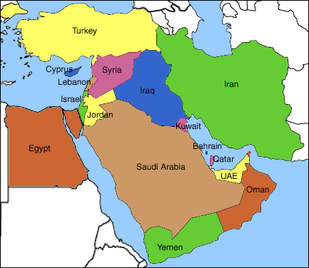
Judaism: History
Judaism is one of the world’s oldest religions.
It started 2000 years before Christianity.
There are around 13.2 million Jews living in the world today – nearly half of these live in a country called Israel.

Slide 15
Judaism: Key People
Abraham around 2000 BC. The LORD had told Abram to leave his country and kindred and go to a land that he would show him, and promised to make of him a great nation, bless him, make his name great, bless them that bless him, and curse "him" that curses him.
https://en.wikipedia.org/wiki/Abraham
Moses 1391–1271 BC Moses lead the Israelites out of slavery in Egypt and gave them God’s law. https://en.wikipedia.org/wiki/Moses
King David 1040 – 970 BC the second king of the United Kingdom of Israel, an ancestor of Jesus
https://en.wikipedia.org/wiki/David
Notes:
Abraham, birth name Abram, is the first of the three biblical patriarchs. His story, told in chapters 11 through 25 of the Book of Genesis, plays a prominent role as an example of faith in Judaism, Christianity, and Islam. The Bible's internal chronology places Abraham around 2000 BCE. The LORD had told Abram to leave his country and kindred and go to a land that he would show him, and promised to make of him a great nation, bless him, make his name great, bless them that bless him, and curse "him" that curses him.

Slide 16
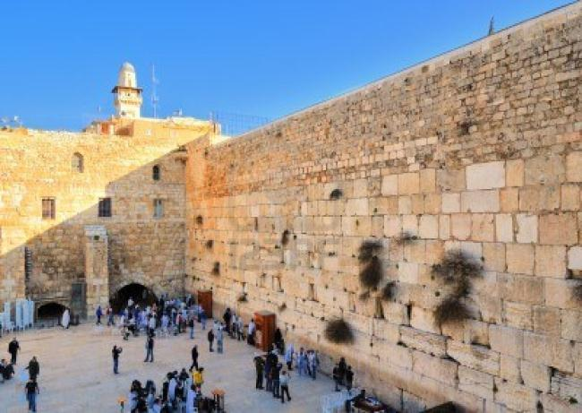
http://www.biblewalks.com/WesternWall
Wailing wall in Jerusalem.
Jews only have one Temple in Jerusalem. This is the remains of one wall the Jewish temple, which was torn down by the Romans in 70 AD.

Slide 17
HOLY CRIBS: THE SYNAGOGUE
Bing Videos Holy Cribs: Synagogue

Slide 18
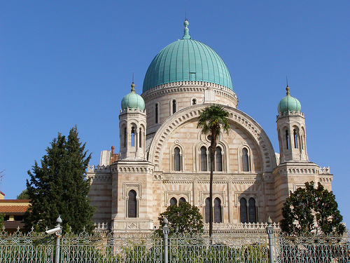
http://www.biblewalks.com
Great Synagogue of Florence
Synagogues are consecrated spaces that can be used only for the purpose of prayer; however a synagogue is not necessary for worship.

