Slide 1
World Religions: Islam

Slide 2
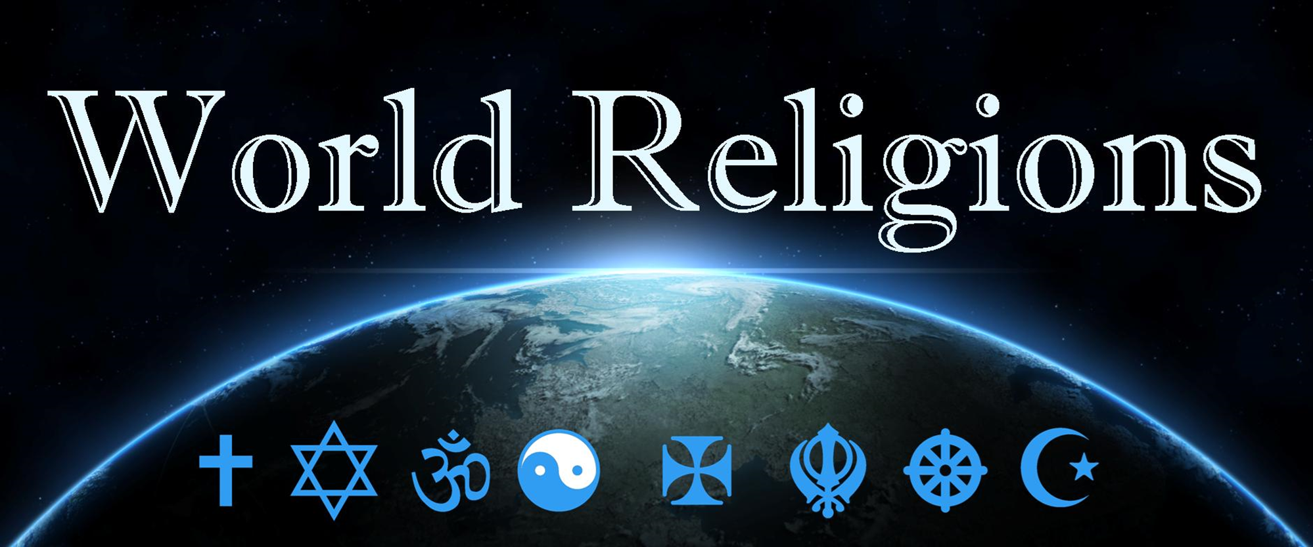
Islam, the way of submission to Allah

Slide 3
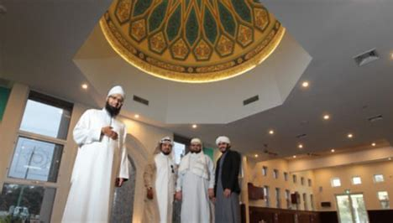
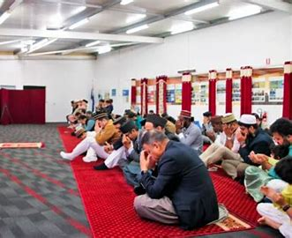
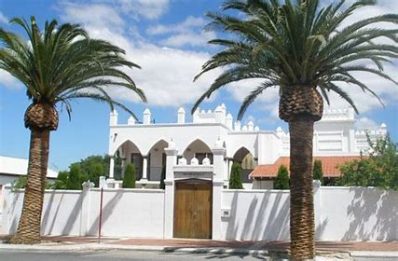
Islam, the way of submission to Allah
Islam: Mosque
http://www.abc.net.au/local/photos
Notes:
Mosques in Perth WA

Slide 4
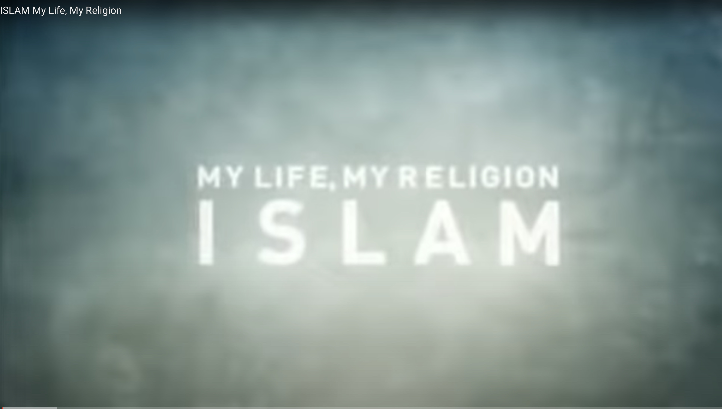
RSLSWR12 My Life, My Religion - Islam (28mins).mp4 (sharepoint.com)
Notes:
Mosques in Perth WA

Slide 5
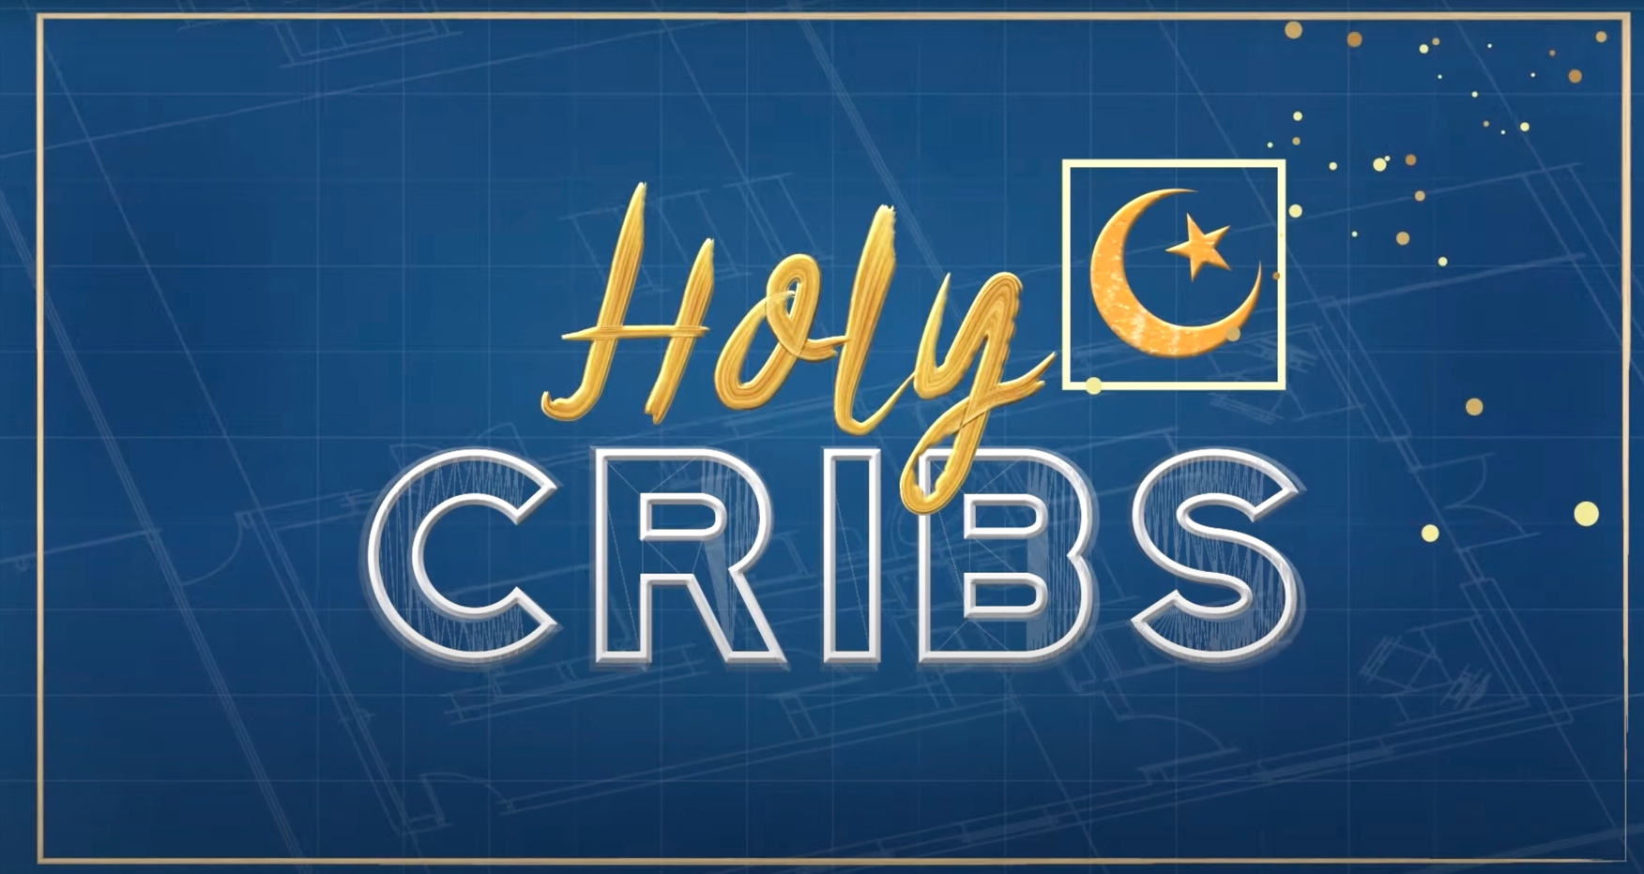
HOLY CRIBS: MOSQUE
ttps://www.bing.com/videos/riverview/relatedvideo?&q=holy+cribs+mosqueyoutube&&mid
Notes:
Mosques in Perth WA

Slide 6
HOW ISLAM BEGAN ...
ttps://www.bing.com/videos/riverview/relatedvideo?&q=how+islam+began+in+10+minutes&qpvt=how+islam+began+in+10+minutes&mid
Notes:
Mosques in Perth WA

Slide 7
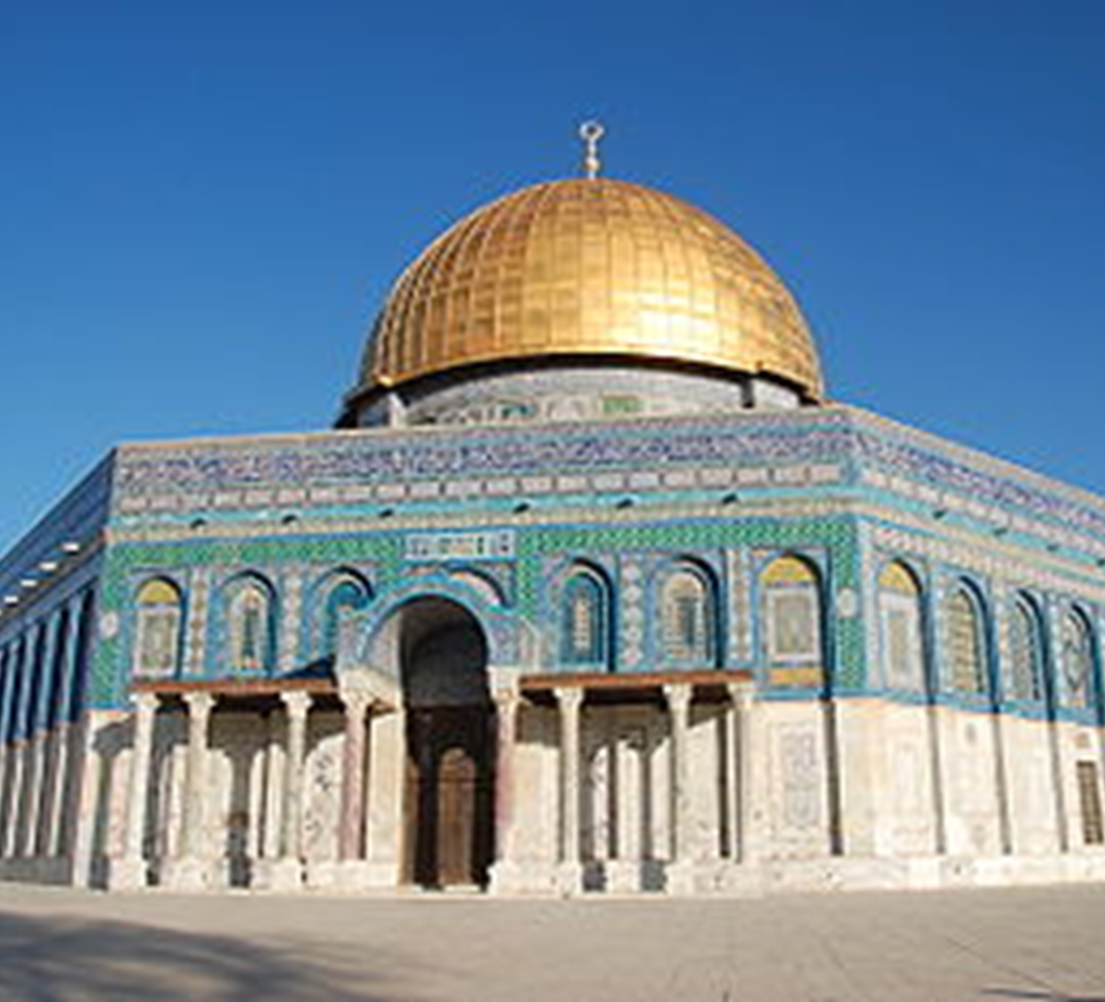
The Dome of the Rock
Completed in 691-692 BC, the oldest existing Islamic building in the world.
The Foundation Stone, is in the centre.
According to Islamic tradition, this rock is the spot from where Muhammad ascended to Heaven .
http://www.mizanproject.org/the-dome-of-the-rock-
Notes:
https://en.wikipedia.org/wiki/Dome_of_the_Rock

Slide 8
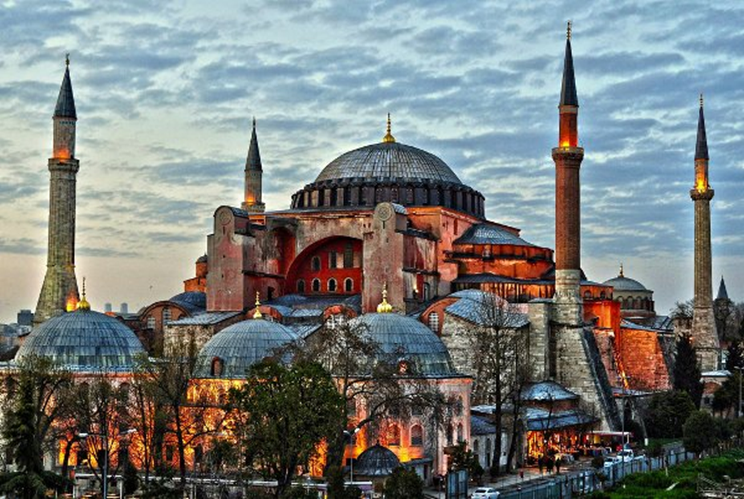
https://www.islamicity.org/hagia-sofia-church-mosque/
Hagia Sophia
From 537 until 1453, it served as a Greek Orthodox cathedral. The building was a mosque from 1453 until 1931. Now a museum.

Slide 9
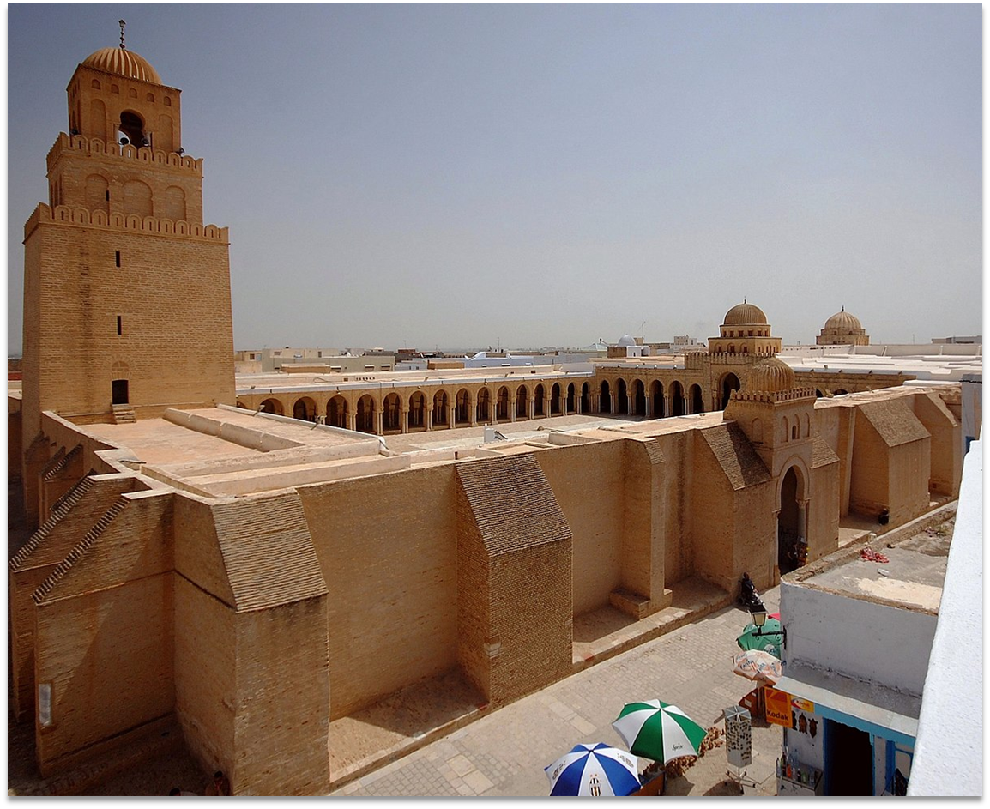
The Mosque of Uqba (Great Mosque of Kairouan)
Founded by the Umayyad general Uqba Ibn Nafi in 670, is the oldest and most prestigious mosque in the Muslim West; its present form dates from the 9th century, Kairouan, Tunisia.
https://thearchaeology.blogspot.com/2015/05/mosque-of-uqba
Notes:
True Tube, cannot get it on YouTube cannot add link from True Tube
Holy Cribs: the Mosque, 7 minutes

Slide 10
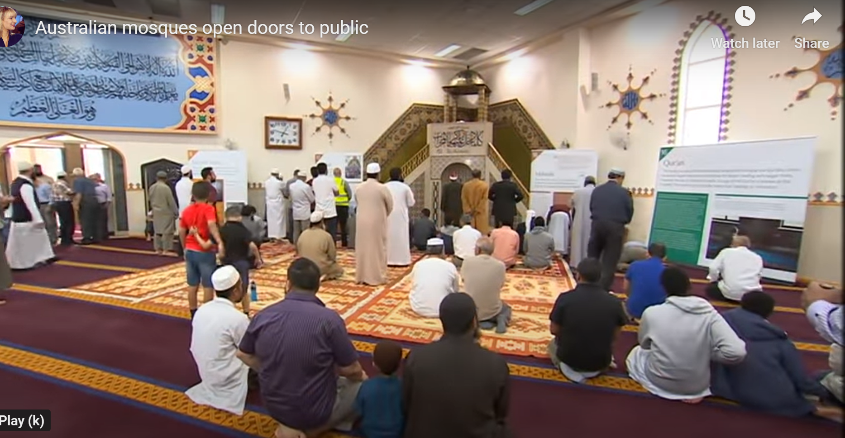
OPEN DOORS IN AUSTRALIAN MOSQUES
Notes:
(1) Video | Facebook 2022 - (2mins)
Australian mosques open doors to public - Bing video 2020 - (7mins)

Slide 11
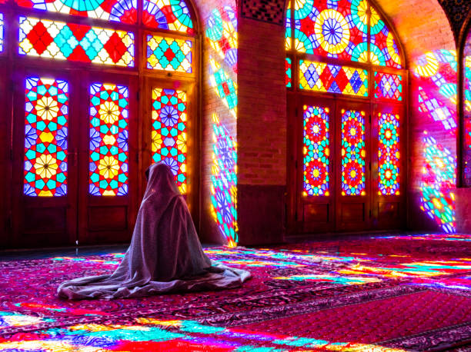
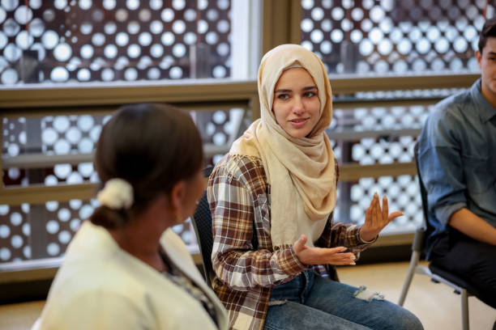
Islamophobia, Jihad, Mosque, Halal
https://www.sbs.com.au/language/arabic/en/article/australia
Notes:
Class intro discussion: what do you know about Islam?

Slide 12
Notes:
MUSLIM HATE IN AUSTRALIA | SOCIAL EXPERIMENT, Staged with actors for see the response of others
MUSLIM HATE IN AUSTRALIA | SOCIAL EXPERIMENT – YouTube

Slide 13
Jihad
The literal meaning of Jihad is struggle or effort, and it means much more than holy war. Muslims use the word Jihad to describe three different kinds of struggle:
A believer's internal struggle to live out the Muslim faith as well as possible
The struggle to build a good Muslim society
Holy war: the struggle to defend Islam, with force if necessary
Many modern writers claim that the main meaning of Jihad is the internal spiritual struggle, and this is accepted by many Muslims. However, there are many references to Jihad as a military struggle in Islamic writings.
Notes:
www.bbc.co.uk/religion/religions/islam/beliefs/jihad_1.shtml#:~:text=Jihad-,The%20literal%20meaning%20of%20Jihad%20is%20struggle%20or%20effort%2C%20and,build%20a%20good%20Muslim%20society

Slide 14
This film left our team in tears! Raised in Sudan, in was Jihad, 5 minutesraised to hate Christians and especially the Jews. But God transformed his life from hate to love. You won't believe the ending! Please share this powerful story of Redemption and share in the comments how this moved your heart with God's love!
This film left our team in tears! Raised in Sudan, in the most radical sects of Islam, he was raised to hate Christians and especially the Jews. But God transformed his life from hate to love. You won't believe the ending! Please share this powerful story of Redemption and share in the comments how this moved your heart with God's love!
Notes:
https://www.youtube.com/watch?v=mtjMANw2hCA

Slide 15
YouTube: Deep Believer
Notes:
This is a very personal testimony and a confronting video but, by the end, you will see it is actually a story of miraculous grace.
It’s important that you view the whole clip before presenting it to any class.
Then you will know how to present it in your particular context.

Slide 16
Halal: Research and make notes
Type in Halal in Google, read and make notes.
https://www.icv.org.au/about/about-islam-overview/what-is-halal-a-guide-for-non-muslims/
What is Halal? What Halal Means - American Halal (halalfoundation.org)
Notes:
ttps://halalfoundation.org/what-is-halal-food-discover-the-meaning-tradition-of-halal-food/
American Halal Foundation
Explainer: what is halal, and how does certification work? - Food & Beverage Industry News (foodmag.com.au)

Slide 17
Dialogue between Christianity and Islam
https://www.publicchristianity.org/
Notes:
Jesus a prophet of Islam? Diaa Mohamed - Centre for Public Christianity

Slide 18
TOUR OF A MOSQUE
MosquesInSouthwark
Notes:
Tour of a Bolton Mosque – YouTube

