Slide 1
World Religions: Hinduism

Slide 2
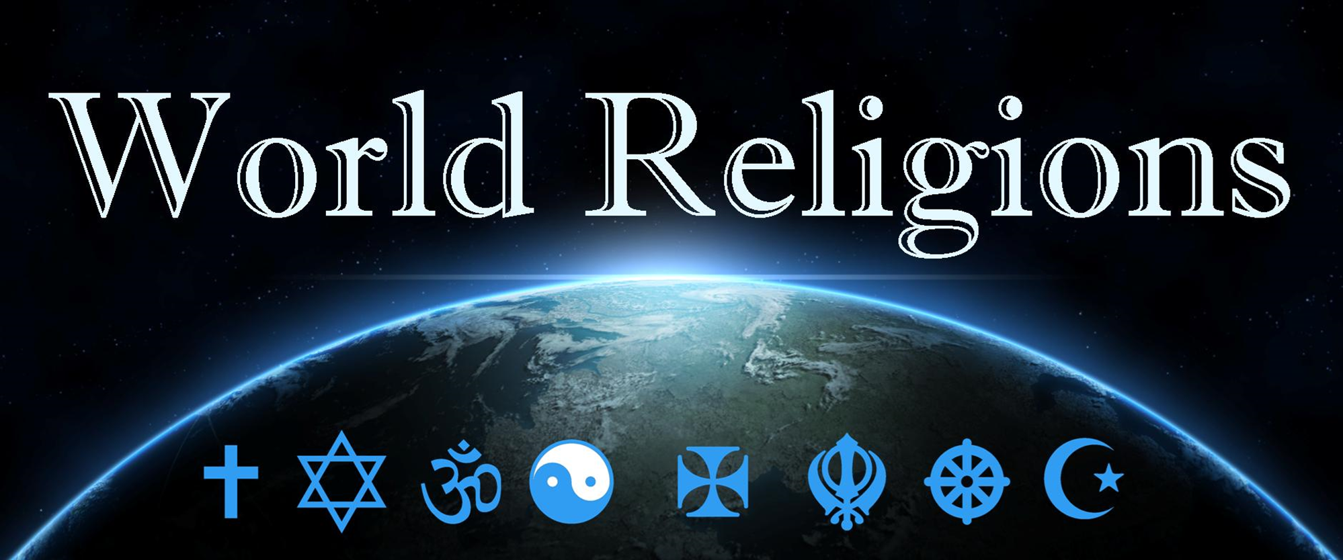
Hinduism

Slide 3
What are the Main ideas we ought to know about a Religion?
Who is God?
Sacred Text, how can I know God?
Universe, God and people?
Death, judgement and heaven?
Life, how should I live and festivals?
Important people and dates?
Notes:
Class intro discussion: what do you know about Buddhism?

Slide 4
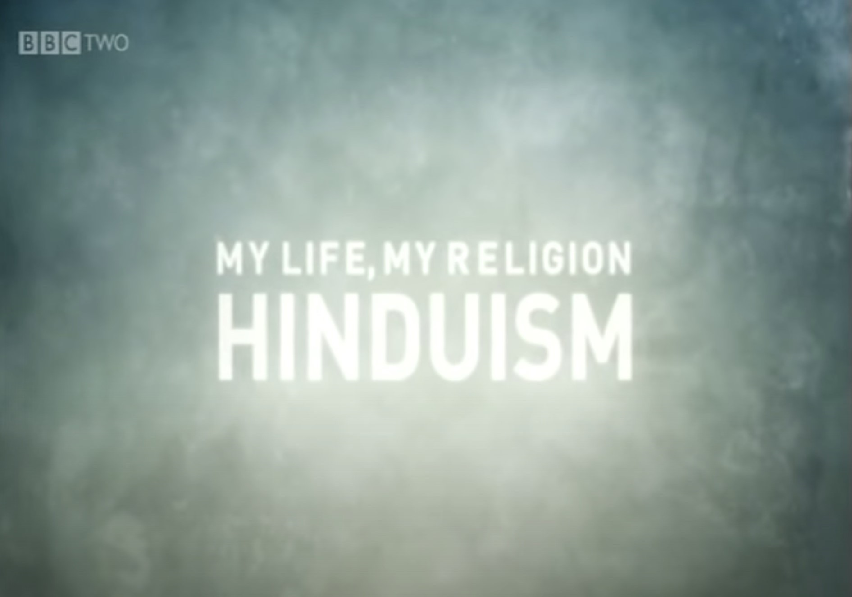
MY LIFE, MY RELIGION: HINDUISM?
my life my religion hinduism - Search (bing.com)
Notes:
Class intro discussion: what do you know about Buddhism?

Slide 5
Hinduism
Believes in tiers (or levels) of multiple gods (hundreds) with one supreme "being" called Brahman. All things are part of Brahman, but the world as we know it has been separated from him and is therefore evil.
Enlightenment is reached through lifelong dedication to one of the many gods.
The 2 most popular gods are Vishnu and Krishna. If enlightenment is not reached in your lifetime, you will continue to be returned to the physical world after death by reincarnation.
If you lived a good life devoted to your god then you are reincarnated to a better position. If you lived a bad life you will be reincarnated to a worse position.o a worse position.

Slide 6
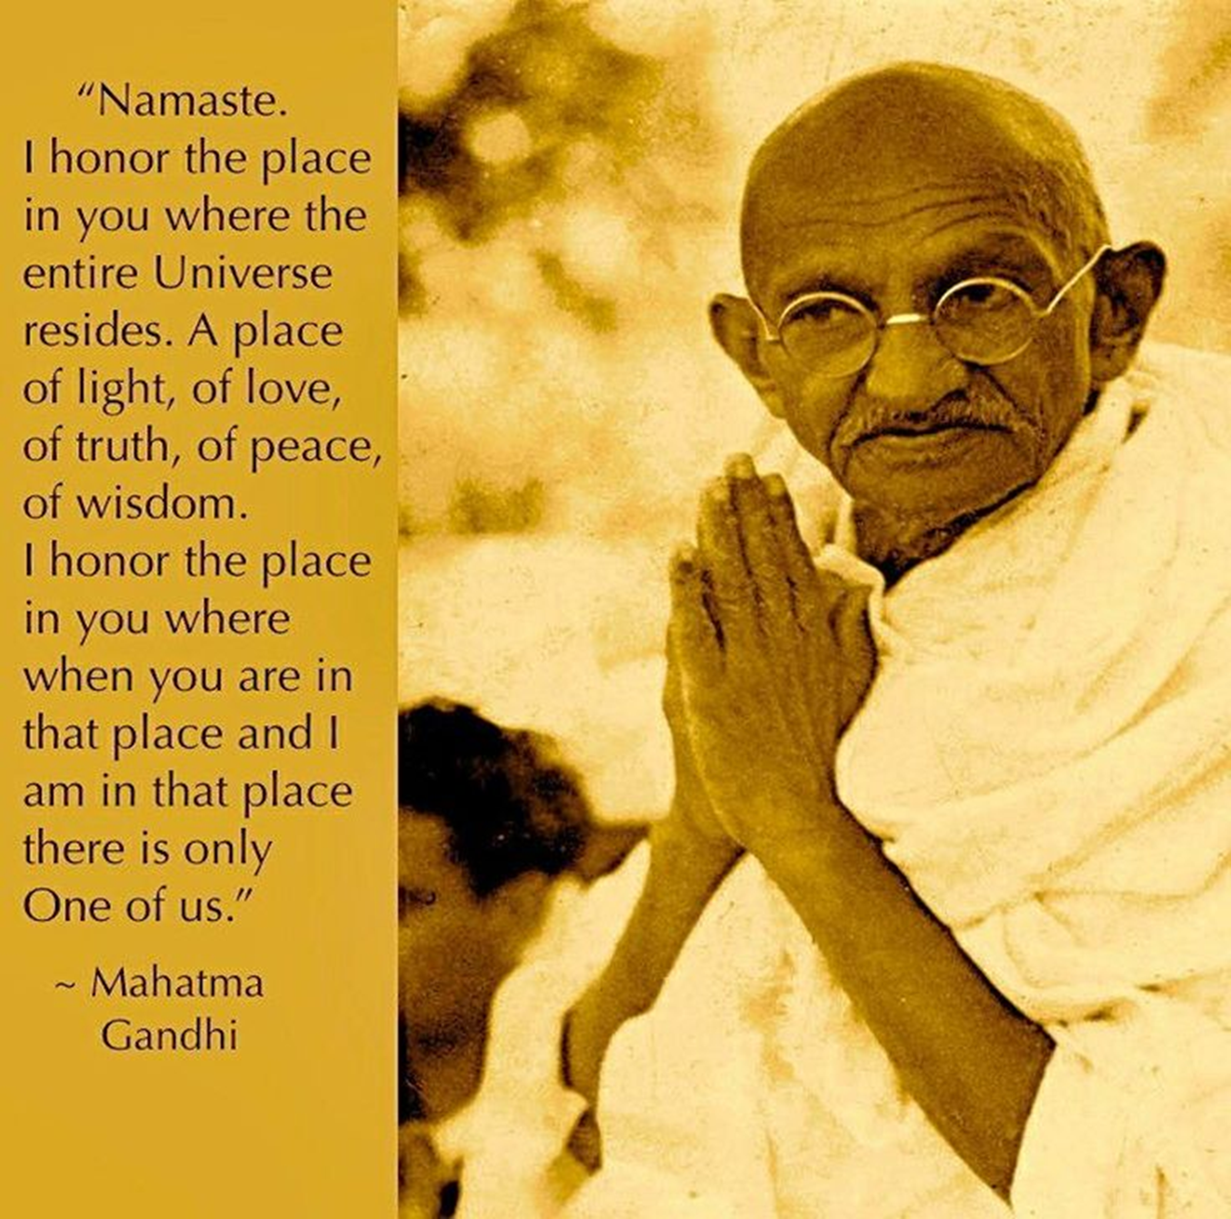
Hinduism
Namaste
“The divine in me honours the divine in you.”
https://www.pinterest.com.au/

Slide 7
Hinduism- some key terms
Brahman – Supreme being, only reality
Atman – Our true self, one with Brahman
Karma – Consequence of actions
Reincarnation – Atman is reborn
Maya – Reality is an illusion
Samsara – The eternal cycle of birth, suffering, death, and rebirth
Moksha – Atman released from samsara and reunites with Brahman

Slide 8
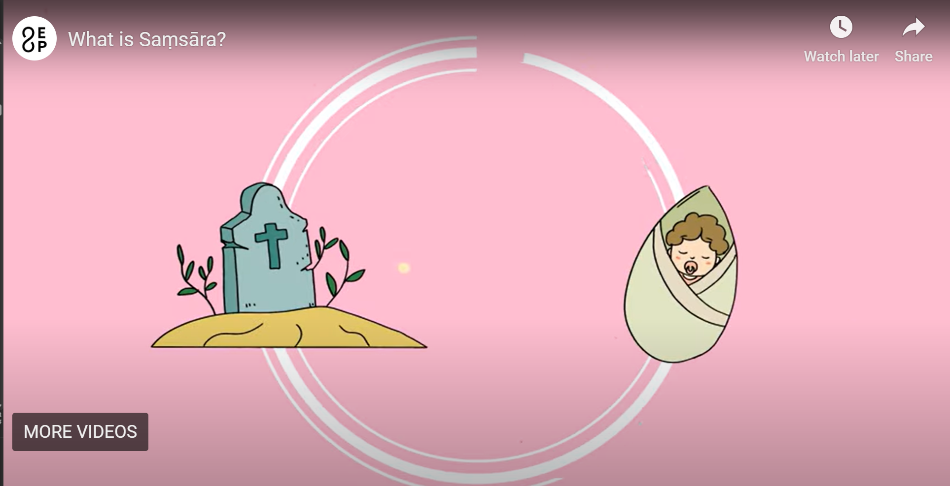
Samsara and Moksha
These two concepts - moksha and samsara - refer to the ultimate goal in Hinduism which is, quite simply, escape from the cycle of life, death and rebirth and to re-merge with Brahman, or ultimate reality.
What is Saṃsāra?
Notes:
https://www.youtube.com/watch?v=GncQtURdcE4 – Groundhog Day trailer

Slide 9
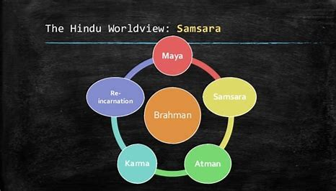
http://3.bp.blogspot.com/wheel_of_samsara_diagram.jpg

Slide 10
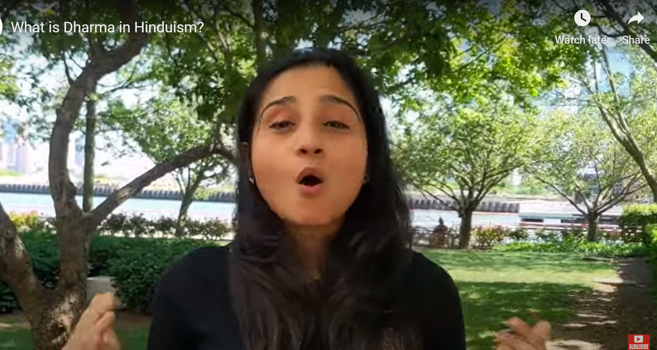
life
Hinduism - The importance of Darma
What is Dharma in Hinduism?

Slide 11
HinduismChristians
“Atman is Brahman” - all living things are ultimately divine.
http://www.world-religions-professor.com/atman-brahman.html
https://en.wikipedia.org/wiki/%C4%80tman_(Hinduism)
Is the soul and atman the same idea?

Slide 12
"Holy Cribs" HinduismChristians
RSLSWR16 True Cribs Mandir (10mins).mov (sharepoint.com)

Slide 13
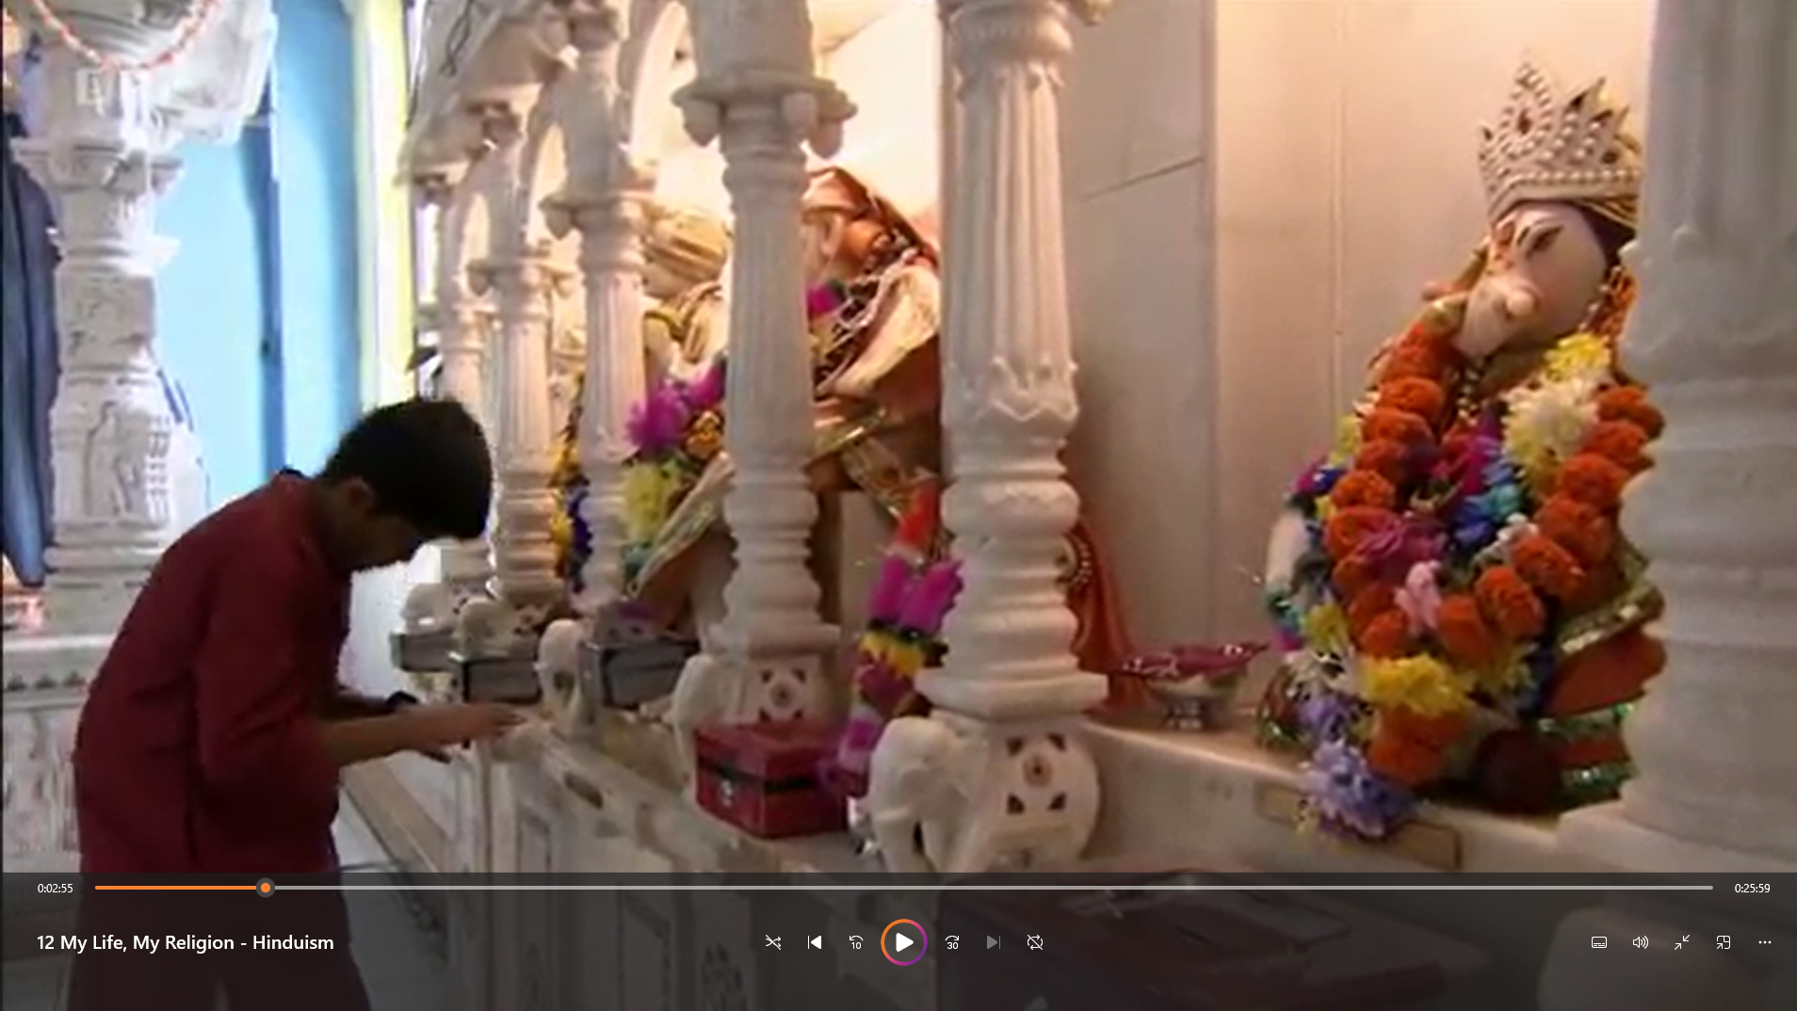
BBC My Life, My Religion: Hinduism (29 mins)
Record some notes in the space of your books, like what is Hinduism…
Notes:
See Mp4 file in Hindu Resources file

