Slide 1
World Religions: Hinduism

Slide 2
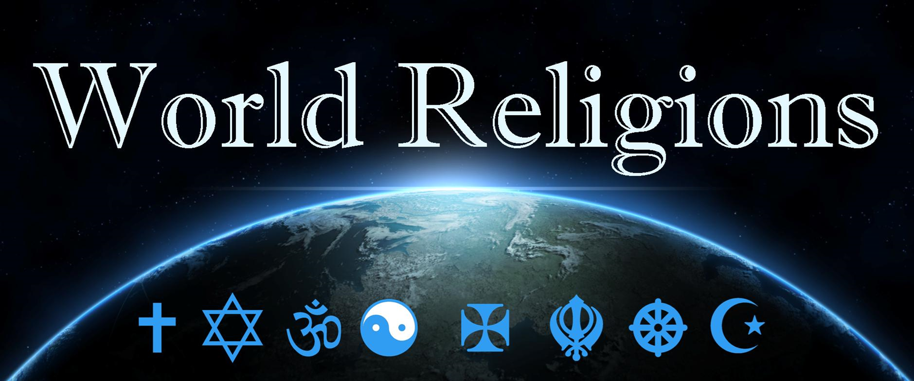
Hinduism

Slide 3
Hinduism – Who is God?Christians
Brahman - the impersonal supreme being, the primal source and ultimate goal of all beings, with which Atman (your soul), when enlightened, knows itself to be identical.
Brahman can be neither known nor worshipped.
He is, according to Hindu teachings, “an impersonal, omnipresent being who cannot be called a knowing being….He cannot be called a thinking being, because that is a process of the weak only. He cannot be called a reasoning being, because reasoning is a sign of weakness. He cannot be called a creating being, because none creates except in bondage”
Notes:
Brahman - the impersonal supreme being, the primal source and ultimate goal of all beings, with which Atman (your soul), when enlightened, knows itself to be identical.

Slide 4
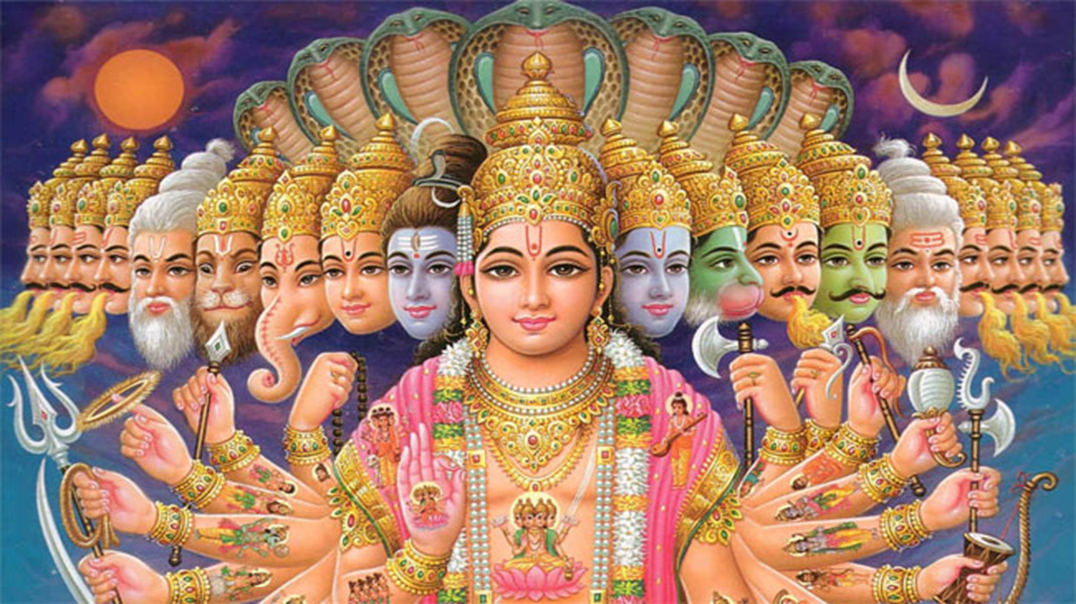
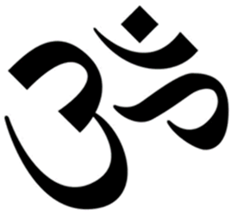
Hinduism – Who is God?Christians
Millions of Gods.
Brahma, Vishnu, Shiva: three main aspects of Brahman.
These three aspects symbolize the entire circle of samsara in Hinduism: Brahma as creator, Vishnu as preserver or protector, and Shiva as destroyer or judge.
https://www.indiatimes.com
Notes:
Brahman - the impersonal supreme being, the primal source and ultimate goal of all beings, with which Atman (your soul), when enlightened, knows itself to be identical.

Slide 5
HinduismChristians
https://www.youtube.com/watch?v=g5E8dVk4XGM
How Lord Ganesha got his Elephant Head? | Mocomi Kids 3 mins
Notes:
https://www.youtube.com/watch?v=g5E8dVk4XGM
How Lord Ganesha got his Elephant Head? | Mocomi Kids 3 mins

Slide 6
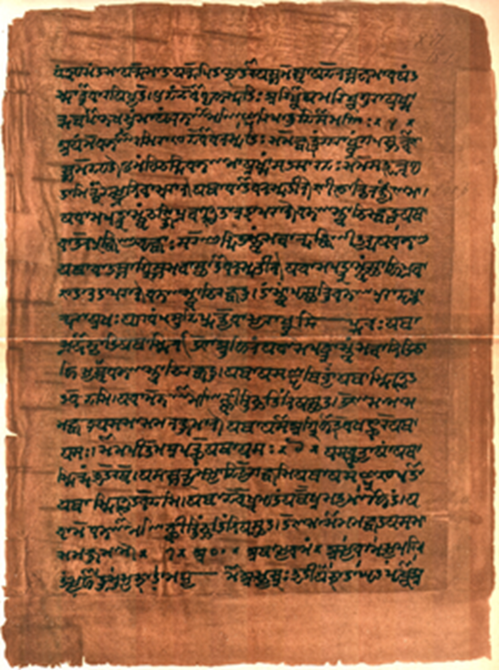
Hinduism – Sacred text, Historical Claim or valued MythChristians
Ramayana and Mahabharta are the most popular Hindu books.
The main story of Ramayana is the story of Lord Rama. Rama was born in a royal family and was suppose to be the king, but because of his step- mother, he was forced to exile from his kingdom for fourteen years. During this period his consort Sita was kidnapped by a demon called Ravan, who was king of Lanka. Rama with the help of his brother, Lakshman, and an army of monkeys under the leadership of Hanuman, rescued Sita. Many Indians believe that the present day Sri Lanka was then the kingdom of Lanka.
Mahabharta is a family epic. In this epic the Pandva family and the Kaurav family who are cousins fight with each other for the control over a kingdom. Kaurav family, which consisted of 100 brothers rule an empire. The five Pandva brothers ask for a small kingdom which belongs to them. The Kauravs refuse to give the Pandvas the kingdom so there is a war between the Pandvas and the Kauravs in which it is believed that all the kingdoms of that period in India took part. In this war the Pandvas, with the help of Lord Krishna win the war.
Before the commencement of the war, while the two armies are facing each other, one of the Pandva brothers Arjun gets depressed. Arjun is depressed because he has to fight against people whom he knows, loves and respects. At this point Krishna, (who was also a king of a kingdom, and participated in this war only as the chariot driver for Arjun) convinces Arjun to fight. Krishna lectures Arjun about life, human beings and their religious duties.

Slide 7
Hinduism – Sacred textsChristians
Shruti, "not of a man”, heard writings or revealed.
The four Vedas, sacred hymns of praise, were created with the universe, “not of a man”.
Rig Veda, the oldest of the Vedas, was composed about 1500 B.C., committed to writing probably after 300 B.C.
The Upanishads, spiritual ideas about each Veda
Smriti, remembered writings of humans
Constantly revised starting in 300BC to 300AD.
Smriti texts are thought to be rooted in or inspired by Shruti.

Slide 8
https://dharmorakshtirakshitah.wordpress.com
Notes:
https://dharmorakshtirakshitah.wordpress.com/2015/04/21/hello-world/

Slide 9
Hinduism - UniverseChristians
Lots of creations accounts
Creation goes though cycle of birth and rebirth too hence is eternal.
The material world is maya, an illusion
The human soul, Atman, is an extension of Brahman
For the Hindu, the goal is to ascend out of this material world and return to Brahman, moksha.
Hindu creation story (2 ½ mins)
https://www.youtube.com/watch?v=Y9yWwFWpbRo

Slide 10
Hinduism – Death
Atman – Our true self, one with Brahman
Karma – Consequence of actions
Reincarnation – Atman is reborn
Maya – Reality is an illusion only Brahman (hence atman) are real
Samsara – The eternal cycle of birth, suffering, death, and rebirth
Moksha -–Atman released from samsara and reunites with Brahman. Three paths Dharma, Inana and Bhakti

Slide 11
Hinduism – Death
The goal of Hinduism is to liberate oneself from Samsara, the seemingly endless cycle of life, death and rebirth, and be reunited with Brahma. Moksha can be achieved in three ways
Dharma, or the path of works. A person has a set of specific social and religious obligations that must be fulfilled. For example, he must follow his caste occupation, marry within his caste, eat or not eat certain foods, and produce and raise a son who can make a sacrifice to his ancestors as well as perform other duties.

Slide 12
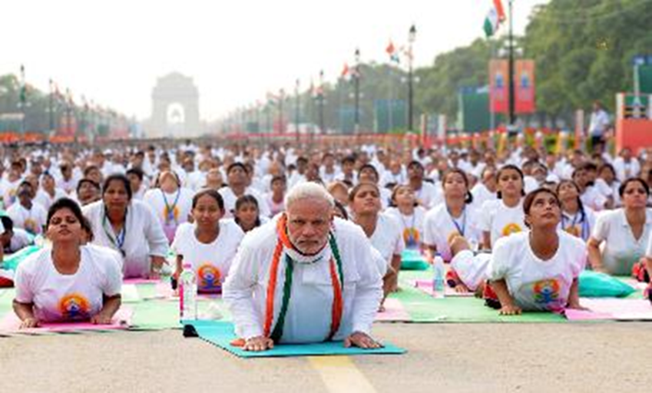
Hinduism – Death
Inana, the path of knowledge. This is a more difficult path and involves self-renunciation and meditation. This aesthetic path is open to men only in the higher castes. It most often includes the practice of yoga, an attempt to control one’s consciousness through posture, breath control and concentration.
22 Reasons to Believe Hinduism is Based on Science;

Slide 13
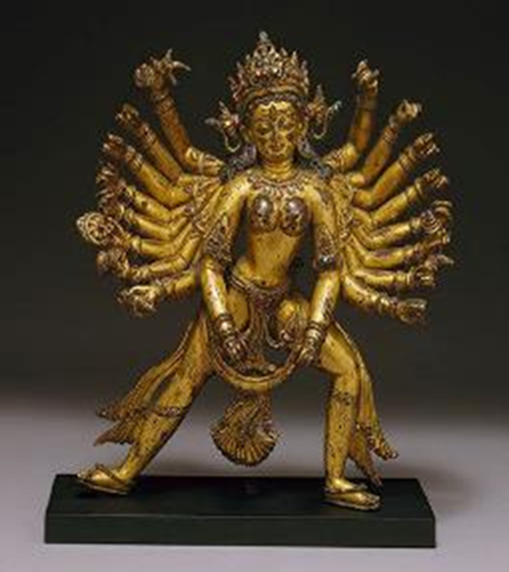
Hinduism – Death
Bhakti, the path of passionate devotion. This is the most popular way to achieve moksha. A devotee may choose any of the 330 million gods, goddesses or demigods in the Hindu pantheon and passionately worship that god. In practice, almost all Hindus who follow this path worship Vishnu or Shiva.
https://www.templepurohit.com/12-manifestations-brahman-hinduism

Slide 14
Hinduism – Life and FestivalsChristians
There are four goals of life in Hinduism, from least important to most as you mature
Karma – pleasure, physical and emotional
Artha – power, wealth, fame
Dharma – moral harmony, duty
Moksha – Atman released from samsara and reunites with Brahman.

Slide 15
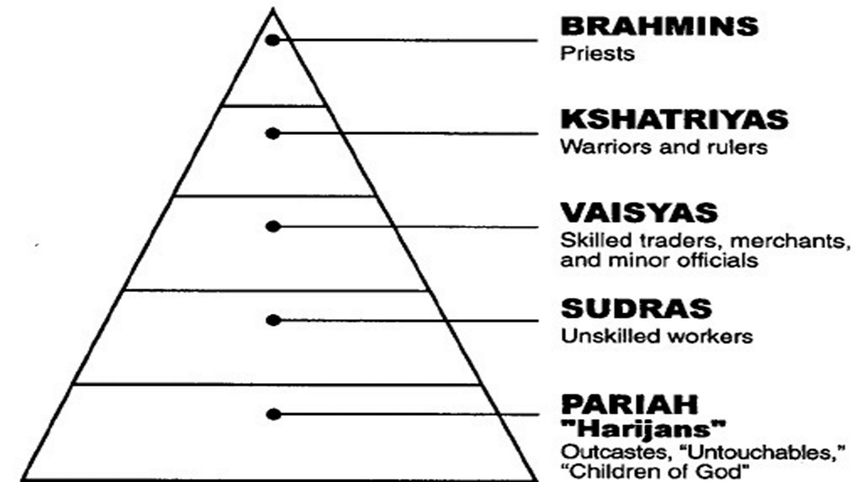
https://southasiajournal.net
Notes:
The hierarchy of classes in Hinduism

Slide 16
Hinduism – the Caste systemChristians
The caste system. The four castes were the Brahmins (priests), Kshatri-yas (warriors and nobles), Vaisyas (merchants and artisans) and Shudras (slaves), plus the untouchables (outside the caste system, subhuman).
The mark on the forehead, a colour dot a bindii is a sign of piety and symbolizes the third eye – the one focused inward towards God
The cow is considered sacred in Hinduism. She is symbolic of abundance, the sanctity of all life, and the earth that gives much while asking nothing in return.

Slide 17
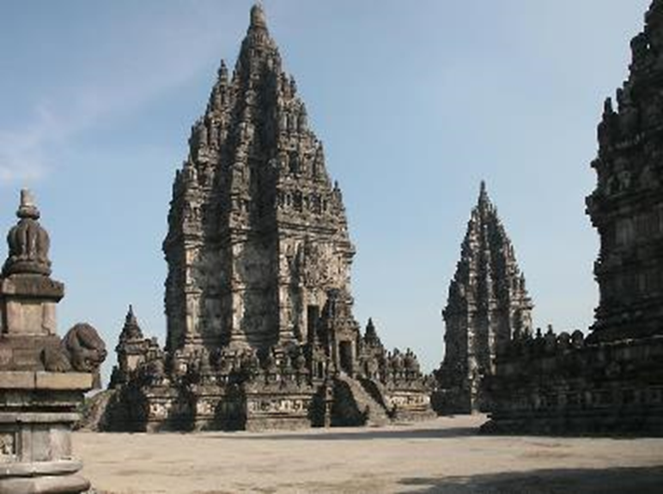
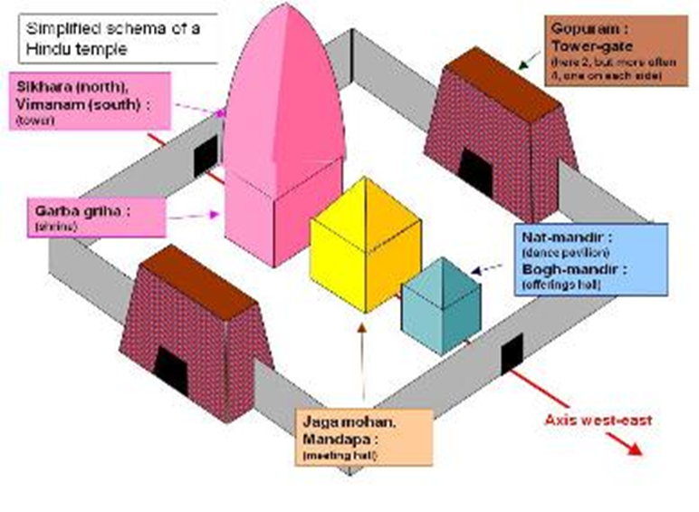
Hinduism – Temple (Mandir)Christians
Temples are heavily decorated with intricate sculptures of the deity that resides within the temple and figures who associate with the deity.
The shape of the temple resembles the mythical mountain home of the Gods.
https://www.studyvillage.com

Slide 18
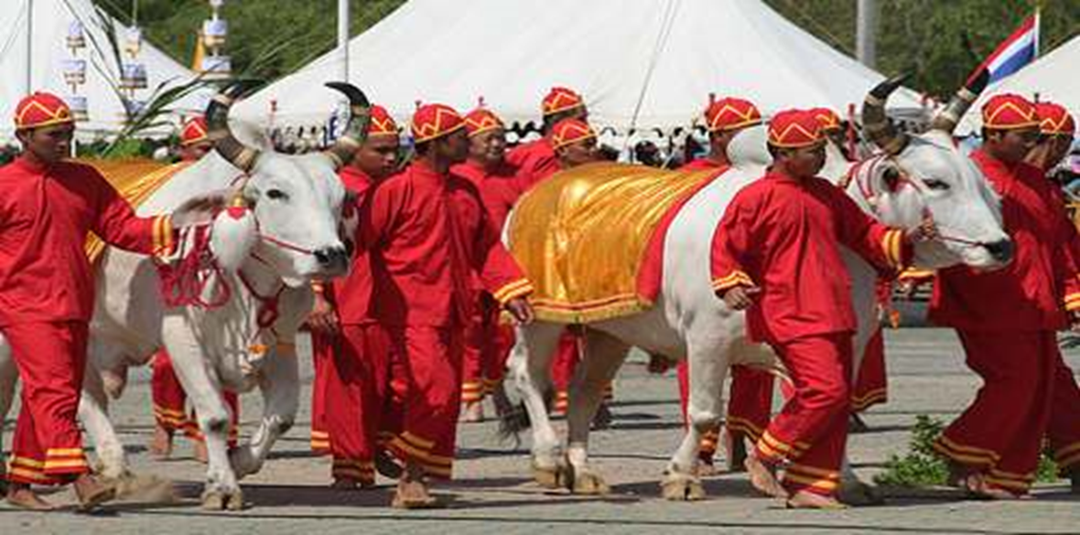
Hinduism - FestivalsChristians
Festivals – Holi (colour), Diwali (lights), Raksha Bandhan
Been to Bali?
Safed Haathi | Hindu Festivals

Slide 19
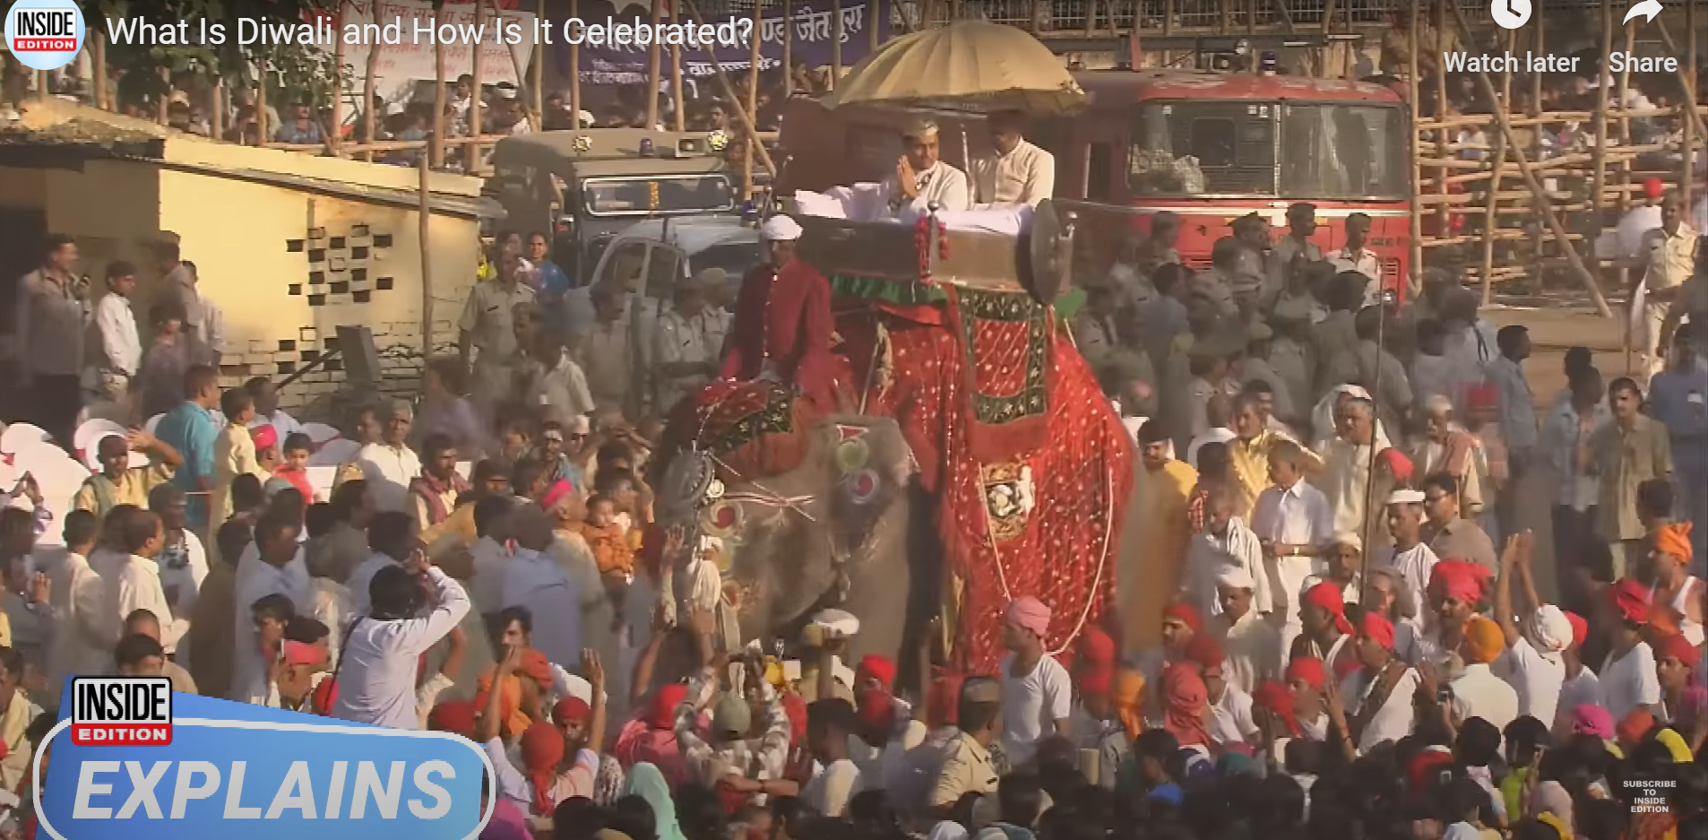
Hinduism – DiwaliChristians
One of the most popular festivals of Hinduism, Diwali symbolises the spiritual "victory of light over darkness, good over evil and knowledge over ignorance".
What Is Diwali and How Is It Celebrated? - Bing video
Notes:
What Is Diwali and How Is It Celebrated? - Bing video

Slide 20
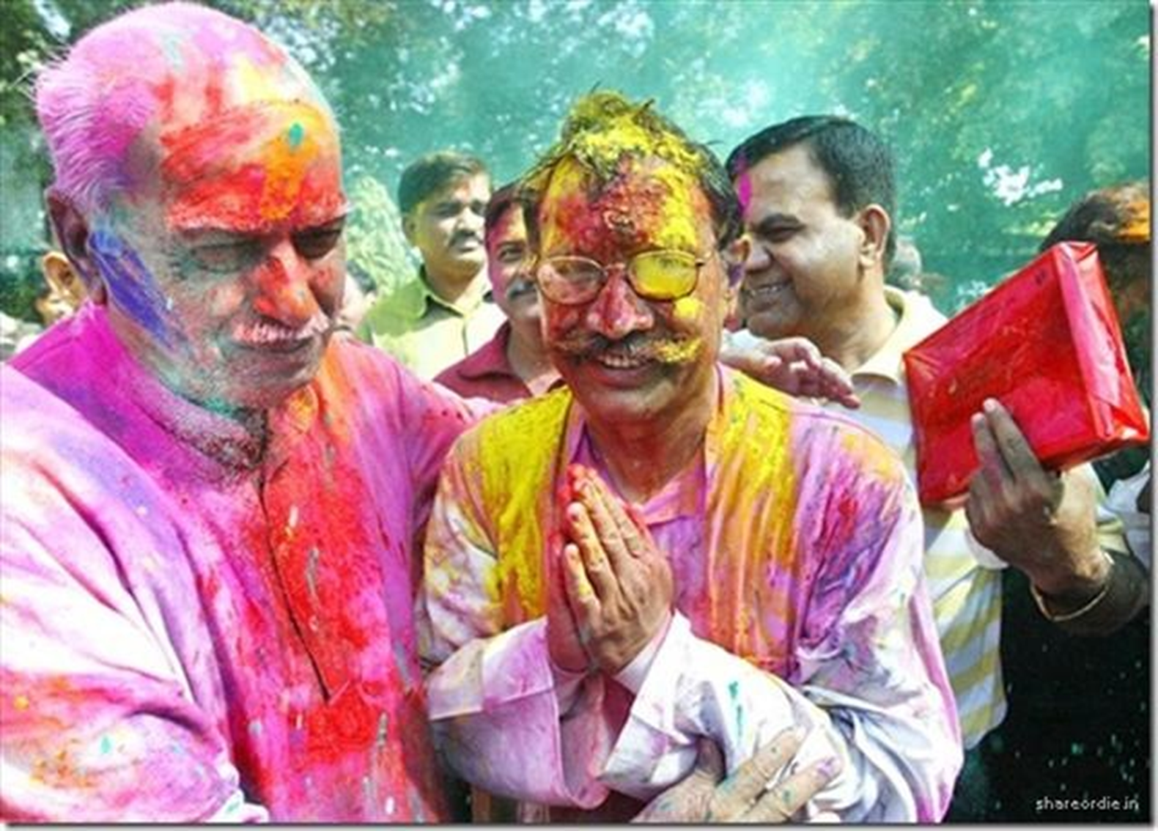
Hinduism – Holi
Hindu spring festival in India and Nepal, also known as the festival of colours or the festival of sharing love.

Slide 21
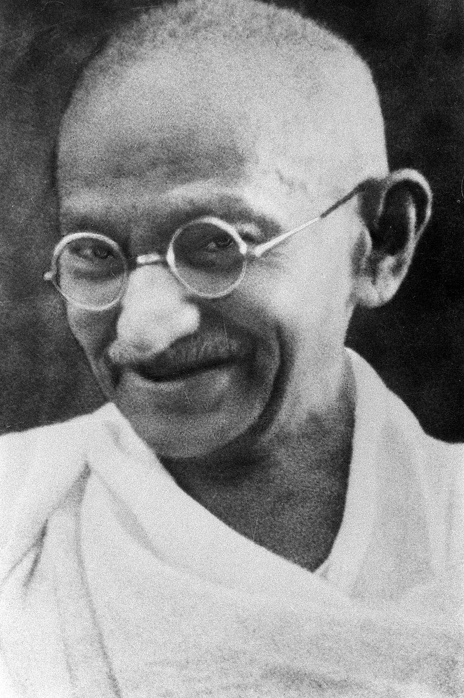
Hinduism – Key People
No single origin or date
https://en.wikipedia.org/wiki/History_of_Hinduism
Mahatma Gandhi 2 October 1869 – 30 January 1948
https://en.wikipedia.org/wiki/Mahatma_Gandhi
https://www.mkgandhi.org/
Notes:
Scholars regard Hinduism as a synthesis of various Indian cultures and traditions, with diverse roots and no single founder.
The history of Hinduism is often divided into periods of development, with the first period being that of the historical Vedic religion dated from about 1750 BC. The subsequent period, between 800 BCE and 200 BCE, is "a turning point between the Vedic religion and Hindu religions",[8] and a formative period for Hinduism, Jainism and Buddhism.
2 October 1869 – 30 January 1948 was the preeminent leader of the Indian independence movement in British-ruled India. Employing nonviolent civil disobedience, Gandhi led India to independence and inspired movements for civil rights and freedom across the world. The honorific Mahatma —applied to him first in 1914 in South Africa,—is now used worldwide. He is also called Bapu (endearment for "father“, "papa") in India.
Raised in a Hindu merchant caste family in coastal Gujarat, western India, and trained in law at the Inner Temple, London, Gandhi first employed nonviolent civil disobedience as an expatriate lawyer in South Africa, in the resident Indian community's struggle for civil rights.

