Slide 1
World Religions: Christianity - Life

Slide 2
Christianity - Life

Slide 3
FaithGateway.com
https://scripture-for-today.blogspot.com
Notes:
The simplest summary of how a Christian life ought to be lived

Slide 4
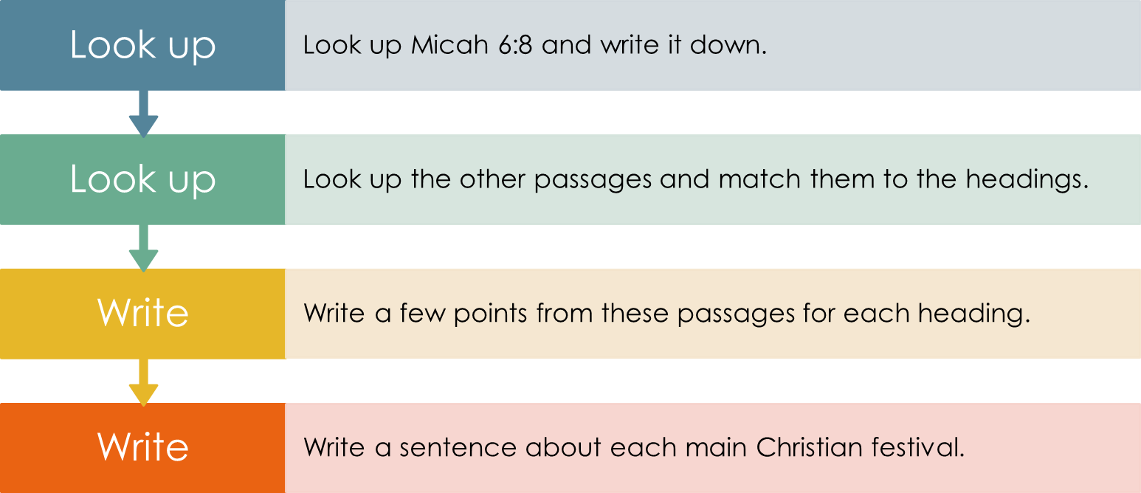
Life, how should it be lived?
Notes:
This slide outlines the individual/paired research task for the remainder of this session

Slide 5
Deeds
Eph 2:8-10
James 2:14-17
WalkFree.org
Notes:
Gal 5:13-25
http://www.ligonier.org/blog/good-works-christian-life/

Slide 6
Telling Others
Matt 28: 19-20
1 Peter 3: 15-17
Matthew 4:19 - Bible verse - DailyVerses.net
Notes:
Romans 10:10-17
https://carm.org/what-is-evangelism

Slide 7
Church
Col 3:16
Heb 10: 24-25
https://www.gotquestions.org/what-is-the-church.html
Notes:
Eph 2:19-22
https://www.gotquestions.org/what-is-the-church.html

Slide 8
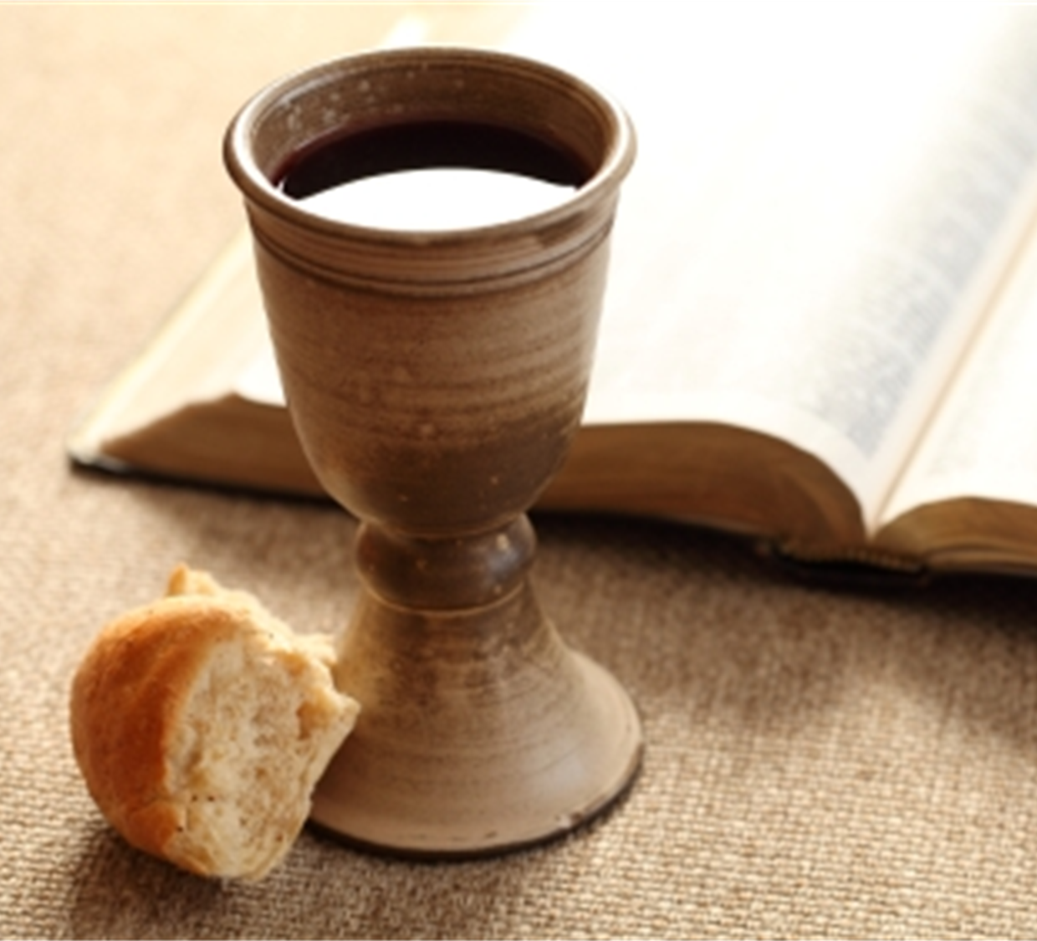
Communion
1 Cor 11:23-26
Acts 2: 46
https://newspring.cc/articles/what-is-communion-and-why-do-we-do-it
Notes:
Mark 14:22-25
https://newspring.cc/articles/what-is-communion-and-why-do-we-do-it

Slide 9
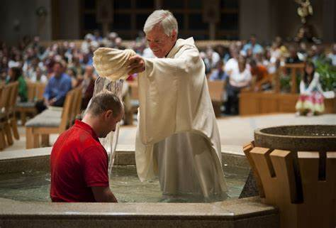
Baptism
Matt 28: 19
Rom 6:1-4
John 3:5
https://www.gotquestions.org/Christian-baptism.html
Notes:
Matt 3:11-17
John 3:22-30
https://www.gotquestions.org/Christian-baptism.html

Slide 10
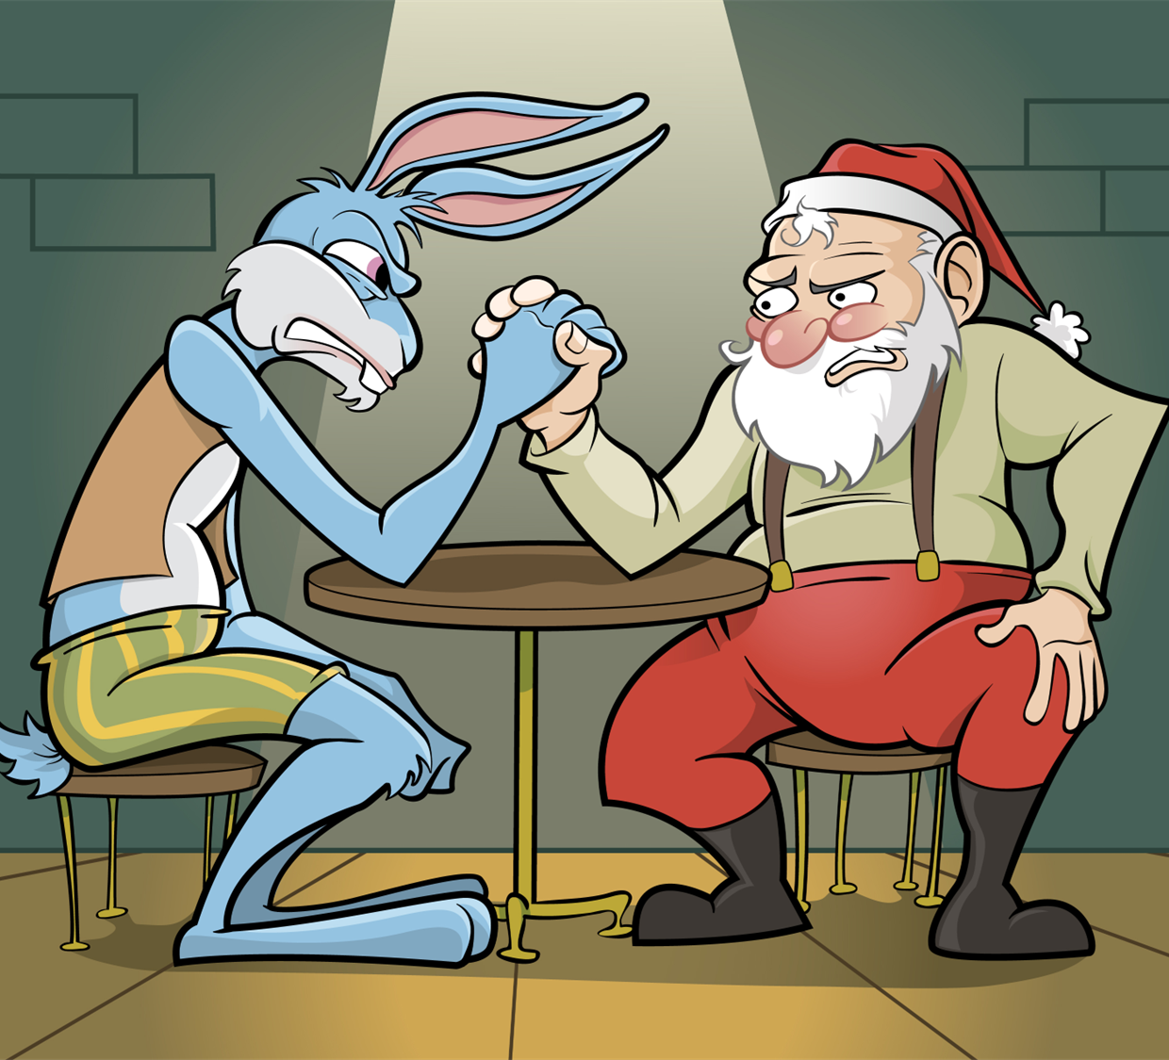
Life – Main Festivals
Christmas
Good Friday
Easter
https://www.ucg.org/members/compass-check

Slide 11
Helpful Links Festivals
THE UNIQUENESS OF CHRISTIANITY - (What Jesus Offers That No Religion Does) - 11mins
https://www.youtube.com/watch?t=373&v=R6IfVnkbmKs
Easter - 5 mins
http://fervr.net/videos/follow
Basic facts
http://www.bbc.co.uk/religion/religions/christianity/beliefs/basics_1.shtml
BBC My Life, My Religion: Christianity - 29 mins
https://www.youtube.com/watch?v=9qtXUr2C6aI

